Slide 1
Increasing Profits through Improved Soil Health
Charles Rohla
Notes:
Good morning, I was asked to visit with you today about planning for a profit. How many of you actually spend time to develop a budget each year that would include a profit for your operation.

Slide 2

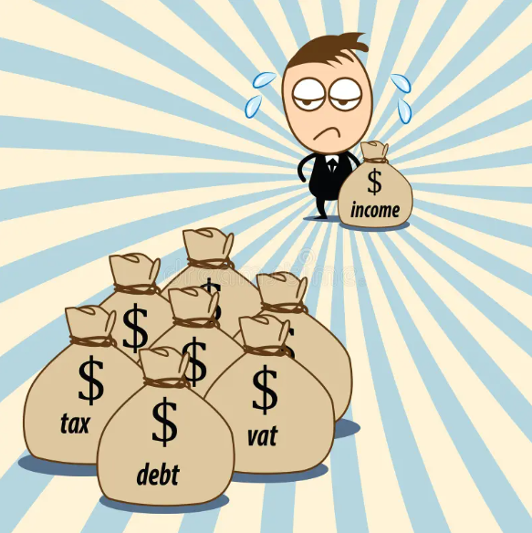
Basic Definition of Profit
Revenue over Expenses
Notes:
What is profit.
Profit is Revenue over Expenses. How does your revenue stack up against your expenses?

Slide 3
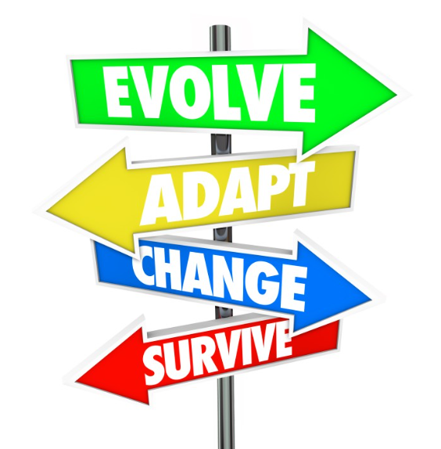
How to Increase Profits?
To determine how to influence profits, you must know where you are spending money.
To adapt to the changing economical environment, you need to focus on things you have control over.
Notes:
To determine profitability, you must keep accurate records at the enterprise level. It is a common occurrence for orchard managers to focus too much time on things that they cannot control instead of the things they can positively impact.

Slide 4
Limiting Factors in a Limitless World
Circle of Concern
Write down one major factor that is keeping your orchard from being more profitable.
What can you control to help us earn more money?
Equipment Prices
Pecan Prices
Demand
Circle of Influence
Fertilizer Prices
Weather
Overhead Costs
Wildlife pressure
Insect Pressure
Inputs
Production
Level
Disease Pressure
Rainfall
Fuel Prices
Fruit Set
Notes:
Examples:​
Influence =
What records you keep​
When you sell and buy​
What you sell and buy​
What enterprises you have​
How much and when you work​
The duties you do within the operation​
​
Concern =
Weather​
Commodity prices​
Regulations​
Equipment prices
Customer demand
Wildlife pressure
Disease pressure
Insect pressure
Tax code​
Equipment breaking (we can maintain it but it still breaks)​
What the neighbor thinks about us​
What our family thinks about us​
Interest rates​
What if….. questions ​

Slide 5
b
c
d
q

Slide 6
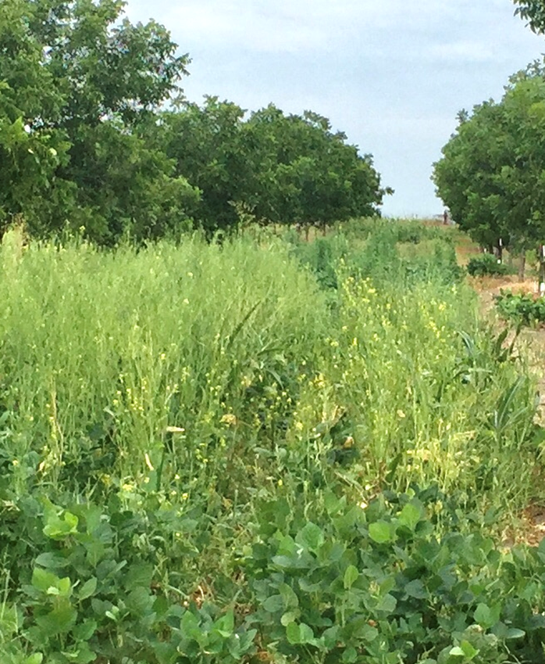
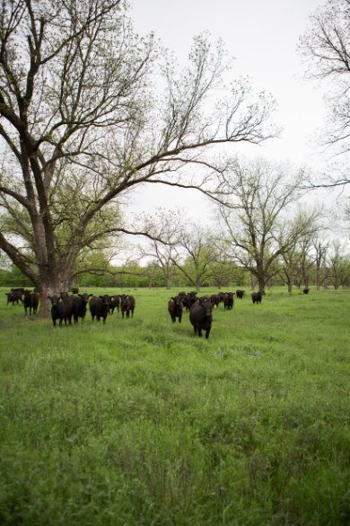
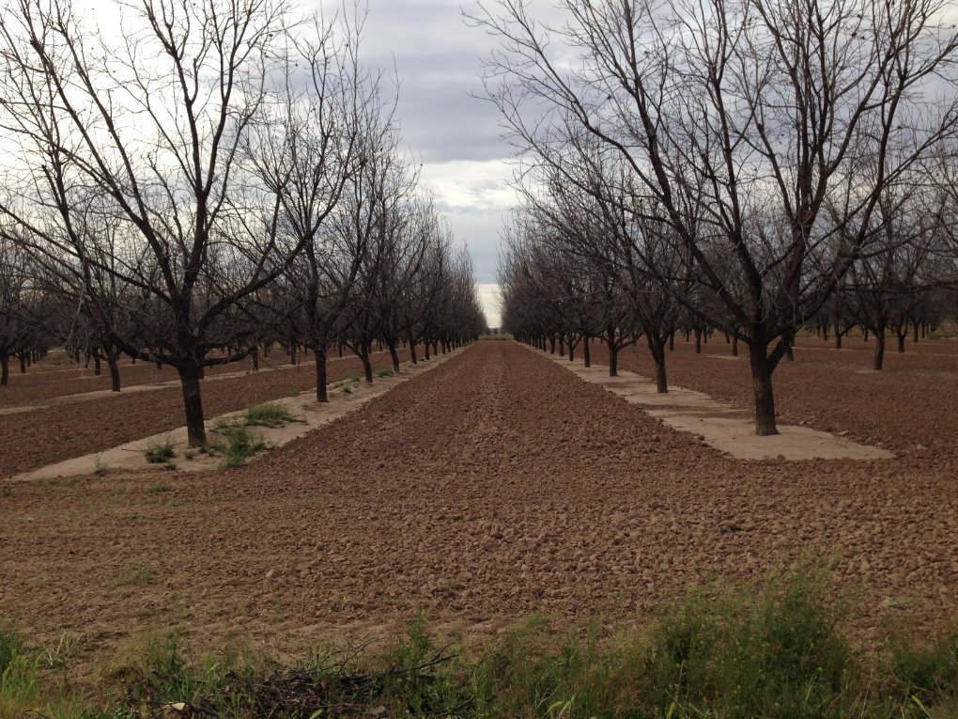
What is a Paradigm?
A set of beliefs, values and practices that define how we see and interact with the world around us.
Notes:
TIME: 5 minutes PRESENTING
Facilitator Notes:
Do the 'What letter is the most different' on the flip chart ? Add example of flip chart here
Speaking Points:
Ask audience what they think a paradigm is
Do the 'What letter is the most different' on the flip chart ?
Segue to this by noting that profit is beyond control is a paradigm – it can be a harmful one.
A paradigm is a set of beliefs, values, and practices that define how we see and interact with the world around us.
In ranching, a paradigm might be the belief that ranching is primarily a way of life, focused on tradition, family, and heritage. These are all good things, but they can also sometimes distract us from the fact that ranching is a business.
It’s important to recognize that the way we see things determines the actions we take, and the actions we take determine the results we get.
In order to get different results, we need to take different actions, but we can’t or won’t until our beliefs change.
For example, we used to believe that the earth was the center of the universe, and then some astronomers realized earth is just one rock revolving around the sun, so we thought the sun was the center of the universe, until we realized that the milky way is just one galaxy in a sea of galaxies.
Ask:
Do some paradigms become obsolete? In other words, is it possible for a set of rules or guidelines to stop working? For the actions they lead us to take, to stop producing the results we want? That phrase, "If you always do what you've always done, you will always get what you always got.” Is it true?
x minutes

Slide 7
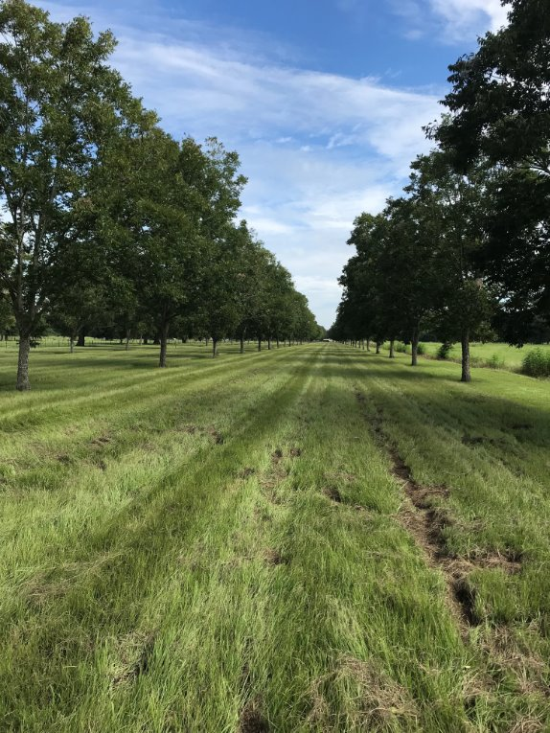

What are some common paradigms?
I have to apply 100 pounds of nitrogen every year.
I have to start spraying for PNC on May 20th.
My neighbor is spraying so I must need to spray too.
Increasing production will increase my profit.
Notes:
TIME: 5 minutes DISCUSSION
Facilitator Notes:
This slide has 3 animated bullet points.
$ Noble Buck $
Speaker Notes:
Read first example and then ask audience, what can we do instead of baling our hay? what if we strip graze instead of bale hay?
Ask audience if they have an example from their ranch or their neighbor’s ranch. Does anyone have examples of things that ranchers in your area do because it's the most profitable way to do them? Or is it just because that's the way their dad, or Grandpa, or their neighbor does things and has always done things.
Read second example, then say that’s probably true, they might laugh at you, and you will laugh too – all the way to the bank
Read third example, and then say flexibility in grazing plans is good. If you do the same thing, the same way every year, you can limit your production.

Slide 8
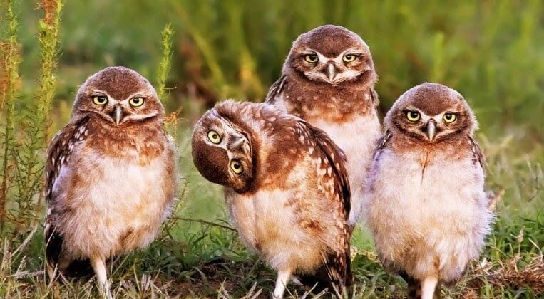
When you change the way you look at things, the things you look at change - Max Planck

Slide 9


Soil Health Principles
Ecosystem Processes
Know Your Context
Water Cycle
Minimize Soil Disturbance
Energy Cycle
Increase Diversity
Maintain Continuous Living Plants/Roots
Nutrient Cycle
Cover The Soil
Community Dynamics
Integrate Livestock
Notes:
To achieve regenerative agriculture, we must practice these six soil health principles. These 6 principles focus on four ecosystem processes. I will not go through each one of these principles today, but if you are interested in learning more, I write about these in an article in Pecan South. The one principle that is perhaps the most important is the first principle, Know your context. What is your goal and want are you willing to do to accomplish these goals. A lot of people will say that they want to improve the land for the next generation, while some will say that their goal to have the highest production you can and other may say that it is to be the most profitable that you can. Knowing your context is how you get started.

Slide 10
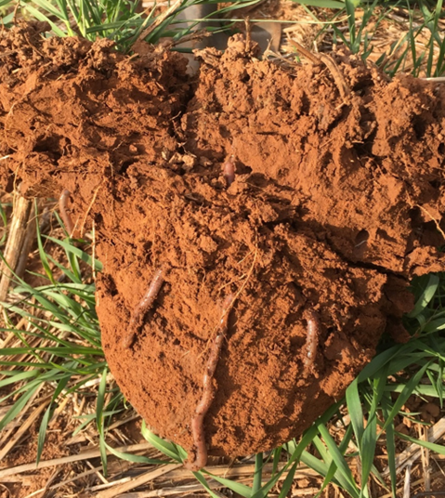
How can Soil Health increase my Profit?
Improving your soil can result in reduced:
  Fertilizer Cost
  Chemical Cost
    Insect Control
    Weed Control
    Disease Control??
  Irrigation Cost
  Increase Production

Slide 11
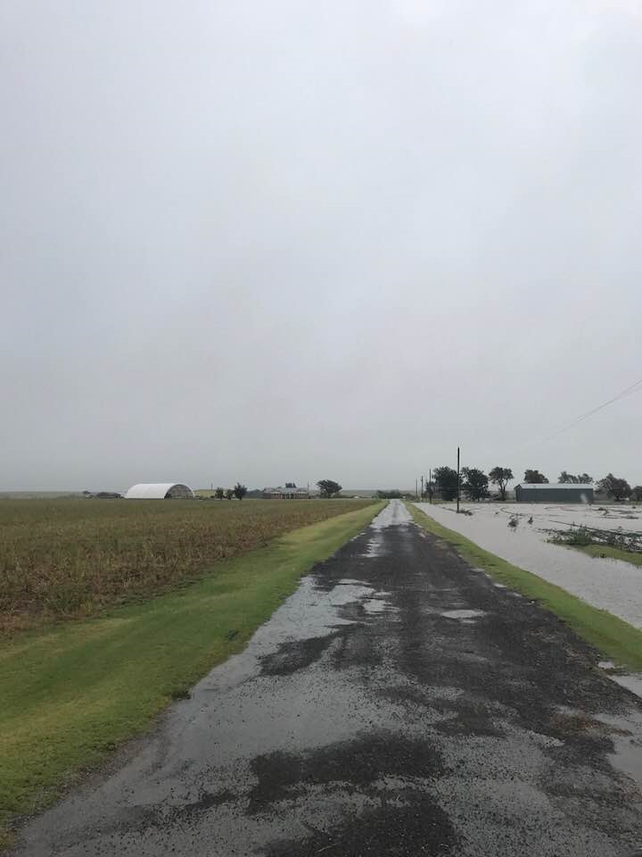
SIX PRINCIPLES AT WORK
Management:
No-till Crop Rotation
Cover Crops
Planned Grazing Management
Management:
Conventional Tillage Small Grains
No Cover Crops
No Grazing
5.3 inch
Rainfall Event
Infiltration Rate= 2.9 in/hr
78,740
gallons of water/Ac
Stored
Infiltration Rate= 0.6 in/hr
16,507
gallons of water/Ac
Stored
377% Increase
October 2017, Comanche Co., OK
Notes:
Pre 06 tilled wheat wheat wheat stockers
06-12 notill wheat wheat wheat stockers
13-15 notill crop rotation less stockers
16-17 notill crop rotation with cover crops less stockers more cows
Oct 2017 picture

Slide 12

Impact of good water infiltration.
Your orchard receives a 2-inch rain event, but your soil is only able to absorb 30% of the water.
So, 1.4 inch of the rainfall leaves the field as runoff.
An acre inch of water equals 27,154 gallons of water.
A pecan orchard on a 40 ft X 40 ft. spacing would have 27 trees per acre.
So, you would have lost over 1400 gallons of water per tree to runoff.
Notes:
For those of you that are irrigating, do you think about the cost associated with each time to flip the switch to turn on that irrigation system.
Have you ever thought about how effectuate is your soils are at absorbing a rainfall or irrigation event. Typical effective rainfall is 20-40%, especially a rain events over 1.5 inches., meaning that for a 2 inch rain event that only less than 0.5 to 1 inch is absorbed into your soil.
So have you thought about ways to increase your soil moisture and water holding capacity. What would saving 30% on your irrigation cost do to your overall profit of your operation.

Slide 13
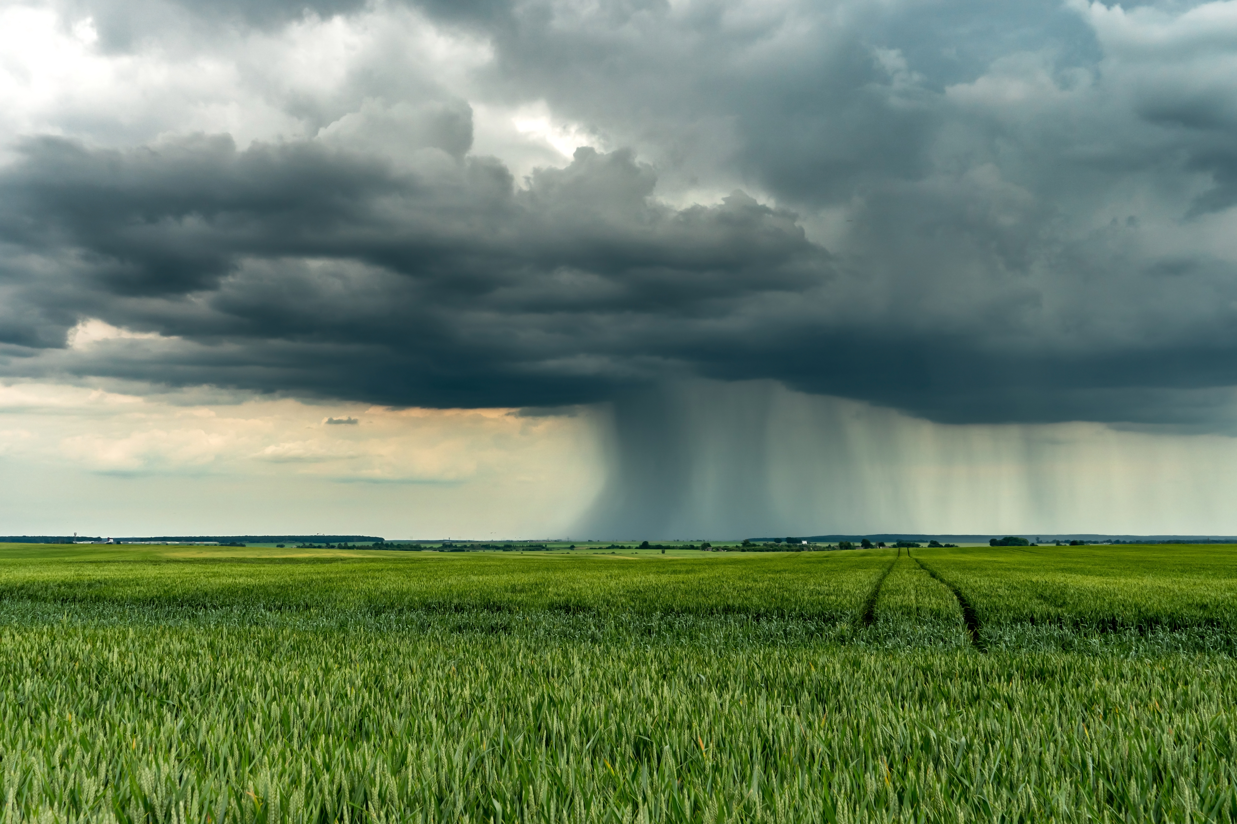
What does that mean to your profit
Results in healthier Trees/Crops
Higher quality pecans
Less insect and disease pressure
What does it cost each time you turn the irrigation system on?
What would saving 30-50% on irrigation cost do to your profit?

Slide 14
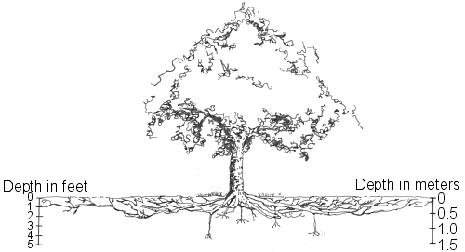
SOM
Every 1% increase in organic matter can result in up to 20,000 gallons of available soil water per acre.

Slide 15
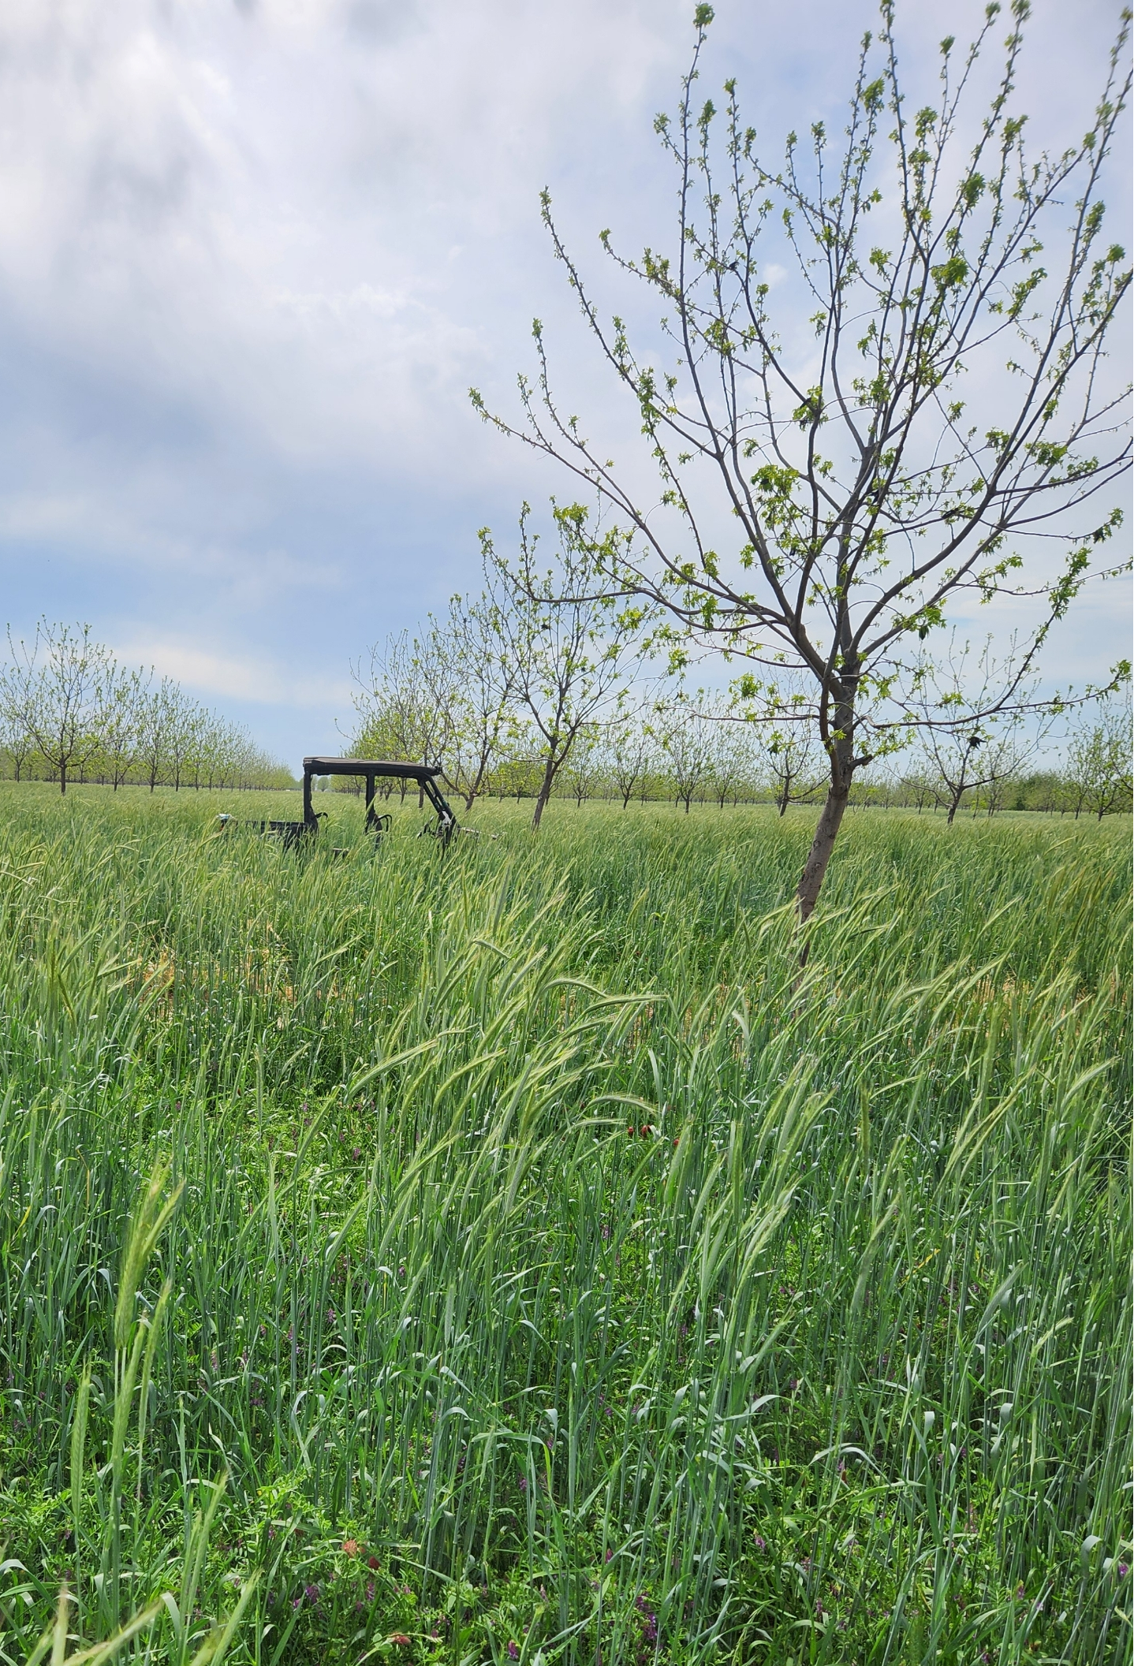
Increase biodiversity above and below ground
Reduces cost of inputs that plants and microorganisms naturally can supply
Improves soil structure and biology
Increases water infiltration rates
Increases soil organic matter
Increases soil water holding capacity

Slide 16
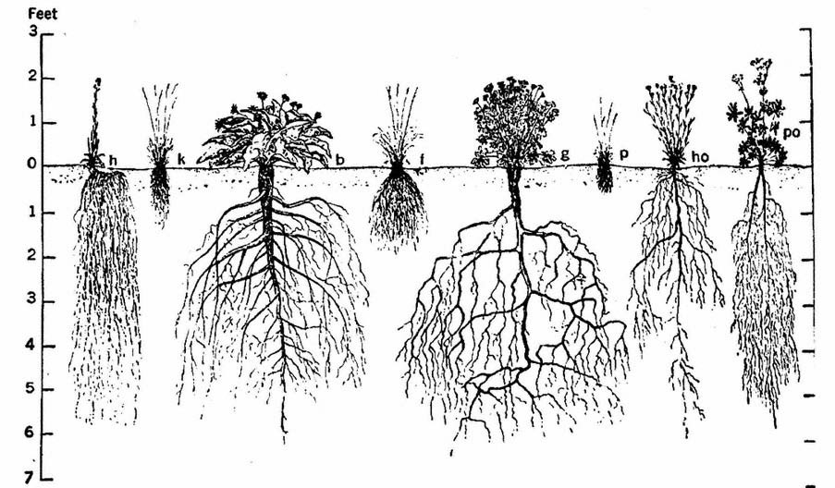
More roots = more exudates and carbon in soil

Slide 17
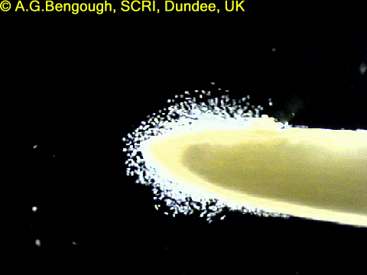
Root exudates feed Microbes

Slide 18
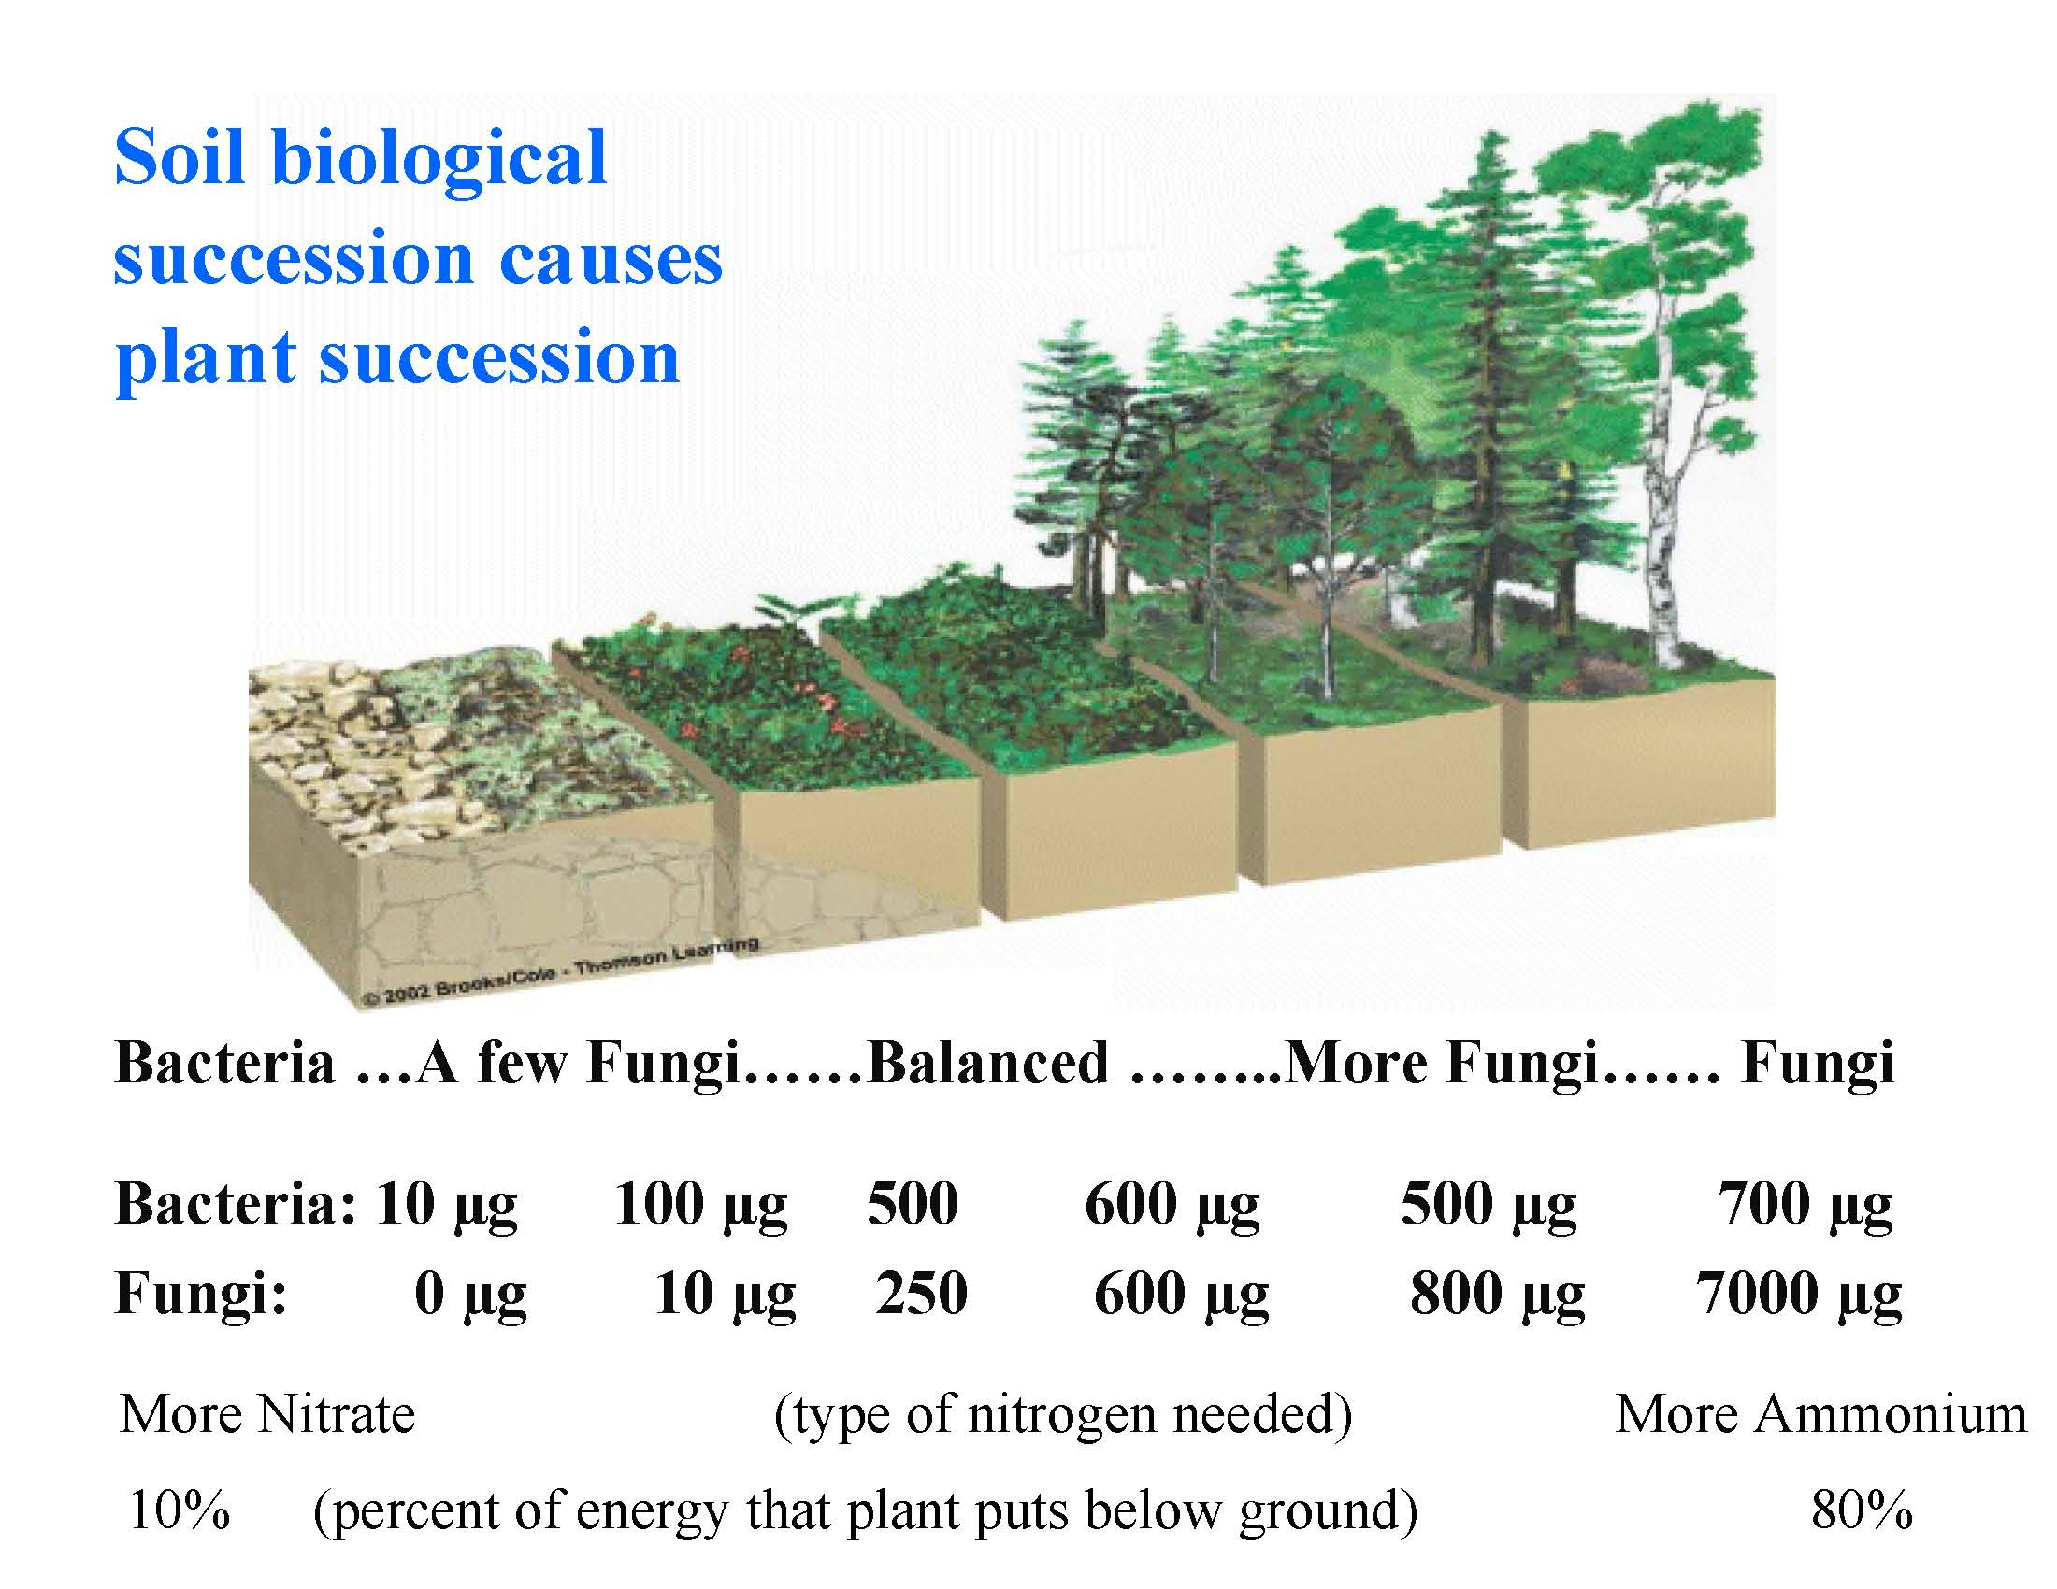
Trees prefer soils dominated by fungi

Slide 19
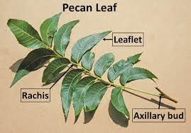
Health of your trees
Evaluate your trees
Do you take annual leaf samples
Do you utilize your leaf samples to adjust fertilizer plans

Slide 20
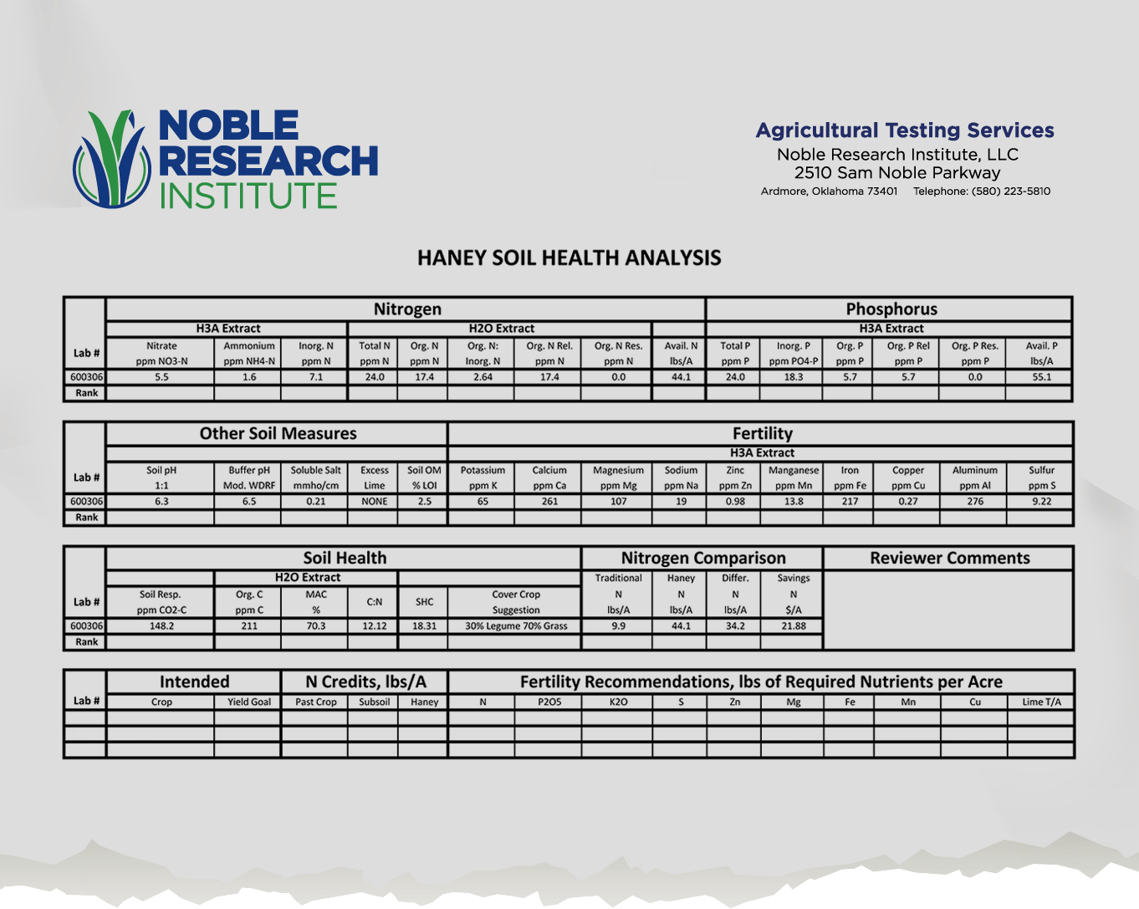

Slide 21
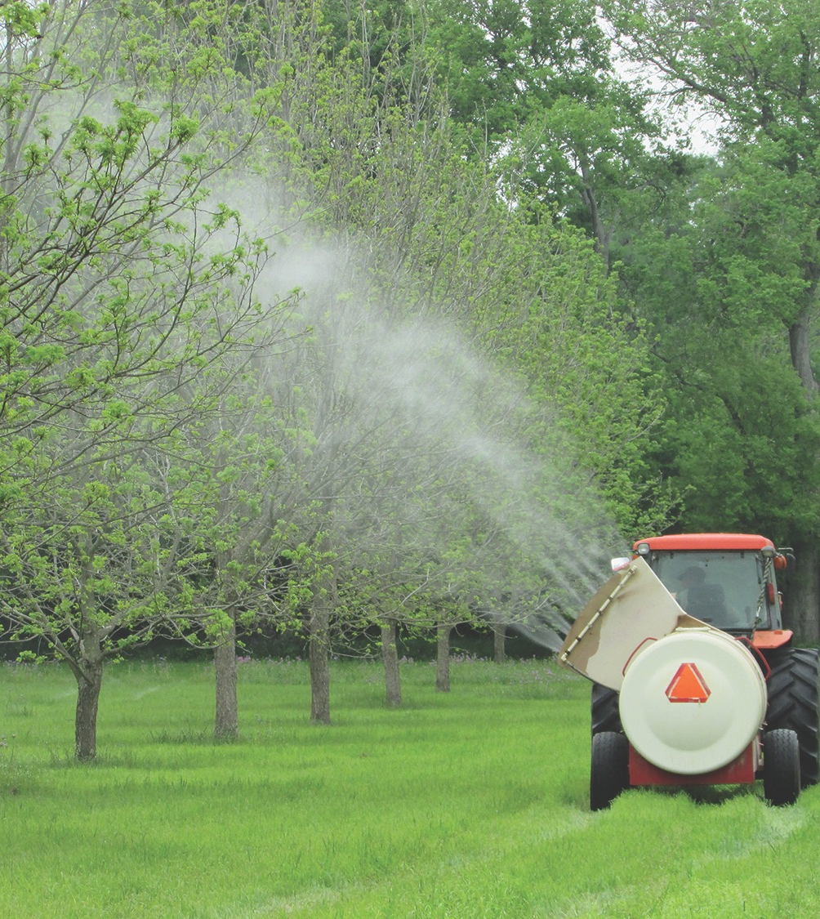
To be Profitable we must a crop to sell
We want to maintain the crop that we have, BUT:
  Consider cost of treatments
    Labor Cost
    Equipment Cost
    Application Cost
  How much does it truly cost each time we use equipment in the orchard?

Slide 22
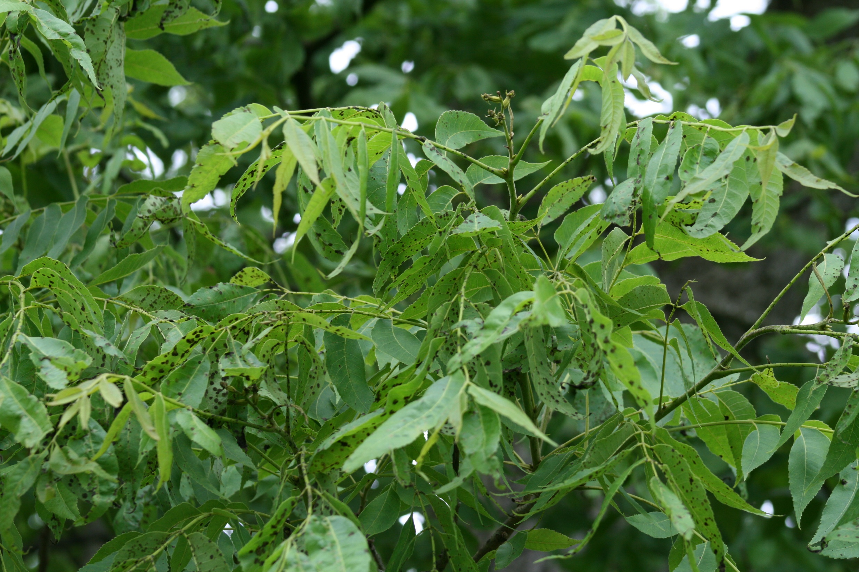
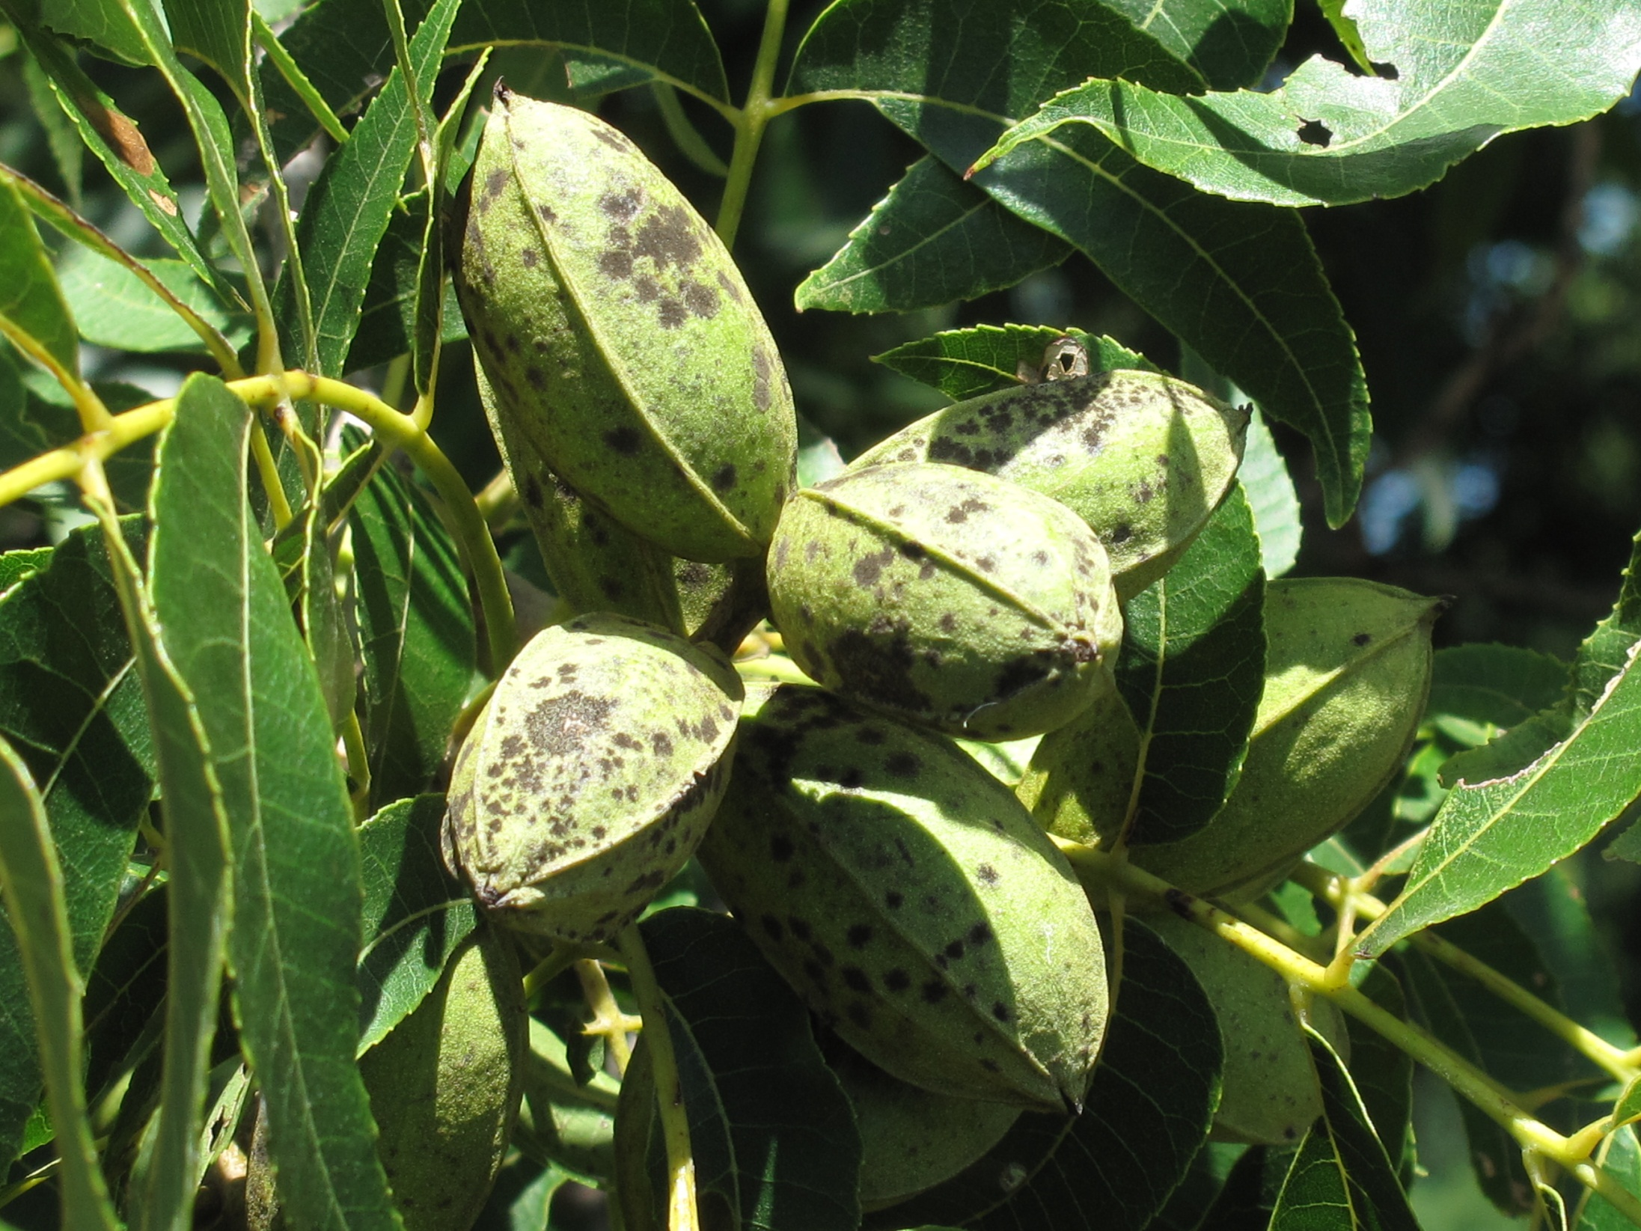
But is treating the symptom the best use of your money and time?
Maybe, be sure that you identify the problem.
But, then ask if there is something that is causing the problem?
(Stop treating the symptoms and address the real problem)

Slide 23
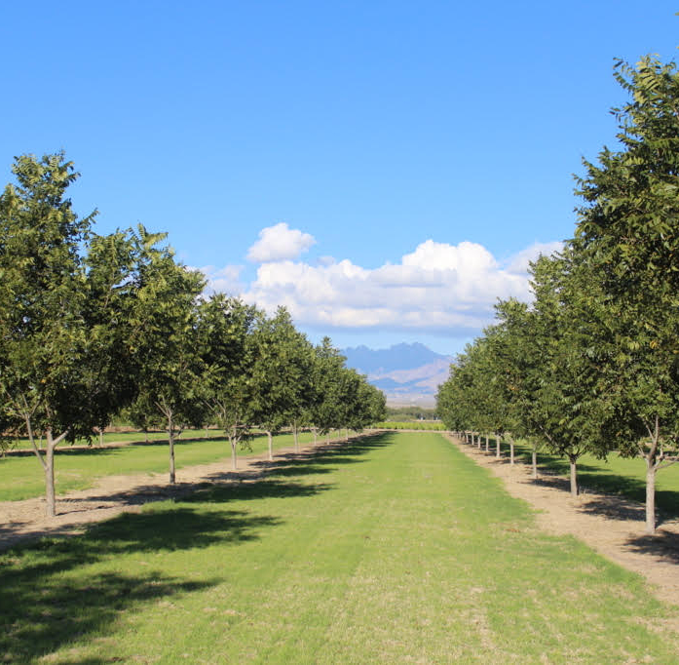
What if you only mowed 2-3 times a year?
What would that save?
    Labor, fuel and repair cost
  Increase water infiltration and water holding capacity,
      Save on irrigation cost
  Increase beneficial insects

Slide 24
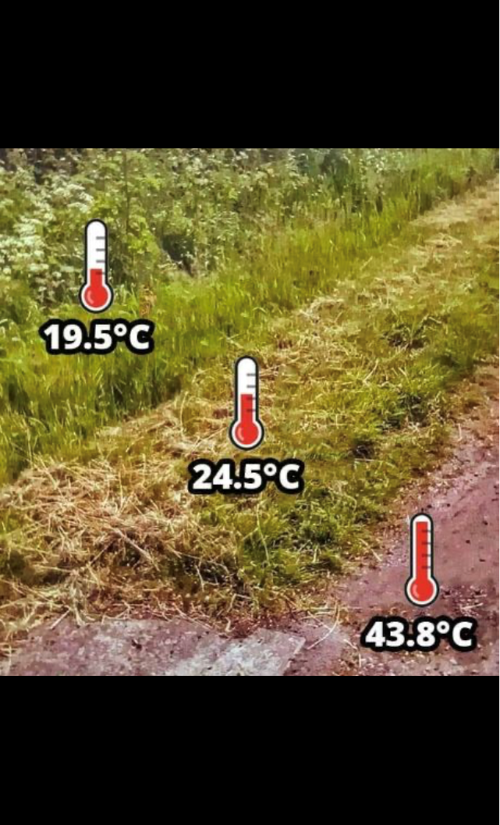
67.1° F
76.1° F
110.8° F
Notes:
Optimum temperature for microbe growth is 60-85 F
Starts to die at around 140 F

Slide 25
To be Profitable takes Planning
Increased Soil Health can increase your profit
Determine where you are spending money
  What does it cost you to spray, mow, irrigate, etc.
    Include labor and equipment costs
Stop putting a band-aid on the symptoms, start addressing the root cause of the problems
Determine cost and profit on each orchard
Profit Per Acre NOT Production Per Acre

Slide 26
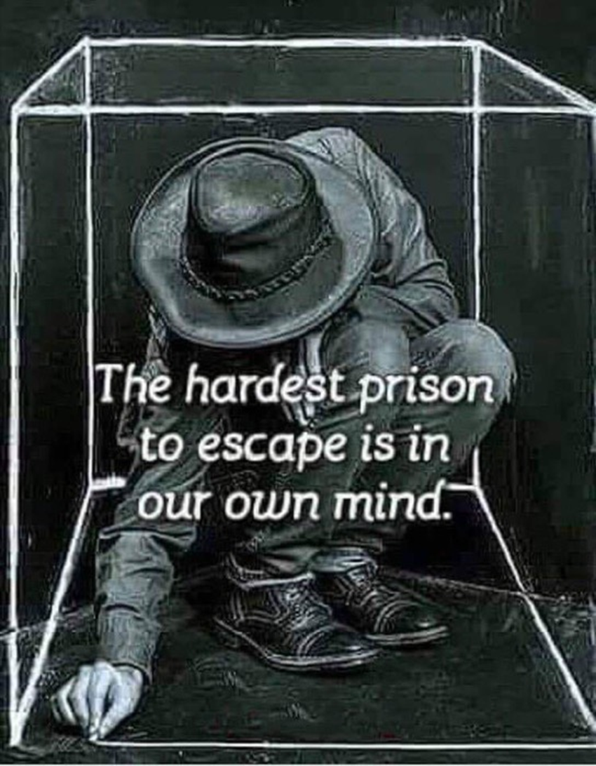
Regenerative Management
Every person & every property is unique, so there is no single recipe or prescription.
Become intentional
Observe things as they are, not what you are expecting to happen
Learn from others
Try new things
Notes:
Knowing your context will help you get started managing your soils.
You should set goals for your operation, like:
I want to fix a problem that I am having
I want to leave my land/operation to my kids, better than it is now, or more profitable than it is now
I want to produce the healthiest crop that I can
Even with identical management, different contexts will see different results.
Become intentional with your goals and plans, context defines things that are practical to change & those that are not.
Observe things as they are, not what you are excepting them to be
Increase your observations
Learn from others, including others that are outside of pecans
Try new things in your orchard - start small

Slide 27
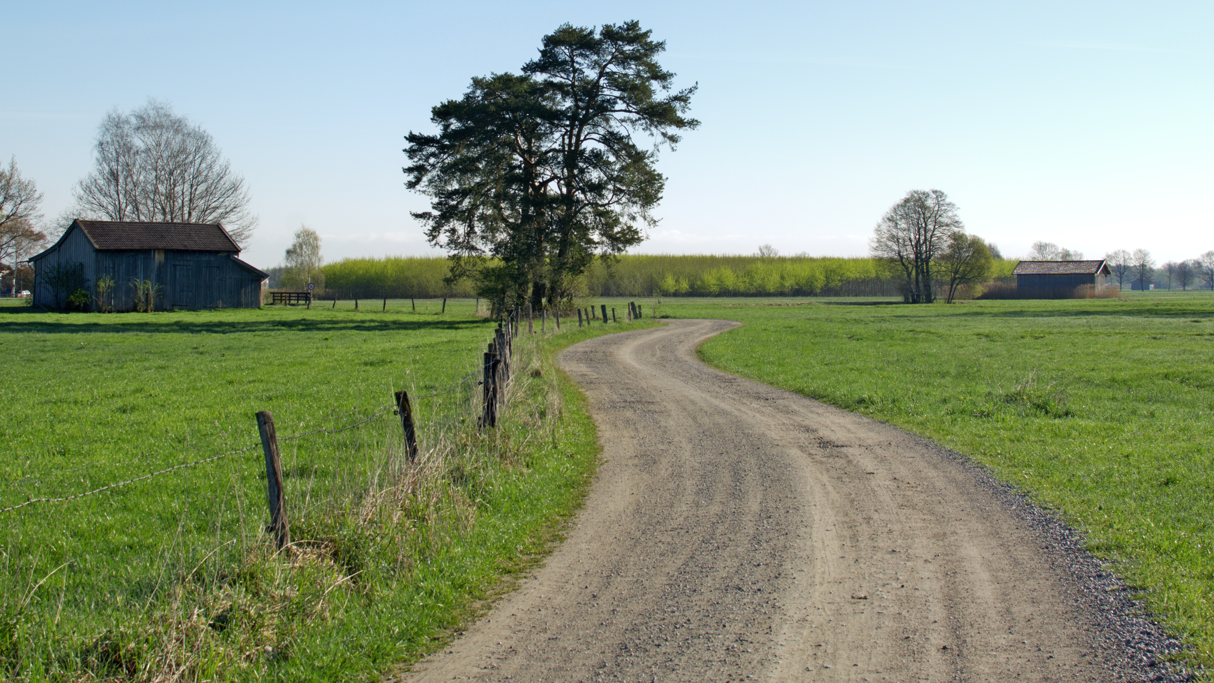
“You don’t have to see the whole staircase, just take the first step.”
- Martin Luther King Jr
Notes:
Remember, this a journey. Some of us may be taking that first step and others have already started the journey. No matter where you are on the journey, we always need to take time to create a clear plan. Therefore, we are going to devote the next segment to helping you create this plan; especially the first step you need to take after leaving this class.

