Slide 1

Pecan Regulatory Updates in New Mexico and Texas
Tiffany Johnson
State Entomologist / Eradication Specialist
Entomology & Nursery Industries
New Mexico Department of Agriculture

Slide 2
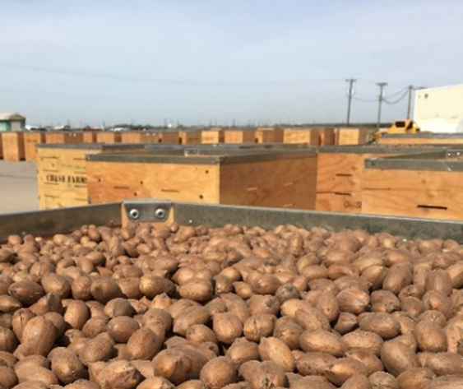
Pecan Weevil Programs
Purpose: slow the spread of pecan weevil between counties and states
Minimal disruption to the industry itself
Meet the needs of all constituents
Provide protections for growers in non-quarantined areas
Provide quarantined growers access to cleaning/shelling/storing industry located in non-quarantined areas

Slide 3
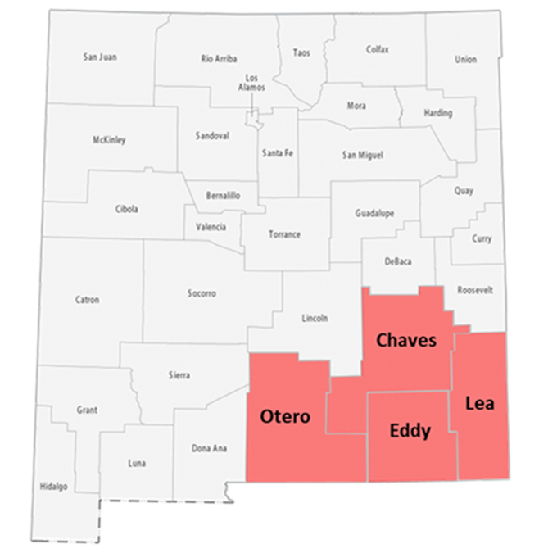
Pecan Weevil Interior Quarantine New Mexico
Includes Otero, Chaves, Eddy, and Lea counties

Slide 4
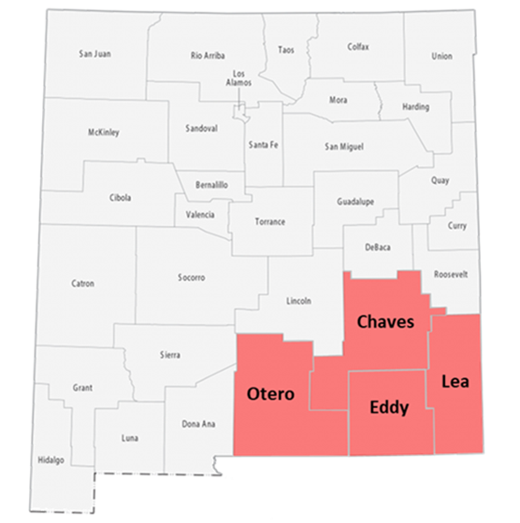
Pecan Weevil Exterior Quarantine Texas
All other states and districts in the United States
Exceptions are Arizona and California
New Mexico
Otero, Chaves, Eddy, and Lea are quarantined
All other counties are exceptions

Slide 5
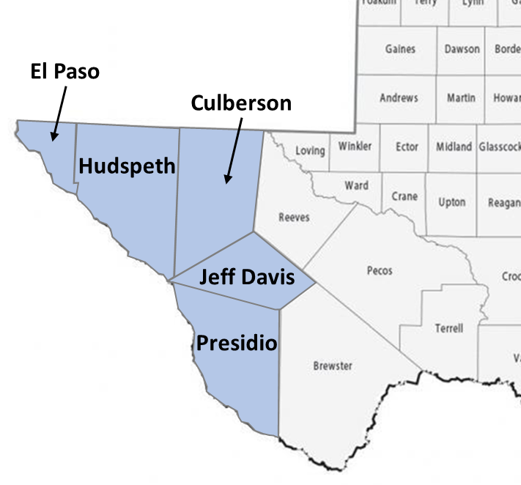
Pecan Weevil Exterior Quarantine New Mexico
All other states and districts in the United States
Exceptions are Arizona and California
Texas
El Paso, Hudspeth, Culberson, Jeff Davis, and Presidio are exceptions
All other counties are quarantined

Slide 6
Pecan Weevil Interior Quarantine Texas
All counties in the state of Texas
Exception of El Paso, Hudspeth, Culberson, Jeff Davis, and Presidio counties
Recently included Pecos County
Pecos

Slide 7
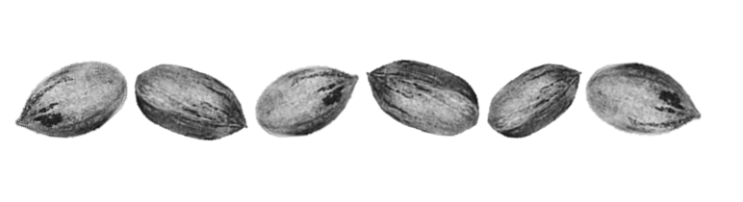
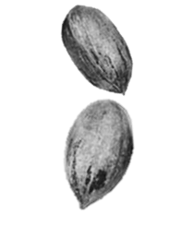
Quarantined Counties
Should not move in-shell pecans and/or pecan-regulated articles out of a quarantine areas into a non-quarantined areas without treatment
Can move regulated materials into quarantined parts
No field-ran nuts into a non-quarantined areas
Shelled pecans are not included in regulation
Treatments should occur in county of origin

Slide 8
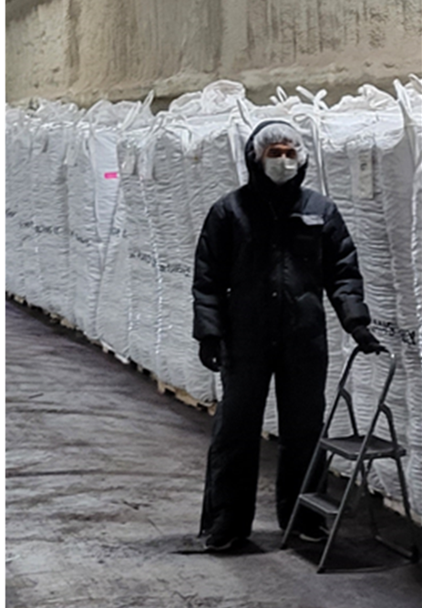
Quarantine Treatment Options
Cold treatment in an approved storage container/facility
0°F for 7 days or
12.2°F for 14 days
Hot water immersion
140°F for 5 minutes

Slide 9
Quarantined Counties
Should not move in-shell pecans and/or pecan-regulated articles out of a quarantine areas into a non-quarantined areas without treatment
Can move regulated materials into quarantined parts
No field-ran nuts into a non-quarantined areas
Shelled pecans are not included in regulation
Treatments should occur in county of origin
Compliance agreements
Must be in place BEFORE product is moved.
For Texas, contact PlantQuality@TexasAgriculture.gov
For New Mexico, contact pecan@nmda.nmsu.edu

Slide 10

New Mexico - Texas Reciprocity Agreement
Limited cold storage facilities
Allow for movement of in-shell pecans from quarantined New Mexico counties into pecan weevil free areas of Texas for cold storage treatment and reciprocated for Texas.
Reduction of pecan weevil risk
Provide additional treatment pathways
Increase compliance with treatments

Slide 11

New Mexico-Texas Reciprocity Agreement
Limited cold storage facilities
Allows for movement of in-shell pecans between Texas and New Mexico for purpose of cold treatment
Compliance agreements
Reduction of pecan weevil risk
Provide additional treatment pathways
Increase compliance with treatments
Shipments are only allowed for pecans in containers (topped boxes, supersacks) in clean, well-sealed trailers
Paperwork is available

Slide 12

Reciprocity Agreement Restrictions
Only for orchard/trees that comply with one of the following:
Not known to have pecan weevil based on inspection
Grower affidavit attesting to being pecan weevil free
Grower affidavit attesting to treatment for pecan weevil
Shipments to cold storage facilities that have compliance agreements with state
Ship in clean, well-sealed trailers
No field-ran nuts

Slide 13

Reciprocity Agreement Process
Interested growers:
Completion of Compliance Agreement & Production Affidavit
Send requests to PlantQuality@TexasAgriculture.gov/ (Texas) or pecan@nmda.nmsu.edu (New Mexico)
Submit completed paperwork to NMDA for final approval and signature.
Prepare shipments to send to ship.
Setup arrangements with the registered cold storage facility
Contact NMDA/TDA when shipment is ready for inspection
Clean Transport Affidavit and Certificate of Origin
Issued Pecan Permit and phytosanitary seals

Slide 14
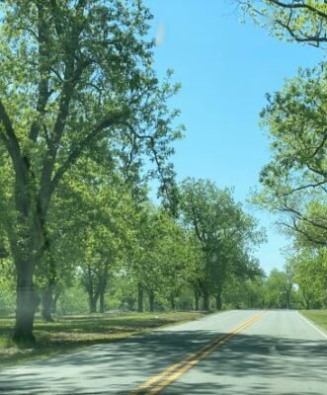
Shipment Checklist
Have Phytosanitary seal on trailer doors
Have documents with each load:
Pecan Permit
Clean Transport Affidavit
Certificate of Origin
Pecan Weevil Production Affidavit
Statement of Contents (Bill of Lading)
Cold Storage destination information
Not pass through pecan production areas
Transit on I-10 directly to treatment facility is allowed
https://fernandinaobserver.com/featured-story/pats-wildways-heirloom-pecans-disappearing/

Slide 15
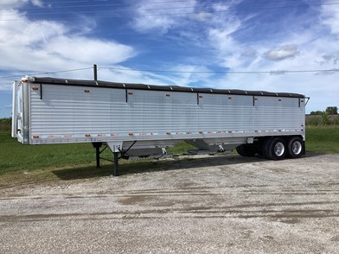
Reciprocity Hopper Agreements
Will allow for transport of hopper trailers
Smaller farms with the inability to sack/box
Fewer cold treatment facilities with ability to hand bulk loads
Similar to New Mexico hopper agreements
Similar agreement setup to previous agreement
Limited to rice/grain hopper trailers
Clean Transport Affidavit updated
Loads into New Mexico will be limited to cold storage in Santa Theresa
Fully signed agreement

Slide 16
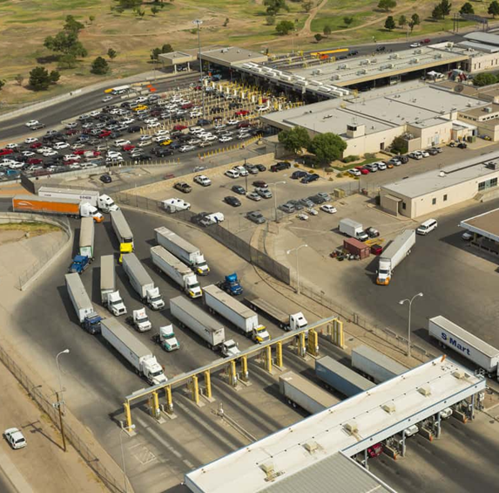
USDA APHIS FRSMP Program
Pecan weevil is not an actionable pest at international ports
Not an invasive pest
States may petition APHIS to recognize state-managed phytosanitary regulations to address pests of concern
Mitigates risk when FRSMP pest moves in with foreign commerce and intercepted at the port
Work with Arizona Dept. of Ag

Slide 17


National Plant Board Resolutions
Two resolutions to request USDA to meet with SENASICA/SADER to consider:
Including 12.2 F for 14 days as treatment to kill pecan weevil as a second cold treatment option.
Allow Mexico quarantined areas of the United States to import in-shell pecans into Mexico with treatment.
Letter sent to Mexico agencies March 27th stating request
USDA/SENASICA bilateral discussion July 21st in Washington

Slide 18

Created solely with monetary donations from private individuals and entities to fund disaster recovery efforts
Assists farmers, ranchers and agribusiness owners in rebuilding fences, restoring operations and other supplies needed to repair/rebuild an agricultural operation
For more information: StarFund@TexasAgriculture.gov or www.texasagriculture.gov

Slide 19
Questions

