Slide 1

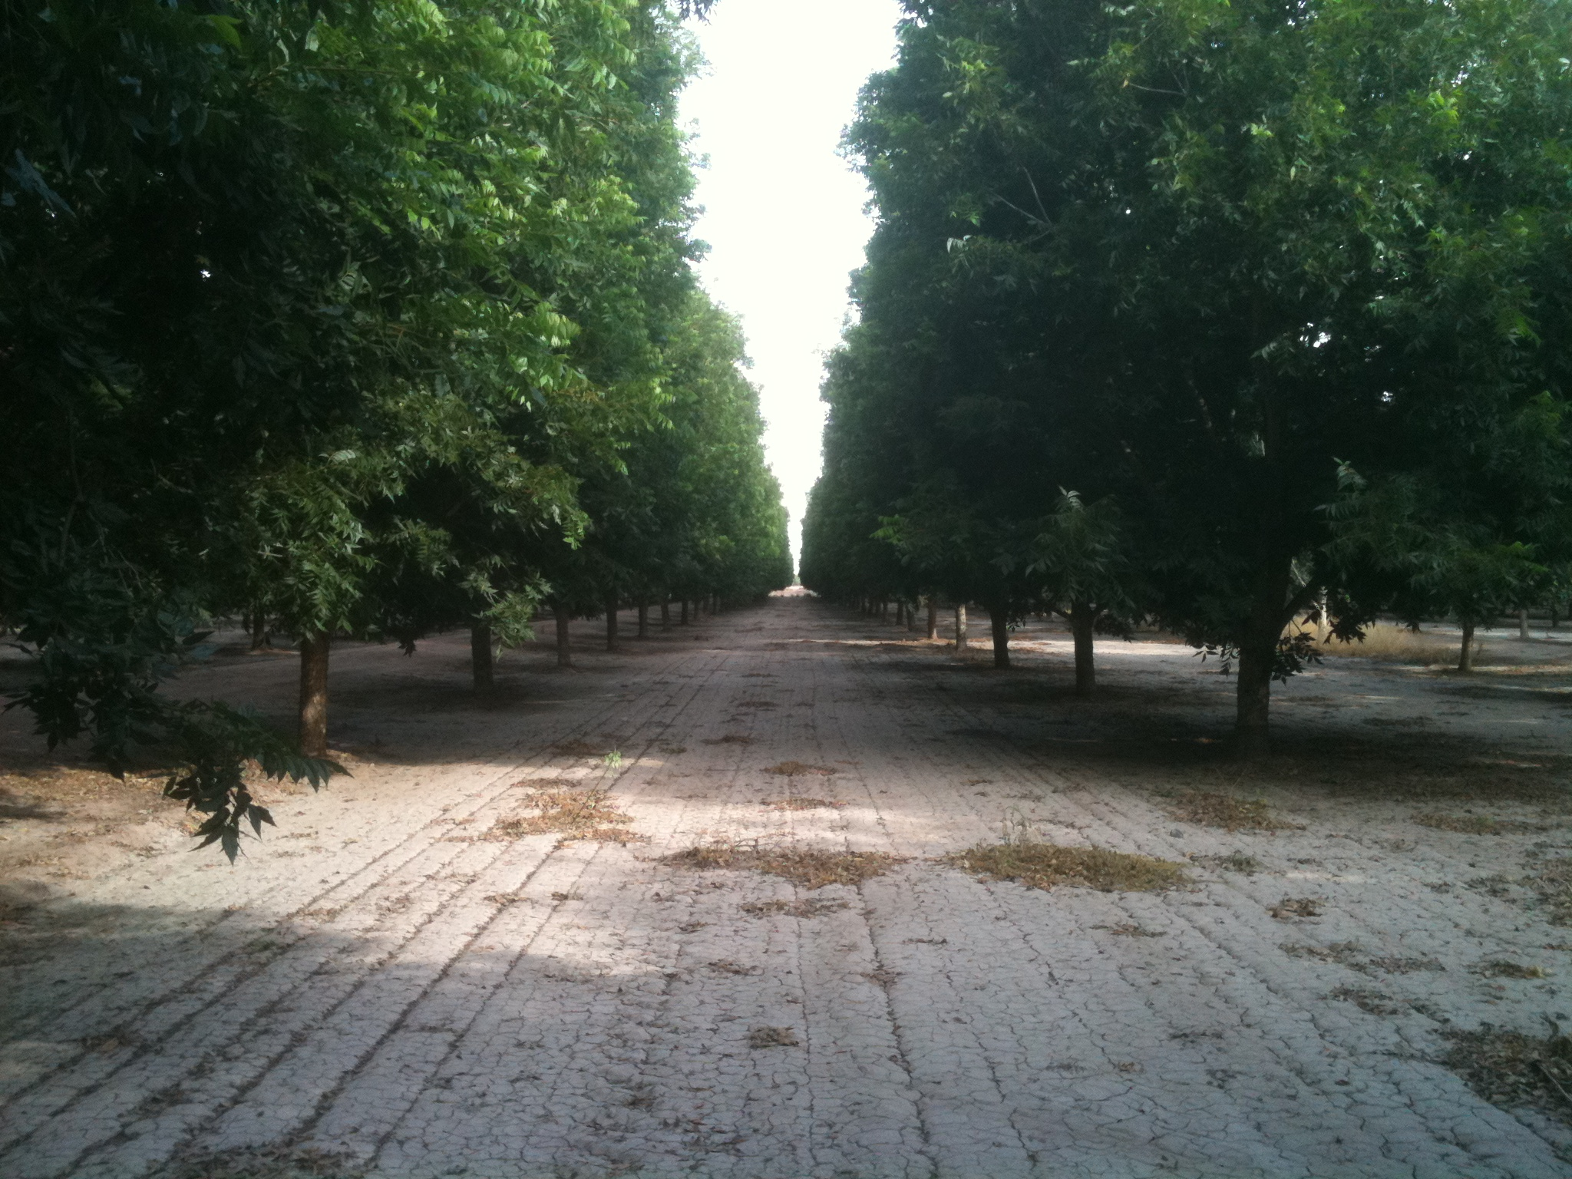


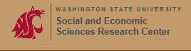
Survey Assessment of Texas Pecan Industry Perspectives: marketing Education, Research & Extension Needs
Monte L. Nesbitt, Larry Stein, Amit Dhingra,
Texas A&M University Horticultural Sciences
Meghan Mabry & Blair Krebs, TPGA
Rose Krebill-Prather, Ph.D. Washington State University

Slide 2
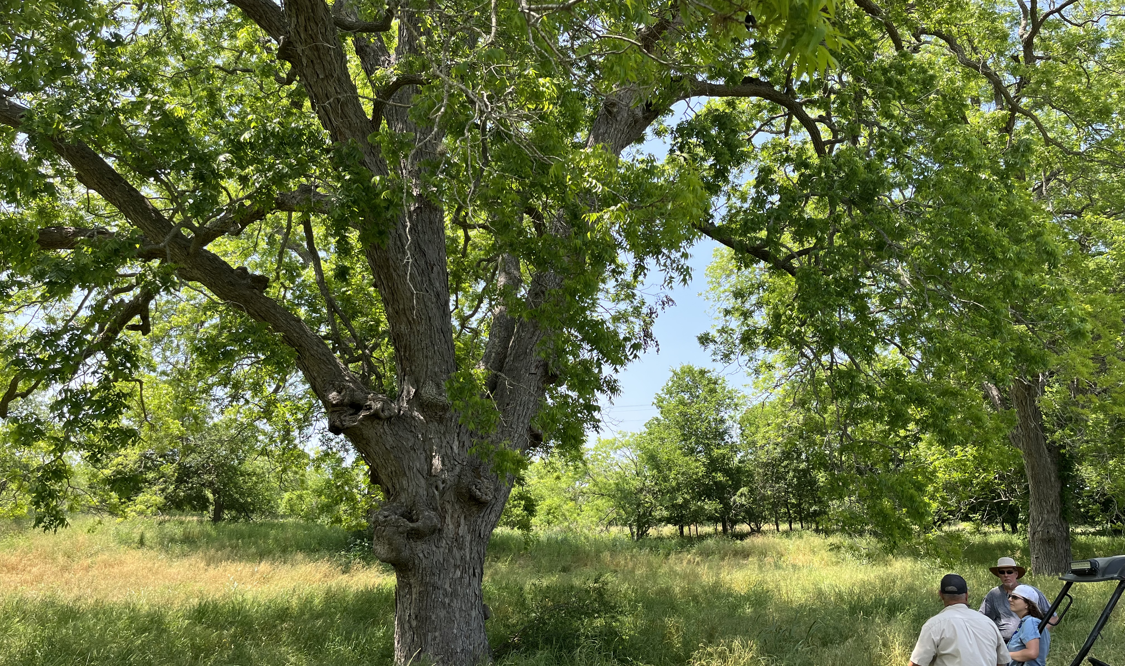
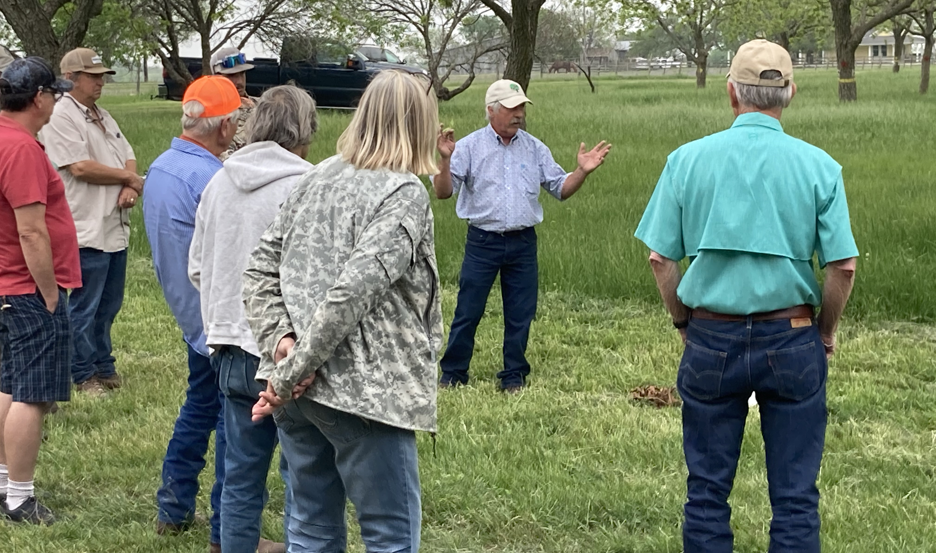
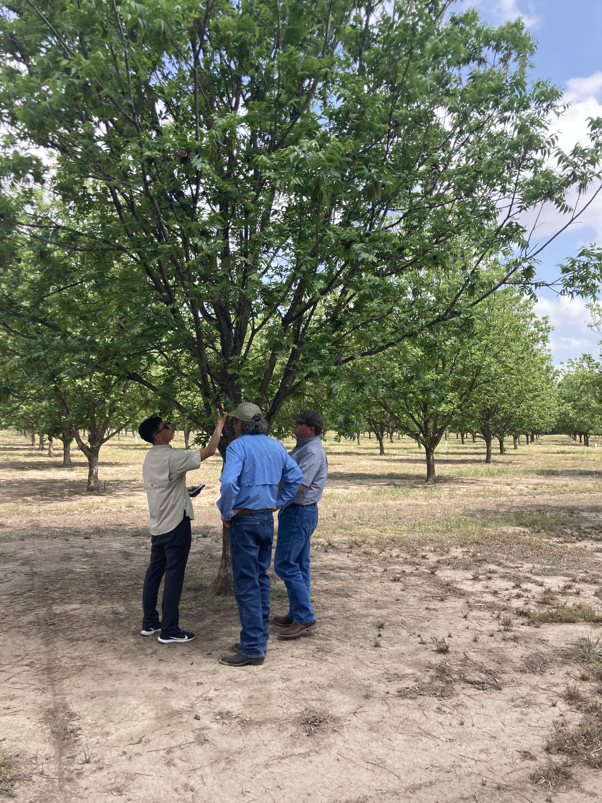
Pecan growing is a Texas legacy—an important Horticultural industry with deep historical impact to our culture and economy.
Over the 2012-2017 Census of Agriculture period, Texas lost 17.5% of its pecan acreage, while elsewhere in the country, pecan acreage grew 7%.

Slide 3
Project 13: “Texas Pecan Industry Development and Sustainability Survey”
TDA Specialty Crop Block Grant
Dec 1, 2022-Sep 30, 2024
Award $58,739.32
Objective: A thorough, Post-Covid survey of the Texas pecan industry that will serve as an assessment of industry development, sustainability, and research needs.
11 “Local” Town Hall Listening Sessions (April-July, 2023) 66 growers from 36 counties 13,200 Acres Represented
Crop Cycle Survey (Sept-Dec 2023) 22% Response of 400 growers (n=86) 16,284 Acres Represented
Industry Perspectives Survey (Sept-Dec 2024) 30% Response of 433 growers/retailers 36,857 Acres Represented

Slide 4
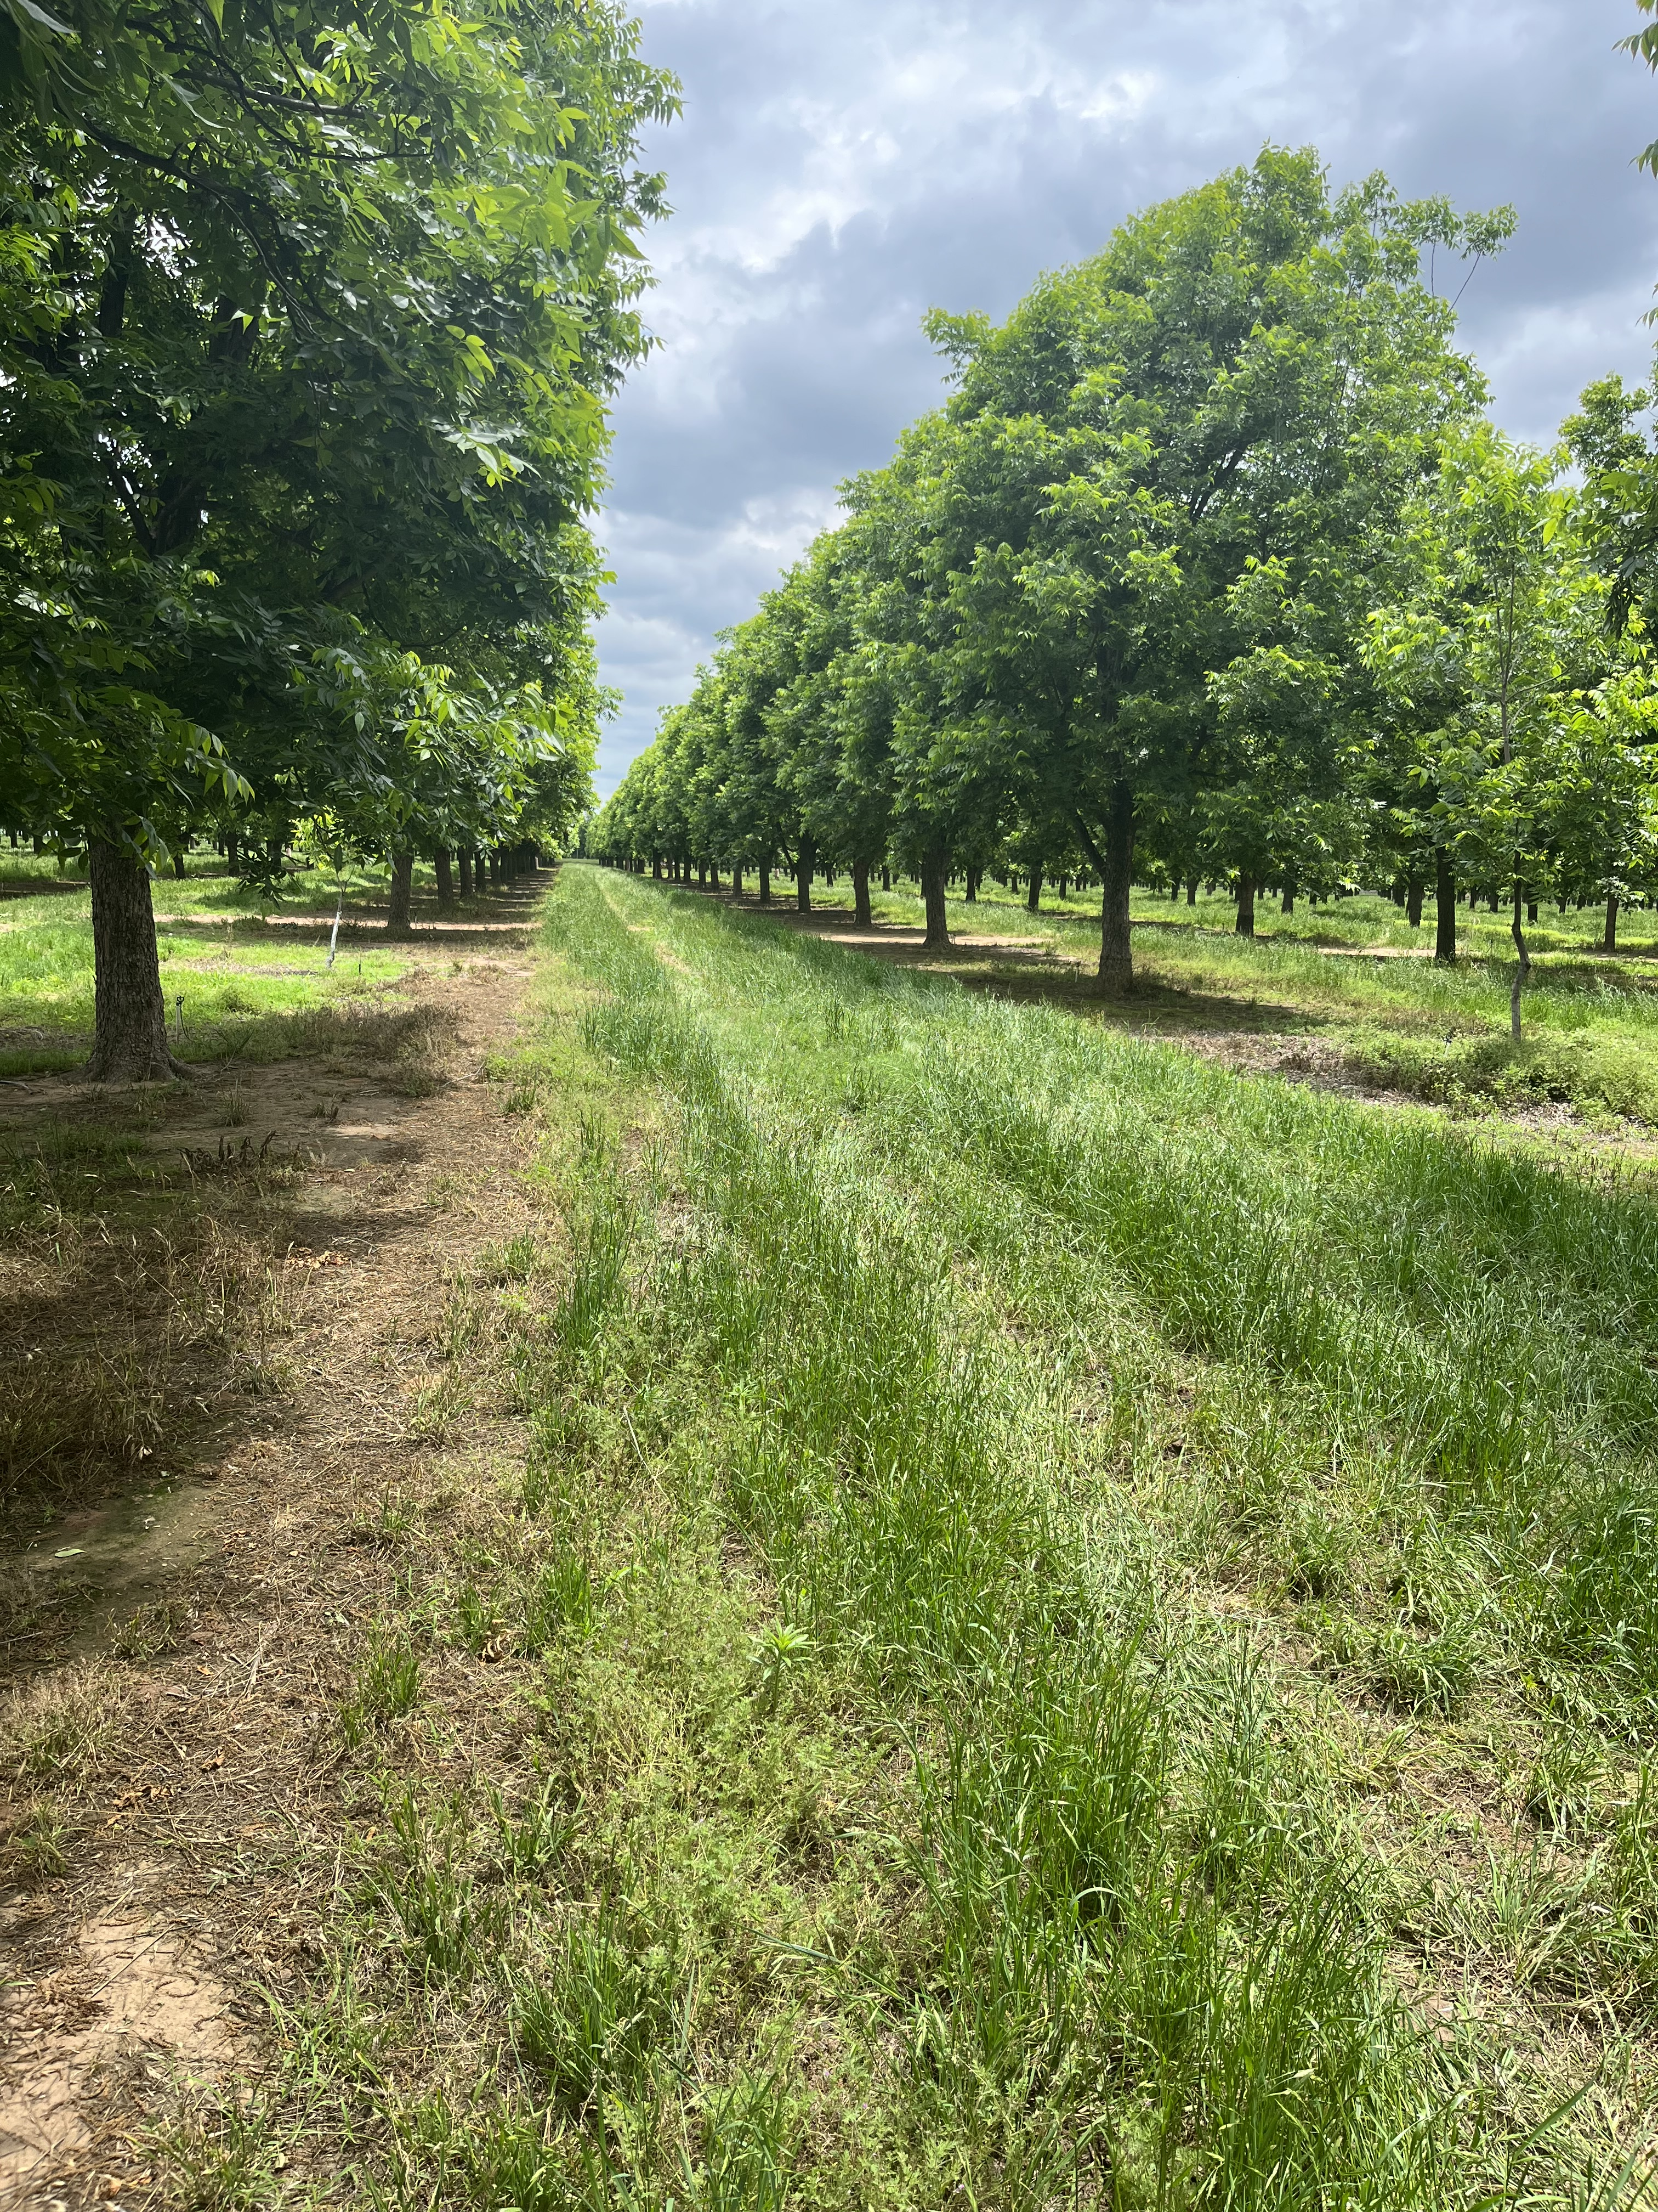
Size, scope,& distribution of the Texas Pecan Industry.
Attitudes, perceptions, and behaviors of Texas pecan growers.
Current condition & future production potential of Texas pecan orchards.
Challenges and obstacles common or unique to subsets of Texas growers.
Past, present and future economic impact of the commercial pecan production industry.
Highest Research priorities for the Texas pecan industry.
Intended Findings
IRB2023-0882M-Exempt status granted (9/15/2023)

Slide 5


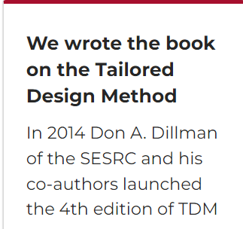

Slide 6
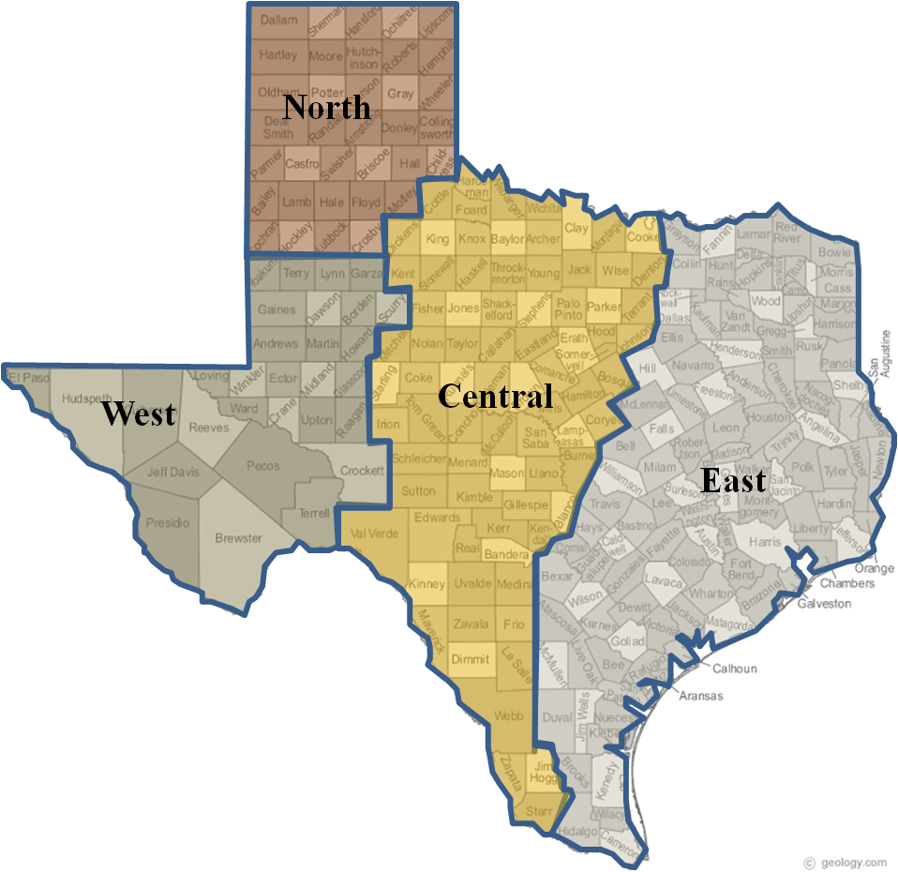
2024 Survey
Mail survey-September 2024, to 443 people
135 Responses (30.8% Response Rate)
97 current Texan pecan growers,
9 retailers, 8 former growers, 13 undeclared role
89% Male, 10% Female
Average age-66 Years, 29% <60, 71%>60
4 (3%)
30 (22%)
27 (20%)
North-Central
Northeast
17 (13%)
South -Central
Southeast
8 (6%)
48 (36%)
36,857 Acres represented, Avg=319
1-10 Acres=38%
11-100 Acres=36%
101-1000=20%
>1,000 acres=6%

Slide 7
Purpose & Type of business

Slide 8
Pecan Business—Yesterday vs today

Slide 9
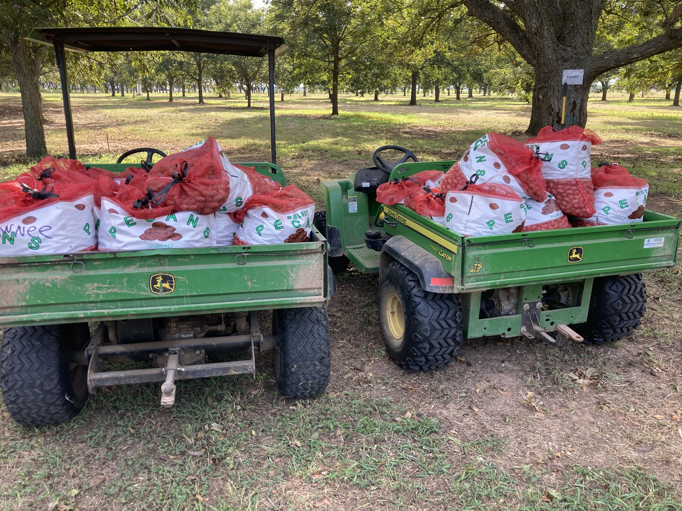
Tree Productivity-Yesterday vs Today

Slide 10
Resource Adequacy--Soil

Slide 11
Resource adequacy-Water

Slide 12
Resource adequacy-Labor
Labor

Slide 13
Resource adequacy-equipment

Slide 14
Market Perspectives
Wholesale marketing is important to the economic success of my orchard: 87% Agreement, 9% Undecided, 4% Disagreement
The current wholesale market situation is economically favorable: 11% Agreement; 27% Undecided, 61% Disagreement
The current wholesale market sets prices for my pecan crop fairly: 13% Agreement, 24% Undecided, 63% Disagreement
I am considering exiting the business because of the wholesale market: 22% Agreement; 37% Undecided, 41% Disagreement;
I am considering expanding because of the wholesale market: 2% Agreement, 30% Undecided, 68% Disagreement
Developing alternative marketing strategies because of the wholesale market: 45% Agreement, 26% Undecided, 30% Disagreement

Slide 15
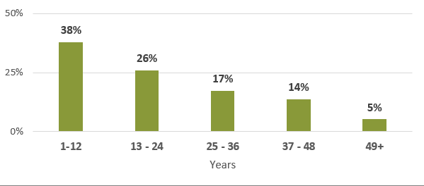
Direct-to-Consumer engagement
54% of survey respondents have retail sale (46% No)
Years that retail business has been active.

Slide 16
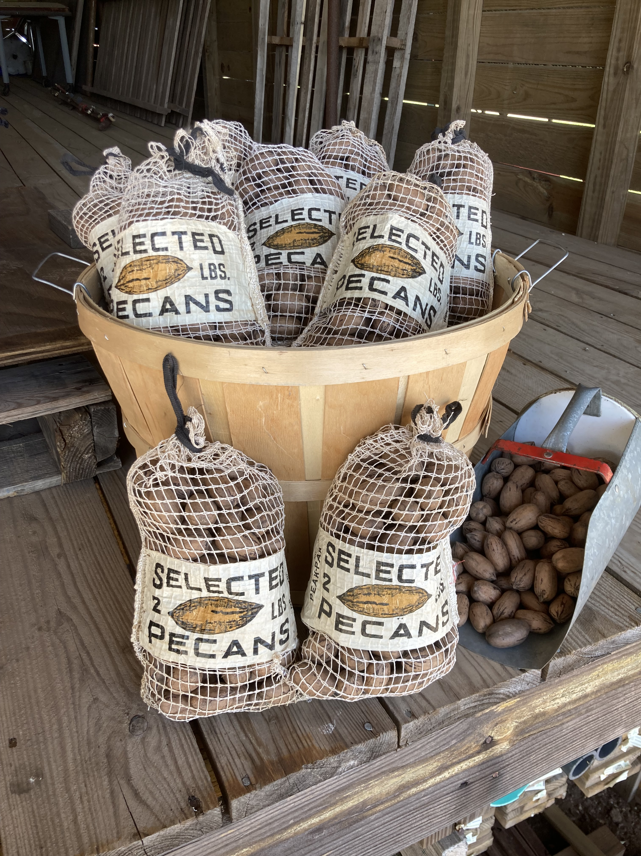
About Direct-to-Consumer engagement
17% buy pecans they did not grow and sell in a retail business
56% sell pecans year-round
46% have on-line sales
19% utilize a dedicated storefront not affiliated with an orchard
20% utilize a dedicated storefront located at a pecan orchard.

Slide 17
What They’ve perceived about Customers
Retail sales of pecans are currently strong: 61% Agreement; 17% Disagreement
Retail sales of pecans are increasing: 62% Agreement; 14% Disagreement
Retail customers are motivated to try new pecan products: 41% Agreement, 43% Neutral, 16% disagree
Retail customers prefer specific varieties of pecans: 71% Agreement, 19% Neutral, 10% disagree
Retail customers believe prices are too high: 41% Agree, 36% Neutral, 22% disagree
Retail customers are seeking expanded ways to cook with pecans: 39% Agreement, 44% Neutral, 18% disagree
Retail customers are not aware of the health benefits of pecans: 47% Agreement, 28% Neutral, 26% disagree

Slide 18
Promotion Perspectives
Pecans need greater promotion in Texas: 67.3% Agreement
Pecan promotion efforts need to be greater to compete with other nuts: 75% Agreement
Health benefit education at the point of sale is beneficial to overall sales: 74% Agreement
Health benefits of pecans need greater promotion: 75.4% Agreement
Pecans don’t have enough national visibility, more mass advertising is needed: 68% Agreement
The federal marketing order has helped the pecan industry since 2016: 17% Agreement; 57% Undecided; 26% Disagreement

Slide 19
Perspectives on Research
Scientific devotion/active research needed for the unique challenges of growing pecans: 86% Agreement
I support more funds toward pecan production research: 68% Agreement
Existing research is appropriate/potentially helpful: 69% Agreement
My future success partially dependent on targeted research: 54% Agreement

Slide 20
Research Priorities
Topic | 1-Lowest | 2-Low | Medium | High | Highest | Priority Score
Fertilizer | 1.0 | 3.9 | 18.4 | 51.5 | 25.2 | 76.7
Pest Mgt | 0.0 | 3.9 | 21.4 | 33.0 | 41.7 | 74.7
Human nutrition | 1.9 | 4.9 | 21.4 | 32.0 | 39.8 | 71.8
Tree water use | 1.9 | 8.7 | 18.3 | 29.8 | 41.3 | 71.1
Economics & Marketing | 4.0 | 6.9 | 24.8 | 33.7 | 30.7 | 64.4
Genetic improvement | 4.9 | 15.7 | 23.5 | 34.3 | 21.6 | 55.9
Alternate Bearing | 9.7 | 4.9 | 40.8 | 28.2 | 16.5 | 44.7
Hedging | 5.9 | 12.9 | 41.6 | 22.8 | 16.8 | 39.6
Salinity | 13.6 | 16.5 | 33.0 | 22.3 | 14.6 | 36.9
Robotics, drones | 15.7 | 18.6 | 35.3 | 22.5 | 7.8 | 30.3
Dwarfing | 28.2 | 32.0 | 24.3 | 13.6 | 1.9 | 15.5

Slide 21
Perspectives on Education Needs
Combined years experience of 79 pecan growers 1,353.5 Years!
I need to know more about growing pecans: 66% Agreement
Knowledge of how to grow pecans successfully is available: 78% Agreement
I have questions on certain topics: 68% Agreement
Advance training course is needed: 61% Agreement
Internet information is beneficial: 76% Agreement
Internet information can be trusted: 43% Agreement

Slide 22
Need for Extension Outreach
I don’t need outside support to be successful: 70% Disagreement
I can solve my own problems: 48% Disagreement; 22% Agreement
Extension agents are available locally to help: 43% Agreement; 38% Disagreement
I utilize state Extension specialists in Texas when I have an issue: 55% Agreement; 26% Disagreement
I utilize state Extension specialists outside Texas when I have an issue: 24% Agreement; 47% Disagreement
Extension is NOT where I seek answers- 33% Agreement; 39% Disagreement

Slide 23
Where to Go For Help
Resource | Never | Little | Occasionally | Regularly | Frequently | R+F Sum
Pecan South Magazine | 0% | 2.9% | 19.4% | 39.8% | 37.9% | 77.7%
Fellow grower | 8.8 | 6.9 | 27.5 | 27.5 | 29.4 | 56.9
TPGA Conference | 35.0 | 13.6 | 15.5 | 17.5 | 18.4 | 35.9
TPGA News | 17.6 | 19.6 | 30.4 | 25.5 | 6.9 | 32.4
Internet (University-based) | 10.7 | 10.7 | 49.5 | 20.4 | 8.7 | 29.1
State Specialist/Univ. faculty | 24 | 6.9 | 41.2 | 16.7 | 10.8 | 27.3
Ag Chemical Distrib. Co. | 33.3 | 10.1 | 31.3 | 13.1 | 12.1 | 25.2
Local Fertilizer/Seed Co. | 35.6 | 15.8 | 25.7 | 13.9 | 8.9 | 22.8
The Pecan Grower Magazine | 52.0 | 9.0 | 20.0 | 11.0 | 8.0 | 19.0
Internet (Non- University based) | 20.8 | 20.8 | 39.6 | 12.9 | 5.9 | 18.8
Chemical Pesticide Tech Rep | 52.5 | 13.1 | 18.2 | 10.1 | 6.1 | 16.2
County Agent | 30.3 | 15.2 | 41.4 | 9.1 | 4.0 | 13.1
Texas Pecan Board | 46.1 | 27.5 | 18.6 | 7.8 | 0 | 7.8

Slide 24
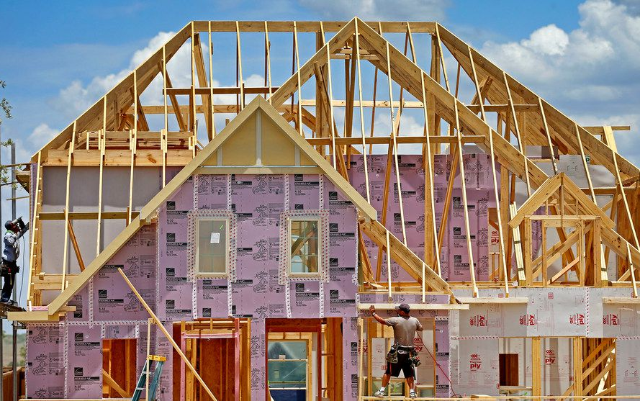
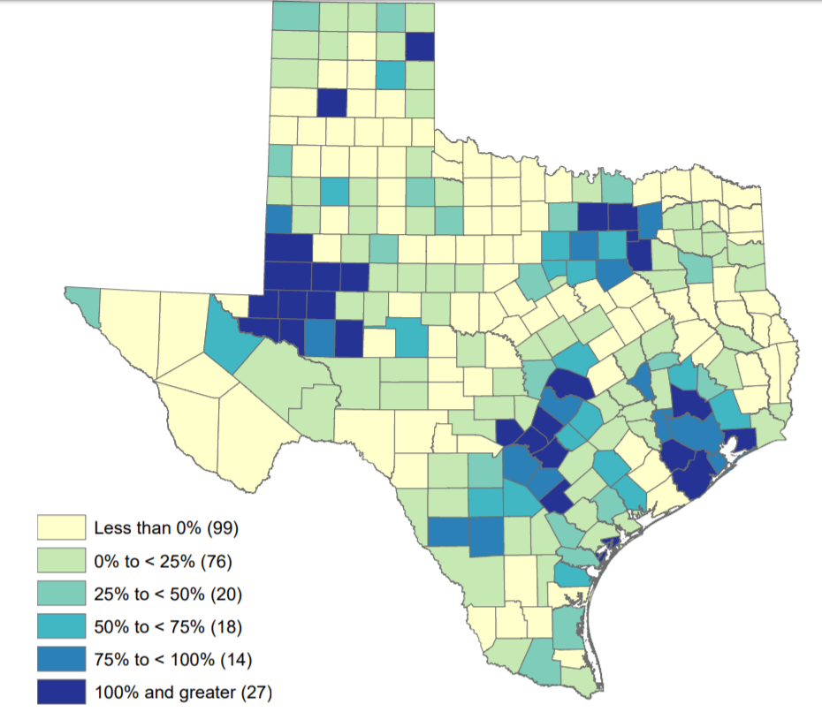
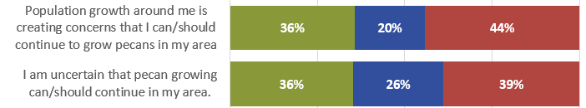
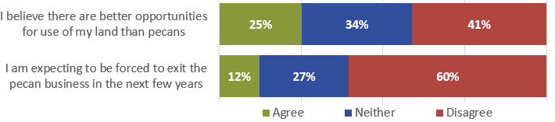
Continuation Influences
2010-2050 % population change
Texas Demographic Center

Slide 25
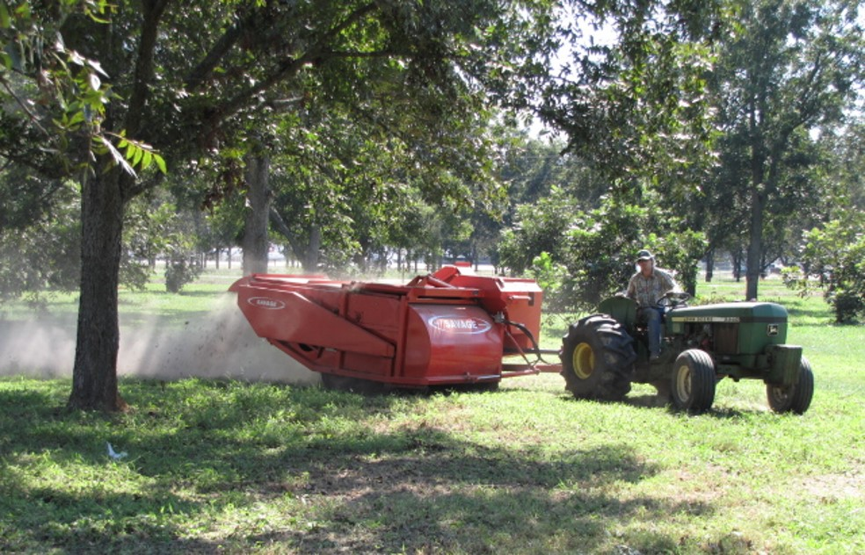
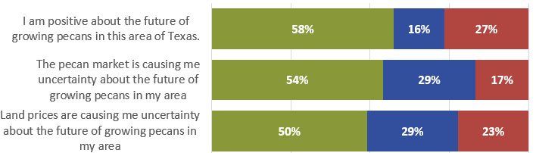
Continuation influences
“Everyone around here is one real estate transaction away from the land becoming too expensive to grow pecans…”
(Goldthwaite Town Hall Session, 2023)

Slide 26
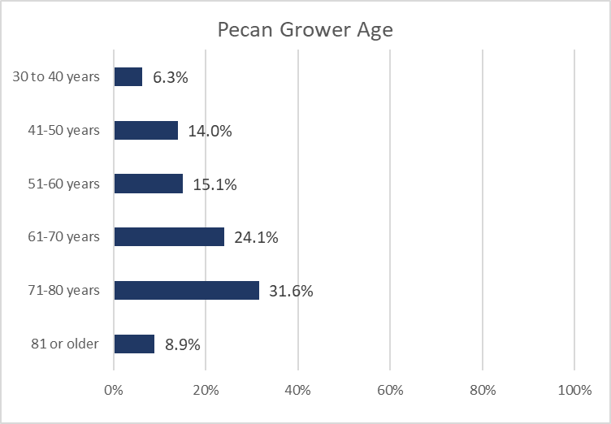
Continuation Plans
64.6% & 71.4% Retirement Age+
Continuation of pecan production business for at least next 4 years | 69%
Sell land and orchard to retire | 2%
Sell land and orchard, dissatisfaction with business | 5%
Hold land, cessation of pecan production | 7%
Undecided | 8%
Other | 10%
I have a succession plan that will keep land in pecan production | 20% Agreement
My succession plan doesn’t insure continuation of pecan production | 36% Agreement
At Risk to Not Continue: 4,570.6 Acres of survey participants
18,380.4 Acres of USDA Improved Acreage (~20%)

Slide 27
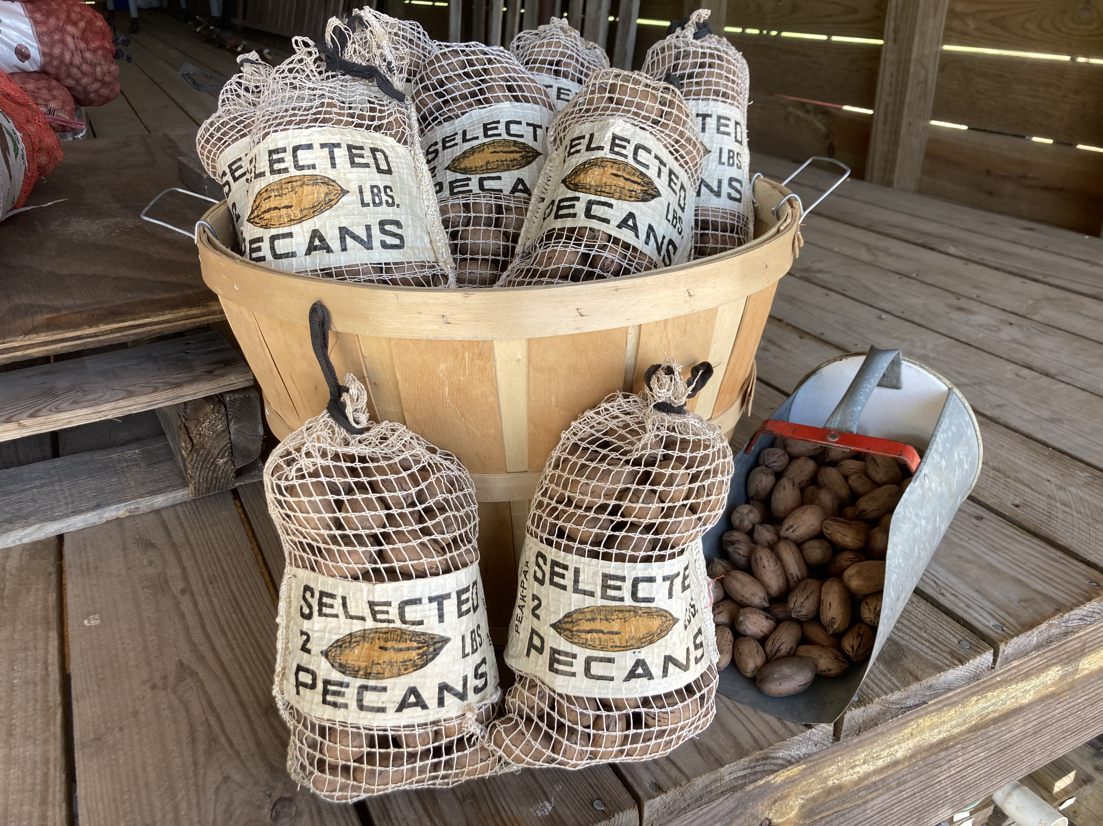
Closing Thoughts
The current Texas pecan grower populous is very diverse, facing an array of production and marketing challenges in the face of a difficult Pecan Market and Economy.
Age demographics, the high presence of sole proprietorships, coupled with population growth, land prices, and labor outlook create potential for further significant industry constriction.
Extension & research must align with grower perceived needs for education, outreach, and research to provide a high level of support to the existing industry.
Change is real!

Slide 28
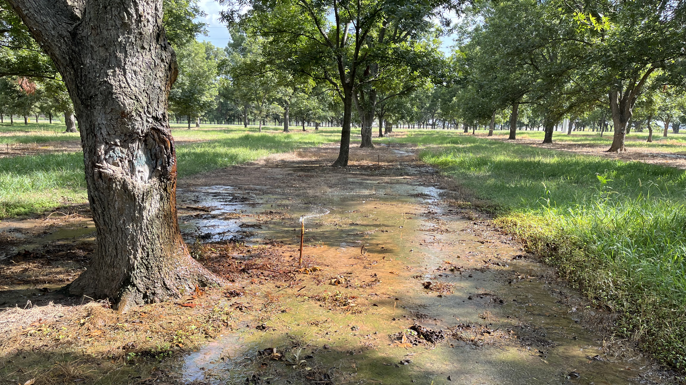
Thank you
Monte Nesbitt
979-321-7028
Monte.Nesbitt@ag.tamu.edu

