Slide 1

Rooting for the Home Team
Richard Heerema
Extension Pecan Specialist

Slide 2
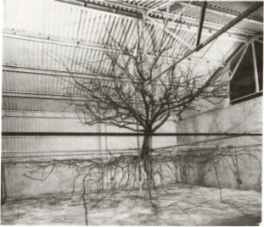
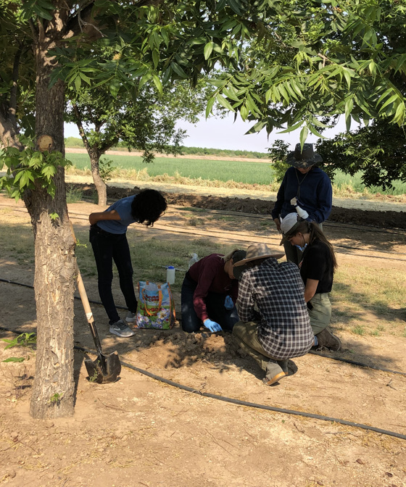
How to learn about roots?
Rogers and Head, 1969 (from Kozlowski and Pallardy, 1997)
Notes:
Geoelectric methods for imaging tree roots: Electrical Resistivity Tomography (ERT), Electromagnetic Induction (EMI), Modified Earth Impedance (MEI), and Ground Penetrating Radar (GPR)

Slide 3
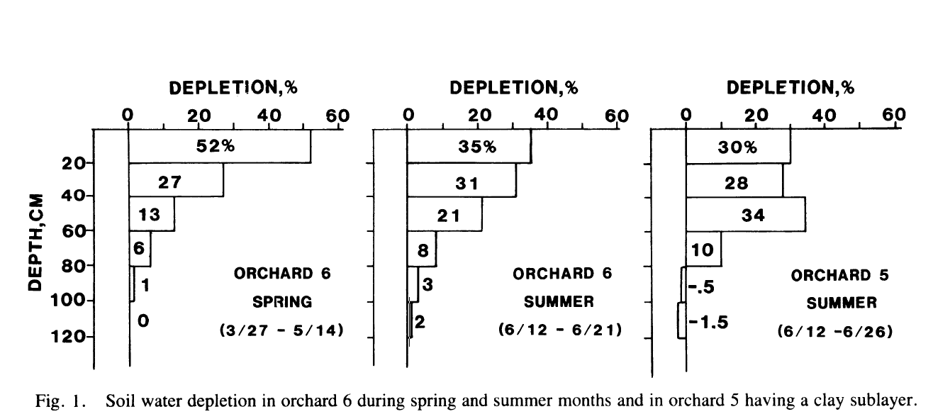
Buried Sensors
Miyamoto, 1983

Slide 4
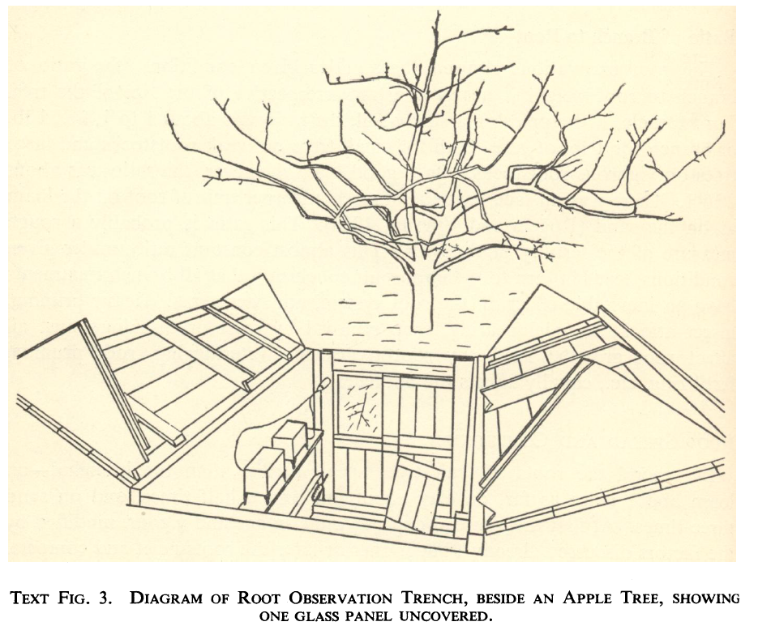
Rogers and Booth, 1959-1960

Slide 5
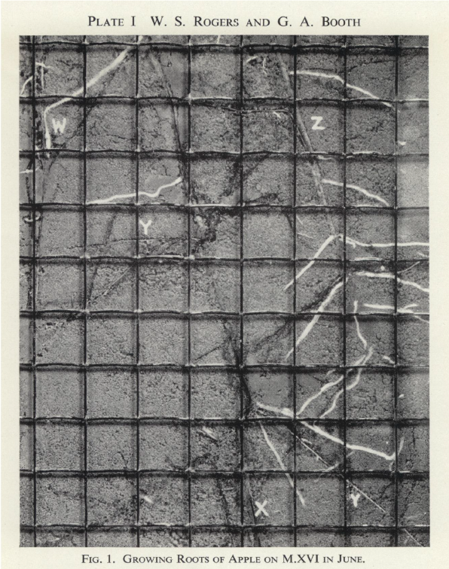
Rogers and Booth, 1959-1960

Slide 6
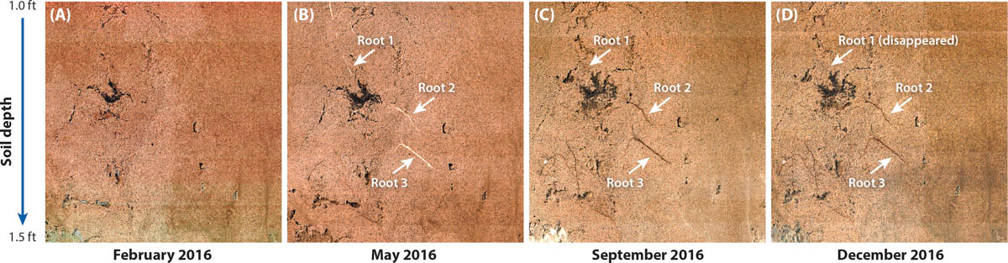
Minirhizotron
Ma et al., 2022
https://ucanr.edu/sites/calagjournal/archive/?image=fig2022a0008p75.jpg

Slide 7
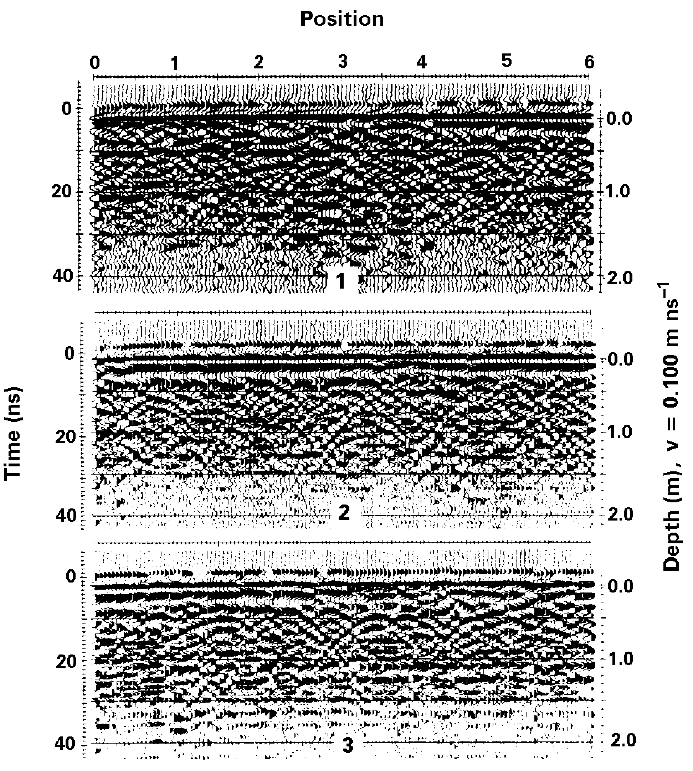
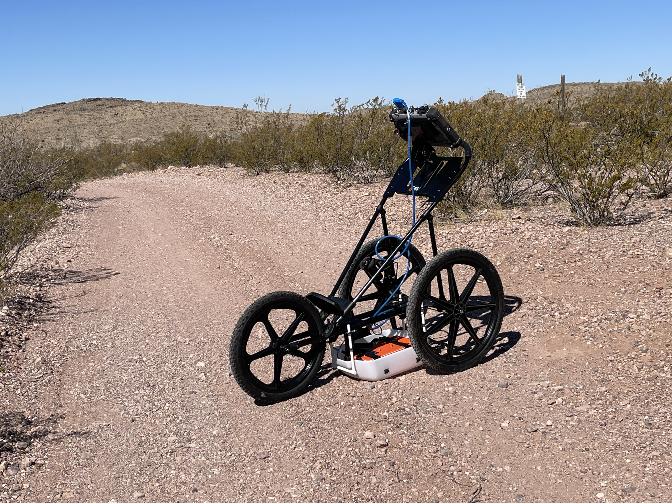
Ground Penetrating Radar
Photos courtesy of Dr. Liz La Rue (UTEP)
Hruska et al., 1999
Notes:
Geoelectric methods for imaging tree roots: Electrical Resistivity Tomography (ERT), Electromagnetic Induction (EMI), Modified Earth Impedance (MEI), and Ground Penetrating Radar (GPR)
Ground-penetrating radar measurement as a method of mapping
tree roots has several advantages over other methods.
(1) It is capable of scanning root systems of large trees under
field conditions in a short time.
(2) It does not disturb soils or damage the trees examined
and causes no harm to the environment.
(3) Being noninvasive, it allows repeated measurements that
reveal long-term root system development.
(4) It allows observation of root distribution beneath
streams, lakes, rocks, roads and buildings.
(5) Its accuracy is sufficient to resolve coarse roots with
diameters from less than 1 cm to 3 cm or more.
(6) It can characterize roots at both the individual tree and
stand levels, facilitating correlations with tree- and stand-level
measurements of physiological processes (e.g., sap flow and
eddy correlation) in complex ecological studies.

Slide 8
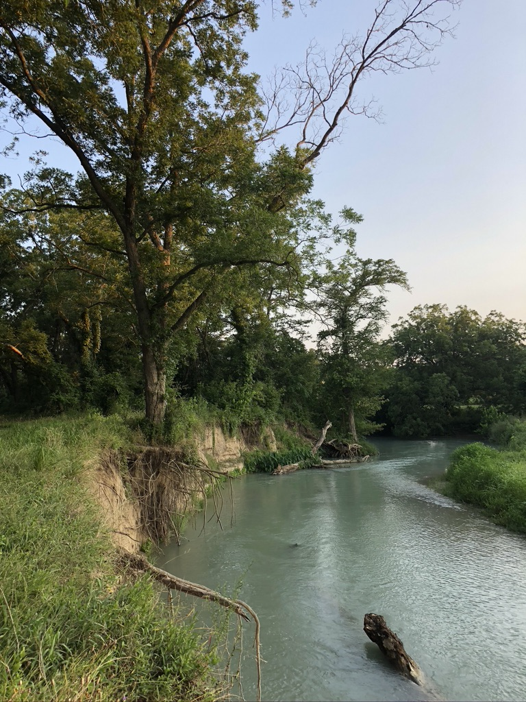
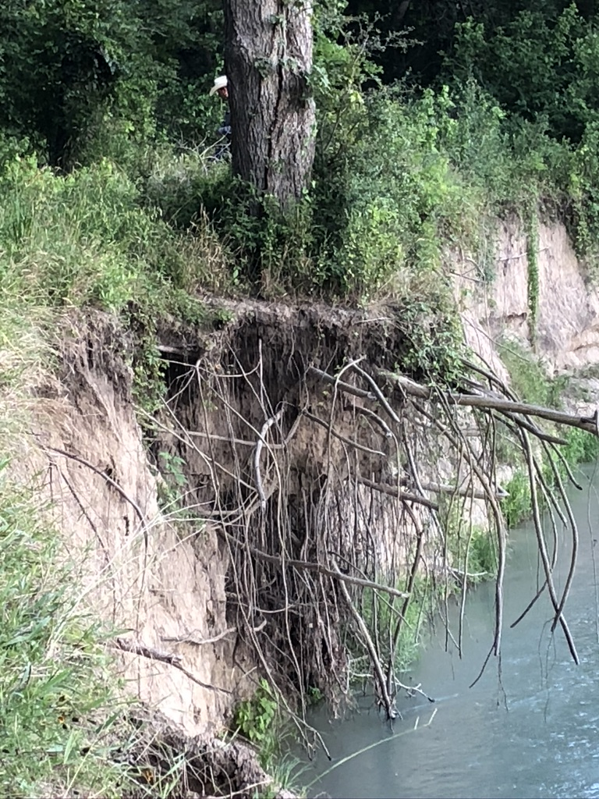
Root Structure and Function

Slide 9
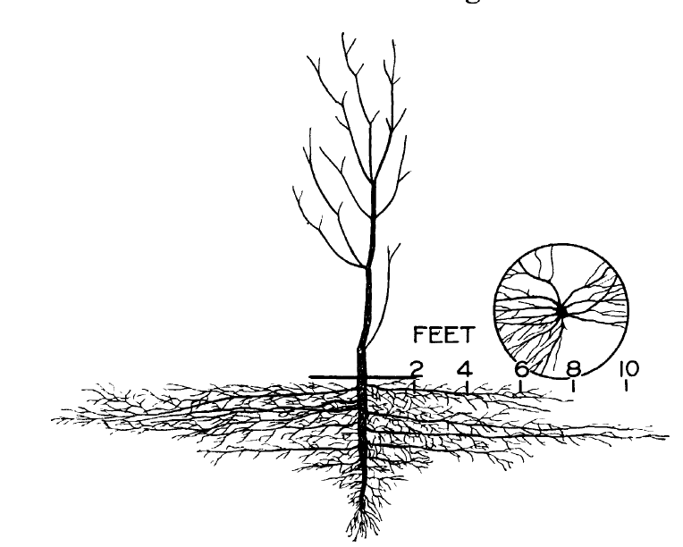
Root Structure & Function: Tap Root
Woodroof and Woodroof, 1934

Slide 10
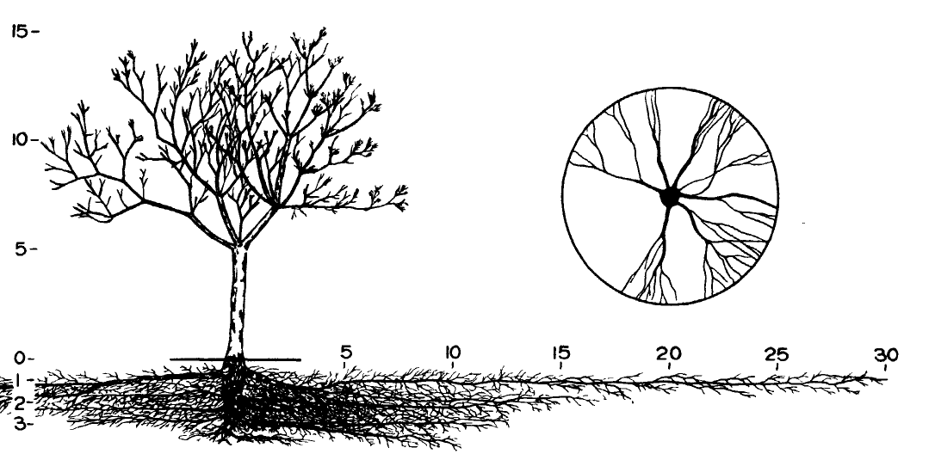
Root Structure & Function: Lateral Roots
Woodroof and Woodroof, 1934
Notes:
Brace roots– laterals near surface
Vertical roots go from the laterals (up→ humus striver roots; down--> sinkers)
Convey nutrients and water.

Slide 11
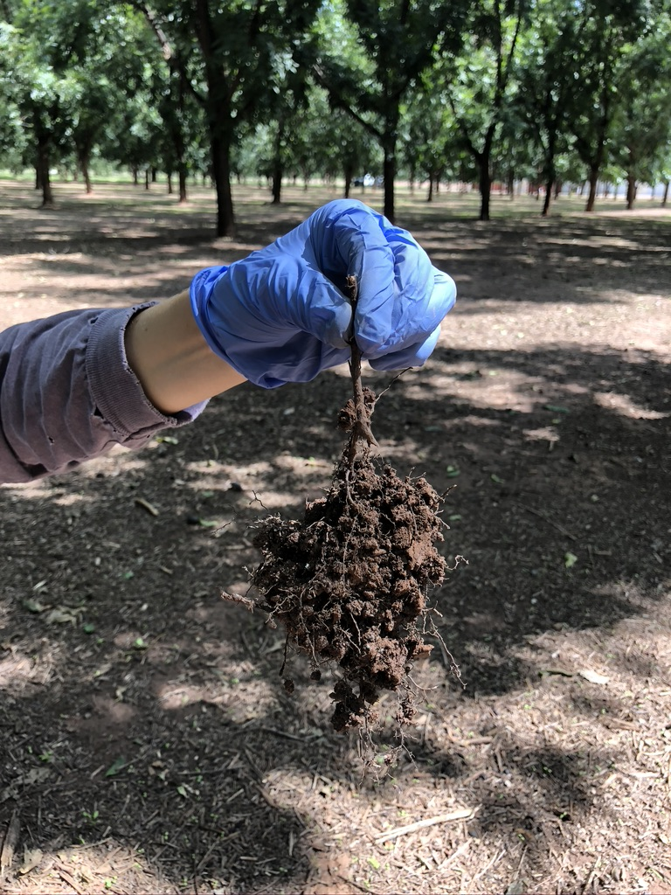
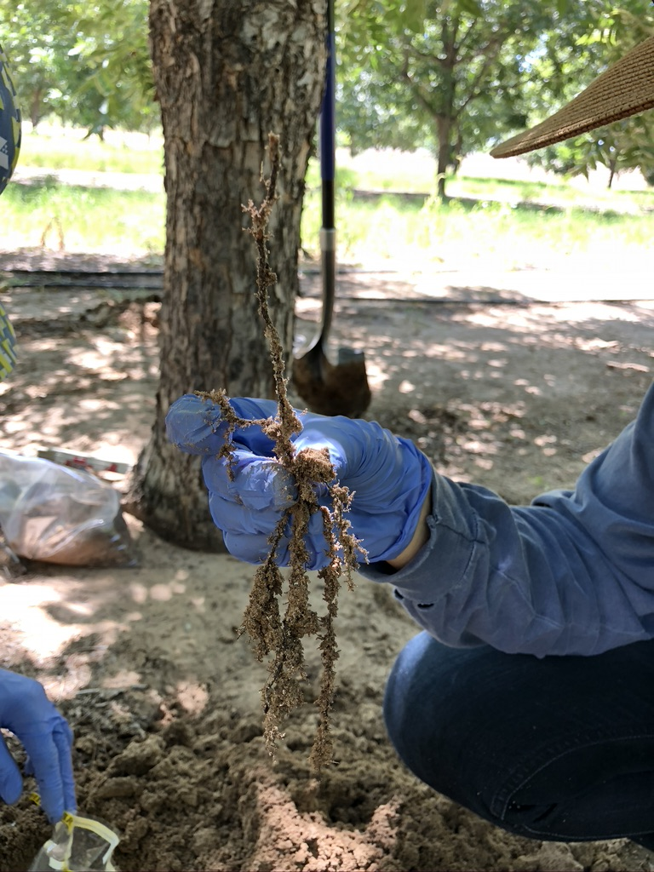
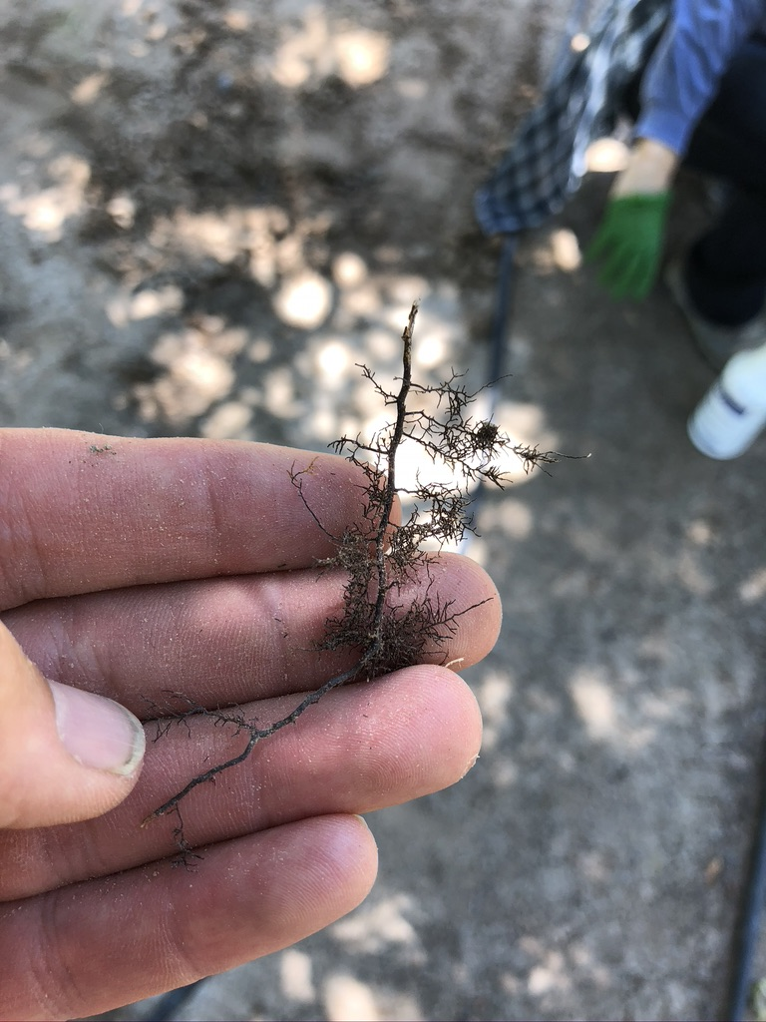
Root Structure & Function: Fibrous Roots

Slide 12
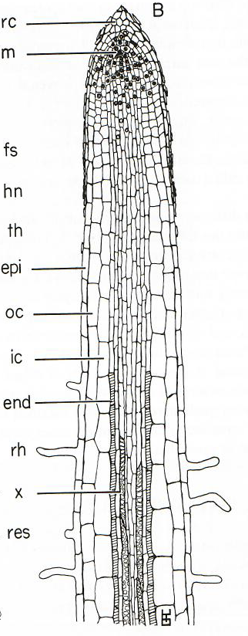
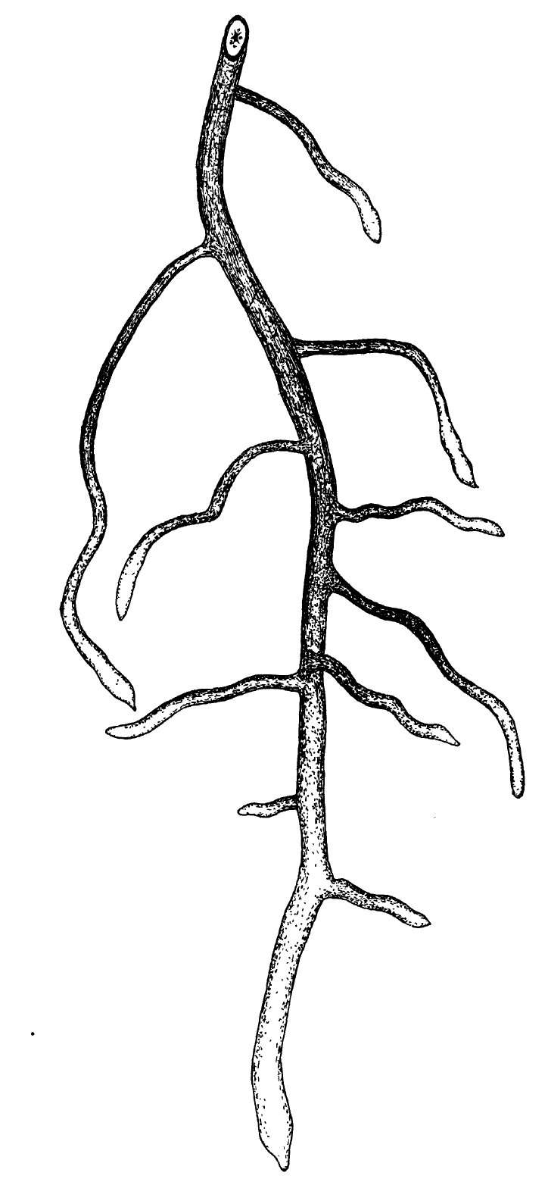
X
X
X
X
X
X
X
Kozlowski and Pallardy, 1997
Woodroof and Woodroof, 1934

Slide 13
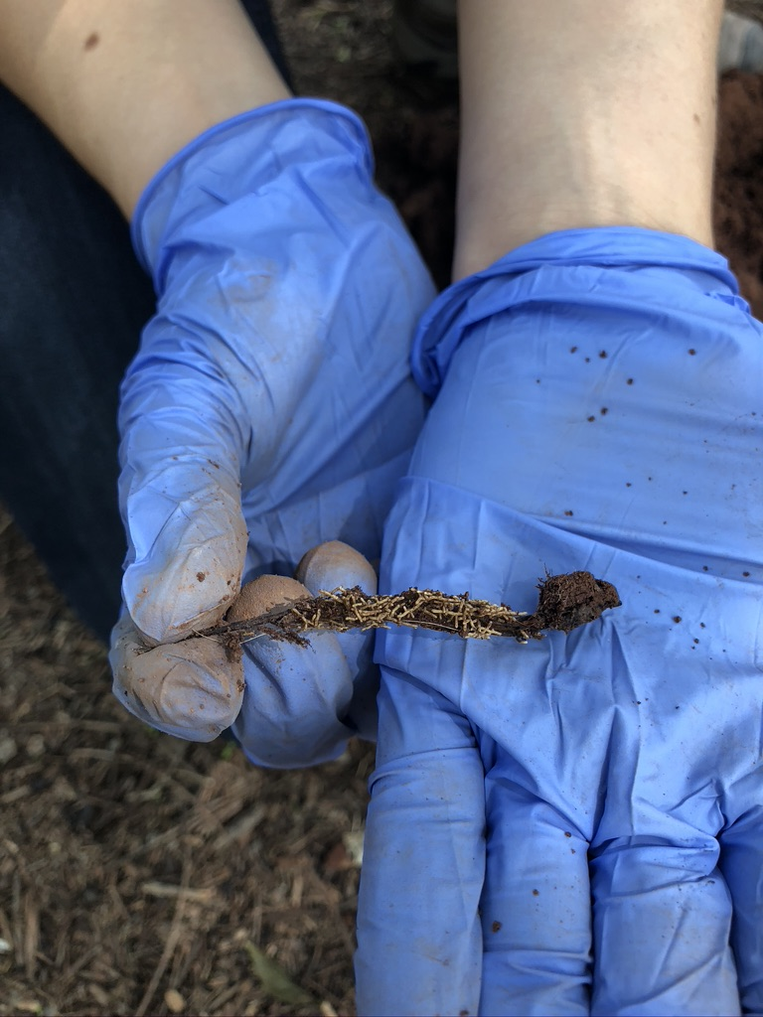
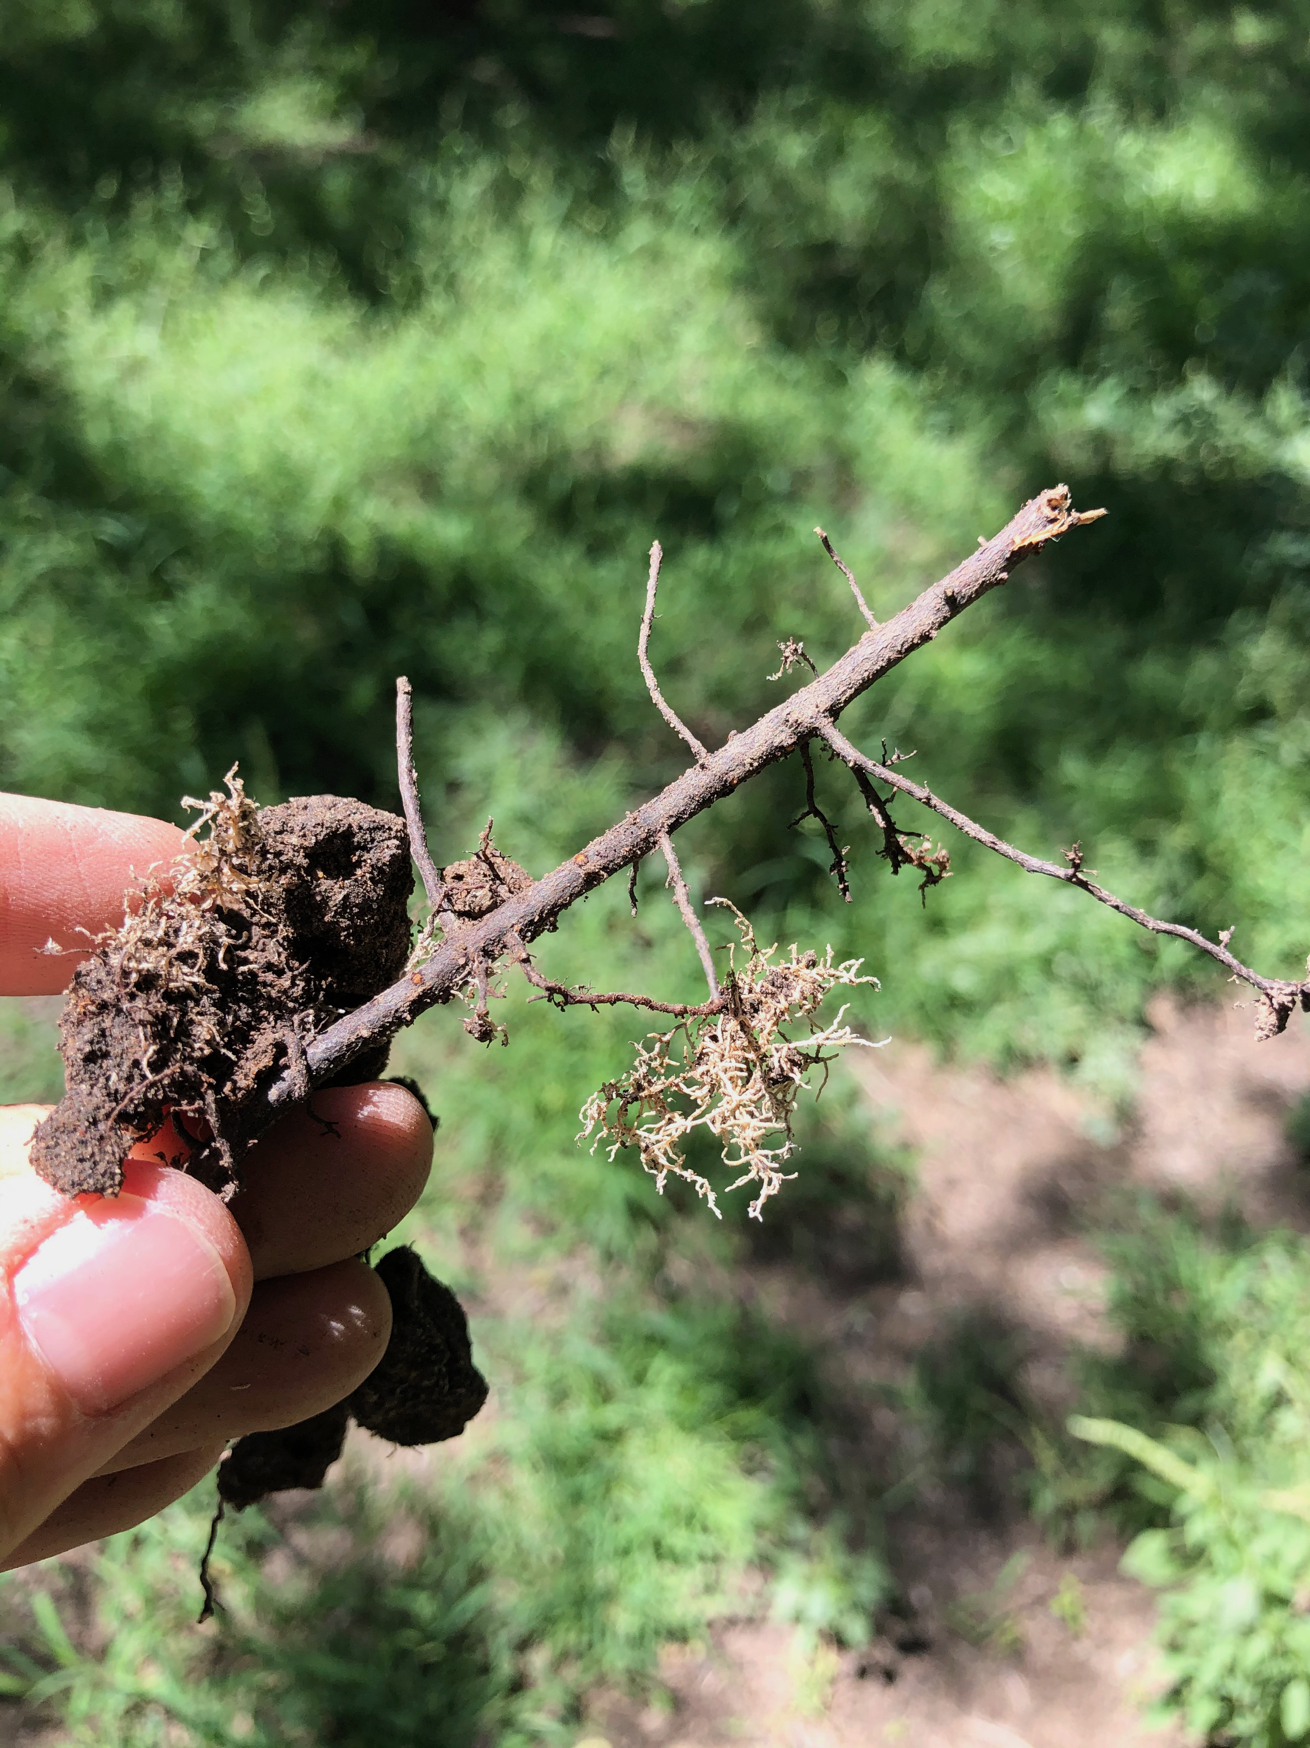
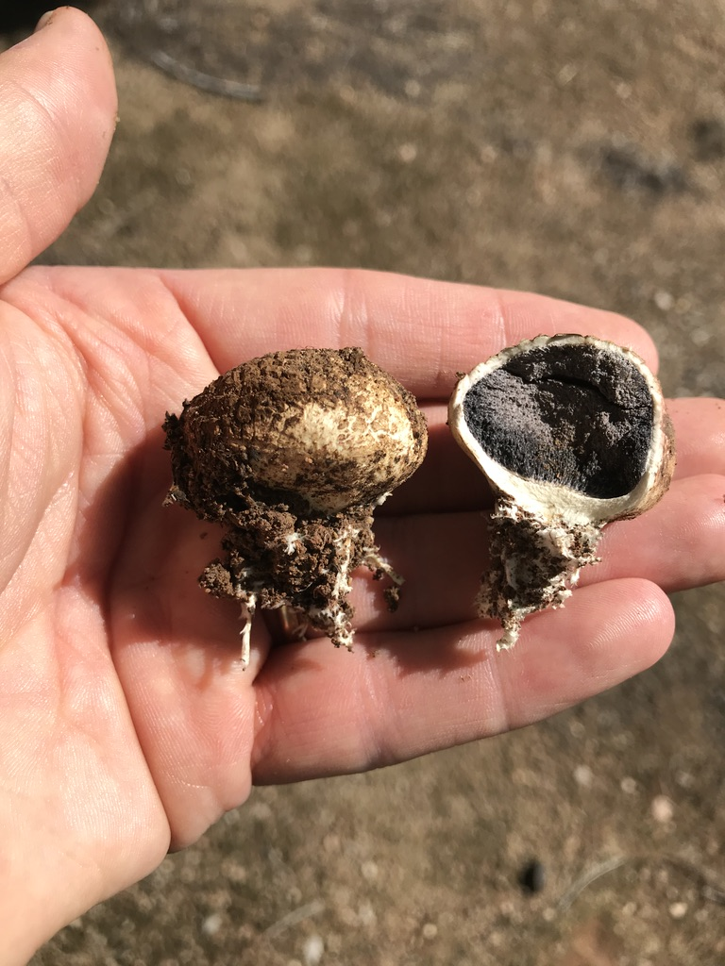
Mycorrhizal Fungi

Slide 14
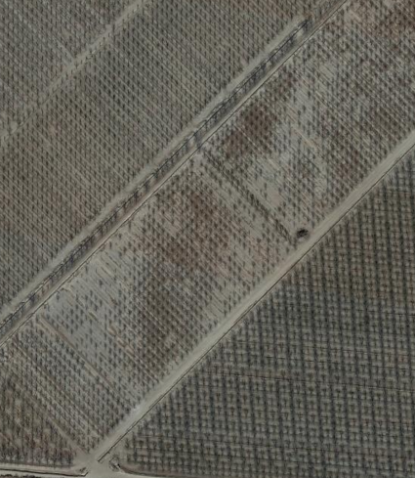
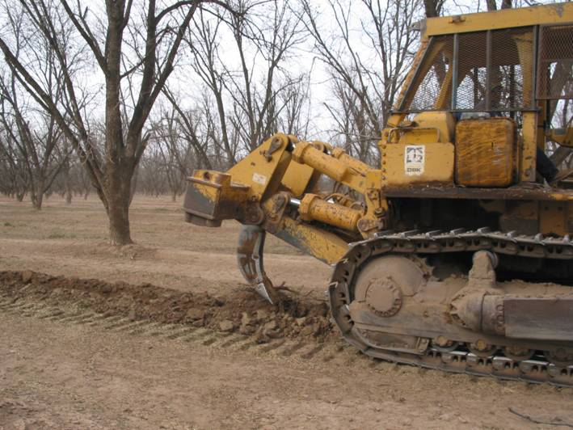
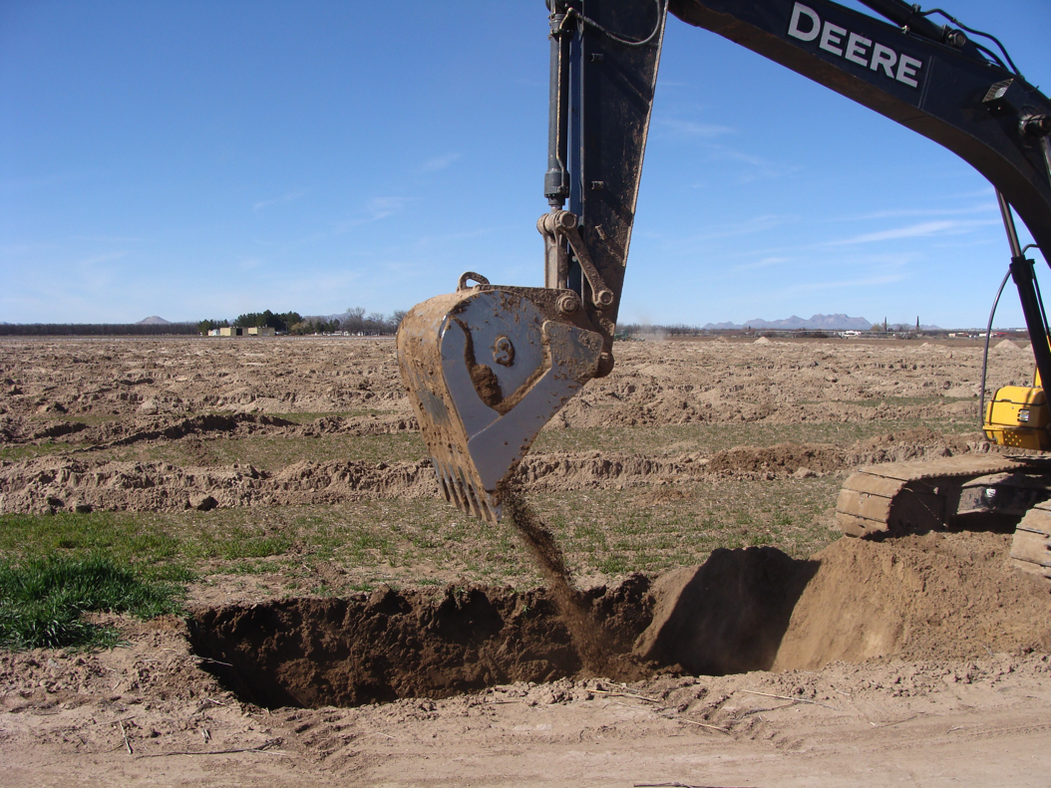
Managing for Healthy Roots: Site Selection & Modification

Slide 15
Rootstock Genetics
USDA-NIFA-SCRI 2016-51181-25408 (Coordinated Development of Genetic Tools for Pecan)
USDA-NIFA-SCRI 2022-51181-38332 (Trees for the Future)
Notes:
3-5 dS/m in soil
Water 1800 TDS

Slide 16
Elliott
Percent Living Trees
Giles
Ideal
Peruque
Riverside
Shoshoni
VC1-68
Planting and Observation Dates
Smith et al., 2021

Slide 17
Salt Tolerance Genetics in Pecan
USDA-NIFA-SCRI 2016-51181-25408
Smith et al., 2021

Slide 18
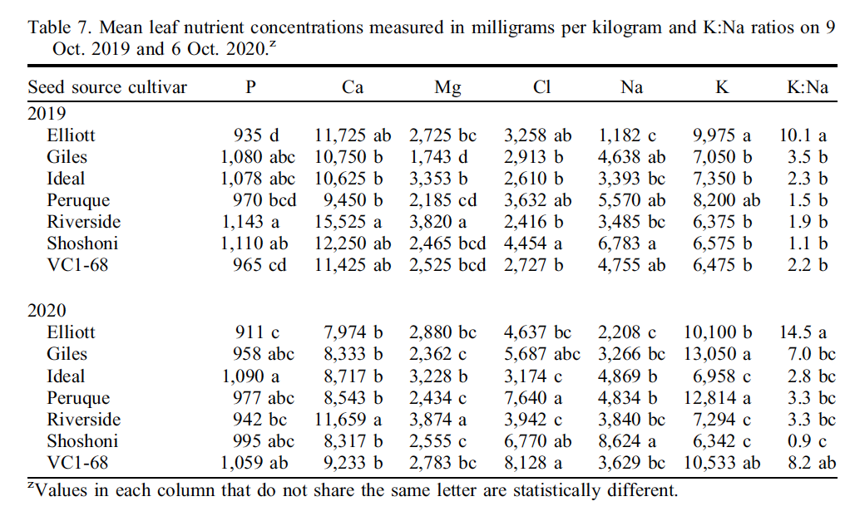
Smith et al., 2021

Slide 19
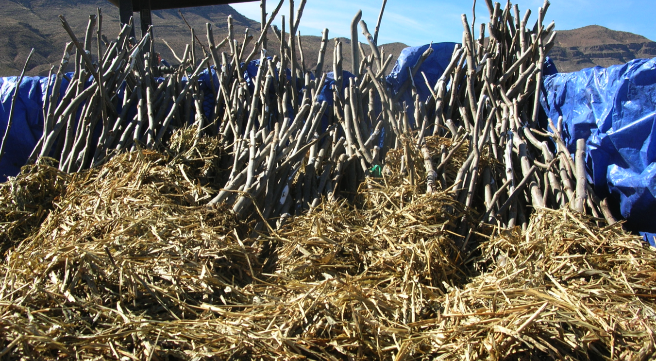
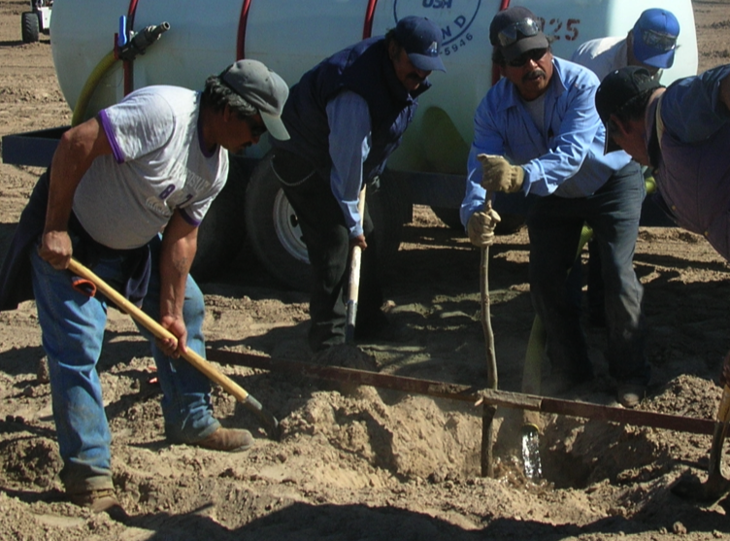
Planting Pecan Trees: Preventing Root Drying

Slide 20
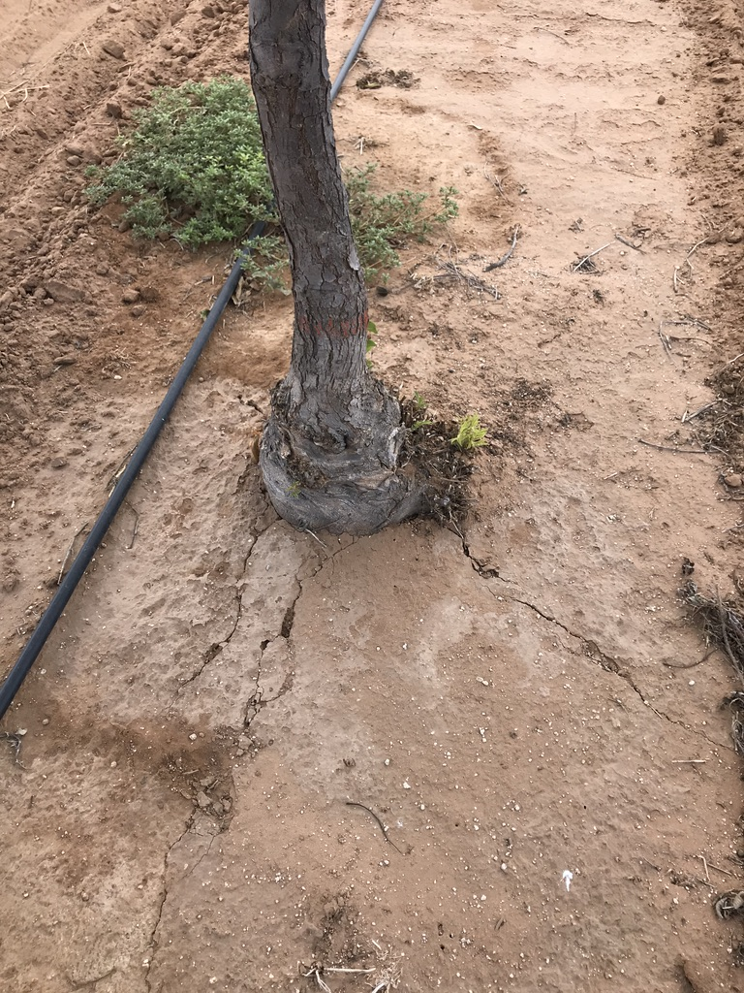
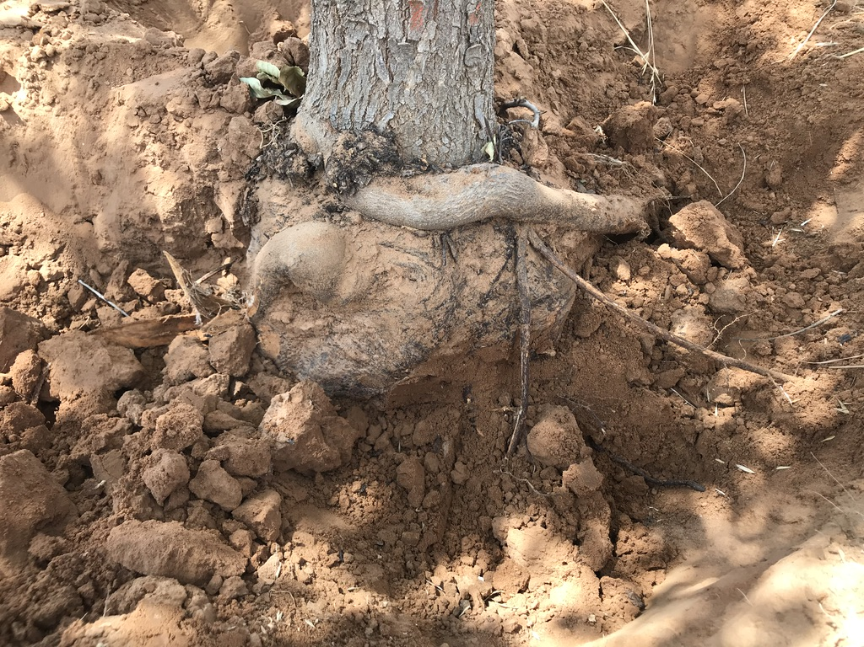
Planting Pecan Trees: Circling Roots

Slide 21
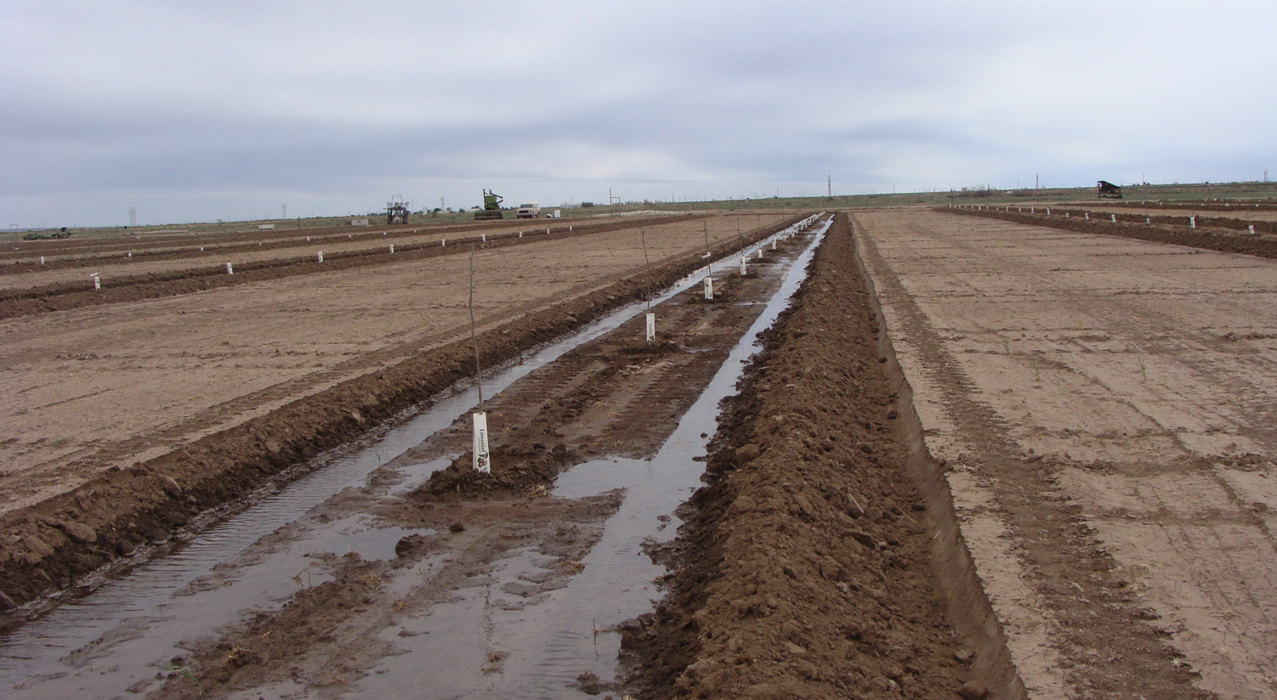
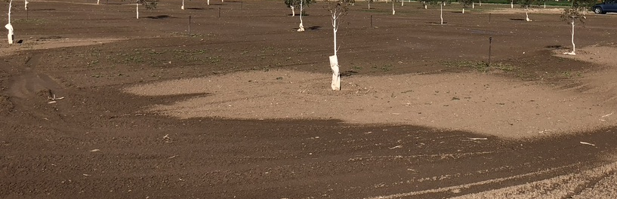
Planting Pecan Trees: Irrigation

Slide 22
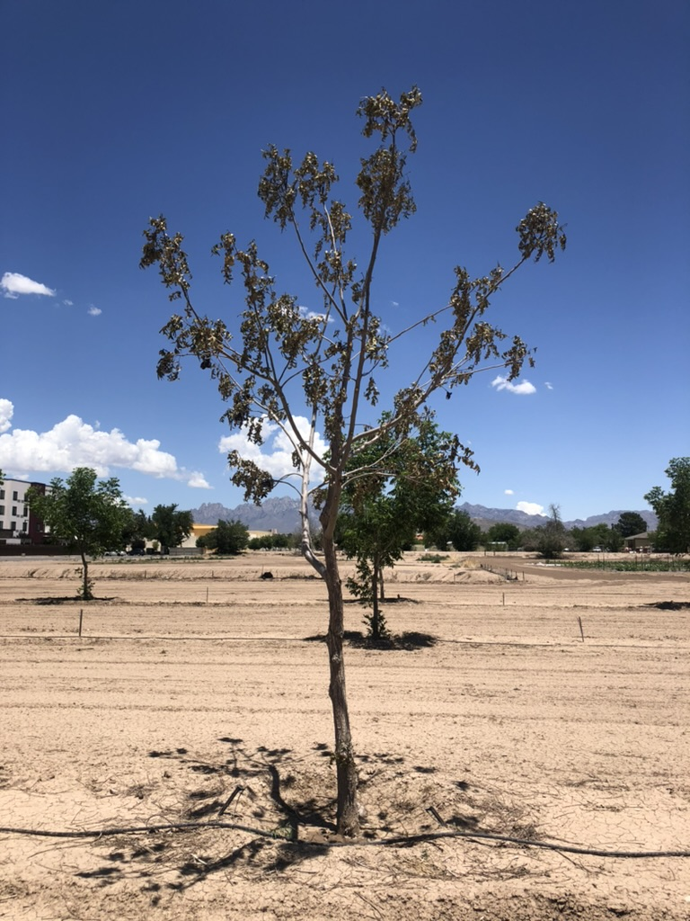
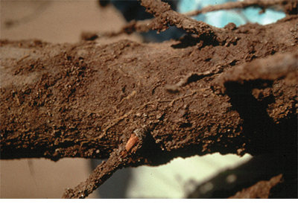
Root Diseases in Pecan: Cotton Root Rot
Heerema et al., 2010

Slide 23
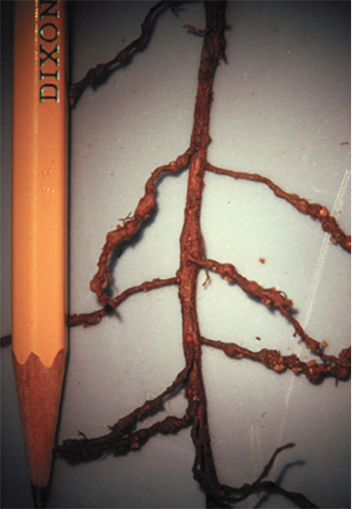
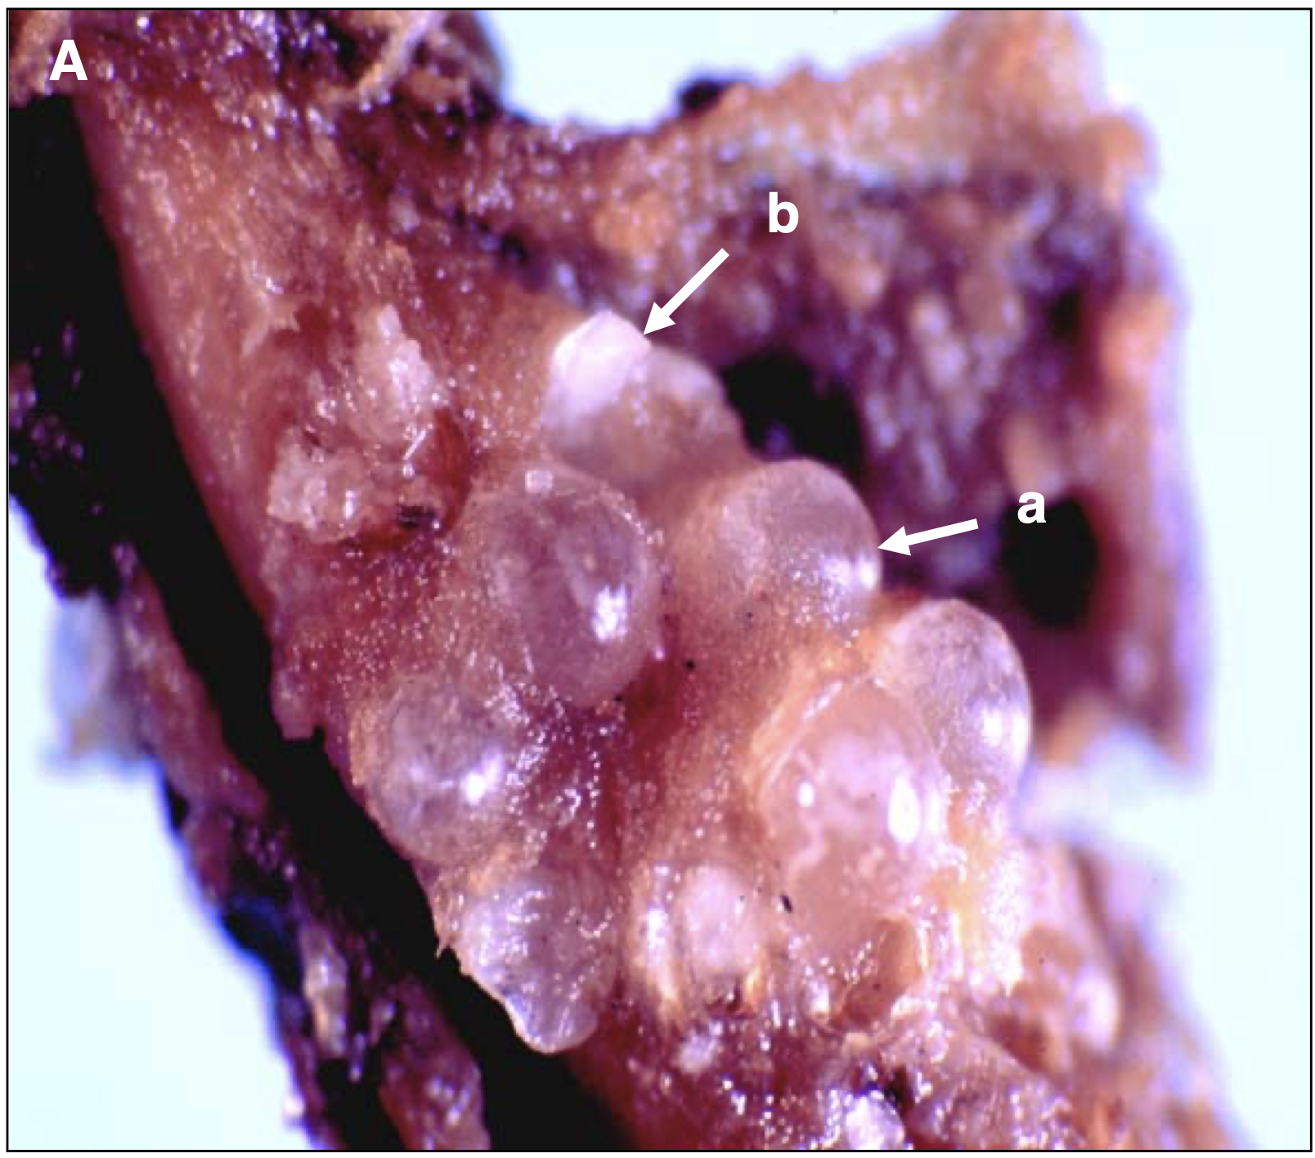
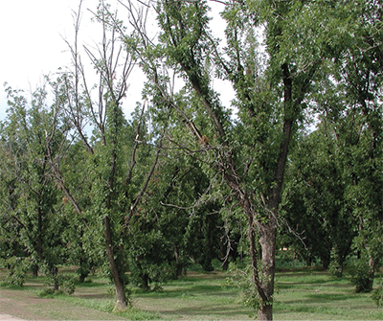
Pecan Root Diseases: Pecan Root Knot Nematode
Brito et al., 2006

Slide 24
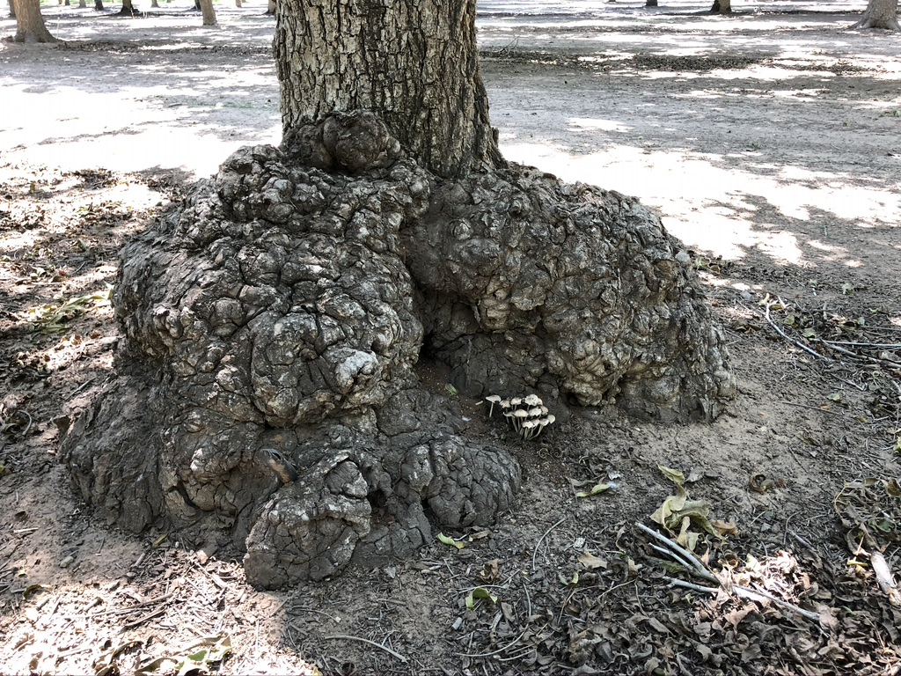
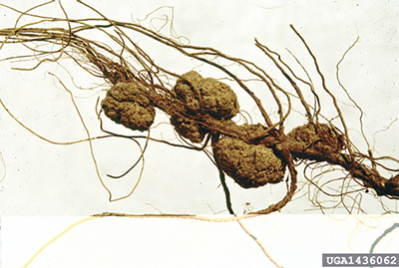
Pecan Root Diseases: Crown Gall
Crown Gall

Slide 25
Sources & Further Reading
Brito, J. A., R. Kaur, D. W. Dickson, J. R. Rich, and L. A. Halsey. 2006. The Pecan Root-Knot Nematode, Meloidogyne partityla Kleynhans, 1986. Fla. Dept. of Agriculture & Cons. Svs Nematology Circular No. 222. https://ccmedia.fdacs.gov/content/download/11006/file/nem222.pdf
Hruska, J. J. Cermák, and S. Sustek. 1999. Mapping tree root systems with ground-penetrating radar. Tree Physiology 19: 125-130.
Kozlowski, T.T. and S.G. Pallardy. 1997. Physiology of Woody Plants (2nd edition). Academic Press, San Diego.
Ma, X., H.E. Dahlke, R.A. Duncan, David Doll, Paul Martinez, B.D. Laminen, and A. Volder. 2022. Winter flooding recharges groundwater in almond orchards with limited effects on root dynamics and yield. California Agriculture 76(2): 70-76.
Myamoto. 1983. Consumptive water use of irrigated pecan. Journal of the American Society for Horticultural Science 108(5):676-681
Rogers, W.S. and G.A. Booth. 1959-1960. The roots of fruit trees. Scientific Horticulture 14:27-34.
Rogers, W.S. and G.C. Head. 1969. Factors affecting the distribution of roots in perennial woody plants. In Root Growth (W.J. Whittington, ed.), pp. 280-295. Butterworth, London.
Smith, C.A., J.L. Walworth, M.J. Comeau, R.J. Heerema, J.D. Sherman, and R. Norton. 2021. Impacts of maternal genotype on pecan seedling performance in an alkaline, saline-sodic soil. HortScience 56(9):1015-1022.
Woodroof, J.G. and N.C. Woodroof. 1934. Pecan root growth and development. Journal of Agricultural Research 49:511-530.

