Slide 1
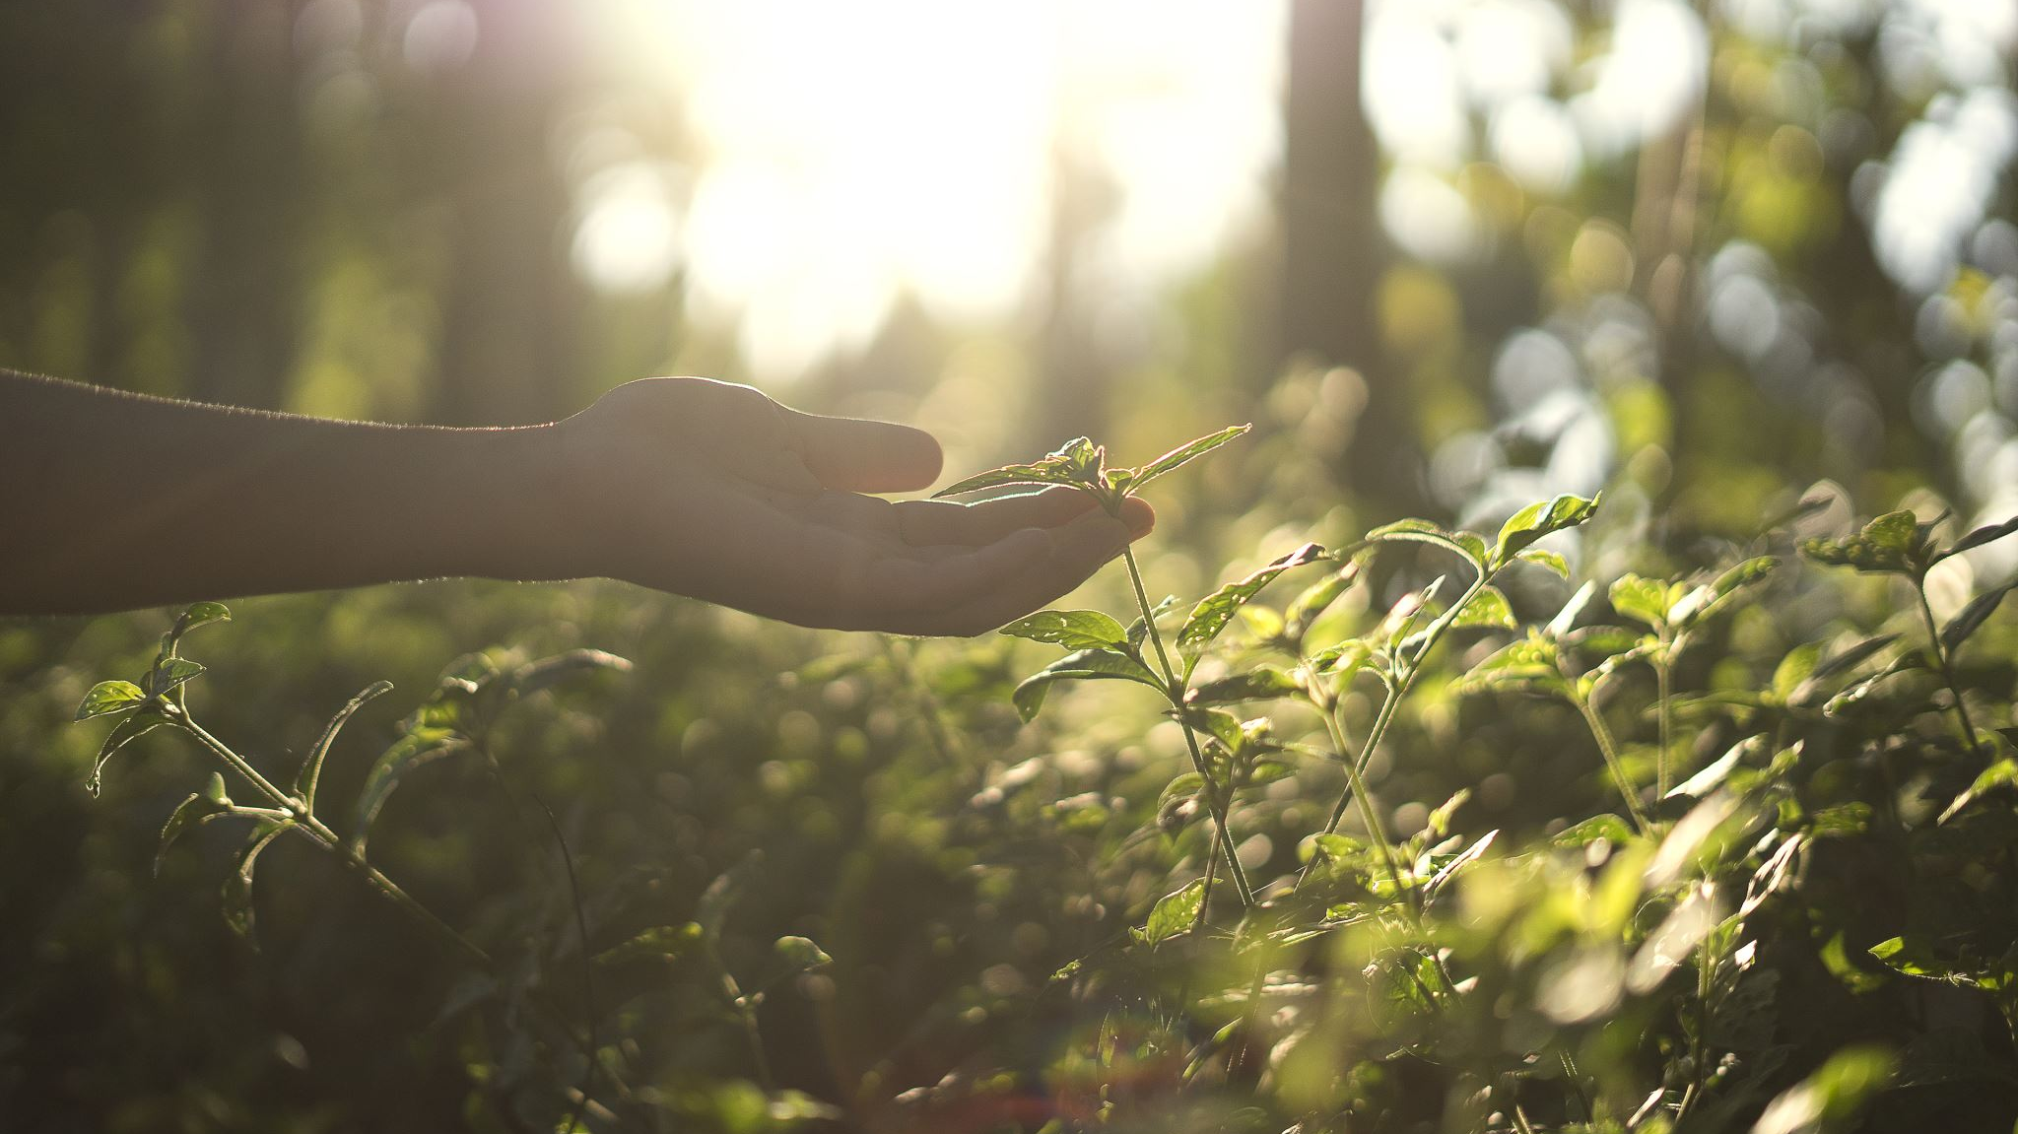
Biological Insecticide & Fungicide Options for Pecans
Bob Whitney
Extension Organic Program Specialist
Dr. Holly Davis
Field Development Manager
Certis Biologicals

Slide 2

Bob Whitney
Extension Organic Program Specialist
Texas A&M AgriLife Extension
Dr. Holly Davis
Field Development Manager
Certis Biologicals
Texas A&M Research and Extension Center
1229 North US Hwy 281
Stephenville, Texas
https://AgrilifeOrganic.org
bob.whitney@ag.tamu.edu
Office: 254.974.9442
Cell: 979.571.2086 “best way”
With a MS and Ph.D. in entomology from Kansas State University. Recently, she served as Assistant Professor and Extension Specialist with Texas A&M University AgriLife Extension in the Lower Rio Grande Valley. Davis is the author or co-author of numerous newsletters, extension publications, peer-reviewed publications and two books dedicated to her field. She is currently located in Southwest Texas.
hdavis@certisbio.com
https://www.certisbio.com

Slide 3
Environmentally Responsible Agriculture
IBM Institute for Business Value, 2020
18,980 consumers in 28 different countries
Since 2014 global sustainability and environmentally responsible investment is up 68 percent and now tops 30 trillion US dollars
78% of consumers say it’s at least moderately important that brands offer “clean” products
77% sustainable and environmentally responsible
76% support recycling
72% want natural ingredients
over 70% would pay a premium of 35% on average for brands that are sustainable and environmentally sound!
Constant ads on TV, Internet, Radio about pesticide lawsuits! Concerns about health – COVID, Climate change issues, etc.

Slide 4
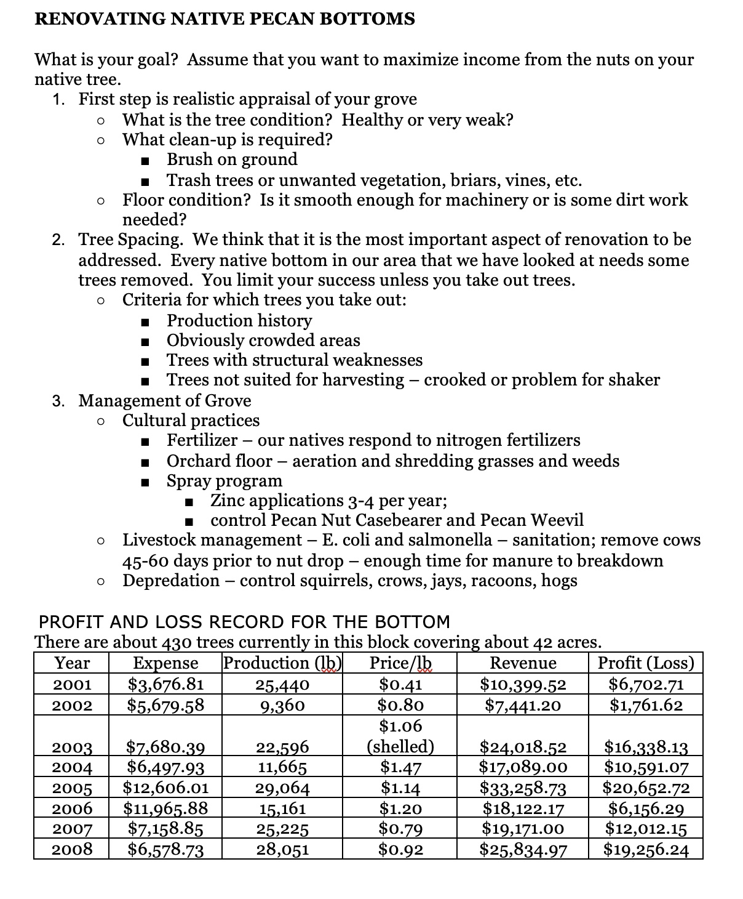
Natural
Native Pecans
Paul Lollar and Danny Davis, 2008

Slide 5
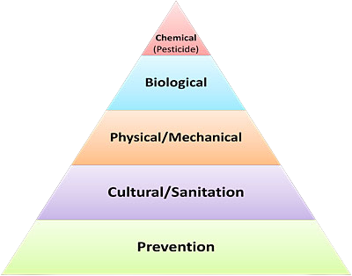
Integrated Pest Management
Prevention – environment
Cultural – resistance Sanitation – clean up crop residues
Mechanical – traps or trap crops, exclusion
Biological – beneficials, some biological sprays
Chemicals – ??

Slide 6
Based on a multi-pronged goal, sustainable agriculture seeks to:
Increase profitable farm income
Promote environmental stewardship
Enhance quality of life for farm families and communities
Increase production for human food and fiber needs

Slide 7
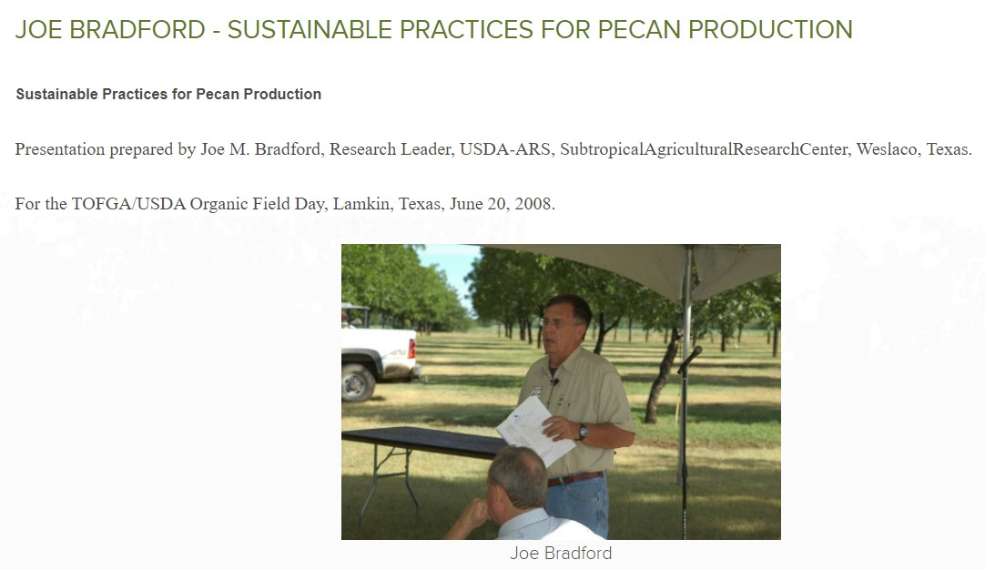
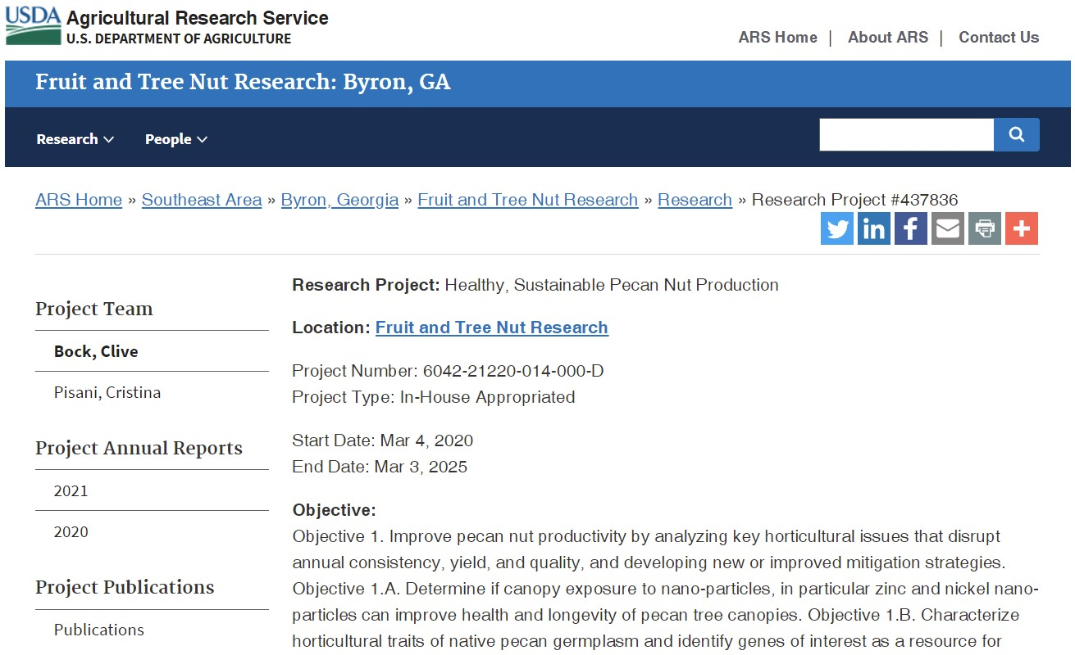
Sustainable Pecan Production

Slide 8
Regenerative Agriculture Pillars
Increasing plant, animal and insect diversity through crop rotations and cover cropping
Minimizing soil disturbance
Keep the soil covered
Reduced synthetic chemical and fertilizer applications
Holistic integration of livestock
Keep a living root in the ground

Slide 9
IPM starts here and all systems follow!
Soil
Good soil health, nutrition, organic matter, structure, permeability, water holding capacity, etc.
Resources
Use Web Soil Survey, google maps, soil web app, Extension, other farmers
Use
Best land for crops because they do better!
Test
Test soil – typical, Haney, PLFA test
Treat problems by being proactive to prevent problems. Lots of tools for issues that grow into problems!
Record
Record results in spreadsheet and compare year on year for improvement
Treat

Slide 10
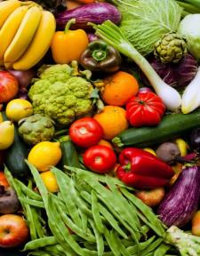

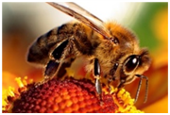
Biopesticides are used in an integrated approach with traditional
chemical pesticides to control pests while offering these benefits:
Managing Maximum Residue Limits (MRLs)
Flexibility & Harvest Management (PHI & REI)
Resistance Management
Worker Safety
Preserving Beneficial Insects and Pollinators (Bees)
Food Safety and Consumer Perception
Sustainability Programs
Residue Reduction, Resistance Management, Efficacy, Safety

Slide 11

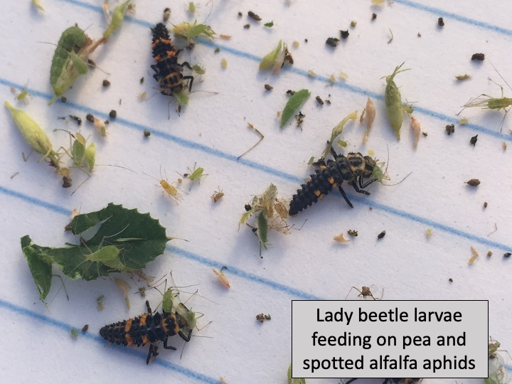
Benefits of Biologicals
Fundamental tool for IPM
  Unique modes of action make valuable tool for mixing/rotating for resistance management
  Highly specific – impacts target pests only
  Reduced/no effect on beneficial insects or mites
Compatible with fertilizers, herbicides, fungicides and insecticides (varies with product – see labels)
Many have no toxic residues (exempt from tolerance)
4-hour REI, 0-day PHI (varies by product – see labels)
Most OMRI listed

Slide 12
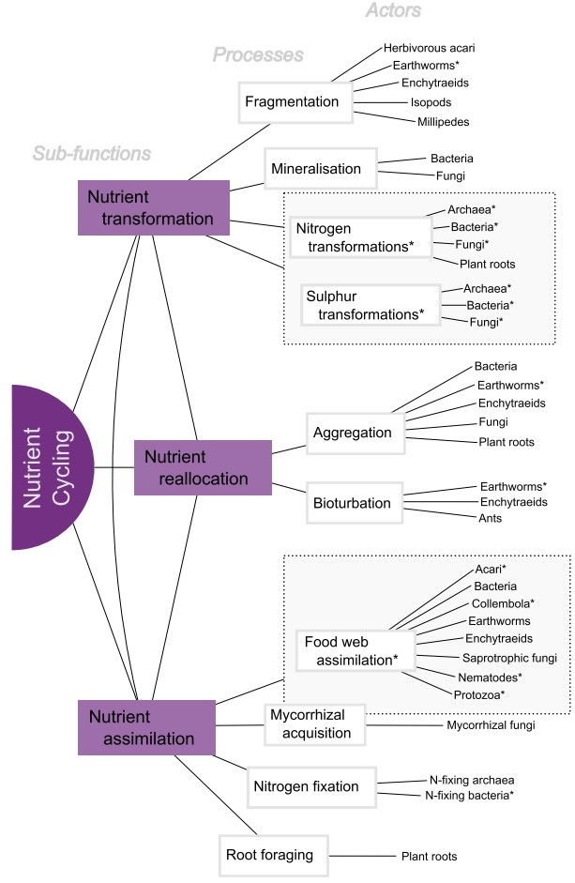
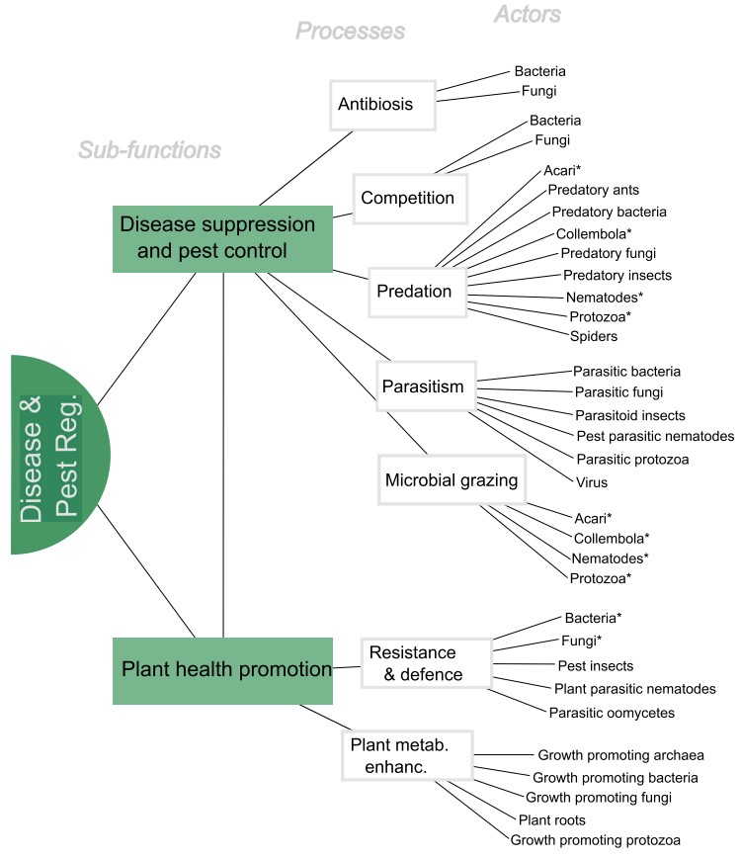
“The life of soils: Integrating the who and how of multifunctionality.” Soil Biology and Biochemistry, 2022.

Slide 13

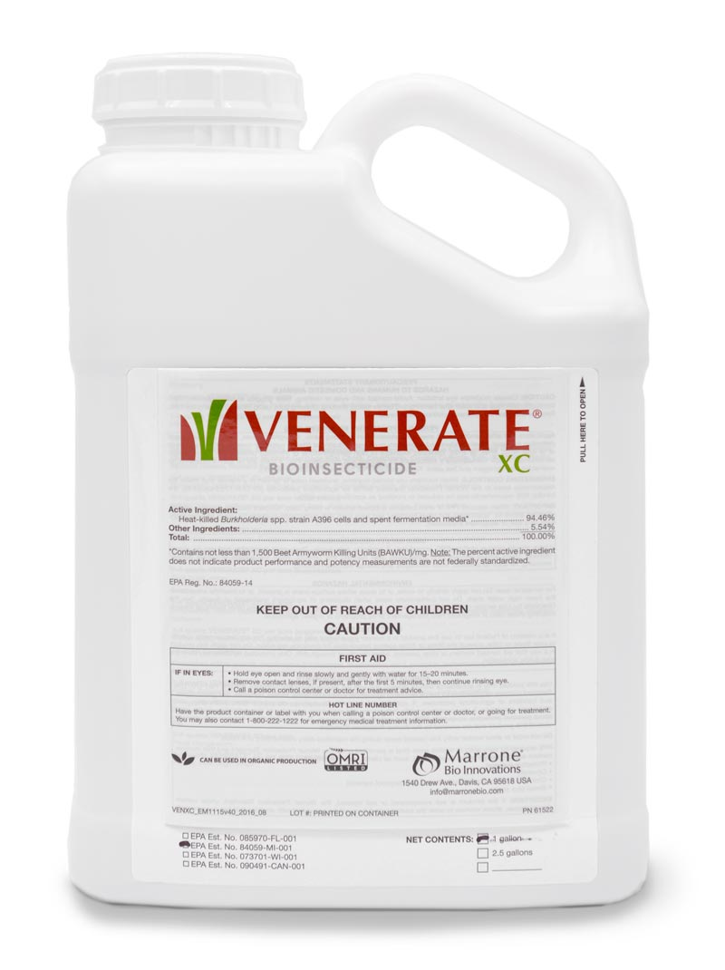
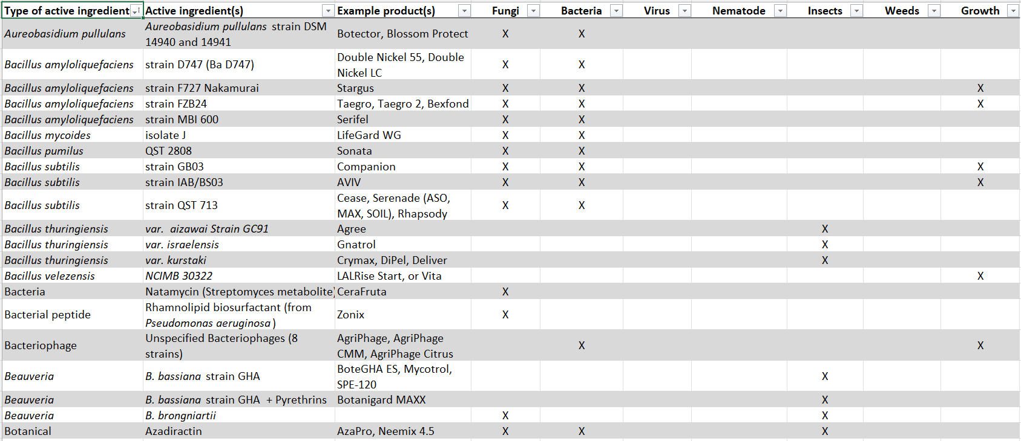
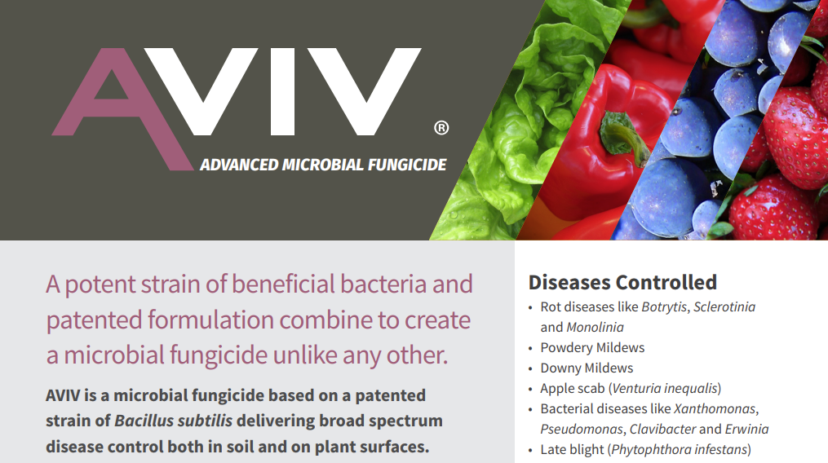
Organic Materials
List

Slide 14







CERTIS USA –
6 KEY TECHNOLOGY PLATFORMS
-------------------------Microbial Technologies-------------------------
BACTERIA
FUNGI
BACULOVIRUS
BACTERIOPHAGE
BIOCHEMICALS
NEEM SEED EXTRACTS
Bioinsecticides:
Bacillus thuringiensis: azawai strain GC-91; kurstaki strains SA-11, SA-12, EG2348, EG7841 (USA),;
Biofungicides/SAR:
B. amyloliquefaciens,
B. mycoides, B. subtilis
Bioinsecticides:
Beauveria bassiana
Isaria fumosorosea
Bionematicide:
Purpureocillium lilacinum
Biofungicide:
Trichoderma spp.
Bioinsecticides:
Cydia pomonella GV
Helicoverpa zea NPV
Spodoptera exigua NPV
S. frugiperda NPV
Bactericides: Bacteriophages
Polyoxin-D zinc salt
Copper hydroxide
Copper octanoate
Potassium bicarbonate
Potassium silicate
Terpene extracts
Soaps (fatty acid salts)
Baits
Insecticide/IGR:
Azadirachtin
Fungicide/Acaricide:
Clarified neem oil
Within the top 2 as a global leader in Bt, Ba/Bs, Beauveria, Virus, and Neem technologies

Slide 15
Biopesticide Technologies
MICROBIALS
AI Type | Active ingredient | Product trade names | Targets
Viruses | Bacteriophage | AgriPhage (several) | Plant pathogenic bacteria
 | Baculoviruses | Cyd-X, Madex, Gemstar | Codling moth/OFM, Corn earworm
Bacteria (Bacillus spp.) | B. amyloliquefaciens | Double Nickel | Fungal & bacterial plant diseases
 | B. mycoides | LifeGard | Fungal & bacterial plant disease, PVY
 | B. thuringiensis | Agree/CryMax/Deliver/Javelin | Lepidoptera larvae
Fungi | Beauveria bassiana | BoteGHA, BotaniGard, Mycotrol | Soft-bodied insects, mites
 | Isaria fumosorosea | PFR-97 | Soft-bodied insects, mites
 | Purpureocillium lilacinum | MeloCon LC | Plant parasitic nematodes

Slide 16
Biopesticide Technologies
BIOCHEMICALS
AI Type | Active ingredient | Product trade names | Targets/Uses & other characteristics
Botanical extracts | Azadirachtin | Neemix, Azatin | IGR vs. immature insects; Antifeedant/repellant vs. adults
 | Clarified neem oil | Trilogy, Triact, others (H&G) | Contact fungicide/acaricide
Microbial extracts | Polyoxin-D | Oso | Fungal plant pathogens (chitin synthesis inhibitor)
 | Spinosad | Seduce, Firefighter, Bug & Sluggo | Bait formulations vs. ants, earwigs, cutworms, slugs
Fatty acids | Potassium salts | Des-X | Insecticidal soap (contact desiccant)
 | Caprylic & capric acid | Homeplate | Burn-down herbicide
 | Copper octanoate | Cueva | Low-load copper fungicide/bactericide
“Bio-chemicals” | Copper hydroxide | Kocide, ManKocide (+mancozeb) | Copper fungicide/bactericide
 | Peracetic acid | Rendition | Contact disinfectant (fungi & bacteria)
 | Potassium bicarbonate | Carb-O-Nator | Contact fungicide
 | Potassium silicate | Sil-MATRIX / AgSil | Plant defense activator (fungi, mites, insects) / Nutritional

Slide 17
Organic Materials List

Slide 18
Organic Materials List

Slide 19
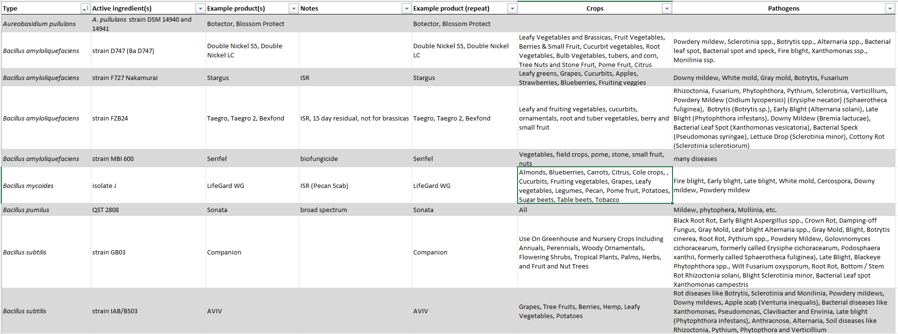
Organic Materials List

Slide 20
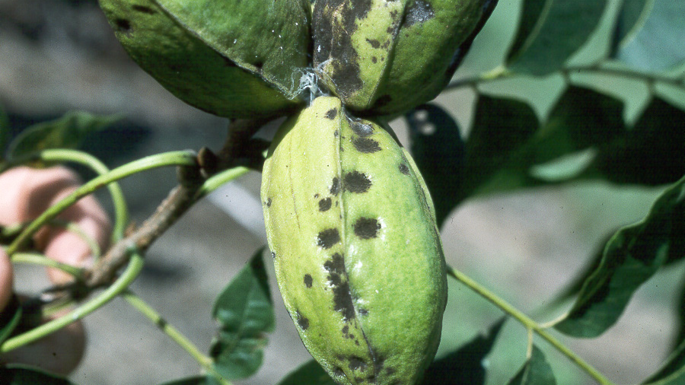
Pecan Diseases
Pecan Scab
  Bacillus mycoides (LifeGard, Certis) 2008 study
  Reynoutria sachalinensis (Regalia, Marrone Bio) 2018 study
  Potassium silicate (Sil Matrix, Certis) Several studies on conventional AgSil
  Bacillus amyloliquefaciens strain D747 (Double Nickel, Certis) rotate possibility
  Copper sulphate (pentahydrate) 2018 study
  ISR and SAR plant responses
    Fungal and bacterial endophytes - Endophytic bacteria have been found in virtually every plant studied, where they colonize the internal tissues of their host plant and can form a range of different relationships including symbiotic, mutualistic, commensalistic and trophobiotic. Most endophytes appear to originate from the rhizosphere or phyllosphere; however, some may be transmitted through the seed. Endophytic bacteria can promote plant growth and yield and can act as biocontrol agents. Endophytes can also be beneficial to their host by producing a range of natural products that could be harnessed for potential use in medicine, agriculture or industry.

Slide 21

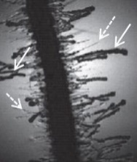
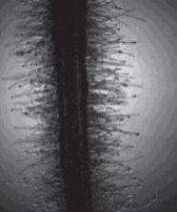
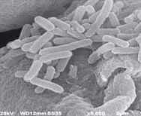
Bacillus amyloliquefaciens D747
Inhibition zone
Multiple modes of action:
Antimicrobial lipopeptides kill pathogenic bacteria & fungi on contact.
Ssc alone
Ba
Two formulations:
Double Nickel 55 (WG)
Double Nickel LC (liquid)
Ssc
Z. Landa
Colonizes roots, flowers, other plant surfaces, outcompetes pathogens.
Broad crop & disease labeling:
  Foliar/fruit spray
  Soil drench, drip/sprinkler chemigation
  Seed treatment
Bacillus amyloliquefaciens (Ba) inhibiting white mold Sclerotinia sclerotiorum (Ssc).
Stimulates plant defense (induced resistance).
Promotes plant growth and yield.
Other names:
Amylo-X: Certis Europe,
CBC/BioGard (Italy)
Triathlon BA: OHP professional greenhouse & nursery use
Ethos XB: FMC premix with bifenthrin insecticide for soil application in furrow at planting (corn & soybean)
Nihorimbere et al. FEMS Microbiol. Ecol. 79 (2012): 176-191.
Balestra et al. 2014. L’Informatore Agrario 22: 50-53.
Treated
Untreated
Other Bacillus biofungicides in development:
B. subtilis B1111 (Prophytex)
B. mojavensis R3B
Colonization (arrows) of tomato root hairs by B. amyloliquefaciens after soil drench.
Colonization of kiwifruit flower stigma by BaD747.

Slide 22
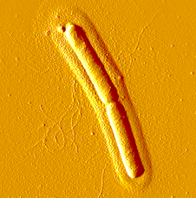
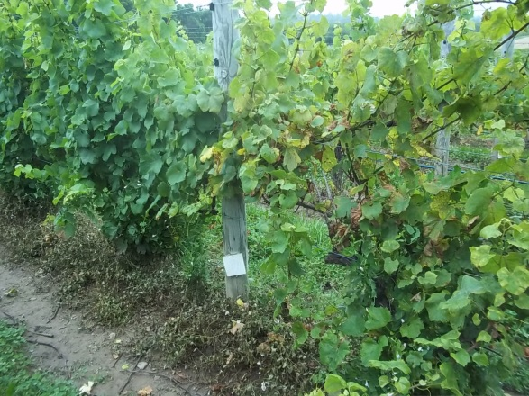


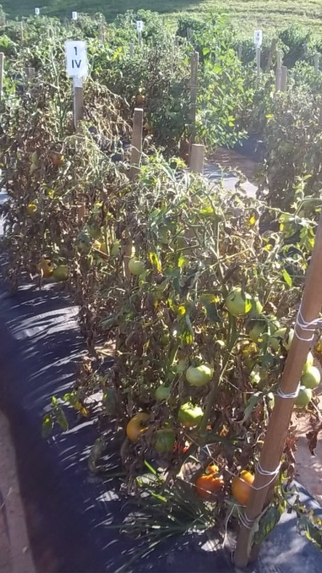
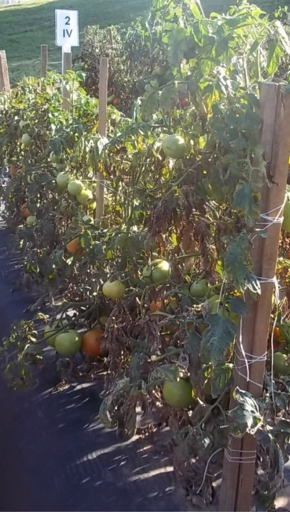
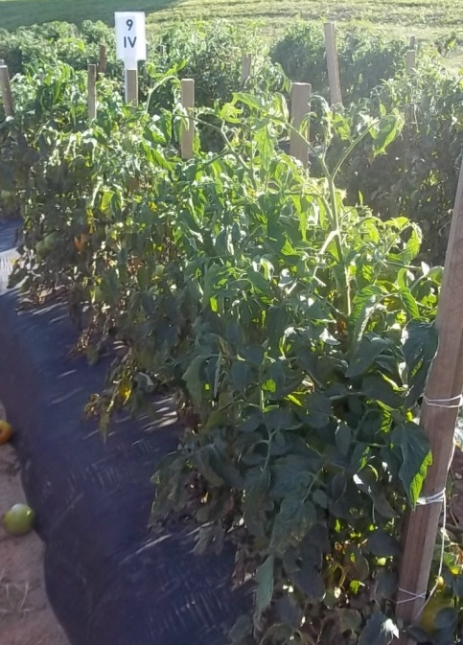
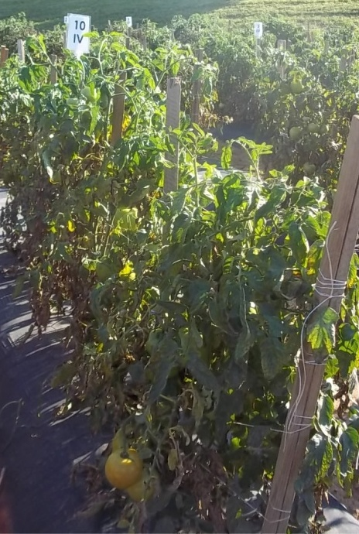
Bacillus mycoides isolate J (BmJ)
B. Jacobsen
MT State Univ.
Mode of action:
Induced resistance (SAR)
Live BmJ activates plant defense against bacteria, fungi, and some viruses.
Primes the plant to respond more rapidly to later infection.
Mode of action similar to acibenzolar-S-methyl (Actigard or Bion)
No direct antagonistic effects on plant pathogens.
WG and LC formulations registered in USA.
LifeGard WG
Untreated check
Above: Control of downy mildew in wine grapes (NY).
Below: Control of bacterial spot in tomatoes (NC)
Untreated
Grower standard
LifeGard program
Actigard program

Slide 23
Copper the Great Protector
Crystalline particles adhere to the
surface of leaves to provide a
protective barrier and act as a reservoir.
Upon contact with water, ppm levels of
bioavailable Cu⁺⁺ ions are released
providing:
Speed & strength of disease control
Dose
Cu ++ ion bioactivity
Residual
Formulation versatility
Applicator and crop safety
Environmental impact
  .

Slide 24
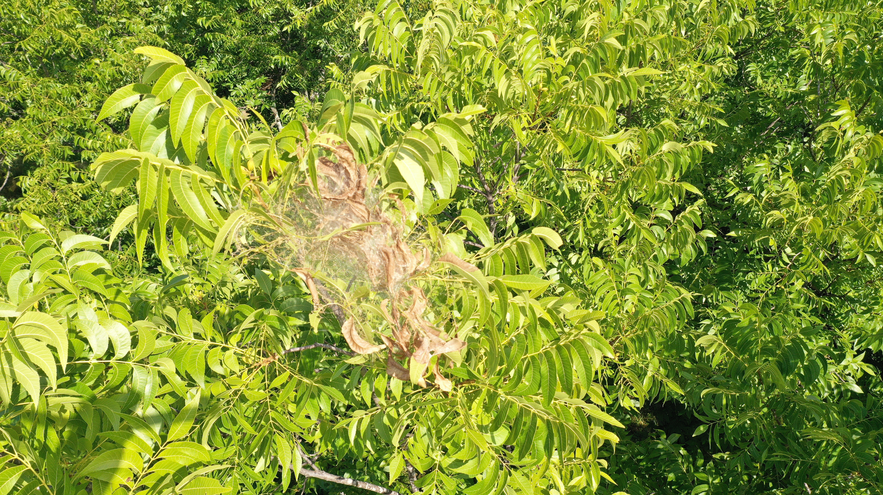
Pecan Insects
Pecan Nut Casebearer – you have many low impact conventional products. Intrepid, Intrepid Edge, FMC Altacor
  Organic – Bt, Venerate, Pyganic, Entrust, Grandevo
Aphids – several low impact conventional products, several organic products that work in the plant PFR-97, boteGHA, DES-X, Venerate, Majestene, Grandevo
Stink bugs – Venerate,
Hickory Shuckworm – see above
Pecan Weevil - Grandevo

Slide 25
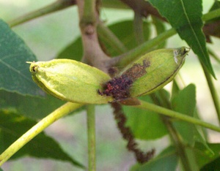
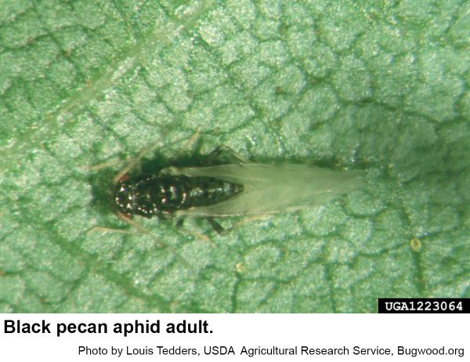
Considerations for Biologicals
Highly specific
  May not target all pests present
  Tank-mix or rotate with conventional pesticides
Not a rescue treatment
  Best results when applied before disease outbreak, when insects are small
  Don’t get knockdown effect – may take 24 hours to a few days to see results
No systemic activity – good spray coverage is key
  Spreader/stickers can help
  New growth is not protected
  May be more sensitive to environmental conditions
    pH of water
    Rainfastness
    Solar UV
    Temperature (in storage)
Pecan nut casebearer
Oklahoma State University Extension

Slide 26
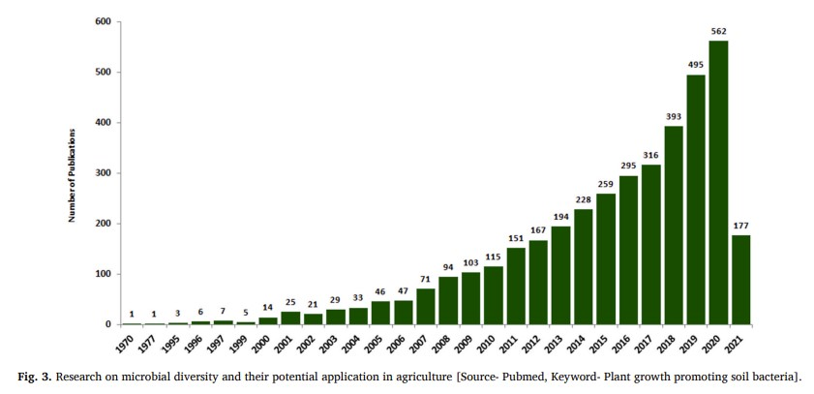
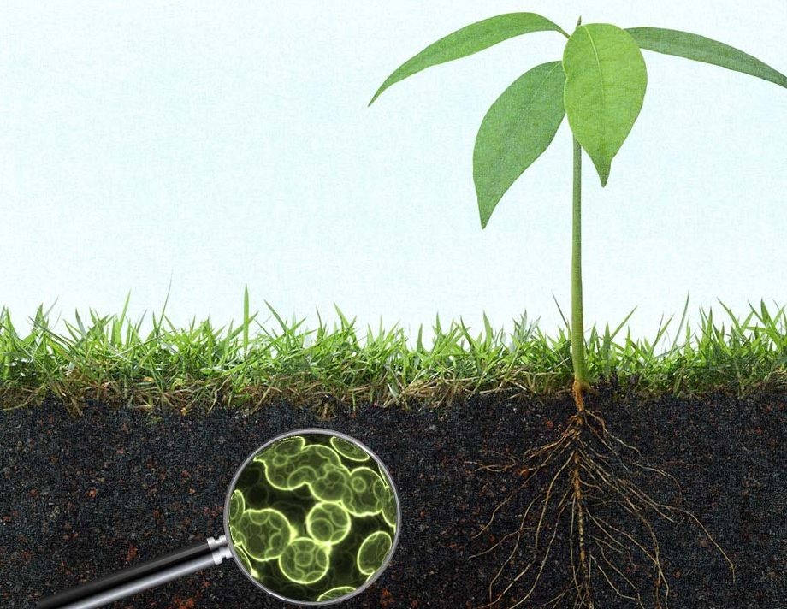
Research continues
Thank you!

