Slide 1
Pecan Bacterial Leaf Scorch (PBLS) is transmitted from Pecan nuts to seedling rootstock
Dr. Angelyn E. Hilton
Reference: Cervantes, K.†, Hilton, A. †, Stamler, R., Heerema, R., Bock, C., Wang, X., ... & Randall, J. (2022). Evidence for Seed Transmission of Xylella fastidiosa in Pecan (Carya illinoinensis). Frontiers in Plant Science, 13.

Slide 2
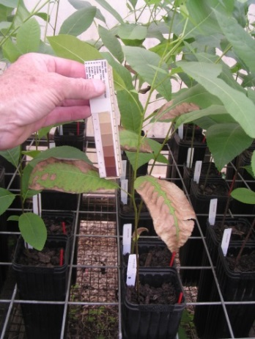
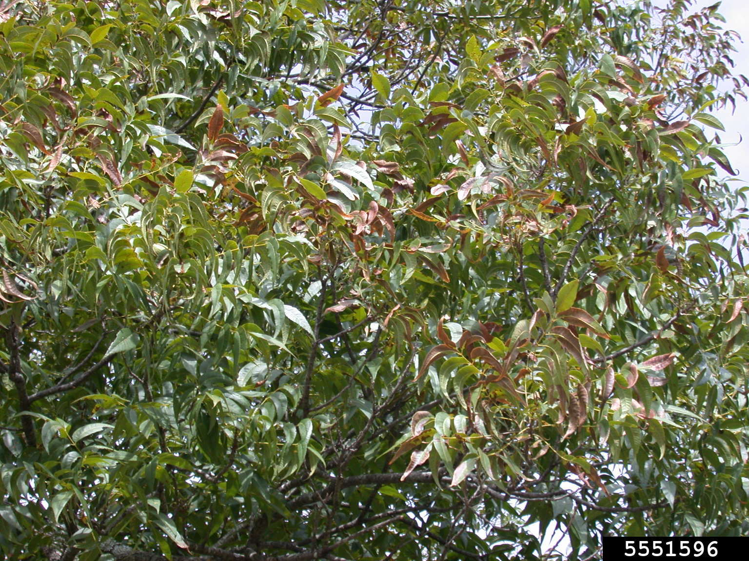
Pecan Bacterial Leaf Scorch (PBLS)
What is Pecan Bacterial Leaf Scorch (PBLS)?
A chronic bacterial disease that can cause significant yield losses in susceptible pecan cultivars.
Symptoms of PBLS
Begins with necroses of leaflet tips and margins, later progressing in a uniform pattern toward the leaf base and midribs.
Lesions are tan to light brown in color when spreading through leaflet tissue.
Defoliation can be severe and may occur on individual limbs or systemically across the entire plant.
Latent infections cause no symptoms
PBLS is caused by the bacterial pathogen, Xylella fastidiosa
Notes:
1-5

Slide 3
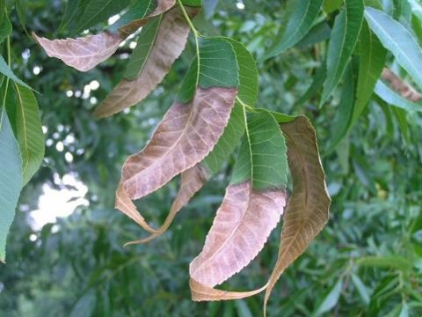
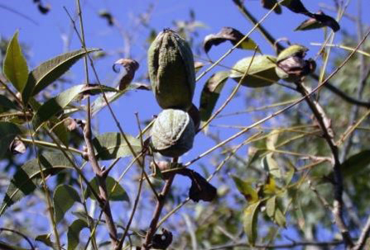
Symptoms of PBLS
Symptoms can be expressed every year
Most prominent late in the growing season
Dependent on environmental conditions
PBLS in pecan leaflets
Rebecca Melanson,
Mississippi State University Extension
Bare rachises remain after defoliation
Rebecca Melanson,
Mississippi State University Extension
Defoliation and branch dieback in mature pecan
Natalie Goldberg
New Mexico State University
Notes:
2-7
3-9

Slide 4
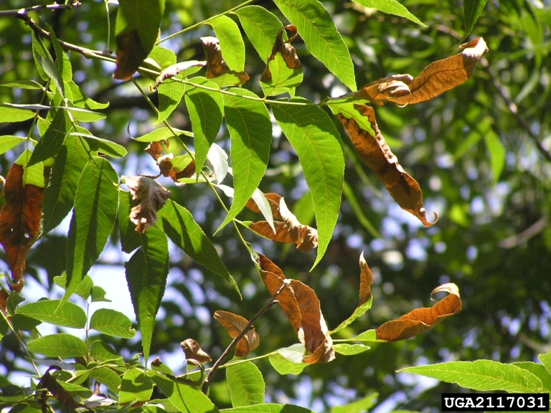
What is the potential impact of PBLS in pecan?
In severe infections, cv. Cape Fear trees were reported to have up to 58% defoliation at the end of the season when compared to non-infected trees.
24% reduction in terminal weight
10-13% reduction in nut weight
14-19% reduction in kernel weight
12% yield loss, a value that could lead to losses of over $466/ha.
Unknown economic impact in other cultivars – but no known resistance
Cape Fear cultivar showing symptoms of PBLS. Rebecca A. Melanson, Mississippi State University Extension, Bugwood.org
Notes:
4-13
Only example in cape fear but we still do not know what the economic impact is in other cultivars. Scorch symptoms resemble other types of problems, such as nutritional issues, and are often over looked as being caused by PBLS. Lack of information between infection and symptom development due to cultivar genotype and also environmental factors.

Slide 5
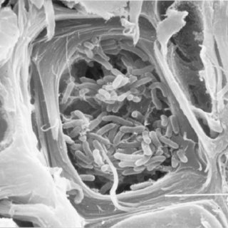
Xylella Fastidiosa is the causal agent of pbls
Xylella is xylem-limited, fastidious, rod-shaped bacteria
Commensalist and pathogen
Classified into six distinctive subspecies (types):
subspecies fastidiosa, pauca, morus, multiplex, sandyi, tashke
Can infect at least 600 different plant species
Expanding host range
Evidence for host specificity
Recognized as a major international pest
Xylella fastidiosa bacteria in a cross section of petiole xylem vessel affected by Coffee Leaf Scorch. Lima, J. & Miranda, Vicente & Hartung, John & Brlansky, Ronald & Coutinho, Antonio & Roberto, Sergio & Carlos, E.. (1998). Coffee Leaf Scorch Bacterium: Axenic Culture, Pathogenicity, and Comparison with Xylella fastidiosa of Citrus. Plant Disease - PLANT DIS. 82. 94-97. 10.1094/PDIS.1998.82.1.94. Accessed Feb. 13, 2020.
Notes:
Scientists are still unsure what triggers the switch between commensalist and pathogen, but hypothesize that the formation of biofilm blocks xylem flow leading to symptom expression
Wide host range-movement of infected plant germplasm, presence of intra- inter-subspecific homologous recombination
Subspecies identification used to be based on non-overlapping hosts but new data supports the presence of multiple Xylella subsp capable of infecting the same host

Slide 6
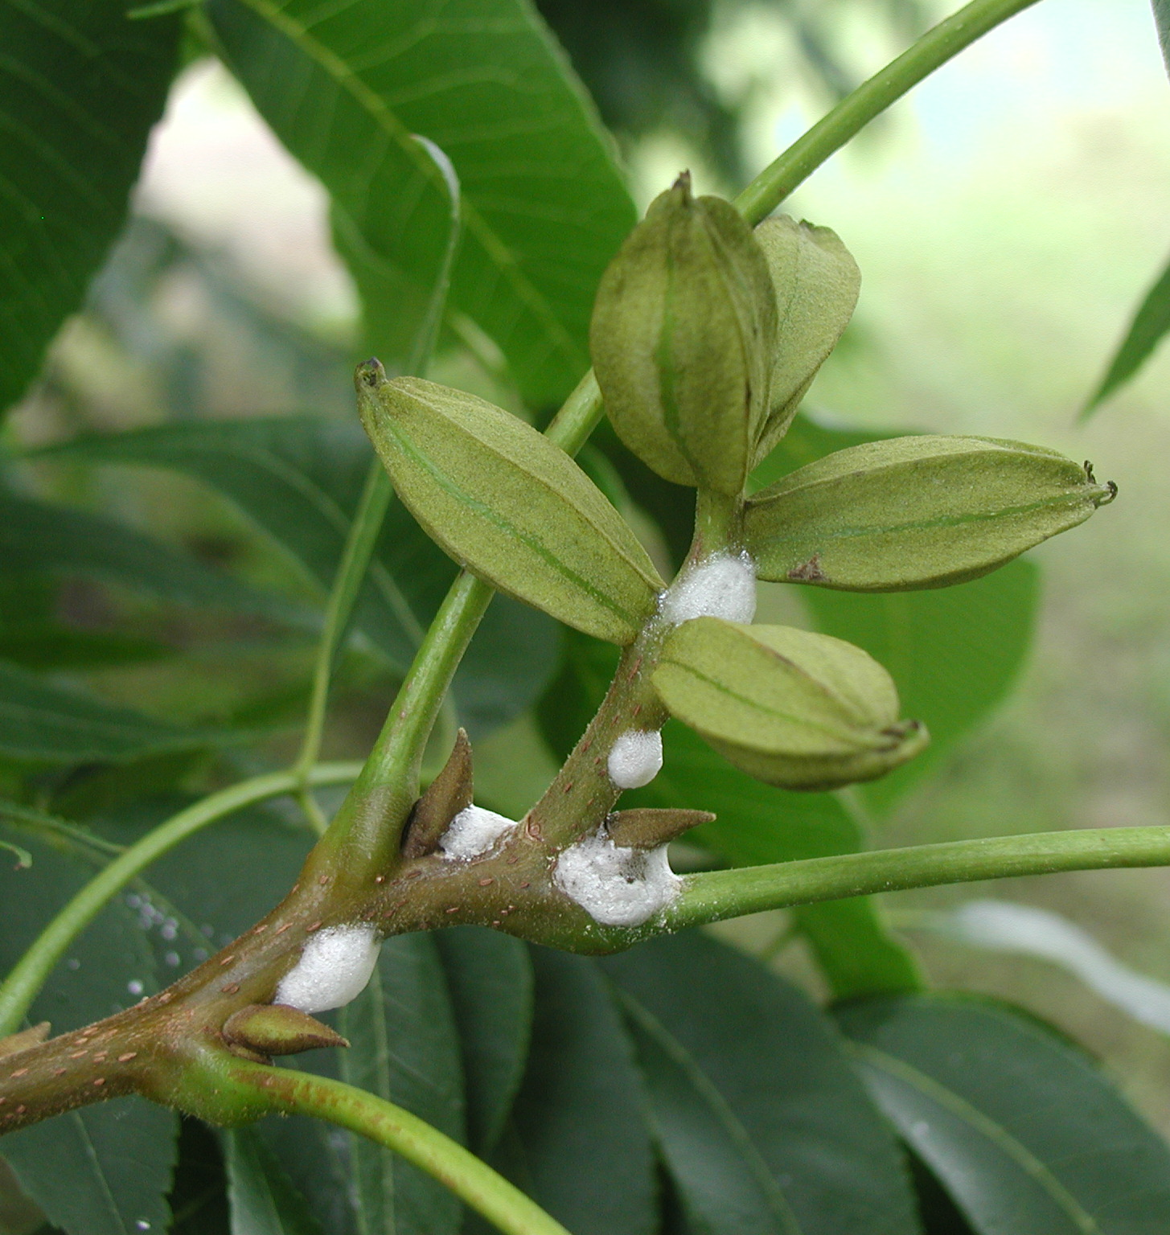
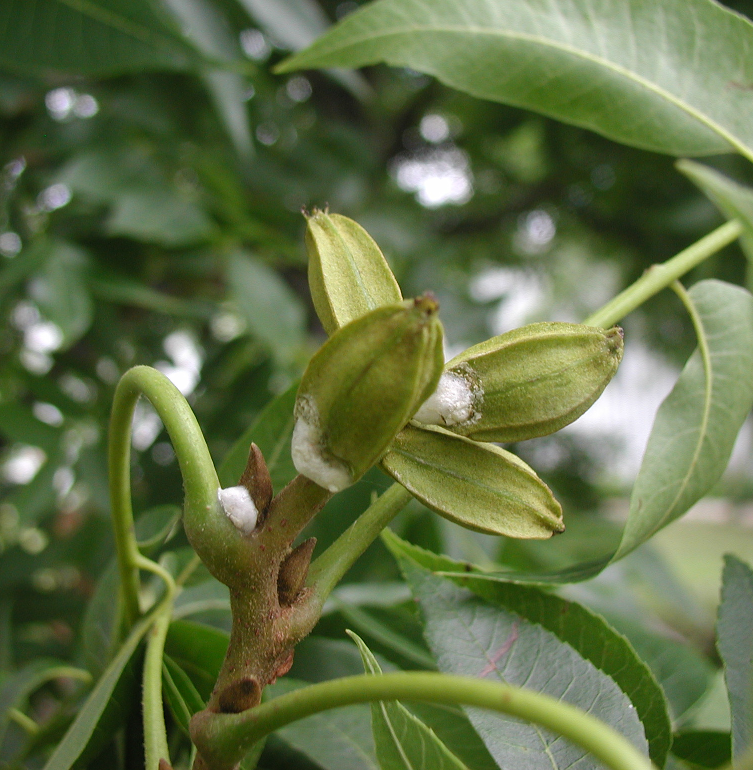
Xylella can be transmitted through xylem feeding insects
Sharpshooter
Spittlebug
Pecan Spittlebug Mass
Bill Ree, Texas A&M University
AgriLife Extension
Pecan Spittlebug Mass
Bill Ree, Texas A&M University
AgriLife Extension
Broad-headed Sharpshooter
Bill Ree, Texas A&M University
AgriLife Extension
Broad-headed Sharpshooter
Bill Ree, Texas A&M University
AgriLife Extension
Notes:
6-6

Slide 7
Xylella can be transmitted via grafting
Commercial pecan propagation is predominantly performed through grafting
Pecan seed is open-pollinated
Ensures clonal germplasm
In addition to vector-mediated transmission, X. fastidiosa can be transmitted between grafting of scions and rootstocks
Infected rootstock to non-infected scions → 85% transmission rate
Infected scions to non-infected rootstock → 21% transmission rate
Symptoms of PBLS caused by X. fastidiosa in pecan trees. (A) Foliar symptoms of PBLS on leaves of the scion (i.e. in the canopy above the graft union). (B) PBLS symptoms on leaves of the rootstock (i.e. on the lower half below the graft union). (C) Premature defoliation of the canopy due to PBLS. Arrow indicates the graft union.

Slide 8
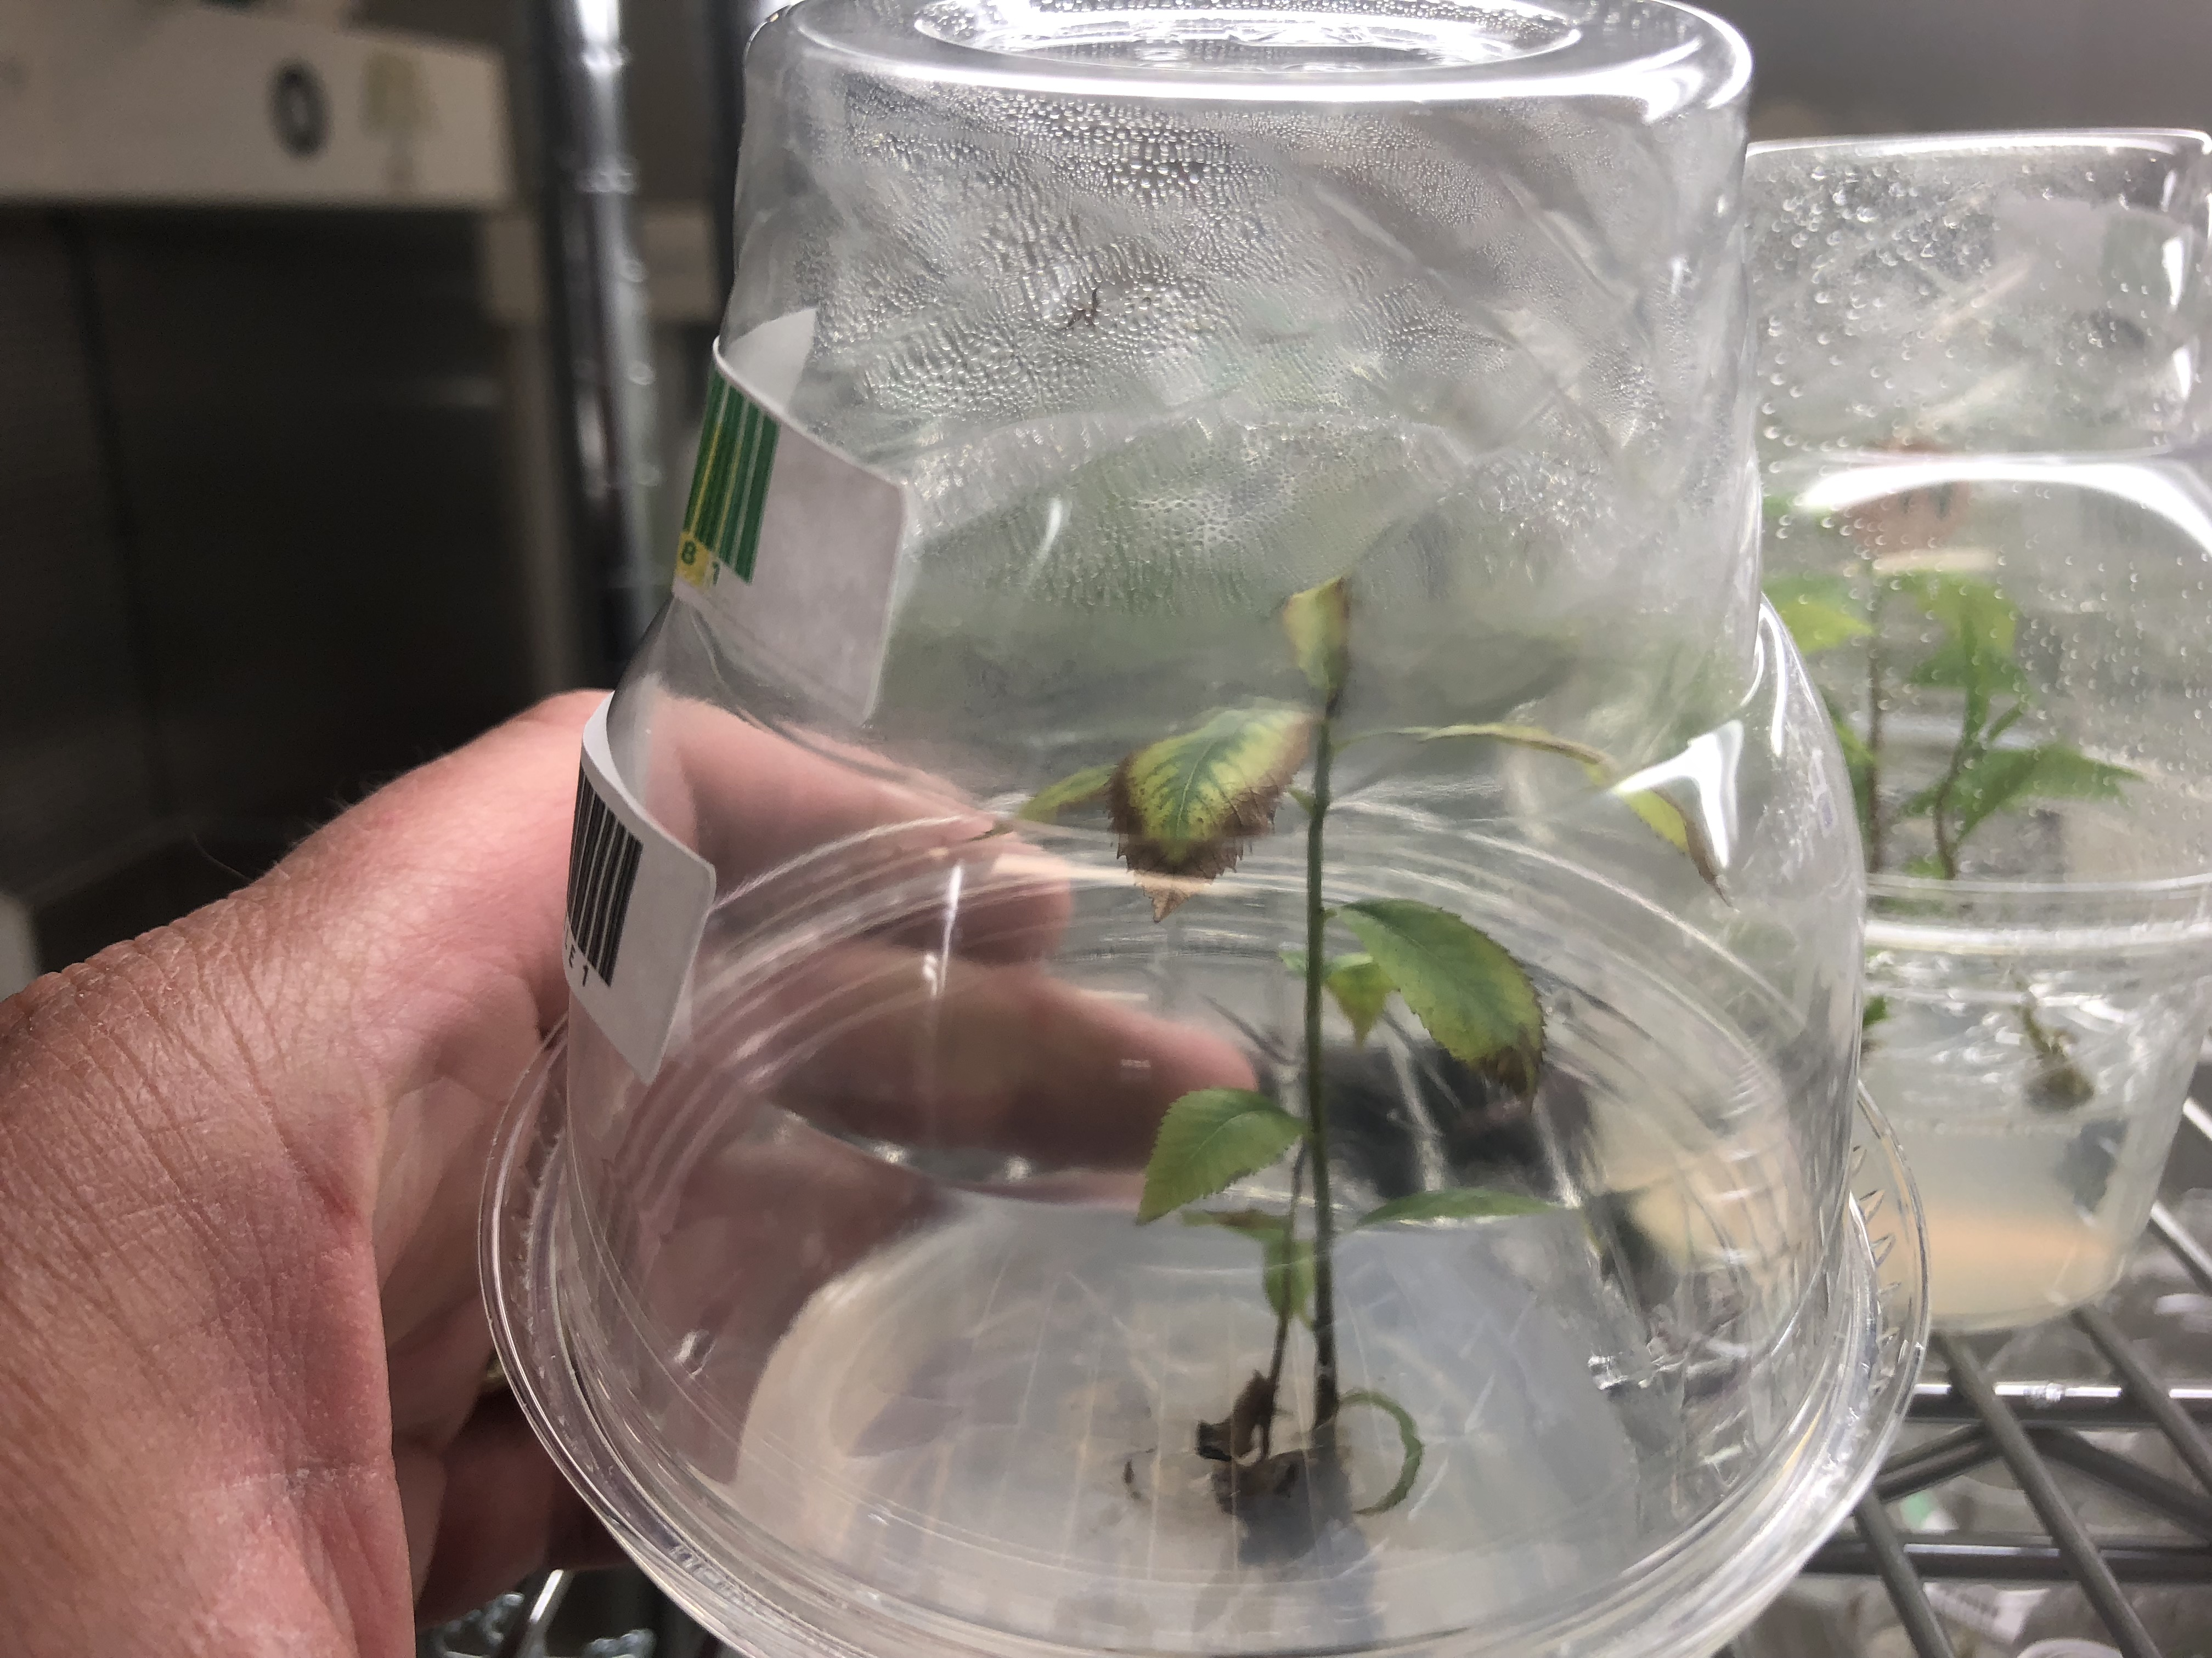
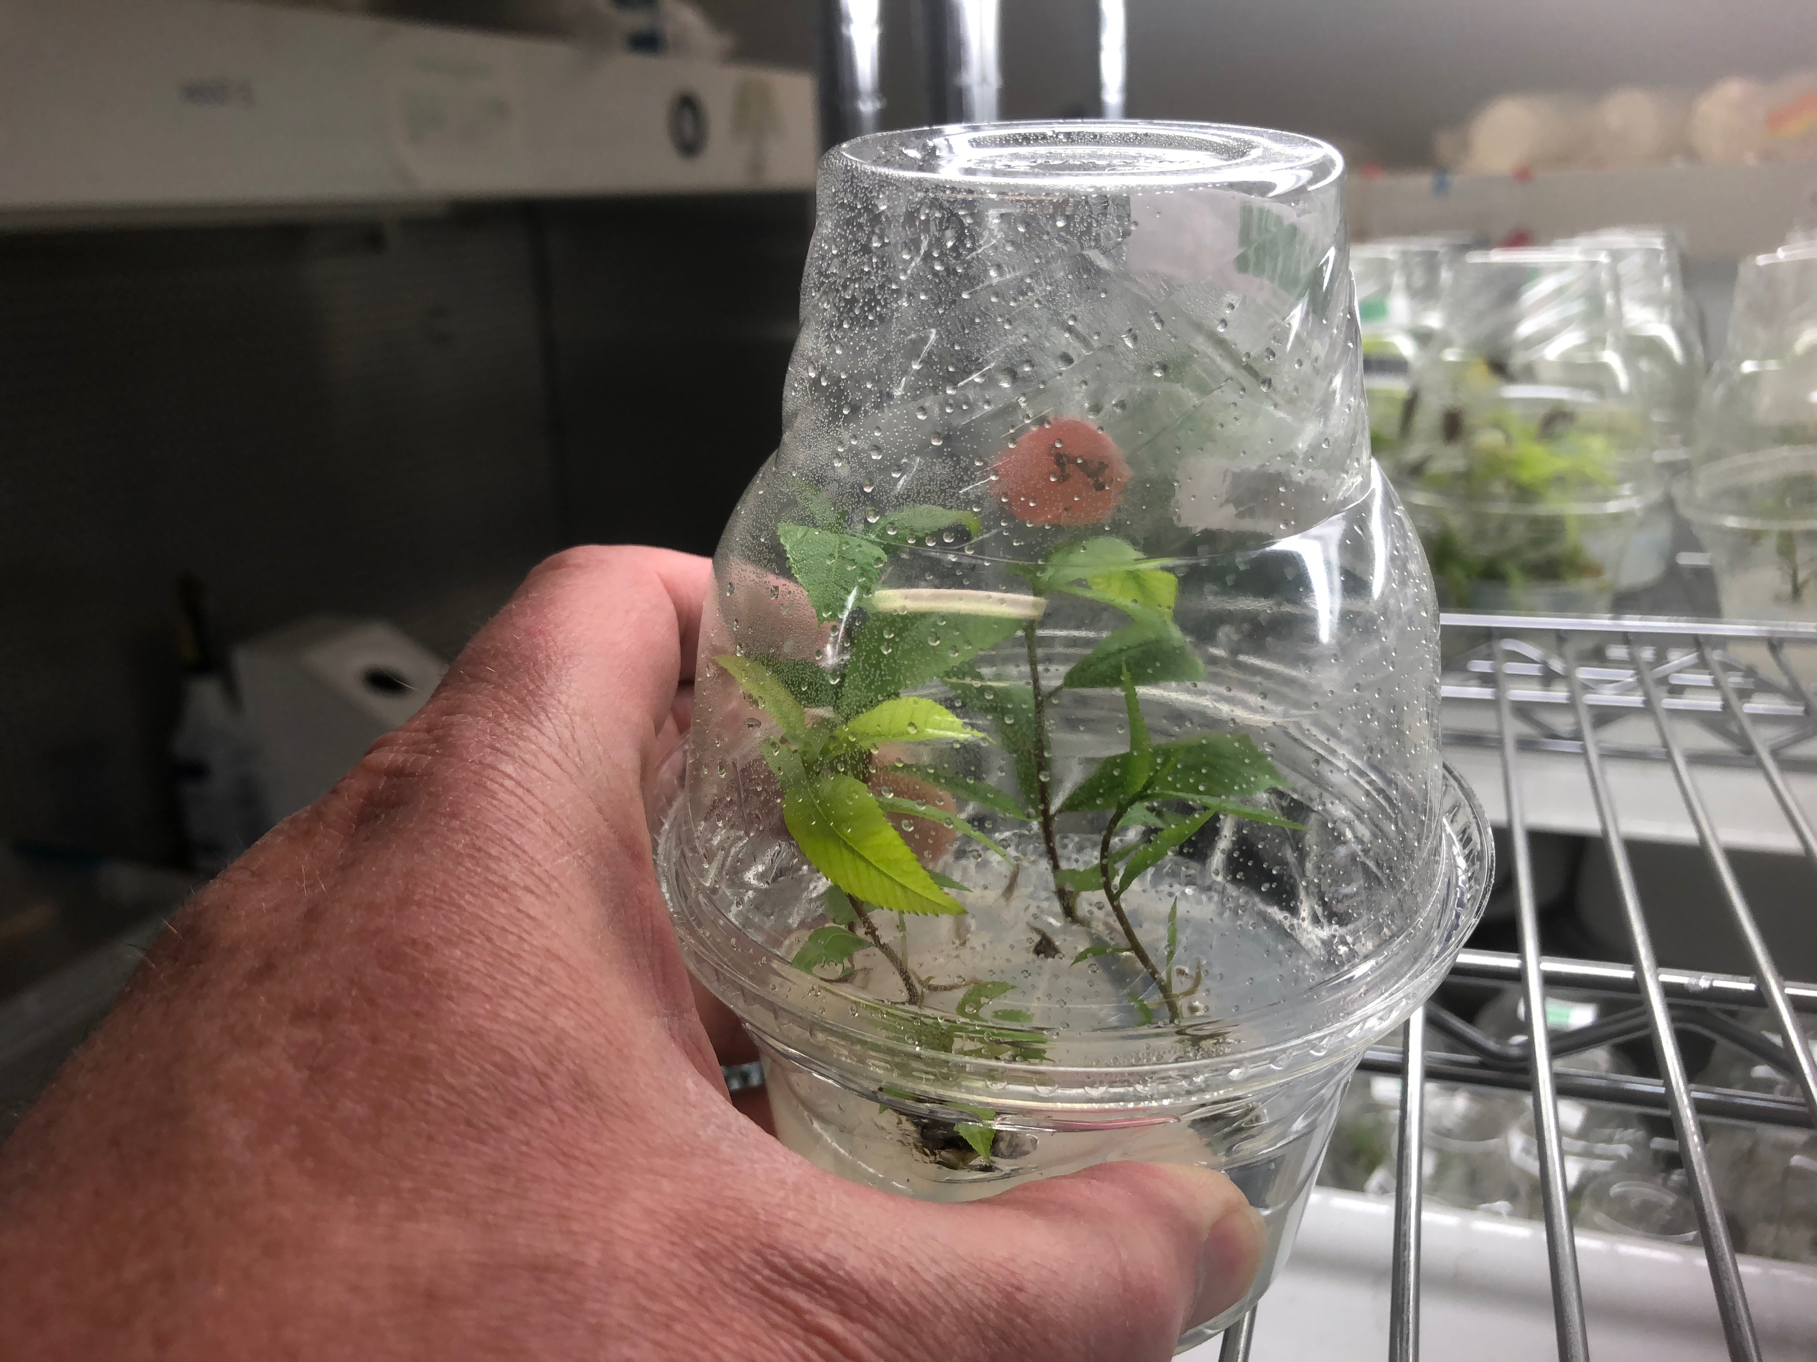
Micropropagation pecan system
Dr. Jennifer Randall from New Mexico State University has developed tissue culture from pecan nuts
She discovered that her cultured plants were infected with Xylella
Not treated Treated

Slide 9
Xylella and the Nut
Can Xylella infect pecan nuts and germinated seedlings?
Stages of nut development in pecan provide an opportunity for nut colonization by Xylella
Does the presence of Xylella affect nut quality?
PBLS symptoms can have a significant impact on nut quality in cv. Cape Fear
High nut quality is important for germination
Stages of pecan nut development. Taken from: Wells, L. 2007. Pecan physiology, p. 1–8. In L. Wells (ed.), Southeastern Pecan Growers’ handbook, Bull. 1397. Cooperative Extension Service, University of Georgia. Accessed on Feb. 17, 2020.
Notes:
During the maturation phase, or fill stage, of pecan nut development, free nuclear liquid endosperm fills the nuts and accumulates storage reserves as cotyledons elongate and thicken (Woodkoof 1927; Jeyaretnam et al. 1999). As is the case for sweet orange, this provides a pathway for X. fastidiosa to travel through the vascular system and colonate developing nuts, raising the possibility for seed transmission in pecan (Li et al. 2003).
Only example in cape fear but we still do not know what the economic impact is in other cultivars. Scorch symptoms resemble other types of problems, such as nutritional issues, and are often over looked as being caused by PBLS. Lack of information between infection and symptom development due to cultivar genotype and also environmental factors.
Transmission of phytopathogens through seed has been found to be consequential on seed physiology and can reduce quality and germination
PBLS can have other detrimental effects on pecan morphology, such as reduced terminal bud weight, as well as nut and kernel development. In cv. Cape Fear, a 10-13% reduction in nut weight and a 14-19% reduction in kernel weight was found in symptomatic trees when compared to asymptomatic trees. These losses carry a significant impact on yield, posing an economic threat to growers and the pecan industry. Extensive study has been done to determine the susceptibility of a variety of pecan cultivars to PBLS, and the repercussions of disease symptoms on nut quality in cv. Cape Fear (R. Sanderlin 2005; R. Sanderlin and Heyderich-Alger 2000; R. S. Sanderlin 2015). Yet, information is lacking as to the direct impact of X. fastidiosa on nut and kernel development in other cultivars.

Slide 10
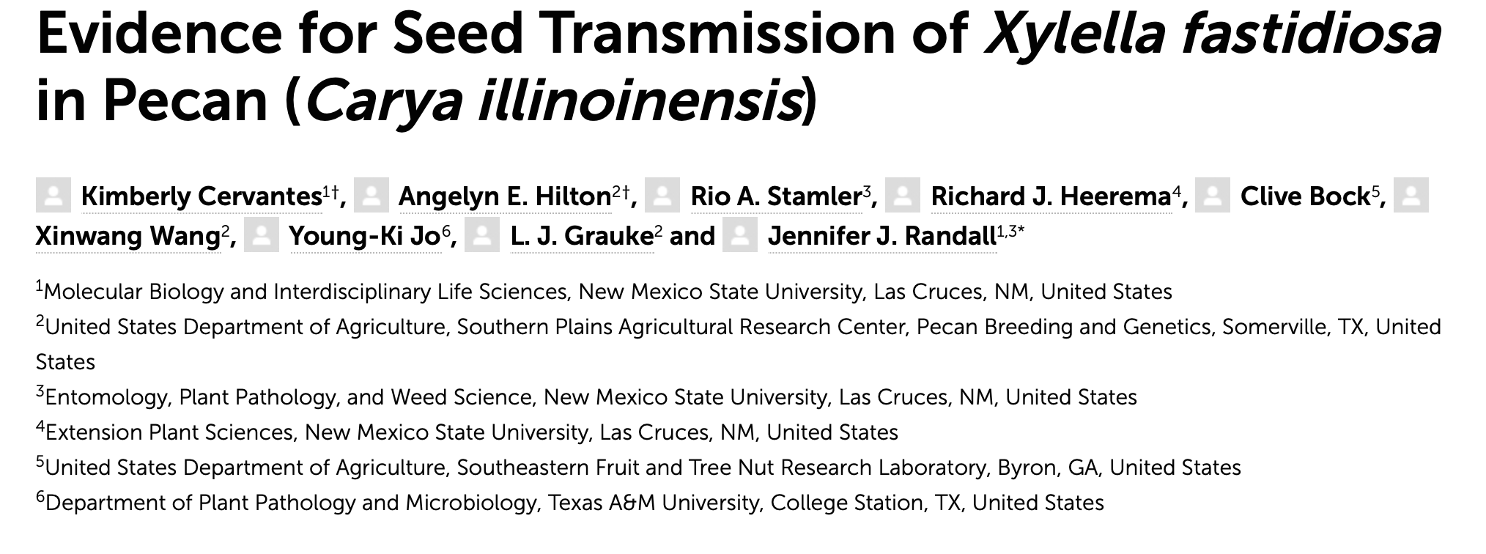
Open Access in Frontiers of Plant Science Journal!

Slide 11
Objectives
Determine the presence of Xylella in developing nuts of different cultivars
Compare the concentration of Xylella in the different anatomical parts of cv. Cape Fear nuts and seedlings
Test the correlation between Xylella concentration and nut fill, and its subsequent impacts on seedling germination and growth
Notes:
Graft transmission is one method; but seed transmission might be another method.

Slide 12
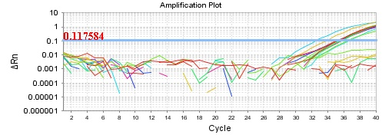
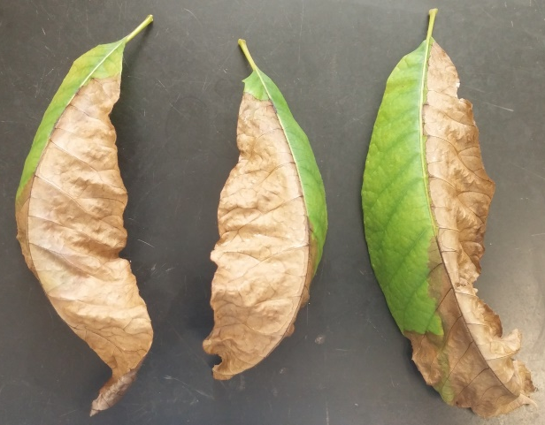
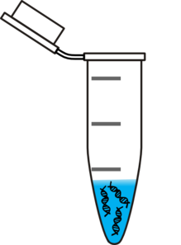
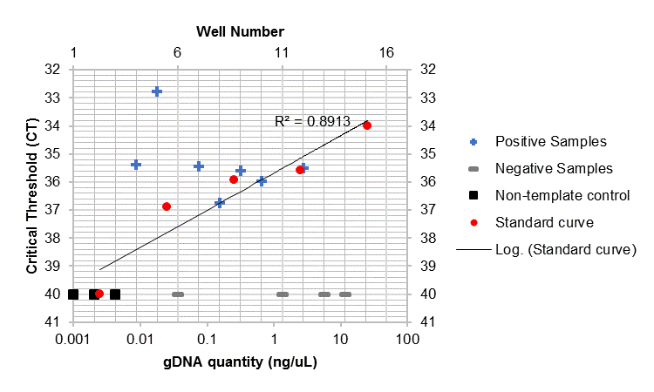
Polymerase Chain Reaction (PCR) Makes Copies of DNA
A
B
1. Collect samples exhibiting symptoms of PBLS
3. Prepare PCR reaction with extracted DNA as template. Perform program in thermal cycler
2. Isolate DNA
4. Thermal cycler detects DNA quantity. Scientists interpret results.

Slide 13
Presence of Xylella in nut endosperm
180 nuts at water stage were collected from 18 pecan trees
A sterile syringe was injected into the integument to extract the sap (endosperm)
The presence of X. fastidiosa was detected by direct qPCR
Xylella was detected in nut endosperm in 14/18 trees
60% in cv. Wichita (Tree 6) tested positive

Slide 14
concentration of xylella in different parts of c.v. Cape Fear nuts
Four anatomical parts were dissected from cv. Cape Fear nuts
Embryo
Hilum
Vascular integument
Outer integument
The total gDNA was isolated and the concentration of Xylella DNA was estimated by qPCR
Highest concentrations of Xylella in the hilum and outer integument

Slide 15
Concentration of Xylella in petioles, shoots, leaflets, and roots of c.v. Cape Fear seedlings
Eight c.v. Cape Fear seedlings germinated from high-quality nuts were harvested after 12 weeks
The petioles, apical shoot, leaflets, and tap roots were dissected from each seedling
Xylella DNA was quantified by qPCR
Petiole samples had the highest concentrations of Xylella

Slide 16
Presence of Xylella in high, medium, and low filled nuts
A
150 nuts were collected and separated by nut fill into three groups
Prior to planting, the seeds were bisected and the section not containing the embryo was harvested and the gDNA isolated
qPCR analysis was performed on a subset of 25 nuts per group to determine the presence and concentration of Xylella
B
The presence of X. fastidiosa was significantly higher in high filled nuts compared to low filled nuts

Slide 17
Impact of nut fill on germination and growth rate of seedlings
A
B
150 cv. Cape Fear nuts were separated into three categories based on nut fill
Nuts were bisected and the half containing the embryo was planted and monitored for germination and growth rate
C
High filled nuts had significantly higher percent germination
Low filled nuts had significantly lower growth rates of germinated seedlings

Slide 18
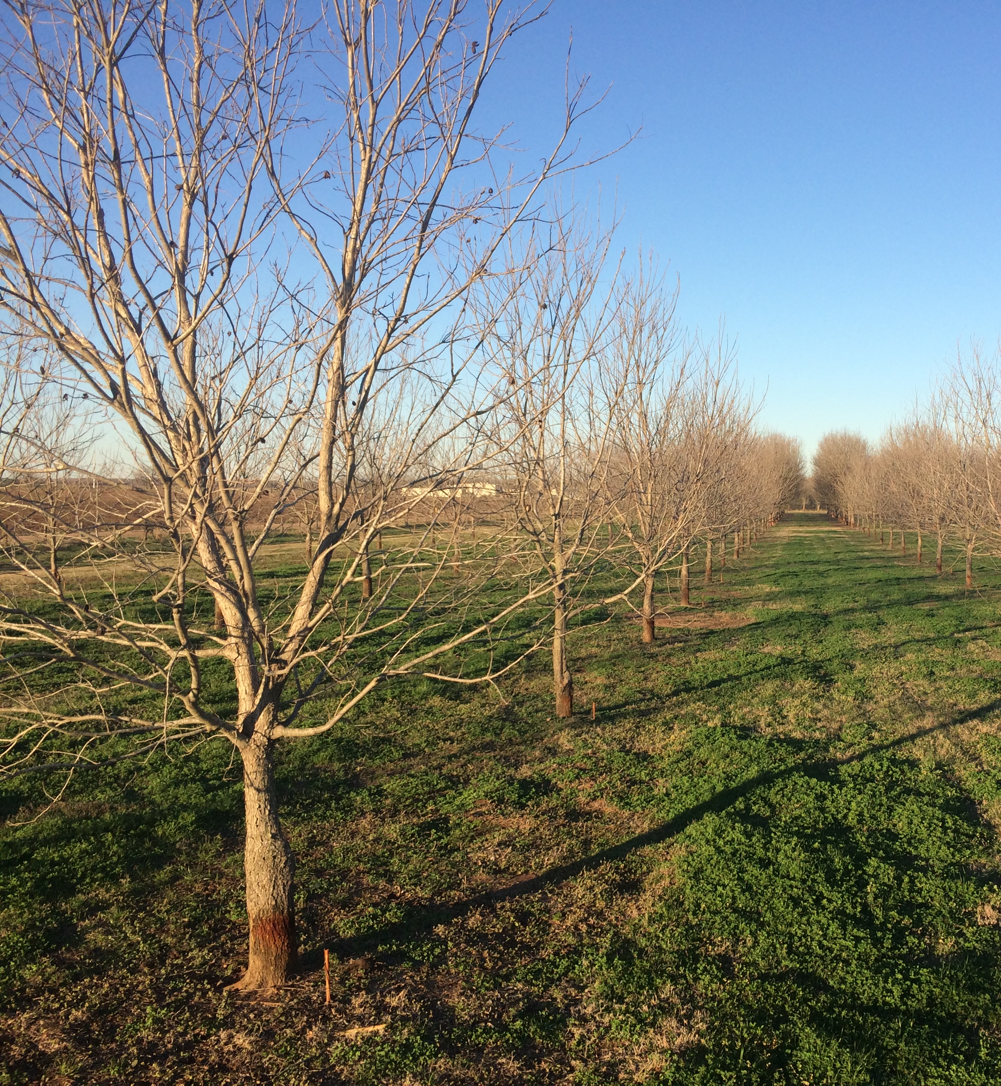
USDA-ARS Pecan Breeding and Genetics Program
National Collection of Genetic Resources for Pecans and Hickories
Mission Statement:
Develop superior pecan cultivars and rootstocks
Determine heritability constants for superior tree and nut characteristics;
Develop host plant resistance to control pecan insects and diseases;
effectively collect, document, preserve, evaluate, enhance, and distribute pecan and hickory genetic resources as part of the National Plant Germplasm System
USDA-ARS Pecan Breeding and Germplasm Repository.
L.J. Grauke, USDA-ARS, Somerville, TX

Slide 19
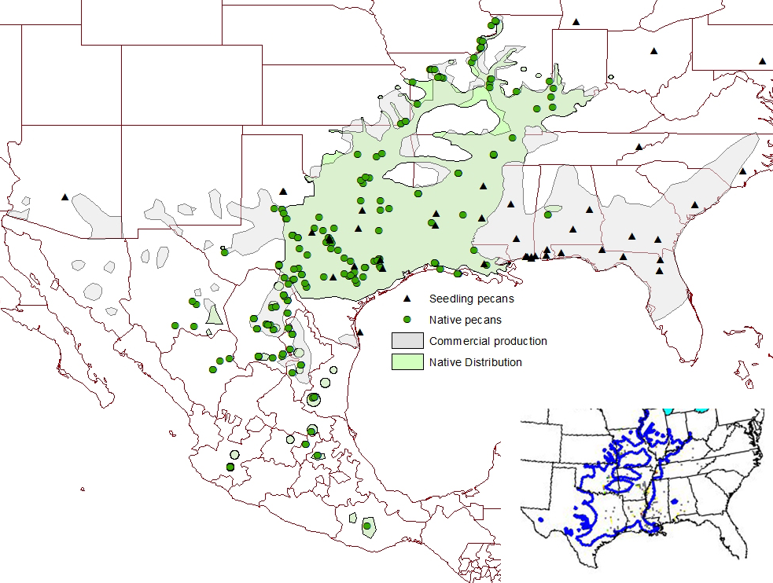
U.S. Pecan Production
Pecan (Carya illinoinensis) is a native tree to North America.
The U.S. produced approximately 227,400 metric tons of in-shell pecans in 2017, and the annual revenue on the cultivated crop now exceeds $650 million
Global demands for pecan have continued to increase annually:
30% increase in the United U.S. global exports of shelled pecans since 2012
Nations now cultivating pecan: China, Korea, South Africa, Australia, Israel, Uruguay, Argentina, Peru, and Brazil
Areas of native and commercial pecan distribution in the U.S. and Mexico, with points of origin for selected individual native and seedling accessions in the NCGR-Carya. Insert is Little's (1971) map. Taken from Pecan South’s “Family Trees: Roots and Resilience” by LJ. Grauke. Accessed Feb. 18, 2020.
Notes:
Highest pecan producing states (in order, descending): New Mexico, Georgia, Texas, and Arizona. Production of in-shell pecans has dropped by 27% and the annual revenue by 40% due to impacts of the trade war and/or natural disasters such as hurricane Michael which destroyed Georgia pecan crop/increased disease pressure.

Slide 20
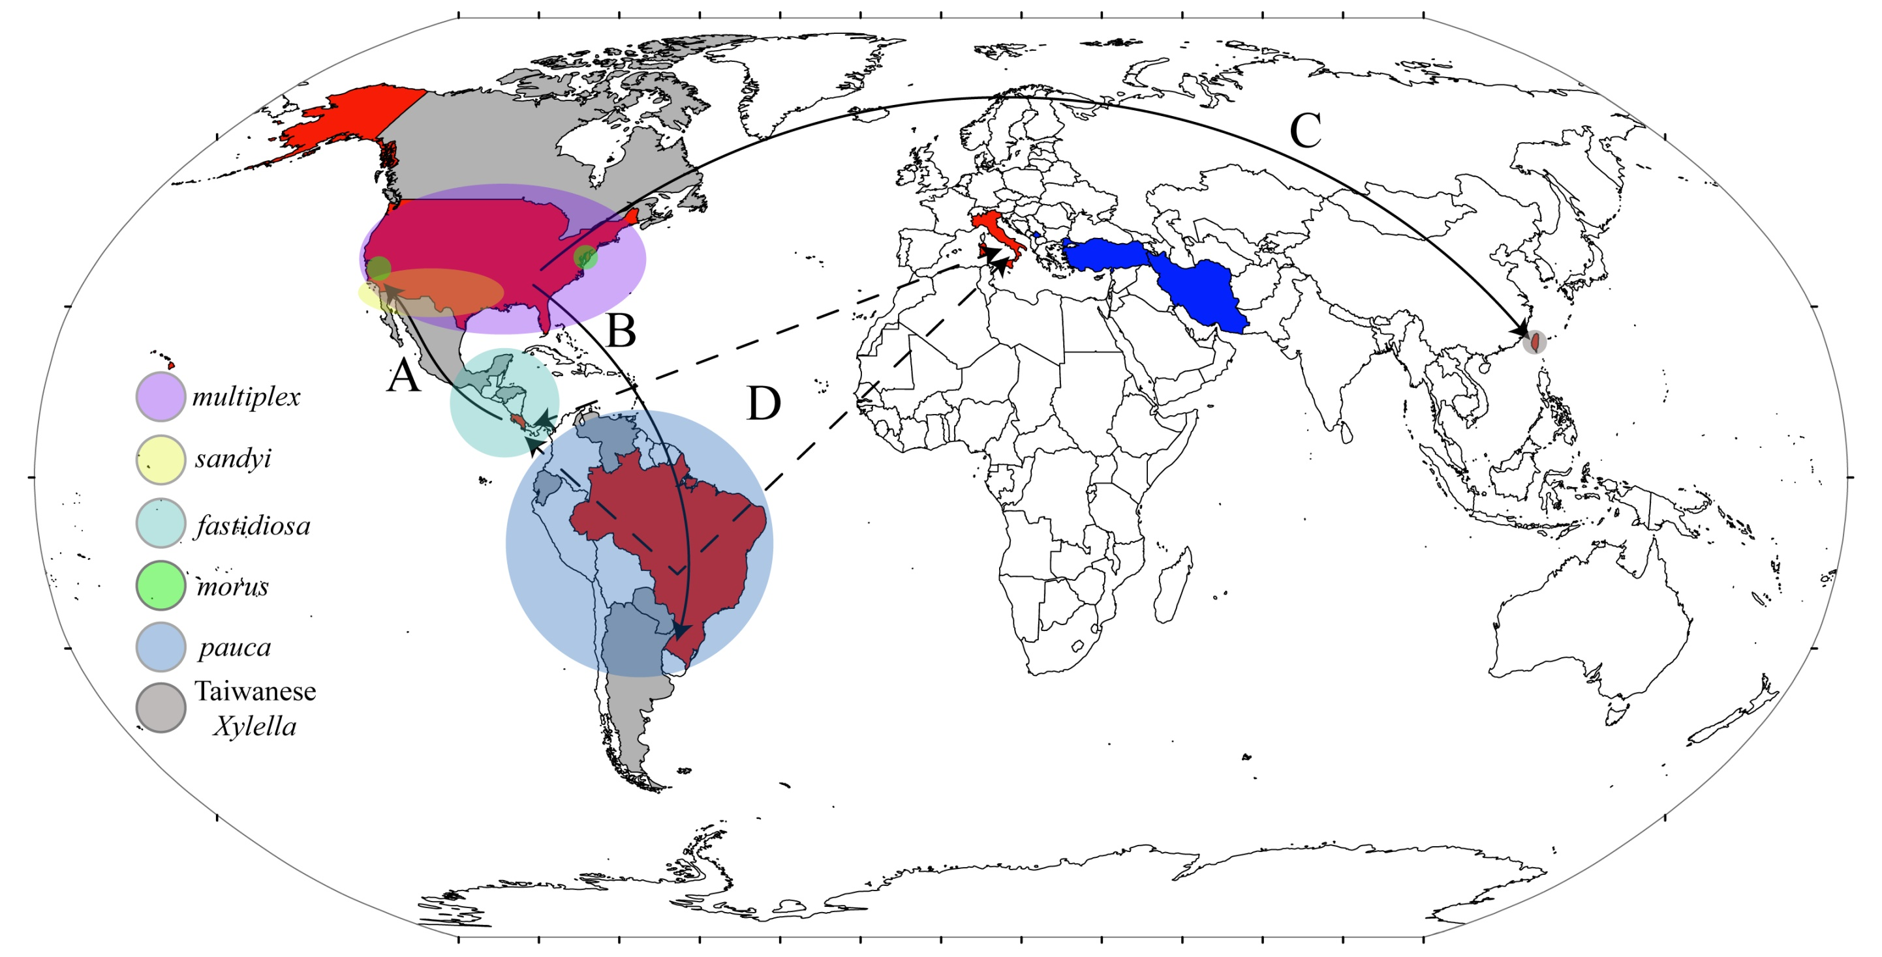
Almeida, Rodrigo PP, and Leonard Nunney. "How do plant diseases caused by Xylella fastidiosa emerge?." Plant Disease (2015).

Slide 21
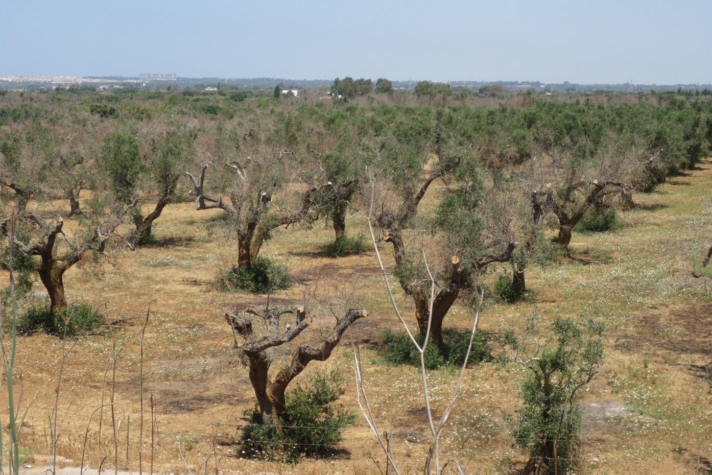
Case Study: Olive Quick Decline Syndrome (OQDS)
Xylella-infected coffee plants were introduced to Leece province, Italy between 2008-2010.
Already spread through Europe, infecting millions of olive trees.
Symptoms that include leaf scorching, twig and branch dieback and, ultimately, tree death.
Xylella has been labeled a quarantine organism by EPPO (EU Directive 77/93).
Rodrigo Krugner, University of California – Division of Agriculture and Natural Resources, ucanr.edu
Notes:
For example new strain subsp pauca is now in olives in Europe and has become significant problem….etc.
European and Mediterranean Plant Protection Organization (EPPO)

Slide 22
Discussion
Xylella is present in developing nuts, mature nuts, and germinated seedlings
Highest bacterial DNA concentrations in the hilum and vascular integument
Infections are systemic in seedlings
The presence of Xylella in nuts is not correlated to low nut fill
We still don’t know how Xylella enters the nut
The impacts on industry trade will be significant when distributing nuts internationally for horticultural purposes (for propagating rootstock) – Dependent on importing nation
There is a direct need for phytosanitation approaches for remediating infected pecan seed
Xylella is NOT a human pathogen. Distribution of nuts used for human consumption will not be impacted.
Notes:
This eliminates the possibility for nut culling as a method of reducing Xylella-contaminated nuts of low quality, an effective approach for limiting disease in other food crops
Pecan development can be separated into three stages, histodifferentiation, maturation, and post-abscission (Jeyaretnam et al. 1999). During histodifferentiation and early maturation phases, water content dramatically increases as it travels through the vascular bundles to the inner tissue of the funiculus which then meets near the base of the integument before branching out into a complex system throughout the kernel seed coat (Woodkoof 1927; Jeyaretnam et al. 1999). The hilum is an elliptical scar that marks the site of previous attachment to the funiculus, and was found to have significant concentrations of X. fastidiosa DNA in the pecan nuts tested.

Slide 23
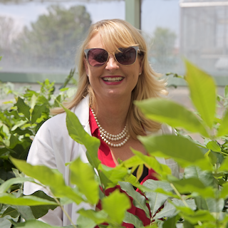
Acknowledgements
Funding Sources
Dr. Kimberly Cervantes
Texas A&M University
Young-Ki Jo
New Mexico State University
Jennifer Randall
Kimberly Cervantes
Richard Heerma
Rio Stamler
Dr. Jennifer Randall
USDA-ARS
LJ Grauke
Xinwang Wang
Clive Bock

Slide 24
Questions?

