Slide 1
Pecan Leaf Dieback
Erin Arthur
Graduate Student | Jo Laboratory
Dept of Plant Pathology & Microbiology
Texas A&M University
Notes:
Good morning, my name is Erin Arthur and I am a graduate student at Texas A&M’s plant pathology and microbiology department. My research is on fungal pathogens in pecan trees, with a focus on the emerging disease Pecan leaf dieback.

Slide 2
Agenda
Background on Pecan leaf dieback
Other Neofusicoccum diseases
Identification in the orchard
Pecan leaf dieback current research
Notes:
Today, I will be talking about what we already know about pecan leaf dieback, how to Identify the disease in the orchard, other diseases caused by similar pathogens in the Neofusicoccum genus, and our current research.

Slide 3
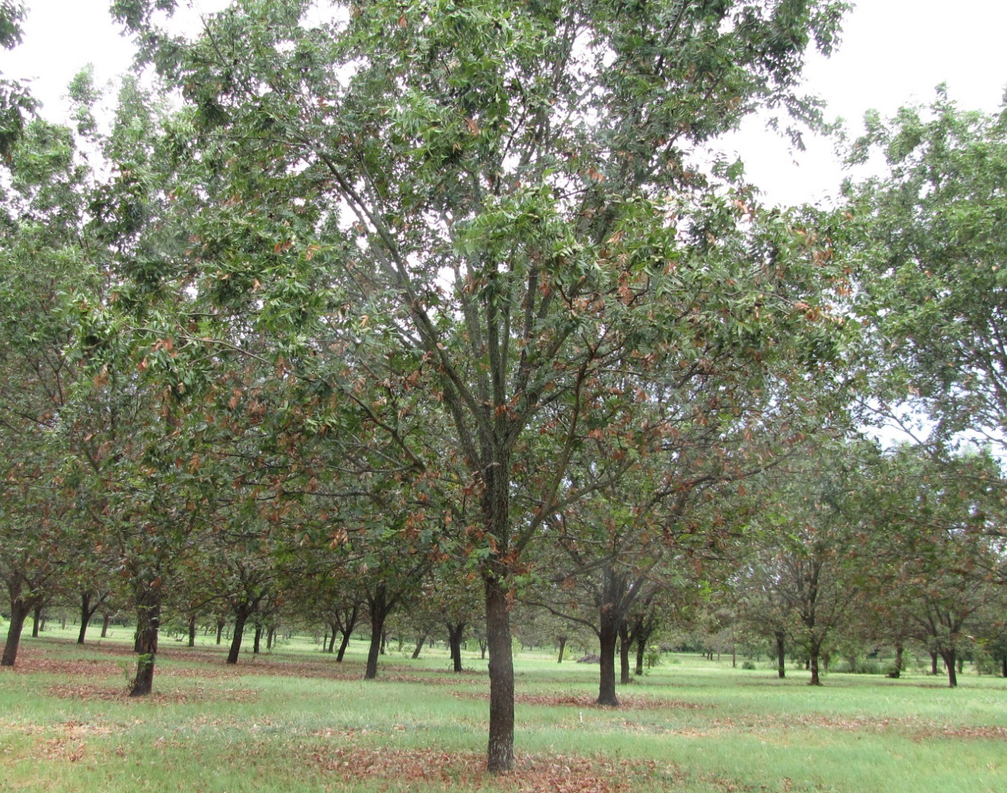
Background
First documented in 2011 (Wells, 2015)
Seen in Georgia, Alabama, Louisiana, and Texas (Graham, 2018; McClure, 2016; Nesbitt, 2016).
Classified as Neofusicoccum caryigenum in 2021 (Brewer, Cameron et al., 2021)
Not much is known, including how best to manage it
PC: Dr. Nesbitt
Notes:
Pecan leaf dieback is an emerging disease in the pecan industry. It was first observed in Georgia by Lenny Wells in 2011. Since then it has been reported in pecan orchards across the southern United states. Last year the causal pathogen of pecan leaf die back was classified as Neofusicoccum caryigenum.

Slide 4
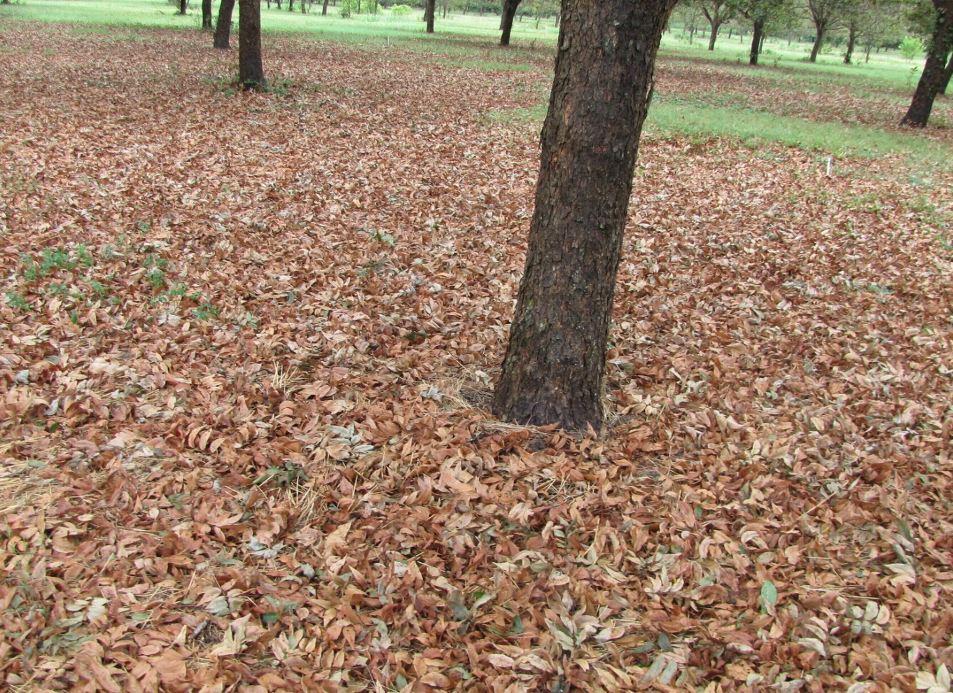
What we know
Often seen later in the season (August-October)
More severe and common after rainfalls
May be worse in orchards that do not use fungicides
Williamson and Burleson counties reported leaf dieback in 2021
Limits the amount of energy stored through winter for the following years’ pecan production
PC: Dr. Nesbitt
Notes:
So what do we know about this disease?
We know that it is usually seen around August to October, but we have isolated it as early as June. Also much like scab, it is worse in years with heavier rainfalls. We expect to see more leaf dieback in orchards that do not use fungicides. Last year and early this year we were able to collect dieback samples from Williamson and Burleson county but we need more samples for our research goals. Lastly, we do know that early defoliation of leaves can limit the amount of energy created late in the season. This is a problem because the energy stores help protect trees through harsh winters and in the spring the tree uses energy stored over the winter to begin pecan production.

Slide 5
Identification
Symptoms move down the rachis
Dead leaves stay on the tree
Leaves look light brown with black rachis
Notes:
The question I get asked the most is how do I know if it’s pecan leaf dieback. So what you are looking for is as the name suggests leaves dying from the terminal ends of leaflets and the symptoms moving back towards the plant. The leaves often stay on the tree for a prolonged time. You’ll also notice in this picture that there is a blackening down the rachis. Here is where we are able to isolate the fungus so if you send us samples please be sure to include the area where the healthy part meets the symptomatic part. Also check to make sure the branch isn’t damaged elsewhere, because that can sometimes give similar symptoms.

Slide 6
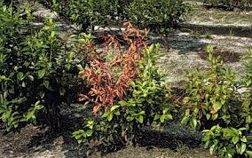
Other Neofusicoccum species
90 known hosts, mostly woody plants
Grape
Blueberry
Sequoia
Walnut
Black poplar
Kiwi
Eucalyptus
Mango
Olive
Lemon
University of California
Amponsah et al. (2008)
Haenzi et al 2021
Notes:
Since not much is known about the epidemiology of pecan leaf dieback, we often look to other closely related species. This genus of pathogens is know to infect a wide variety of woody plants including walnut, olive, and grapevines. They often cause leaf dieback in their hosts like what we see in pecan leaf dieback. However, some of these pathogens are able to create branch dieback, cankers, and fruit rot in their hosts.

Slide 7
Neofusicoccum in Walnut
N. parvum and N. mediterraneum
California reported branch dieback (Trouilllas et al., 2010)
Black rot on Walnut fruit in China (Chen et al., 2019)
2022
PC: University of California
7
T P G A C O N F E R E N C E
Notes:
As many of you know, the walnut tree and pecan tree belong to the same family and are therefore closely related. There have been many reports of Neofusicoccum species infecting walnut trees and causing branch dieback, cankers and walnut fruit rot.

Slide 8
Current Research
In the field, greenhouse and the lab
2022
T P G A C O N F E R E N C E
8
Notes:
Now we will move onto our current research on Pecan leaf dieback in the field, greenhouse, and the lab.

Slide 9
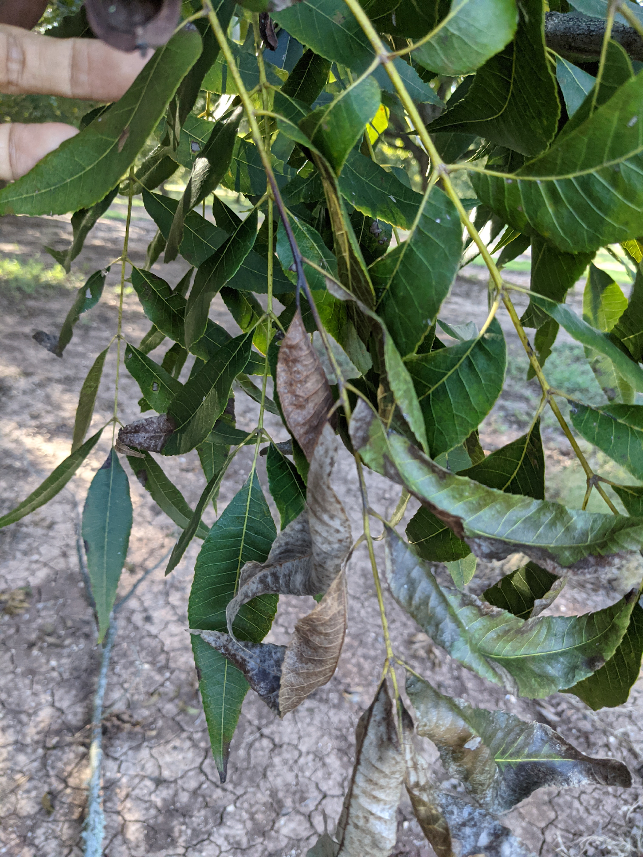
Sequenced Die-Back samples
Isolates came from leaflet samples
Sequenced ITS1-4 region
Came back as a match to Neofusicoccum caryigenum
Whole Genome Sequencing
Notes:
Samples of dieback were collected in Burleson county in 2021. The leaflets were surface sterilized and grown in fungal growth medium. From there we isolated neofusicoccum caryigenum based on morphological observations. The fungus appears green and layered on the agar and grows very quickly. We sequenced the ITS1-4 DNA region which is commonly used for fungal identification.

Slide 10
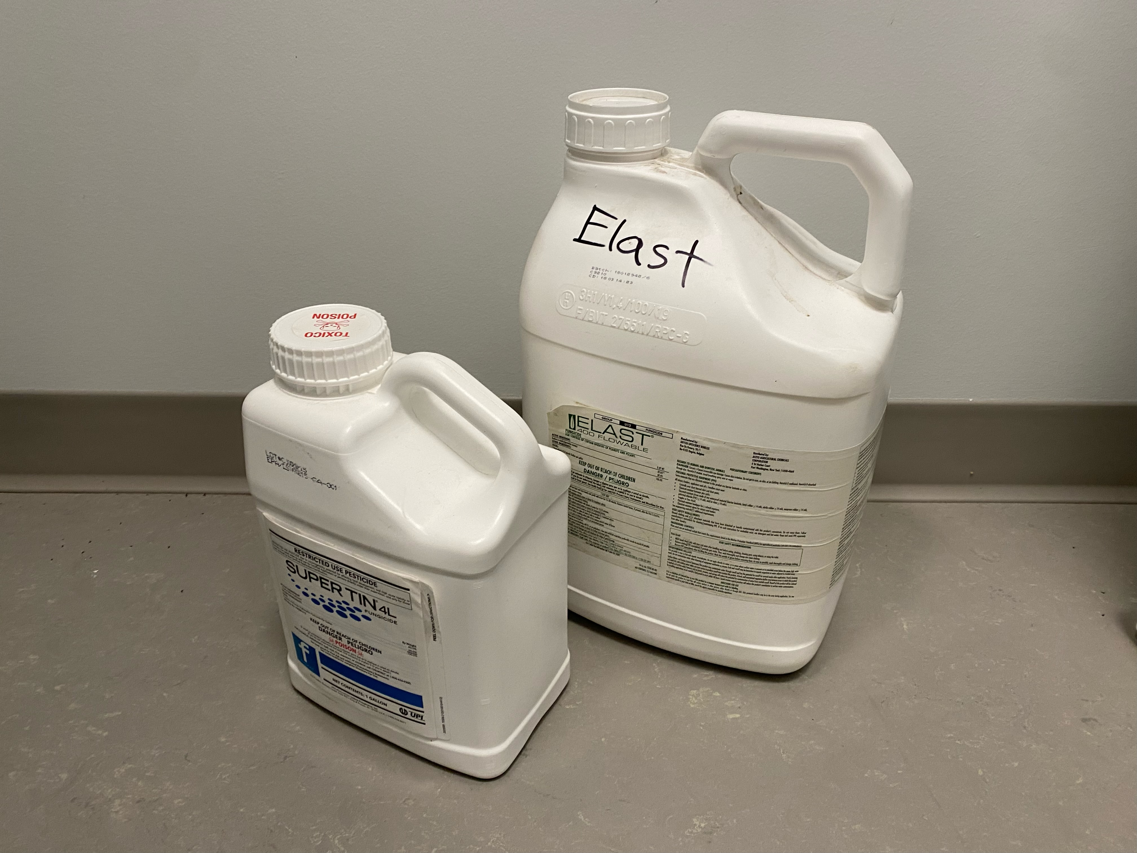
Fungicide Sensitivity
No current management plan or fungicides labeled for Pecan leaf dieback
We expect fungicide resistance
Fungicide assays are used to determine sensitivity and resistance to fungicides
Notes:
Since pecan leaf dieback is a relatively new disease, their have not been any published recommended management plans or fungicides labeled for use against leaf dieback. Furthermore we expect to see fungicide resistance already in Neofusicoccum carygenum due to the frequent use of fungicides in many orchards to treat pecan scab. Therefore, we want to determine which fungicides, N caryigenum is resistant or sensitive to so that we can develop an effective management plan.

Slide 11
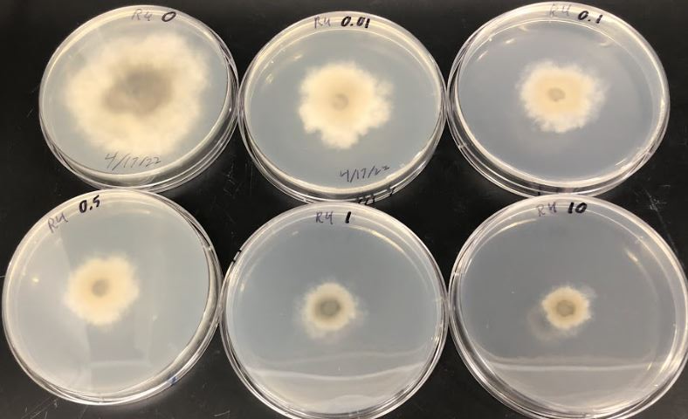
Fungicide Assays
In the lab on petri dishes
Heritage, Tebuconazole, Elast, and Supertin
Resistance or sensitivity
Notes:
The fungicide assays are run in the lab on petri dishes. In the dishes we use a fungal growth media amended with varying concentrations of fungicide. The resistance or sensitivity of the fungus to the fungicide is determined by how much the fungus grows on the plate. The fungicides we are currently testing are Heritage, Tebuconazole, Elast, and Supertin. Hopefully we will have some results for y’all soon on this.

Slide 12
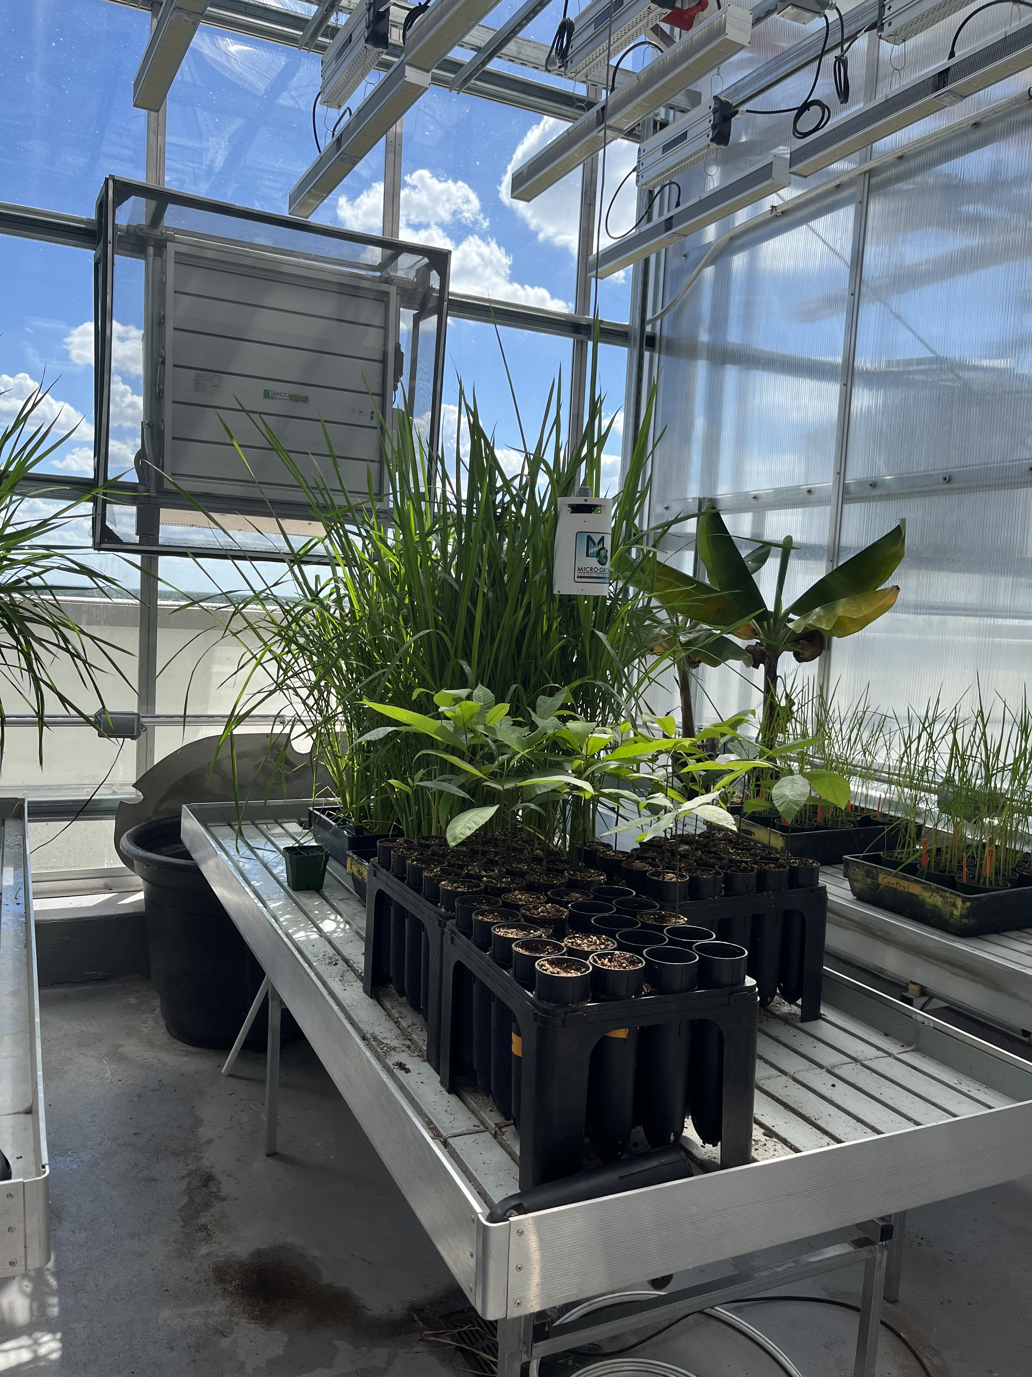
The Greenhouse
Controlled environment
Can inoculate plants without spreading disease
Planted pecan seedlings
Also growing rice and banana plants for other projects

Slide 13
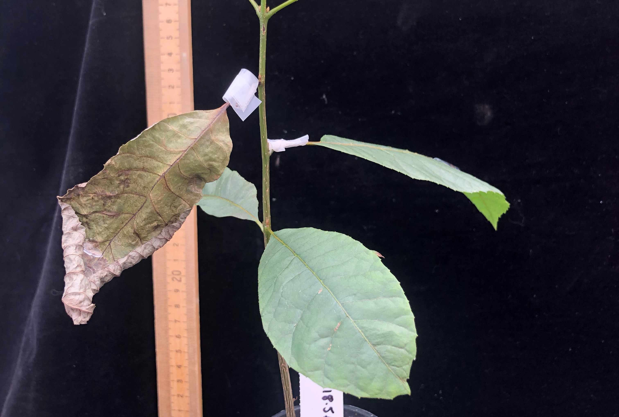
Greenhouse study
Requires a wound
Petiole inoculations had the fastest symptoms
Symptoms moved from the tip of leaf back

Slide 14
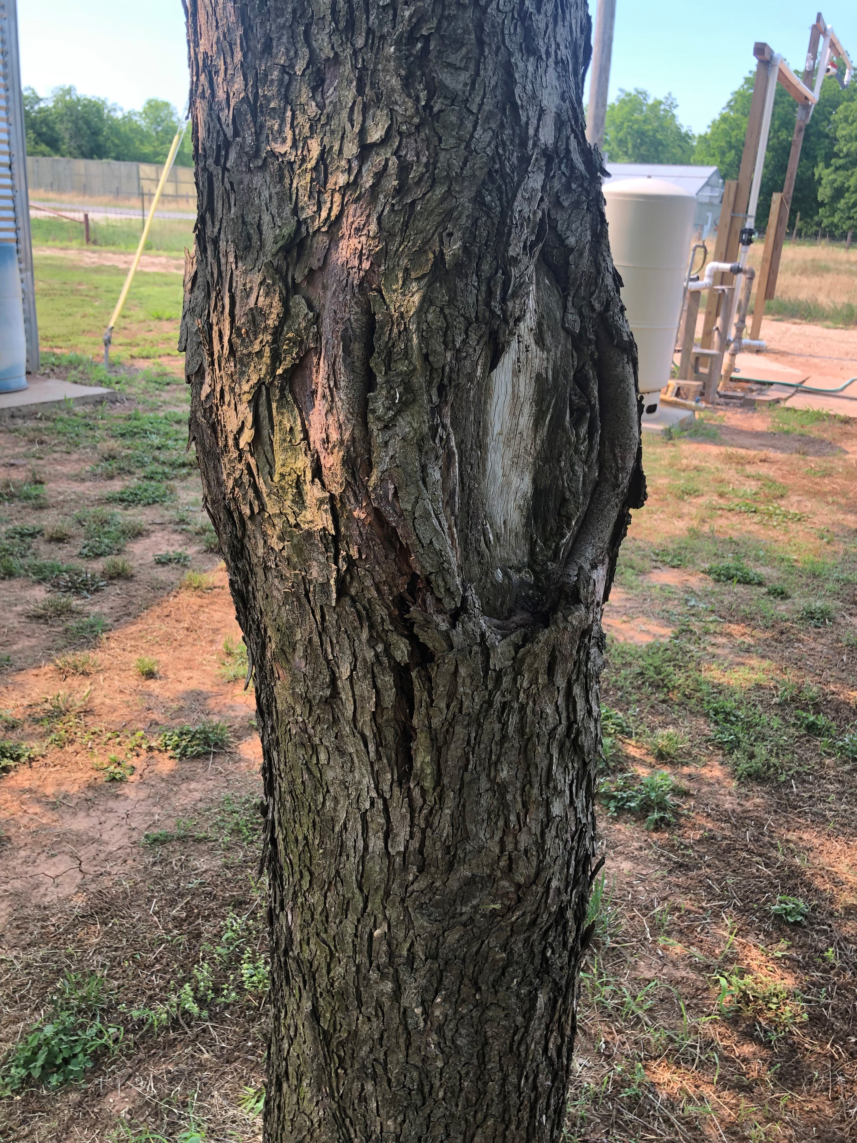
Cankers
Wounds on the Trunk
N. caryigenum isolated from cankers
Entry point, overwintering site, or both?
Pecan leaf dieback may cause cankers
Shaker damage

Slide 15
Canker on seedling

Slide 16
Spore trapping
Building a device that will collect the spores distributed throughout the day
Gives us information as to peak hours, which conditions are favorable and/or most abundantly produce spores
Create primers for N. caryigenum to quickly identify
Previously used for pecan scab

Slide 17
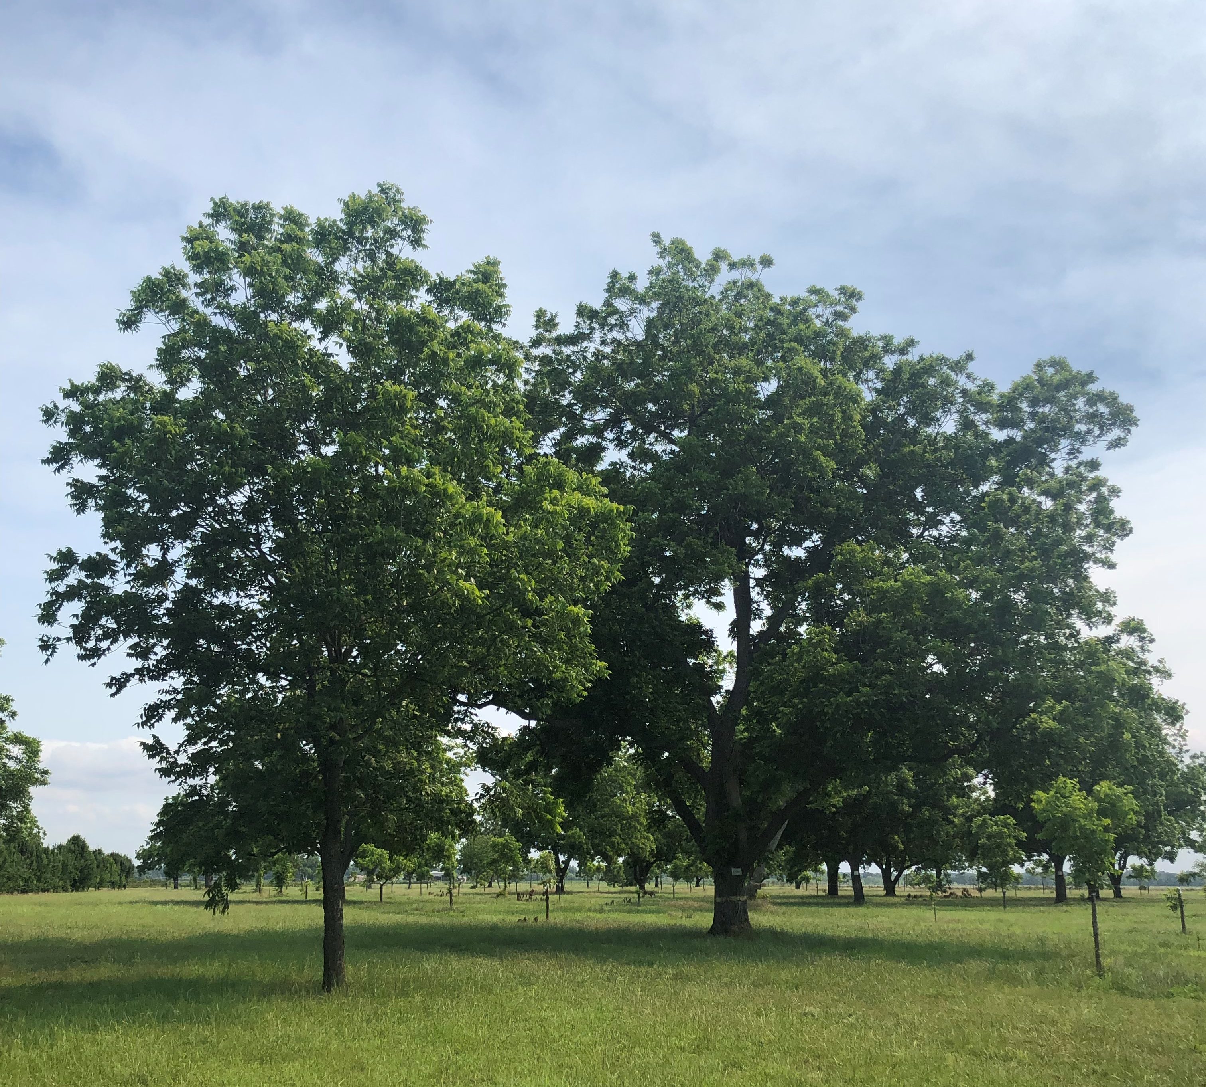
Our goal is to develop a fungicide program
Lab, greenhouse, and field trials
Epidemiology study
Population genetics and geographical diversity

Slide 18
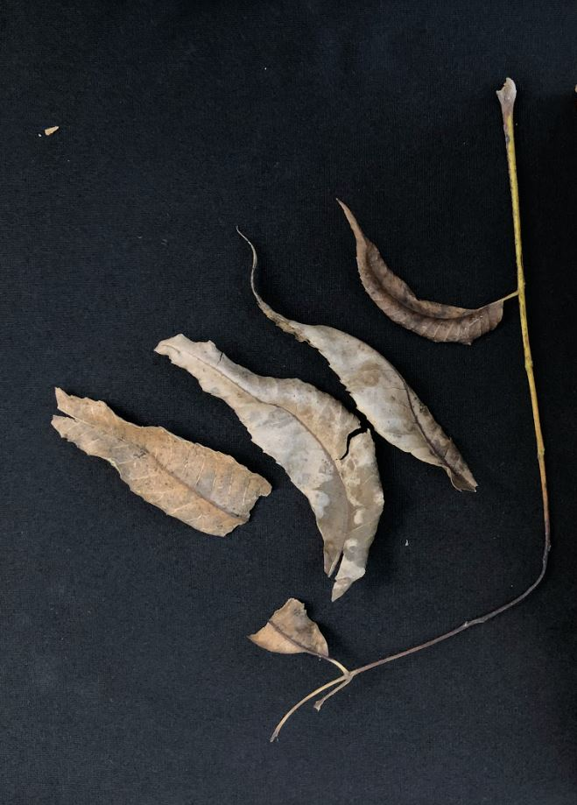
How you can help
We need samples from diverse locations
Include the area where the healthy branch becomes necrotic
Put the branch in a ziplock bag and write down your contact information and what variety the sample came from.
Mail it to us!

Slide 19
Contact Us
Erin Arthur
Email: enarth16@gmail.com
Dr. Young-Ki Jo
Email: yk.jo@ag.tamu.edu
Phone: (979) 862-1758
Our Address:
Dr. Jo
Plant Pathology and Microbiology Building
496 Olsen Blvd.
College Station, TX 77843-2132

Slide 20
Thank you

Slide 21
References
Brewer et al (2021) Mycologia doi: 10.1080/00275514.2021.1880216
Chen et al (2019) Plant dis. doi: 10.1094/PDIS-02-19-0387-PDN
Graham (2018) Pecan south magazine
McClure (2016) Louisiana State University AgCenter.
Nesbitt (2016) Pecan South Magazine
Trouillas et al (2010) Plant dis. doi:10.1094/PDIS-06-10-0412
Wells (2015) UGA Pecan Extension.

