Slide 1

BUSINESS MEETING
2021

Slide 2
Agenda
TPGA Membership & Highlights
TPGA Financial Report
Articles of Incorporation Vote
Board of Directors & Staff
TPGA New Districts, Membership Levels, & Mission Statement
Awards
Adjourn

Slide 3
TPGA Membership
639 members, including 114 new members
Over 63% of TPGA's membership are growers
30% of the membership have between 1-100 trees and are considered small businesses
38% of TPGA's membership has been in the pecan industry 0-5 years, while 11% has been in the industry 40 years or more.
The largest age category for membership is between 61-70 years old, comprising of 26% of members surveyed.
*Data collected from current membership and 2019 membership survey.

Slide 4
TPGA Membership Highlights
100 year celebrations, including a special 100 year recipe booklet
Additional offerings in 2020
Award a Texas A&M horticulture student with the Brison Scholarship
Contract work for other pecan associations
TPGA Membership Directory
Grants and International Promotion
Pieces of Pecan – first consumer magazine for pecans
Website listings and Holiday Trail Map to promote Texas growers
National Pecan Federation funding to have representation in Washington D.C.

Slide 5
Financial Report
For Fiscal Year Ending Dec. 31, 2020
REVENUE:
$536,618.28
TPGA (includes dues, grants, bookstore, management etc.) $81, 074.44
Pecan South (includes advertising, subs, newsletter ) $455,543.84
EXPENSES:
$477,838.97
TPGA (includes member benefits, grants, contributions, salaries, etc. ) $195,223.39
Pecan South (printing, postage, travel, salaries, etc.) $282,615.58
If you would like a complete financial report, please contact the Texas Pecan Growers Association office.

Slide 6
TPGA Articles of Incorporation Vote
The Texas Pecan Growers Association is required to renew it’s Texas Business Organizations Code governing documents with the Texas Secretary of State to remain an organization.
The TPGA Board of Directors voted to renew the governing documents and remove the amendment of expiration.
Membership vote

Slide 7
TPGA Staff
Executive Director, Blair Krebs
Associate Director of Membership, Erin Diserens
Pecan South Managing Editor, Catherine Clark
Office Manager, Jaclyn Uzcategui
Summer Intern, Bailey Gruber
Visit the conference registration desk for any questions or information needed during the show.

Slide 8
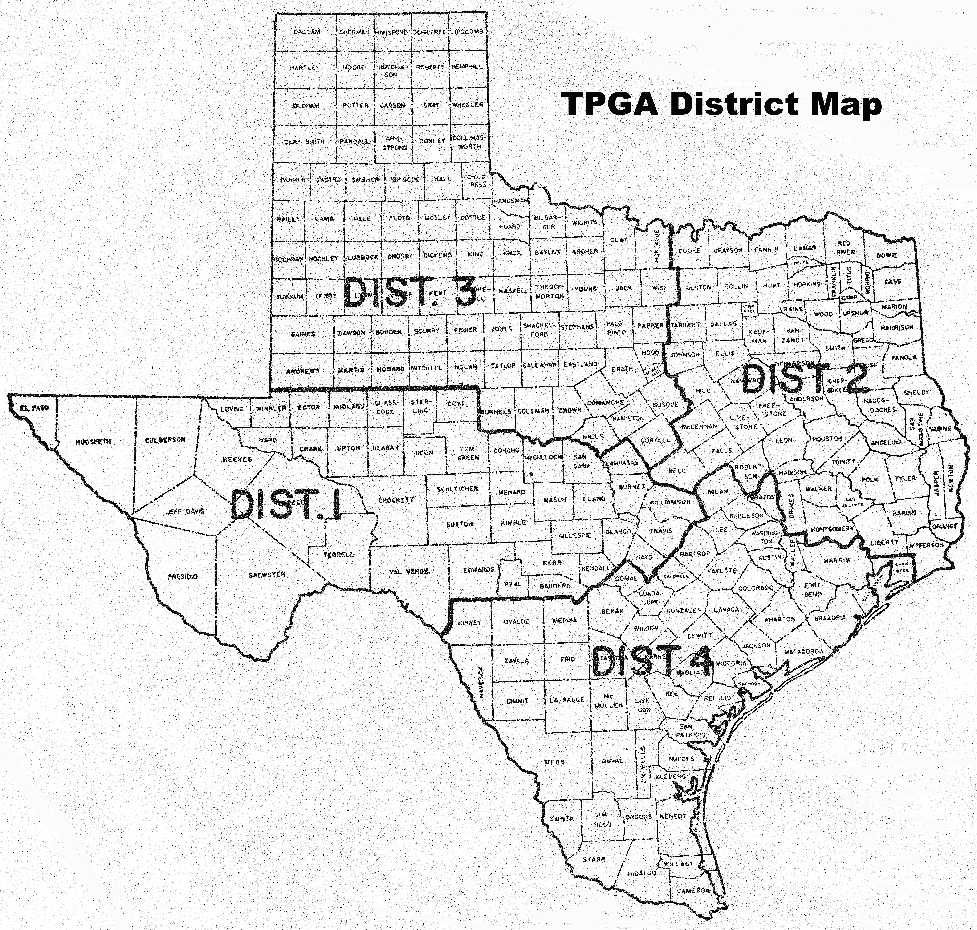
TPGA Board of Directors
President, Shannon Ivey, Tornillo
Vice President, Jake Montz, Wichita Falls
Director Dist. 1, Mary Santos, Tornillo
Director Dist. 1, Winston Millican, San Saba
Director Dist. 2, James Livergood, Palestine
Director Dist. 2, Jim Luscombe, Anna
Director Dist. 3, Larry D. Womack, DeLeon
Director Dist. 3, Will Culllers, Comanche
Director Dist. 4, Troy Swift, Lockhart
Director Dist. 4, Keith Berdoll, Smithville
At-Large, Lalo Medina, Dallas
*No board changes in 2021

Slide 9
TPGA New Districts
The TPGA Board of Directors has approved an updated district map to better reflect the current Texas pecan industry.
Each district is represented by two members of the board of directors and will be implemented with the 2022 TPGA elections.

Slide 10
TPGA
New Membership Levels
TPGA membership dues have remained unchanged since the 1980’s, while activities have increased.
TPGA Bylaws Section 8 states that annual dues are set by the Board of Directors.
The following new due structure will be implemented January 2022.
    Grower/Industry - $200
    Out of State/Non-Voting - $200
    Vendor - $200
    Scientist/County Agent - $0

Slide 11
TPGA
New Mission Statement
To assist Texas pecan growers in growing pecans profitably through education, research, promotion, and advocacy.
Adopted July 2021

Slide 12
TPGA Grower Awards

Slide 13
TPGA Small Grower of the Year
JoeBob and Janet Underwood
Underwood Pecans
Marion, Texas

Slide 14
TPGA Large Grower of the Year
Glenn Honaker
Belding Farms
Fort Stockton, Texas

Slide 15
TPGA Innovative Grower of the Year
Mark Friesenhahn
Comal Pecan Farms
New Braunfels, Texas

Slide 16
TPGA County Agent of the Year
Allison Watkins
Texas AgriLife
Tom Green County

Slide 17
TPGA Conference 2022
Thank you for attending the 100th Annual Texas Pecan Growers Association Conference & Trade Show.
Please join us for the 101st Annual Conference!
  July 10-13, 2022
  Embassy Suites Hotel and Convention Center San Marcos, Texas

