Slide 1
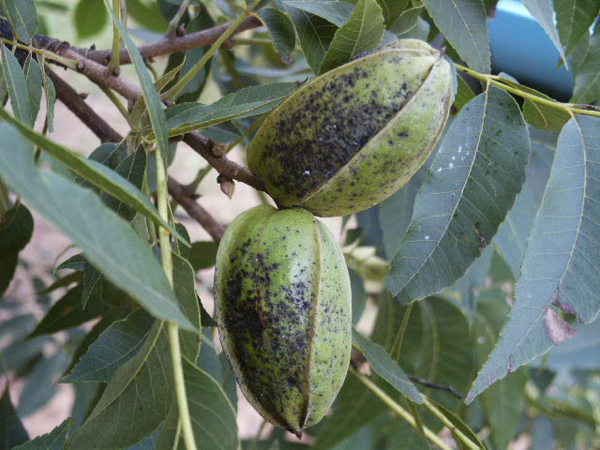
Keys to Pecan Scab Control
Monte Nesbitt, Extension Horticulture
Texas A&M University

Slide 2
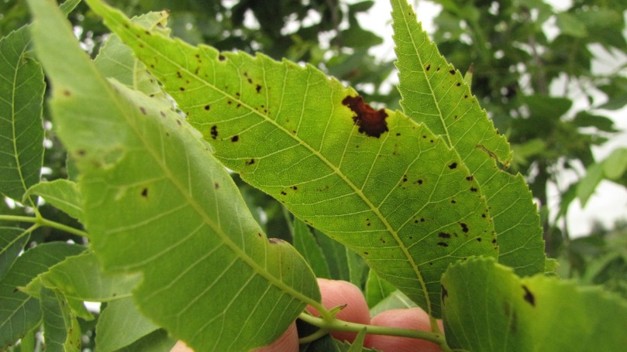
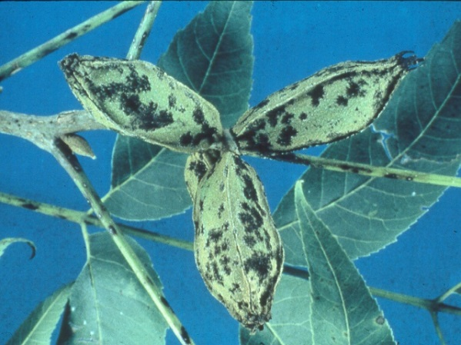
Key #1 Recognition
Dark-chocolate to black textured/fuzzy spots appearing on growing leaf, stem and nut tissue

Slide 3
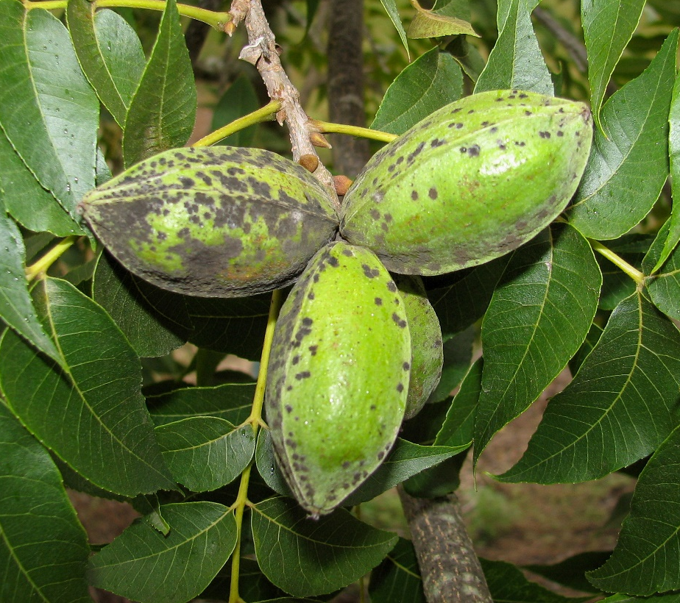
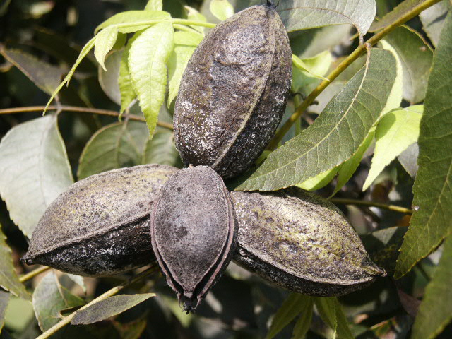
Recognize favorable weather
Warm temperatures (>57 F) (80-90 F optimal)
Sufficient hours of tissue wetness & humidity
10-36, depending on variety
Late afternoon rains with foliage remaining wet all night favor epidemic development.

Slide 4
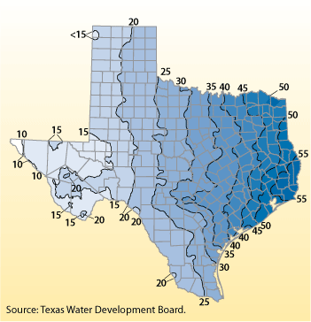
Texas Rainfall 30 year averages
Scab rare or never
Scab most years
???

Slide 5
High Plains
Scab potential is high right now in Texas.
South Central
Gulf Coast

Slide 6
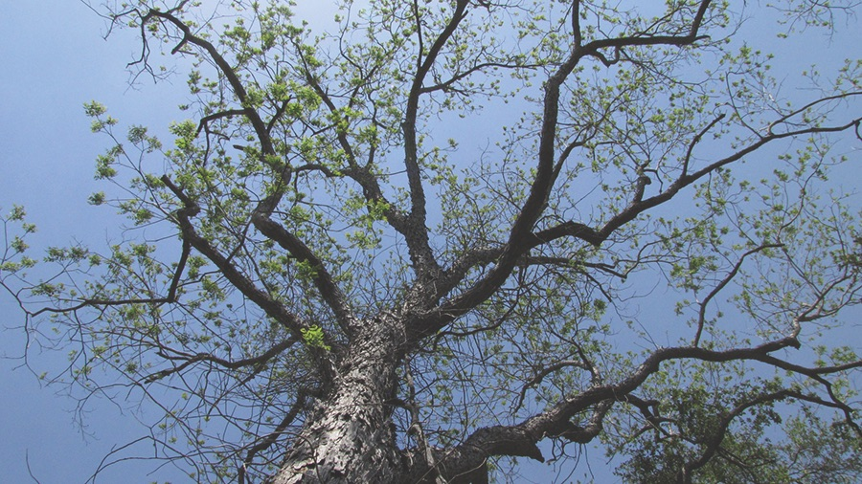
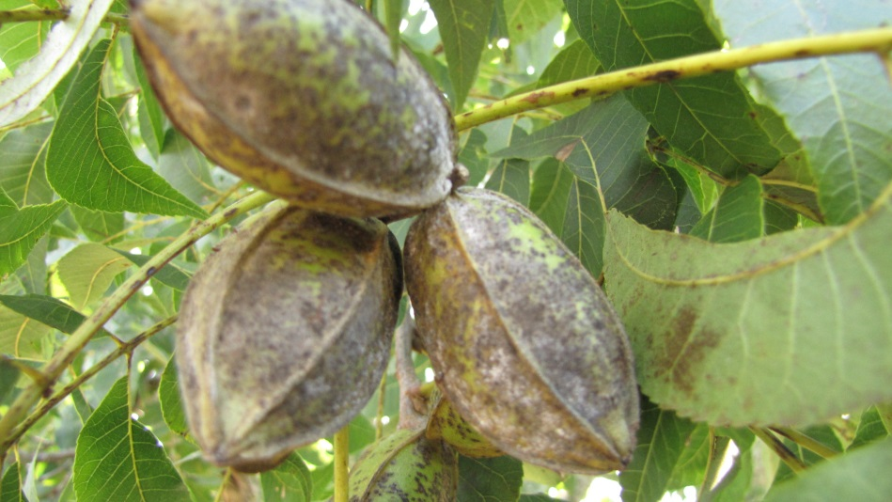
Key #2-Protect foliage with fungicides early
Healthy Foliage is Critical to Good Kernal Quality.
Most leaves are made April & May.
Leaf Scab that develops early can lead to hard-to-control nut scab if weather favors Scab disease.

Slide 7
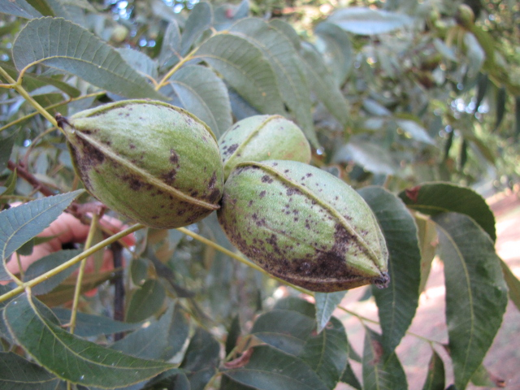
Key #3: Post-pollination cover spray timing must keep pace with rapid nut sizing.
Typical fungicide timing calls for sprays every 14-21 days.
In weather conducive to Scab disease, intervals should shorten to 10-14 days when rapid expansion of nuts is observed---variety influenced.

Slide 8
Key #4: Pecan Varieties Differ in Susceptibility
 | Resistant (+) |  | Susceptible (v)
Kanza | ++++++++++ | Sioux | +++vvvvvvv
Lakota | ++++++++++ | Nacono | +++vvvvvvv
Elliott | ++++++++++ | Kiowa | +++vvvvvvv
Apalachee | ++++++++vv | Choctaw | ++vvvvvvvv
Caddo | ++++++++vv | Cheyenne | ++vvvvvvvv
Oconee | ++++++++vv | Hopi | +vvvvvvvvv
Forkert | +++++vvvvv | Waco | +vvvvvvvvv
Prilop | +++++vvvvv | Tejas | vvvvvvvvvv
Desirable | ++++vvvvvv | Western | vvvvvvvvvv
Pawnee | ++++vvvvvv | Wichita | vvvvvvvvvv
RECOMMENDED FOR EAST TEXAS |  | NOT RECOMMENDED FOR EAST TEXAS

Slide 9
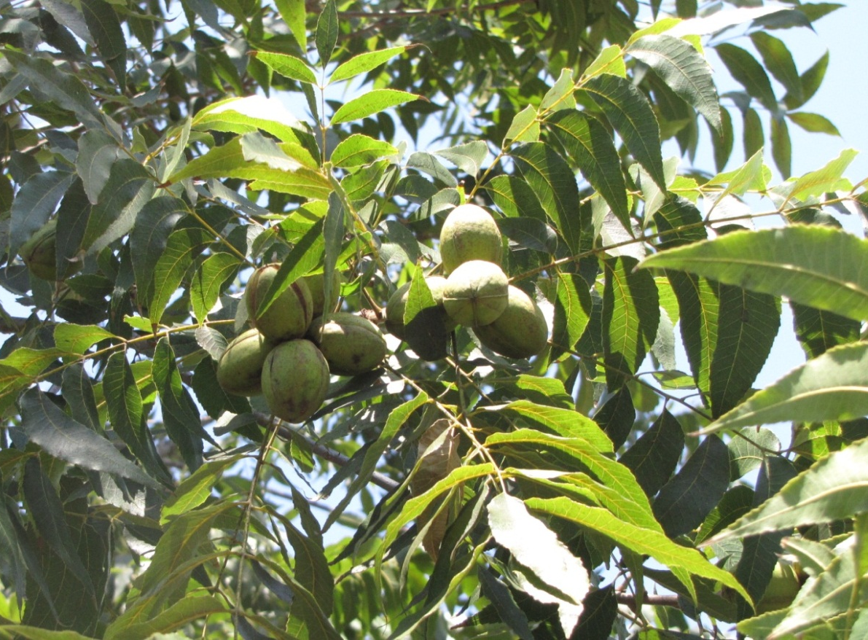
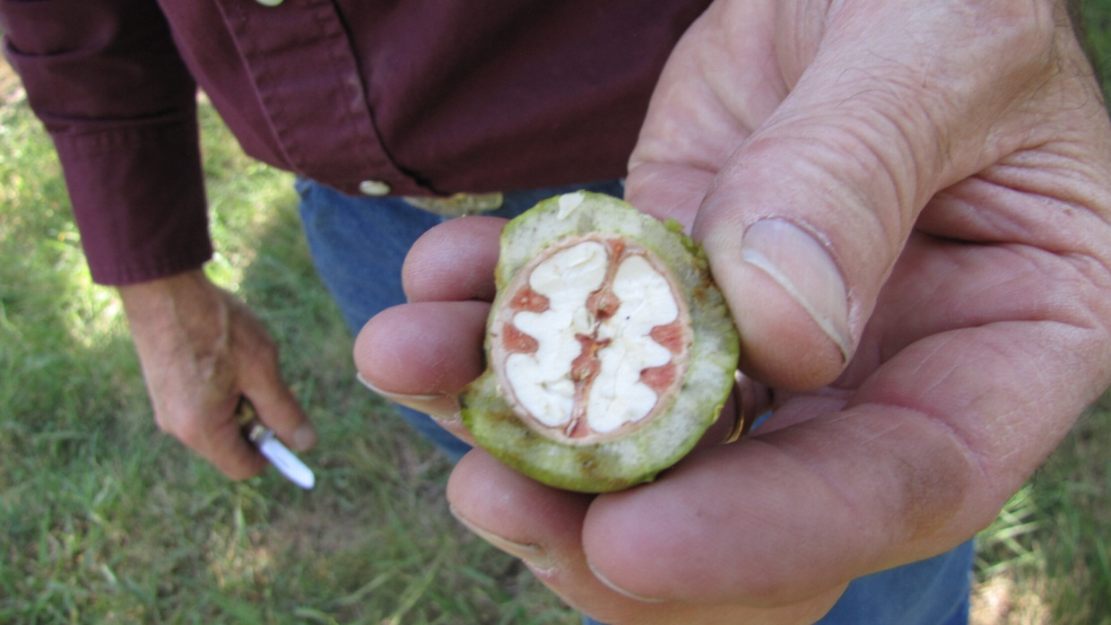
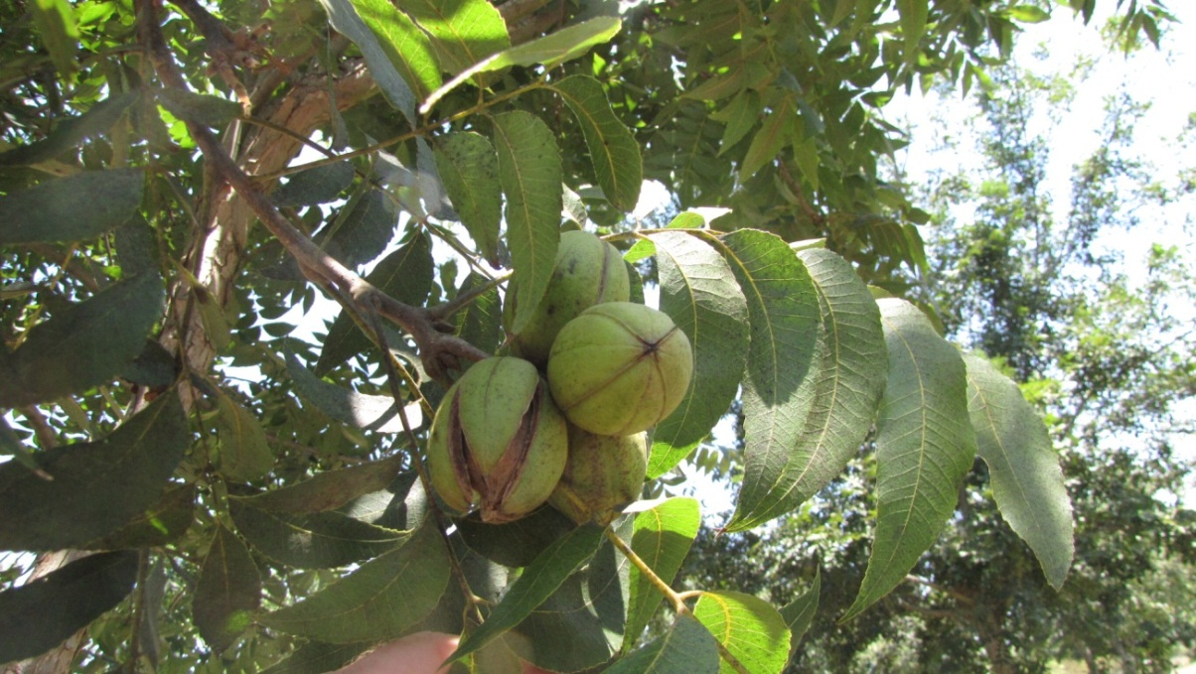
Kanza
Excellent scab resistance
Good kernel quality
Nut size varies with moisture
59 per lb; 52% kernel
Thick shell; thinner than Elliott
Good tree form
Yields well on young and older trees alike
2011 Brownwood, TX

Slide 10
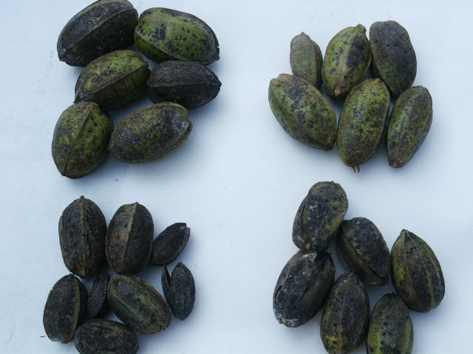
Over Time and In High Pressure Situations, Moderate Resistance in Varieties May Diminish
Jackson
Sumner
Choctaw
Cape Fear

Slide 11
Key #5-Scab will be worse in crowded orchards.
Especially on susceptible varieties in years when weather favors disease development.

Slide 12
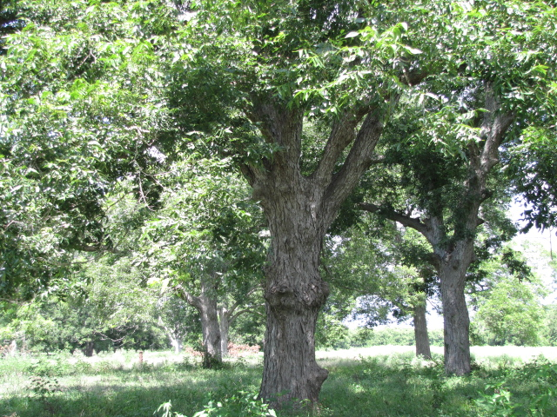
“High Scab Pressure Site”
Crowded trees
River or Creek bottom
Heavily wooded or brushy around orchard—reduced air movement

Slide 13
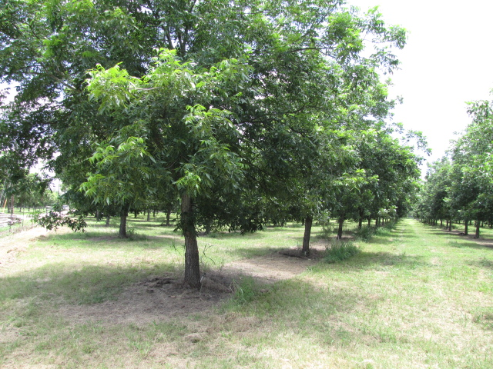
Key #6: The orchard floor is important
Without healthy sod middles, pulling a sprayer through the orchard may be difficult in rainy periods
Aerial application is not very effective.

Slide 14
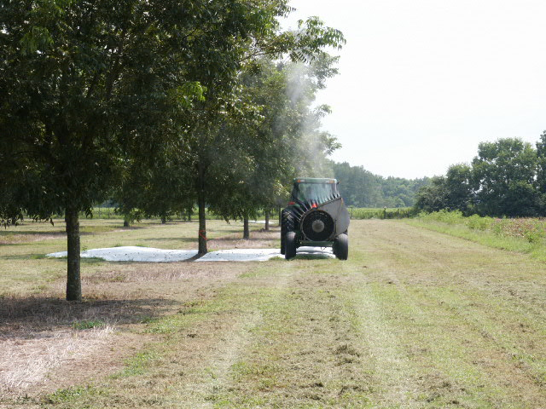
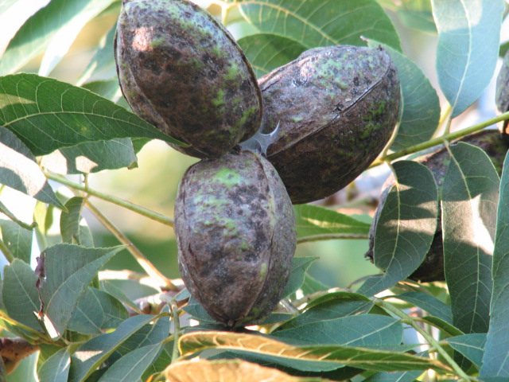
Key #7: The MOA of pecan fungicides necessitates good coverage.
Calibrate Sprayers and Upgrade Sprayers when trees outgrow existing equipment
See Pecan South, March 2021

Slide 15
Evaluate Coverage
Water sensitive cards

Slide 16
Key #8: Fungicide Familiarity
FRAC GROUP | Group | Best Use | Resistance Risk
3 | Sterol Inhibitors or DMI’s- Orbit, Enable, TebuStar, Topguard | Budbreak/Pre-Pollination | Very High
11 | Strobilurins- Abound, Headline, Gem, Pristine | Budbreak/Pre-Pollination | Very High
1 | Benzimidazoles- Topsin-M | For Downy Spot Only | Extremely High
30 | Triphenyl Tin SuperTin | Post-Pollination | Low-Moderate
12 | Dodine E-Last 400 | Post Pollination | Low-Moderate
33 | Phosphites Prophyte, Rampart | Pre-Pollination | Moderate
7 | Succinate dehydrogenase inhibitors: Miravis | Tank Mix | ?

Slide 17
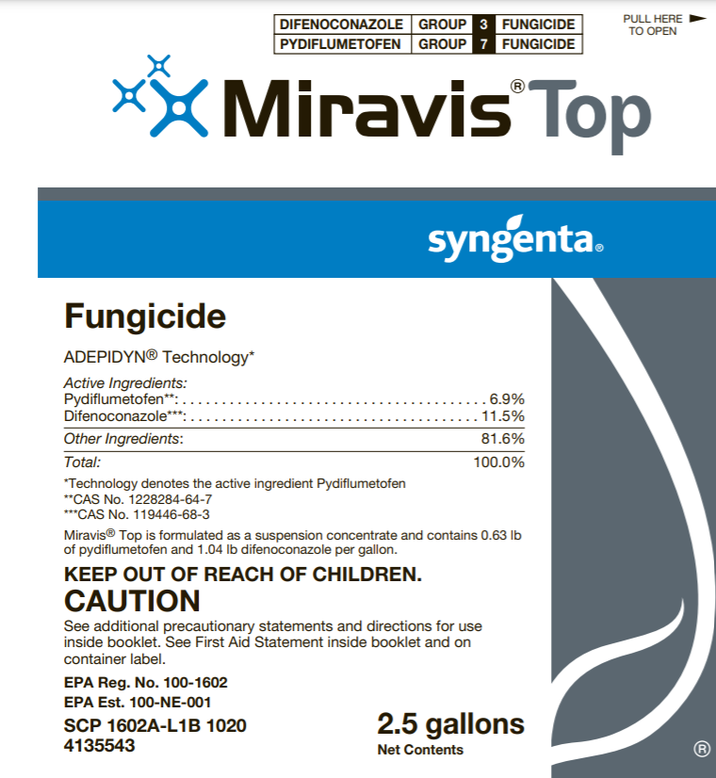
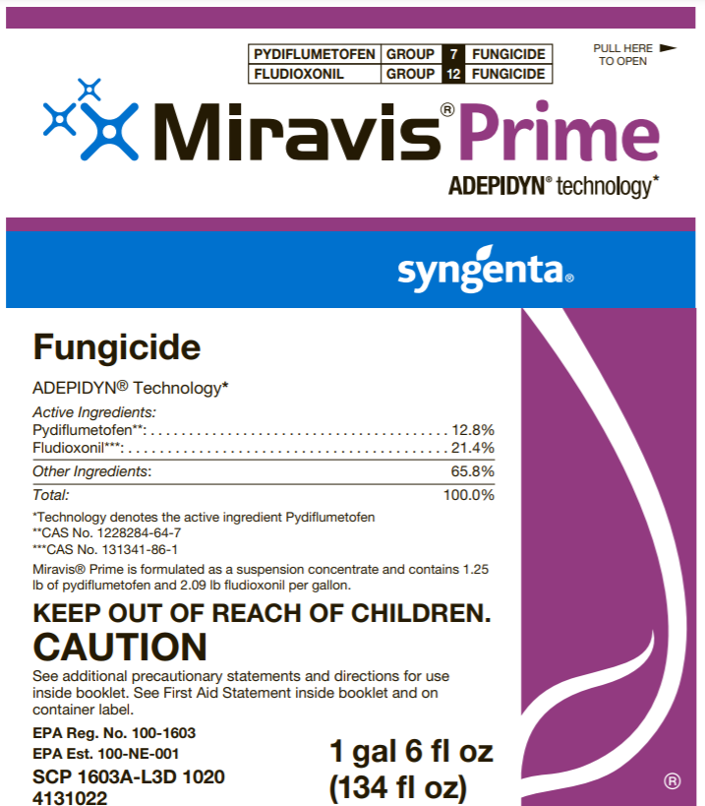

Slide 18
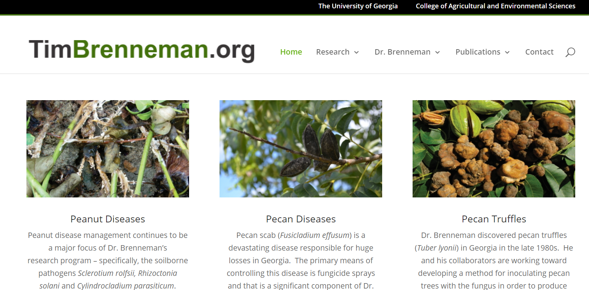
In two 2020 trials on Desirable, the superior treatment was Super Tin + Elast 400 (6 oz + 25 oz) full season (10 sprays).

Slide 19
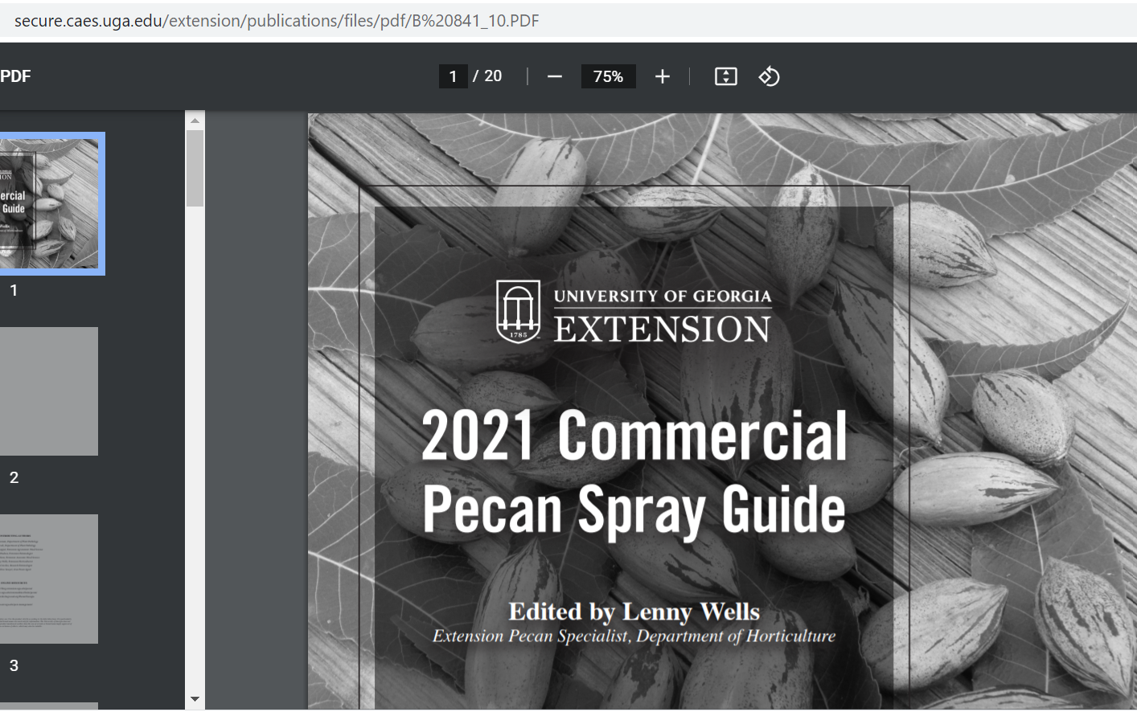

Slide 20
Univ. Georgia Spray Program—L. Wells (2018)
Moderately susceptible cultivars or those under less scab pressure
Absolute
Phosphite–2 qt/acre rate*
Absolute
Elast/Tin
Absolute
Elast/Tin
Elast/Tin
Elast/Tin
*Check mixing compatibility of your phosphite and foliar zinc (or other foliar nutrient) choices prior to application. Some phosphite and zinc products do not mix well.
Absolute is Group 3 & Group 11
https://agfax.com/2018/04/06/georgia-pecans-fungicide-schedule-spray-when-you-need-but-not-more-than-neccessary/

Slide 21
Triphenyl Tin Hydroxide
“Organo-Tins”—Super Tin, AgriTin
Low resistance risk, although lab studies show the possibility.
Weaker on foliage diseases.
Not systemic, protectant only.
Spray as new shuck growth occurs.

Slide 22
Dodine
FRAC Group 12
Old product, which caused bronzing on certain varieties—Barton, Schley, Moore
Protectant properties
Good control of nut scab when tank-mixed or rotated with TPTH
Limits on applications per year should be observed.

Slide 23
Texas Example Spray Guide
Spray | Timing | Problems | Materials
1 | Budbreak Early April | Scab, Downy Spot | Fungicide & Zinc + Nitrogen
2 | 14 days later April | Scab, Downy Spot, Leaf Dieback | Fungicide & Zinc + Nitrogen
3 | 14+ days later May | Scab, Downy Spot, Leaf Dieback Pecan Nut Casebearer | Fungicide & Zinc + Nitrogen + PNC Insecticide
4 | 14-21 days later Late May, Early June | Scab, Leaf Dieback | Fungicide & Zinc + Nitrogen
5 | 14-21 days later Late June, Early July | Scab | Fungicide & Zinc + Nitrogen
6 | 21+ days later Late July, Early August | Scab | Fungicide

Slide 24
Key #9: RESISTANCE MANAGEMENT
Pecan Scab reproduces itself with great frequency during each growing cycle.
Chemicals with narrow mode of action that are repeatedly exposed to the organism ultimately can become non-effective.
Follow EPA Guidelines and restrictions on annual product use per acre---All Orchards!
Rotate Fungicides
Spray with tank mixes with multiple modes of action
Use Products with Reduced risk of resistance.

Slide 25
Active Ingredient | FRAC GROUP | Tradename(s)* | Max product per acre per application and total product per acre allowed per year**
Azoxystrobin | 11 | Abound (Syngenta) | 12 oz/A; 73.8 oz/A/yr
Azoxystrobin + Difenconazole | 11,3 | Quadris Top (Syngenta) | 14 oz/A; 56 oz/A/yr
Azoxystrobin + Propiconazole | 11,3 | Quilt (Syngenta), Quilt Xcel (Syngenta) | 27.5 oz/A; 122 oz/A/yr 21 oz/A; 115 oz/A/yr
Dodine | 12 | ELast 400 (Aceto) | 3 pt/A; 18 pt/A/yr
Fenbuconazole | 3 | Enable 2F (Dow) | 8 oz/A; 48 oz/A/yr
Kresoxim-methyl | 11 | Sovran (BASF) | 4.8 oz/A; 14.4 oz/A/yr
Metconazole | 3 | Quash (Valent) | 3.5 oz/A; 14 oz/A/yr
Phosphorus acid | 33 | Phostrol | 5 oz/A; n/a
Propiconazole | 3 | Orbit (Syngenta), Bumper (MANA), Tilt (Syngenta), Propimax (Dow), others | 8 oz/A; 32 oz/A/yr
Propiconazole + Trifloxystrobin | 11,3 | Stratego (Bayer) | 10 oz/A; 30 oz/A/yr
Pyraclostrobin | 11 | Headline (BASF) | 7 oz/A; 28 oz/A/yr
Pyraclostrobin + Boscalid | 11,7 | Pristine (BASF) | 14.5 oz/A; 58 oz/A/yr
Tebuconazole | 3 | Tebuzol (UPI), Folicur (Bayer), Toledo (Rotam), Monsoon (Loveland), Orius 3.6 F (MANA) | 8 oz/A; 32 oz/A/yr
Tebuconazole + Azoxystrobin | 11,3 | Custodia (MANA) | 17.2 oz/A; 69 oz/A/yr
Tebuconazole + phosphorous acid | 3, 33 | Viathon (Helena) | 2.5 pts/A; 16.5 pts/A/yr
Tebuconazole + trifloxystrobin | 11,3 | Adament (Bayer), Absolute (Bayer) | 8 oz/A; 32 oz/A/yr 7.7 oz/A; 46 oz/A/yr
Thiophanate-methyl | 1 | Topsin M WSB (UPI), others | 1 lb/A; 3 lbs/A/yr
Triphenyl tin hydroxide | 30 | Agri Tin (Nu Farm) Super Tin 80 WP (UPI) Super Tin 4L (UPI) | 7.5 oz/A; 45 oz/A/yr 12 oz/A; 72 oz/A/yr

Slide 26
Co-Mixed Products
Absolute/Absolute Maxx (Bayer)
Tebuconazole (Group 3)
Trifloxystrobin (Group 11)—Gem, Flint
22.6% Each

Slide 27
Key #10-Scab control stops at shell hardening
Infections after Shell Hardening are not Economically Important

Slide 28
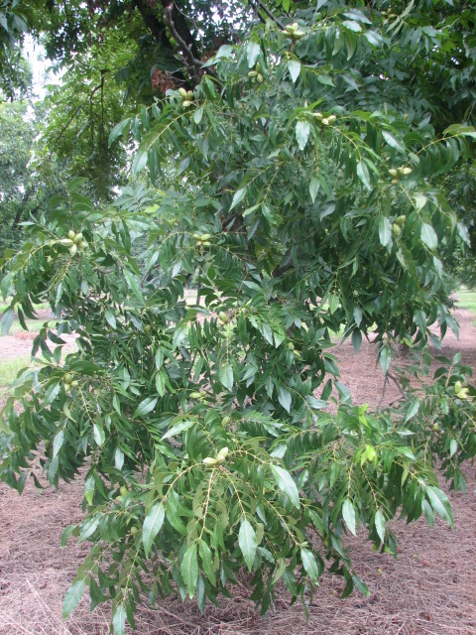
NEED MORE HELP?
Texas Plant Disease Diagnostic Lab
(College Station)
http://plantclinic.tamu.edu
979-845-8032
MLNesbitt@tamu.edu
(979) 862-1218

