Slide 1
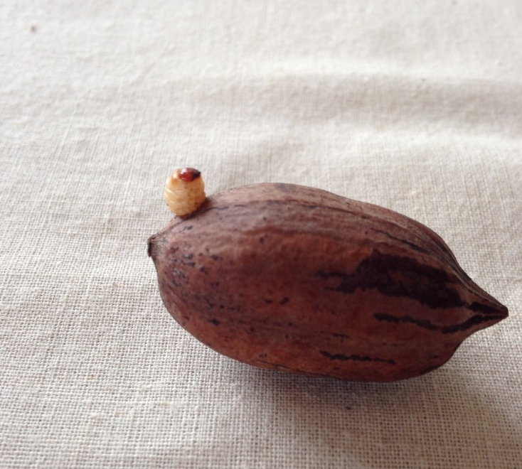
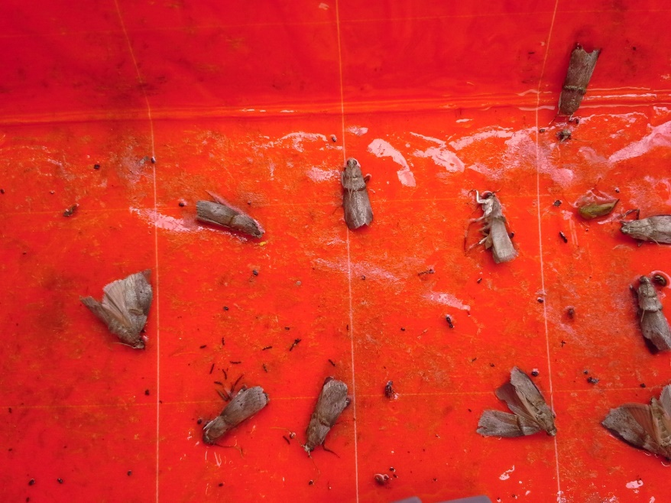
Management of Crop-Destroying Pecan Insects
Monte Nesbitt,
Texas A&M AgriLife Extension
Photos in this presentation are credited to Bill Ree, Extension IPM Specialist-Retired

Slide 2
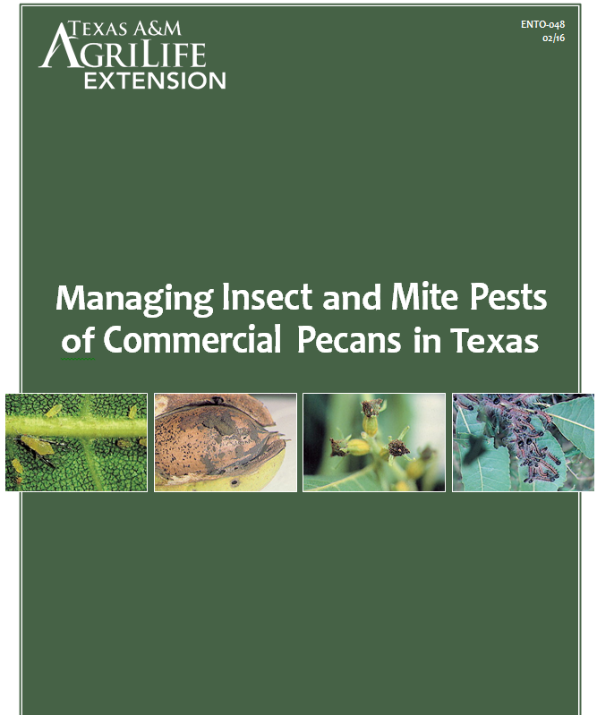
https://www.agrilifebookstore.org/

Slide 3
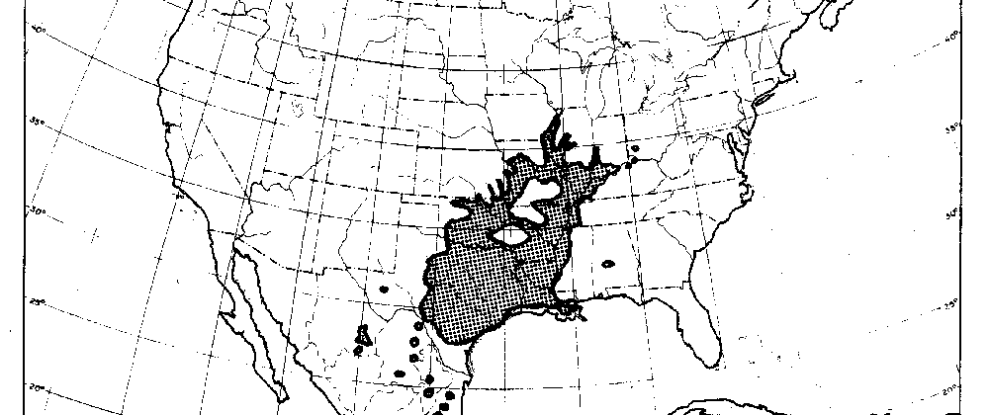
Is it possible a pecan orchard in the Us would not have insect problems?
Even with the best Sustainable, Regenerative, or ORganic orchard development, probably Not………………….

Slide 4
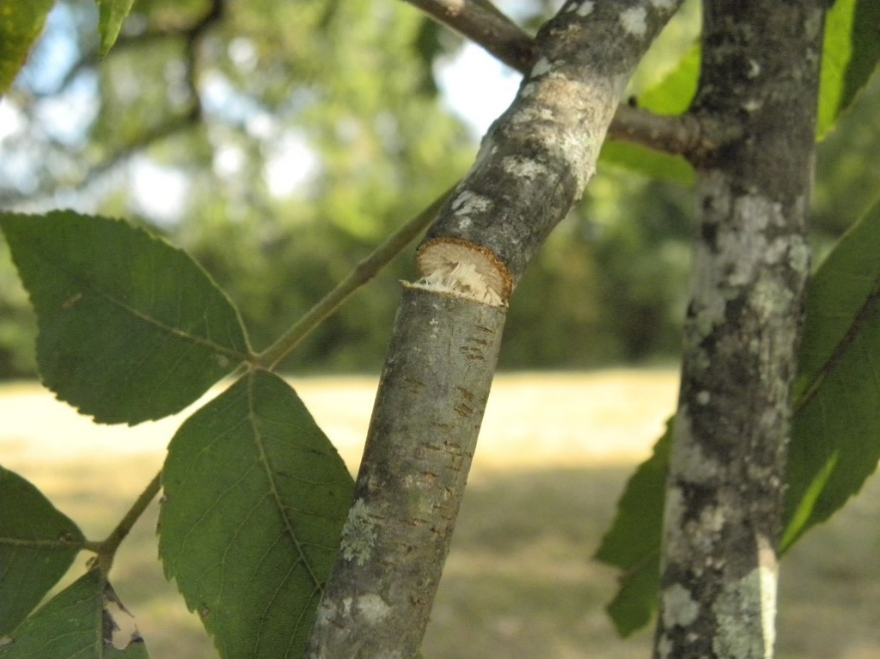
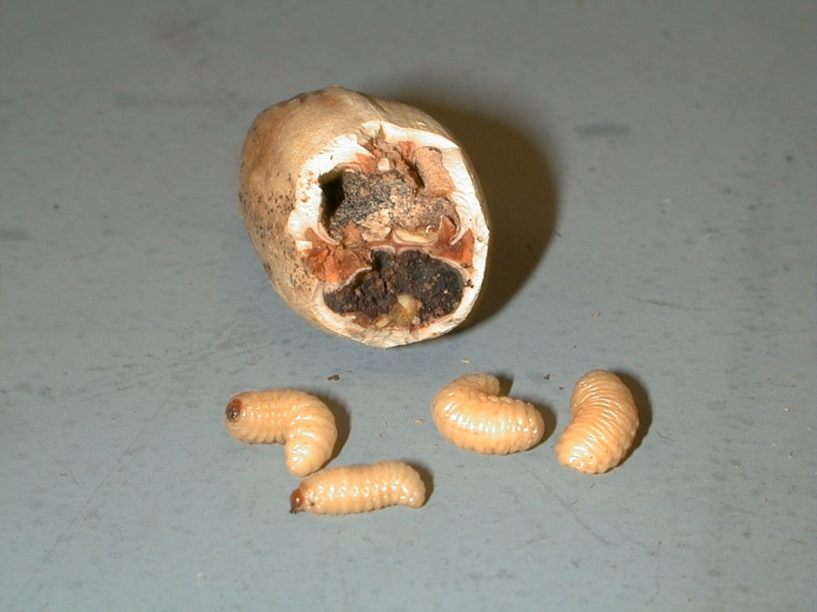
HOW MANY INSECTS FEED ON PECAN ?
67 Twig, Branch & Roots
103 Foliage Feeders
Direct Pests/Crop Damaging
18 Nut Feeding
Slide Credit: Bill Ree

Slide 5
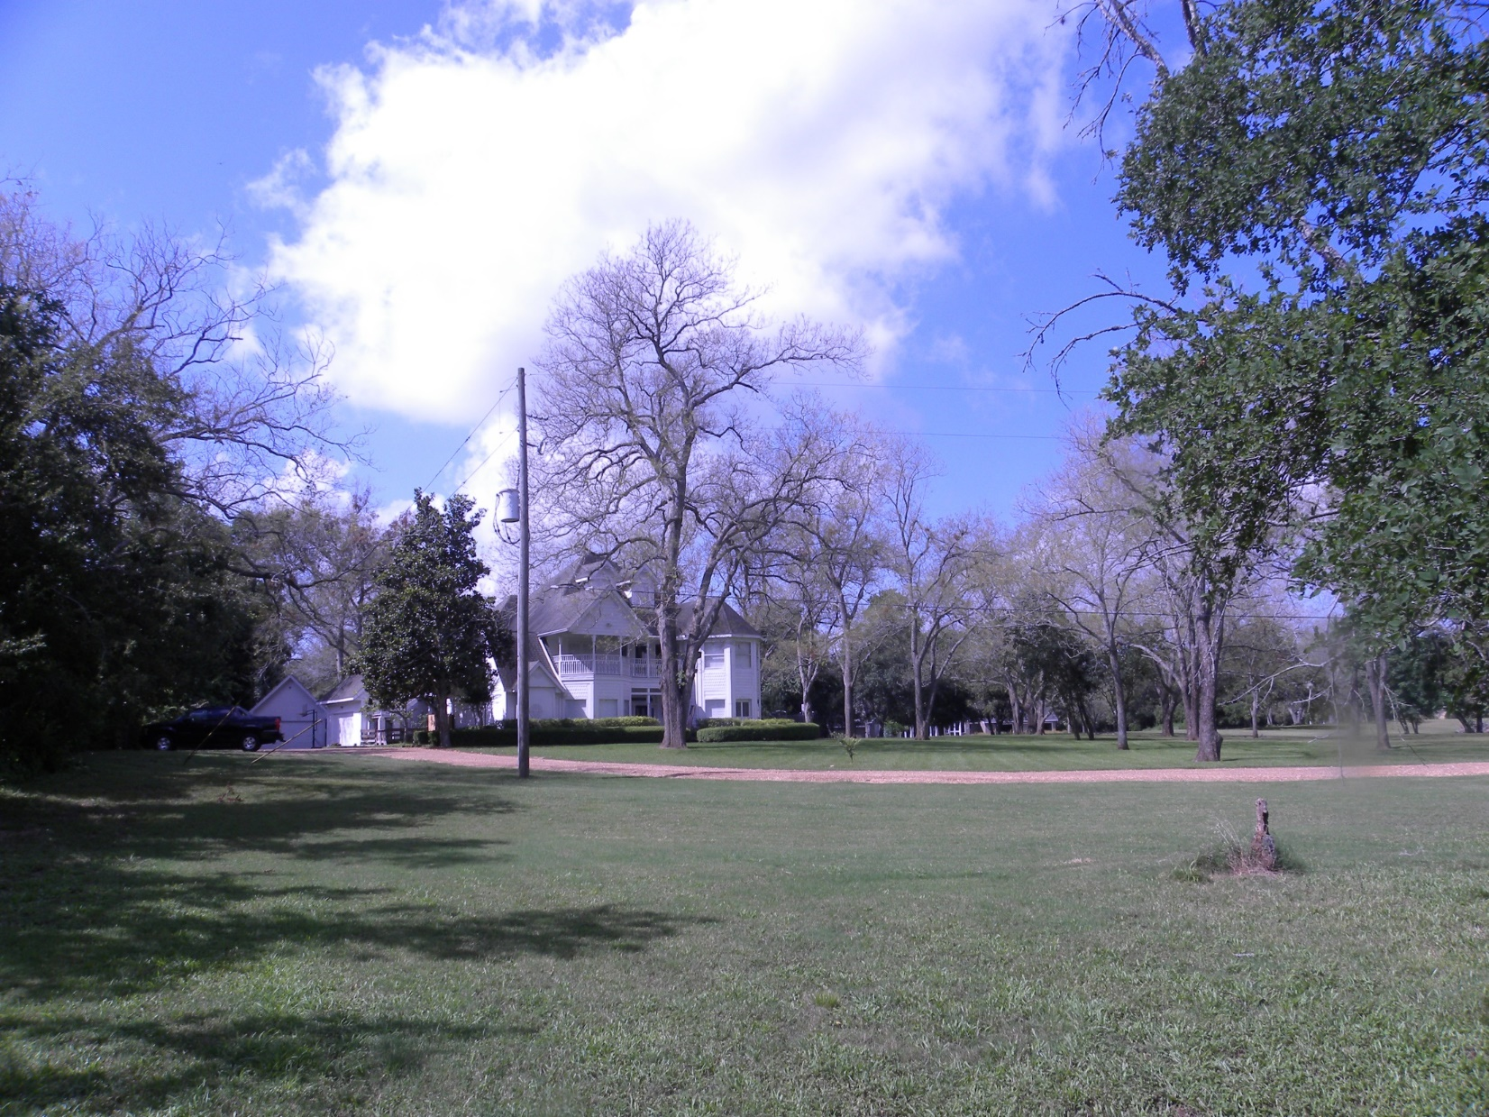
“Minor” foliage feeders can become crop damaging when they impair ability to complete a crop.
Defoliation from walnut caterpillar
June 17, 2014, Fort Bend County, TX
Control with Bio-Rational Insecticides that target Lepidopeterans

Slide 6
Key Pecan Crop-Damaging Insects
NUTS | Damage | Timing
Pecan Nut Casebearer | Nut abortion/cluster reduction | May & June
Pecan Weevil | Nut drop; grubs in harvested nuts | August-October
Hickory Shuckworm | Shuck impairment & track marks on shells | August-October
Stinkbugs | Bitter black spots on kernels | June-October

Slide 7
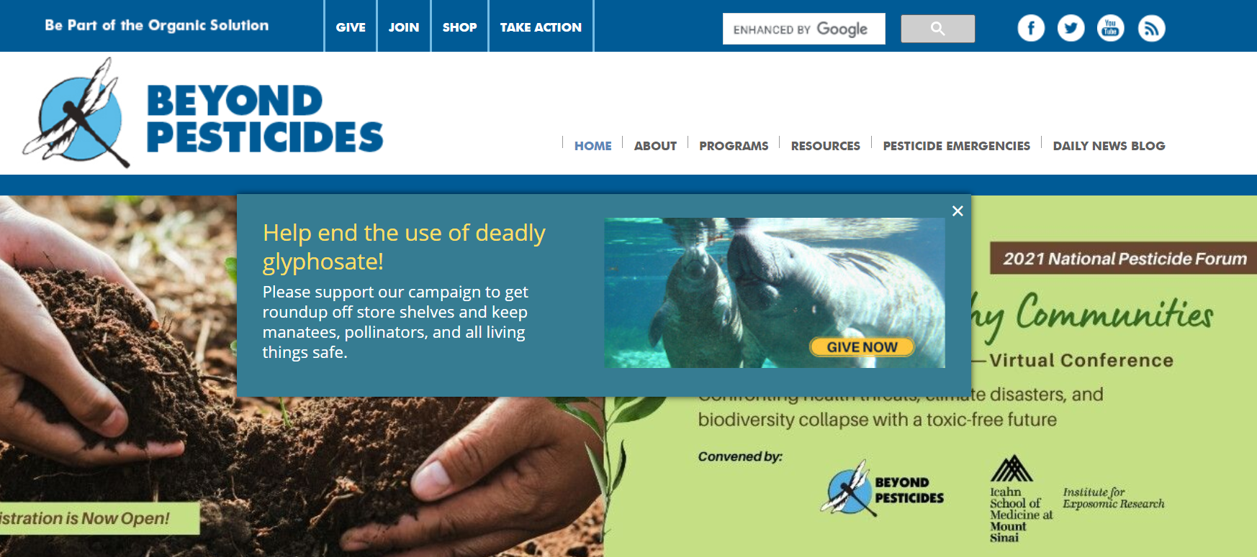
Agriculture is Increasingly Being scrutinized for its Environmental Impacts

Slide 8
IPM is the Pillar of “Conventional” Agriculture
United Nations Food and Agriculture Organization defines IPM as:
“The careful consideration of all available pest control techniques and subsequent integration of appropriate measures that discourage the development of pest populations and keep pesticides and other interventions to levels that are economically justified and reduce or minimize risks to human health and the environment.”
“IPM emphasizes the growth of a healthy crop with the least possible disruption to agro-ecosystems and encourages natural pest control mechanisms."
“IPM” tends to mean insect control, but control of diseases and orchard floor vegetation cannot be compartmentalized away from this discussion.

Slide 9
What are “All Available Pest Control techniques”?

Slide 10
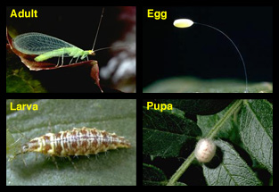
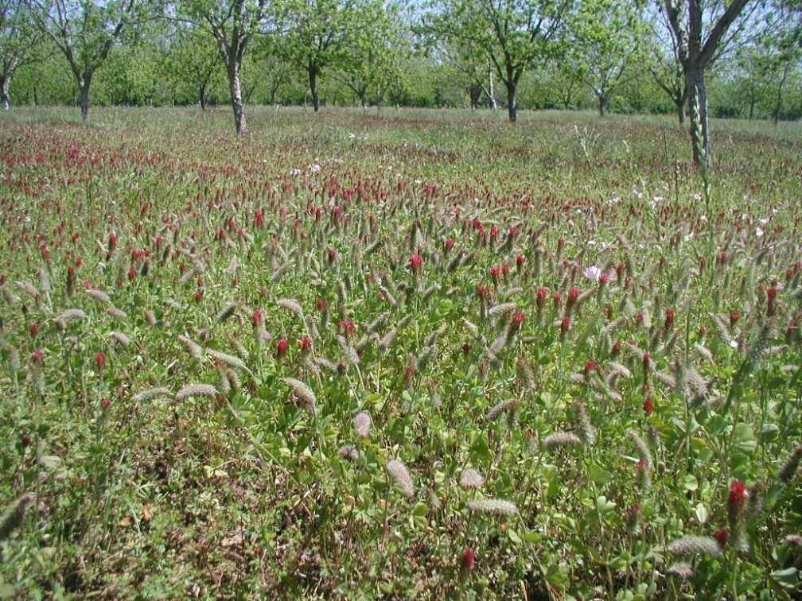
Pest Management OptionS
Population Monitoring & Threshold Assessment
Sanitation—clean fence rows…
Mechanical Means
Traps, Barriers
Habitat Manipulation
Elimination or Creation
Beneficial Insects
Fostering, Releasing
Broad Spectrum Insecticides
Conventional and Organic
Target/Species Specific Insecticides (Bio-rational insecticides)
Conventional and Organic

Slide 11
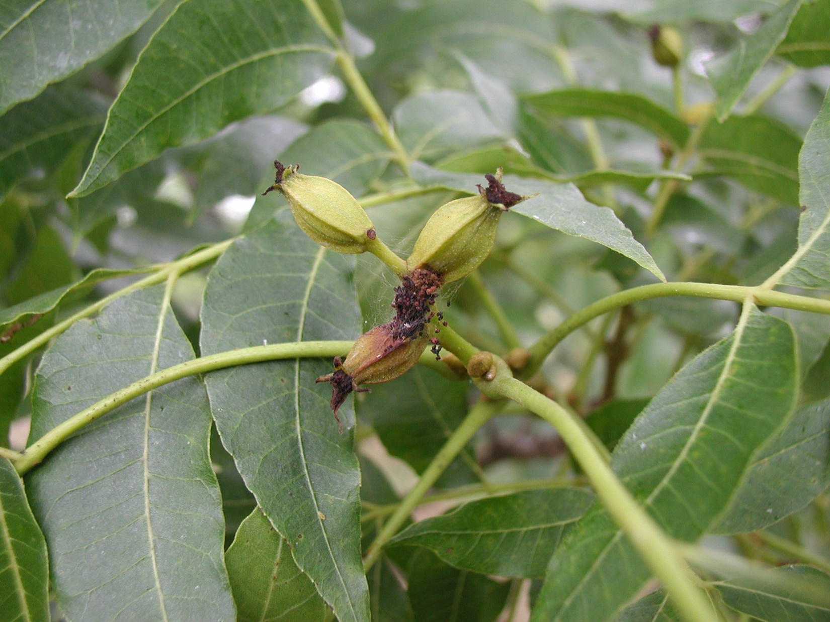
Pecan Nut Casebearer: A threat to destroy entire pecan crops in May

Slide 12
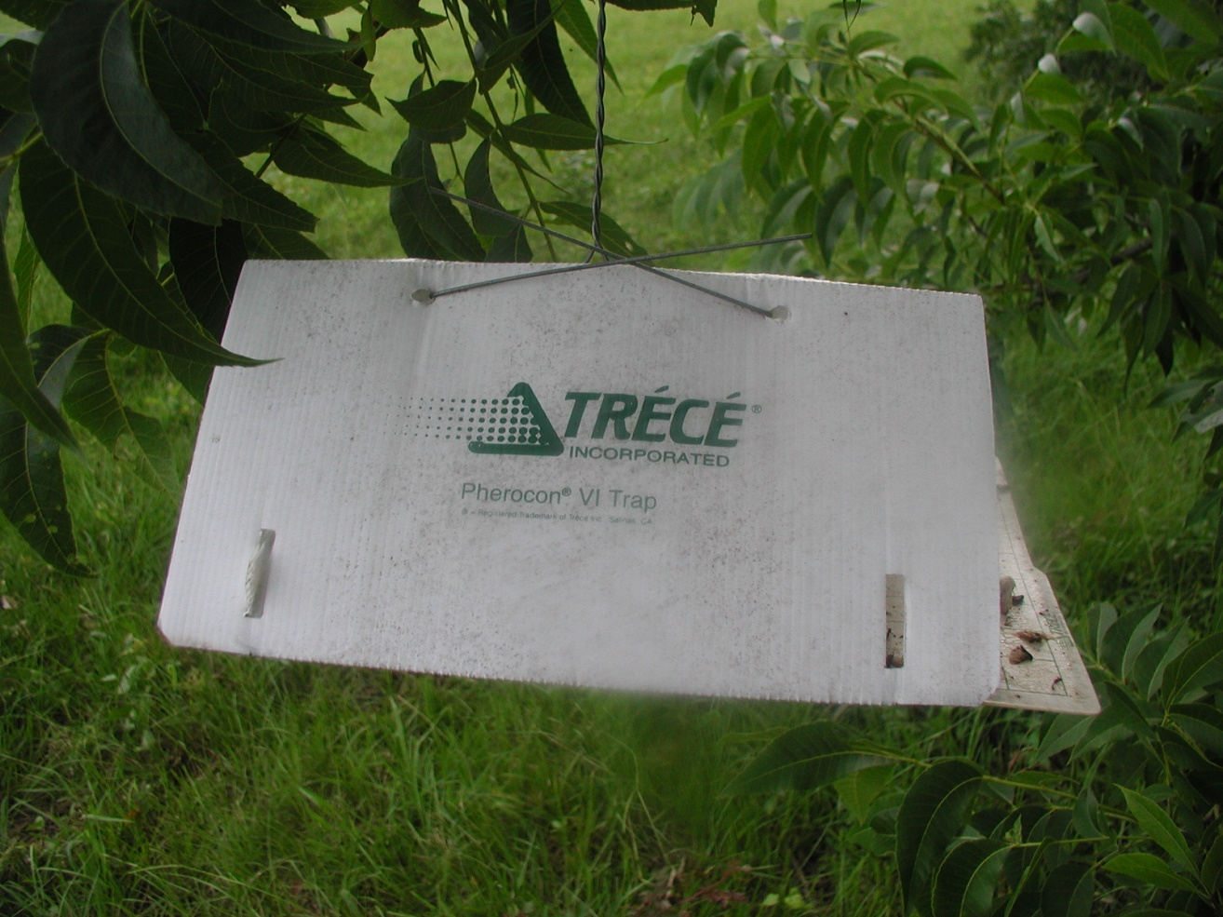
Scouting and timing of damage is refined by use of pheromone traps.

Slide 13
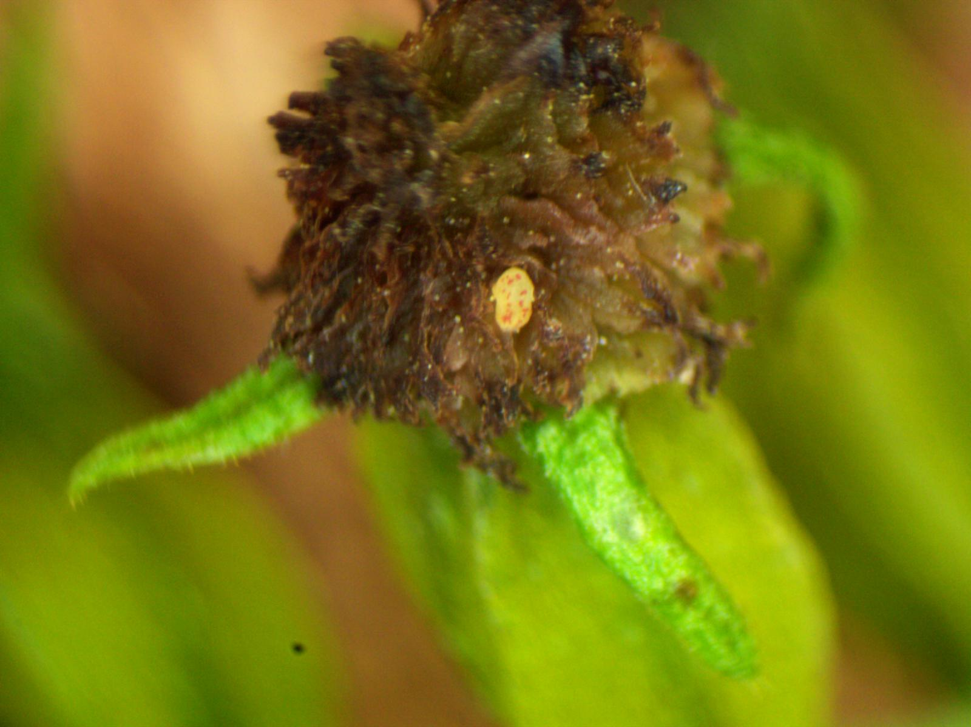
PNC Egg Deposition—Indicates nut entry damage within three days.
Control with Bio-rational or Conventional insecticides when significant egg lay detected

Slide 14
If crop load is heavy, PNC may act as natural crop thinning. For light to moderate croploads, PNC can take the whole crop.

Slide 15
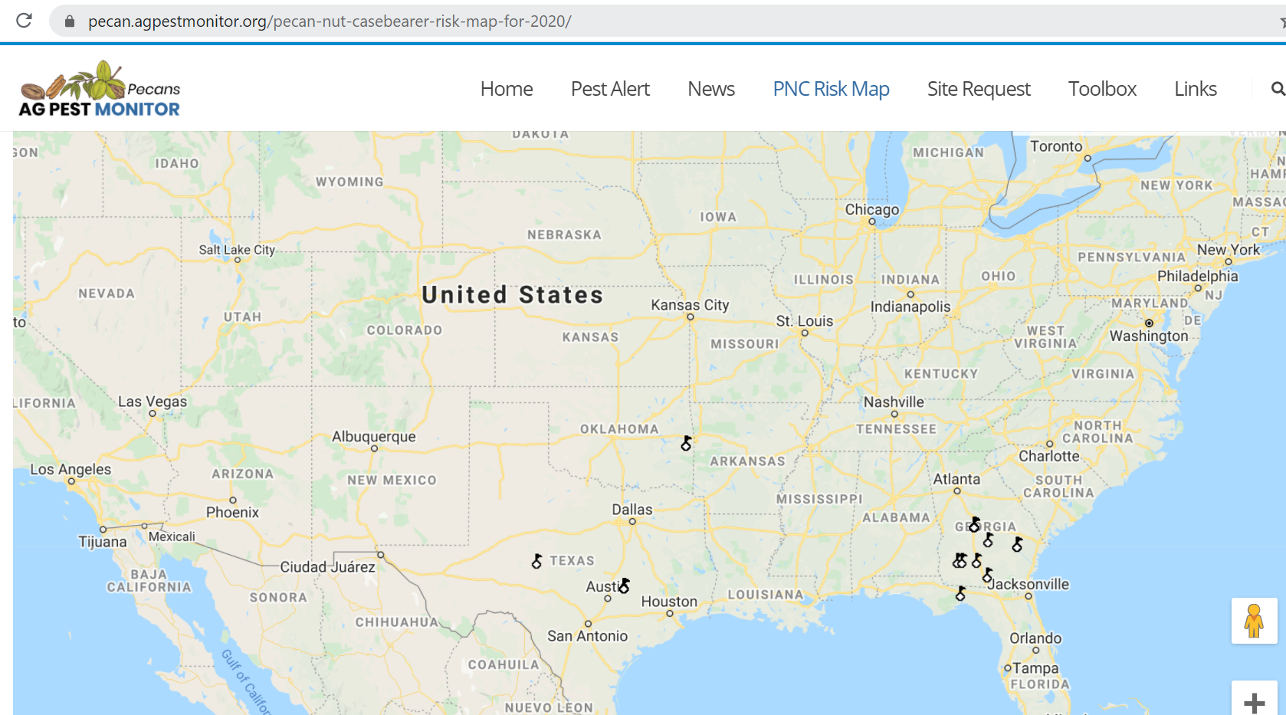
Websites like agpestmonitor.org provide computer-generated forecast based on growers’ local trap capture data.

Slide 16
TWO INFESTED CLUSTERS OUT OF 310 CLUSTERS (0.6%)
OR
Found at expected 10% egg lay time or later is an action threshold on crops that are not evaluated to be overloaded.

Slide 17
Conventional/IPM Control | Organic Control
Biorational Insecticides Intrepid Spinosad generics Bt—Javelin, Dipel | Organic-approved insecticides Spinosad generics Bt—Javelin, Dipel
Broad Spectrum Insecticides Lorsban | None

Slide 18
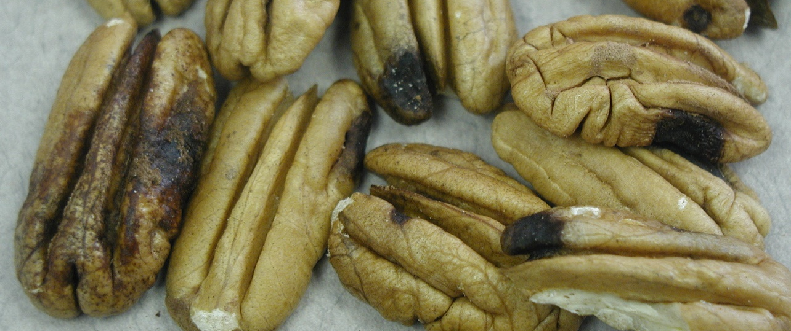
STINK BUG/LEAFFOOTED BUG DAMAGE……In addition to nut drop prior to Shell hArdening

Slide 19
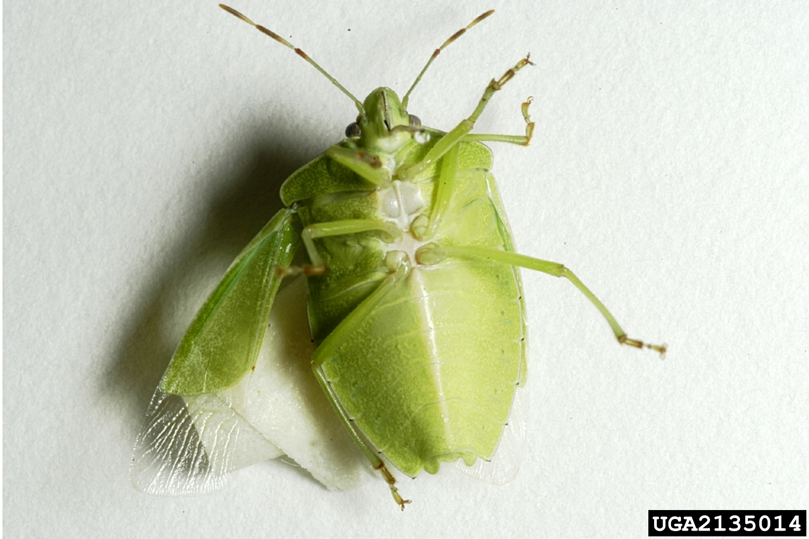
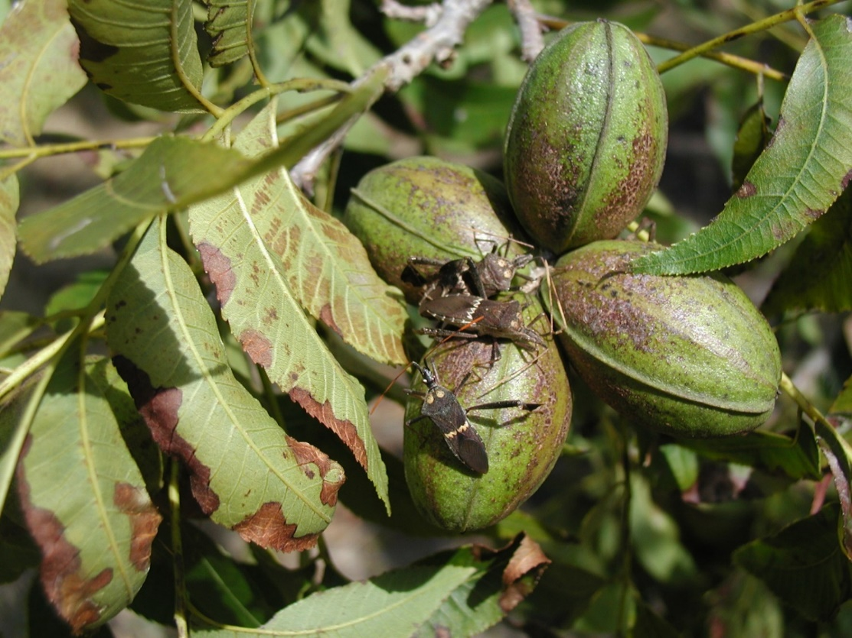
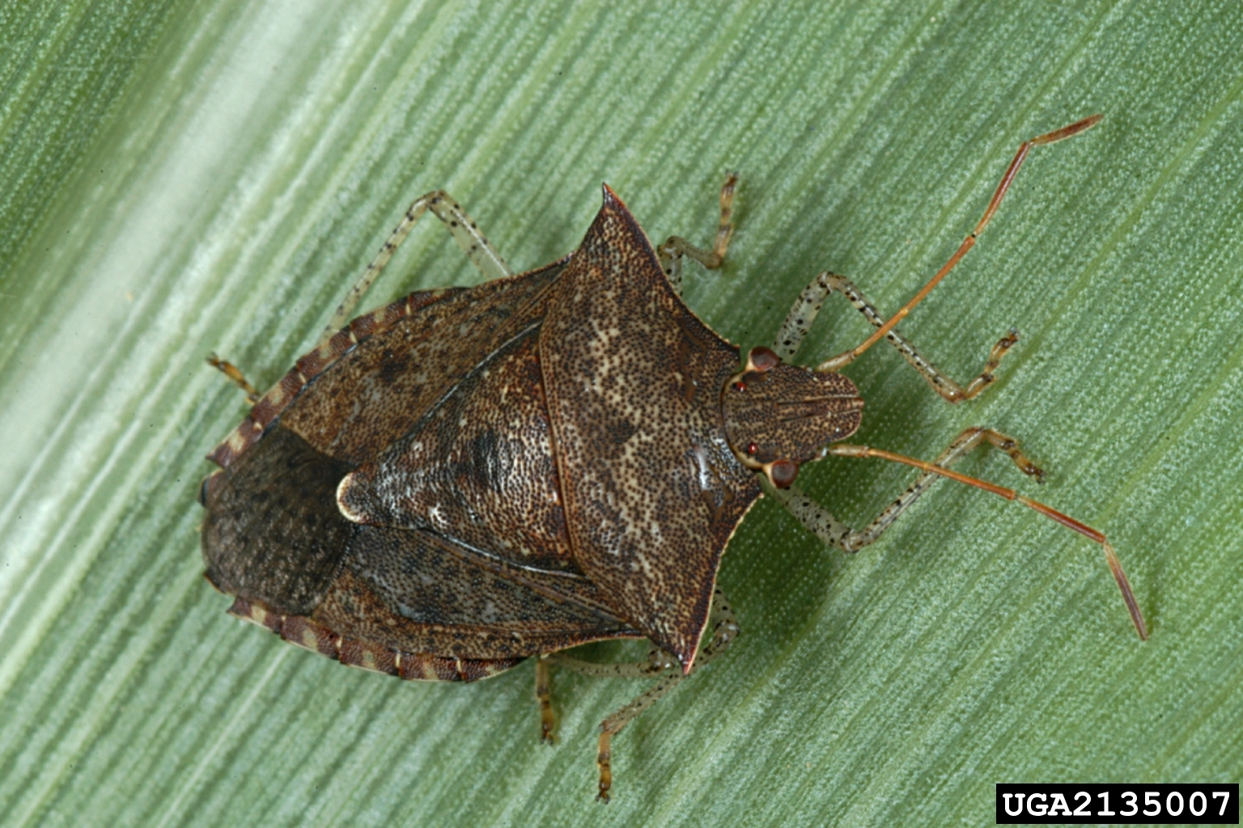
Southern Green
Dusky Brown
Western Leaffooted Bug

Slide 20
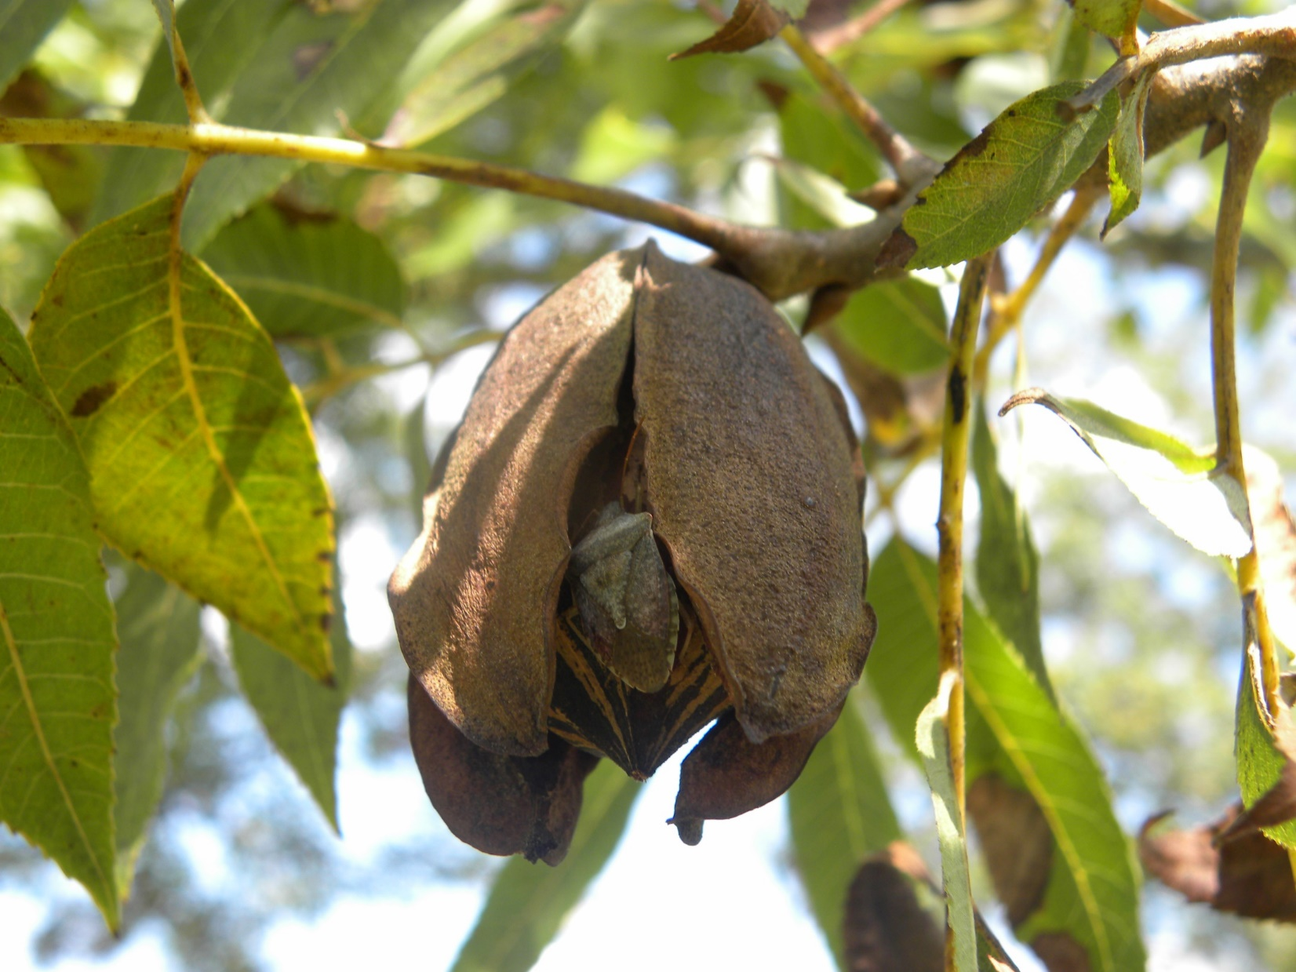
Most damage is after shell hardening, even up to shuck split and harvest.

Slide 21
Conventional/IPM Control | Organic Control
Broad Spectrum Insecticides Pyrethroids-Bifenthin, Lambda-Cyhalothrin, Zeta-cypermethrin, other | Pyrethrins
Trapping/Monitoring: | Trapping Monitoring
Sanitation: Weed Mgt, fence rows | Sanitation: Weed Mgt, fence rows

Slide 22
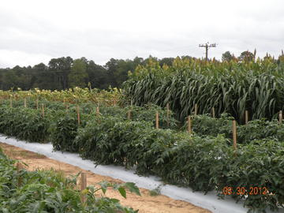
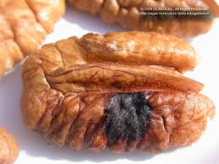
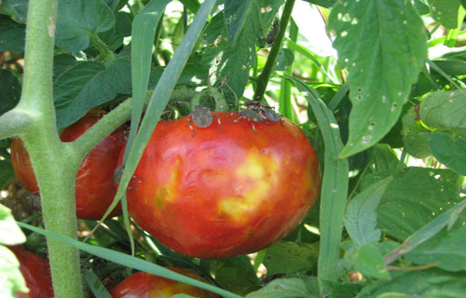
Trap Crops-companion plantings to attract stinkbugs and focus control in smaller areas.

Slide 23
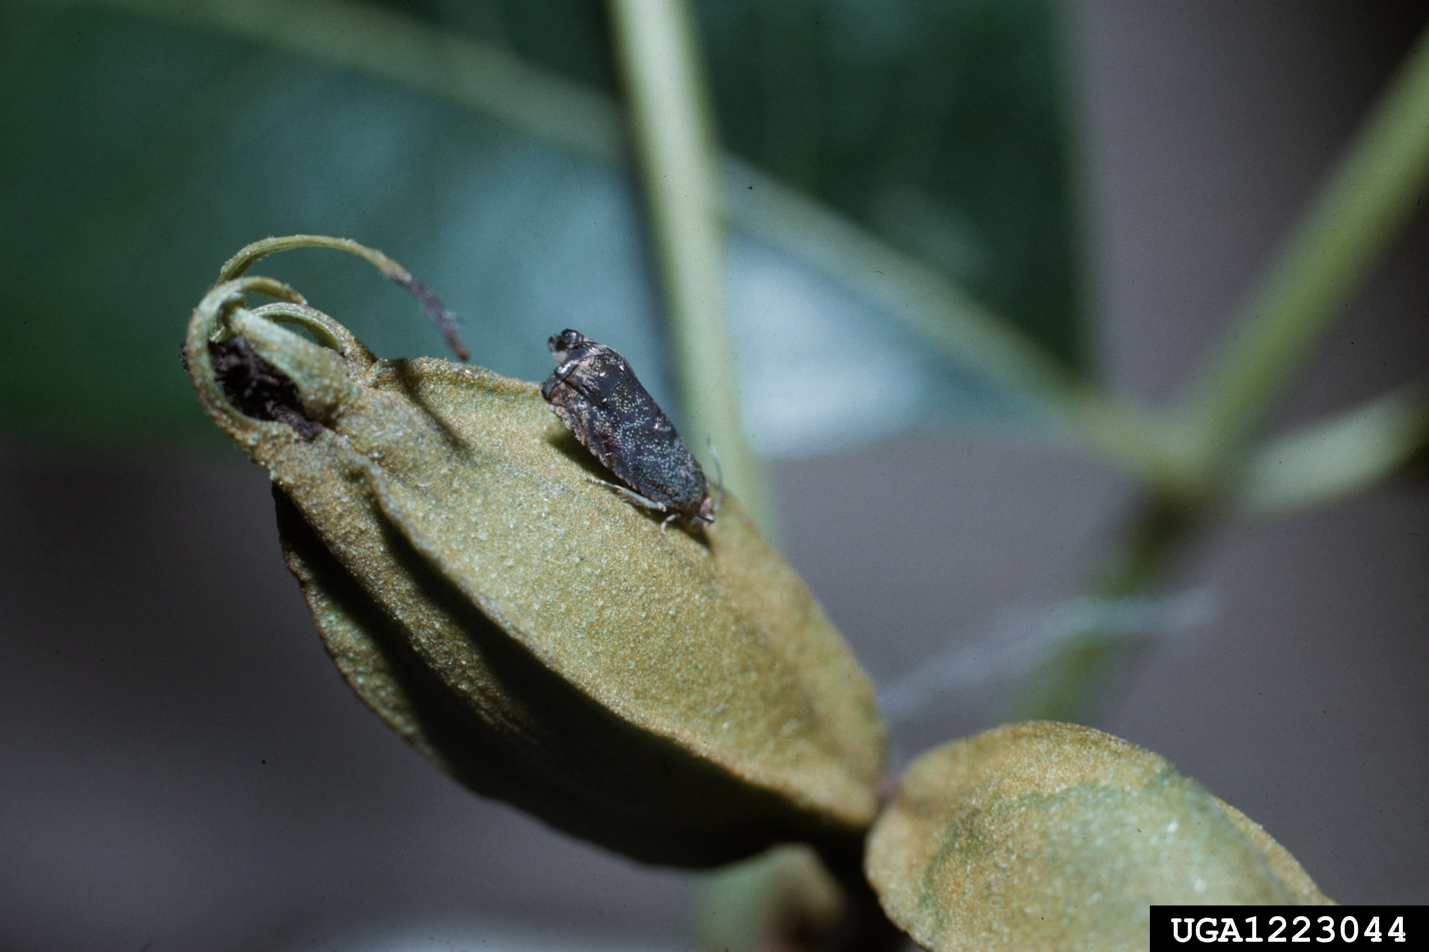
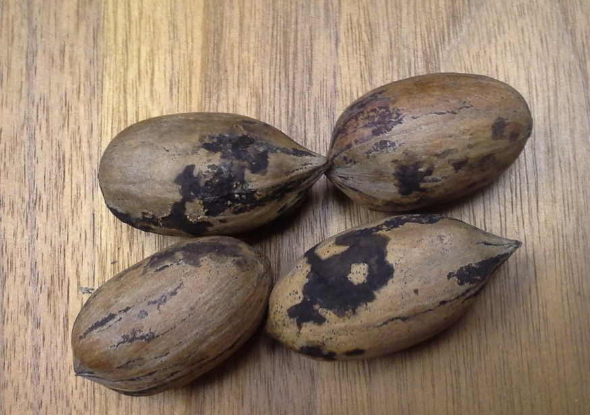
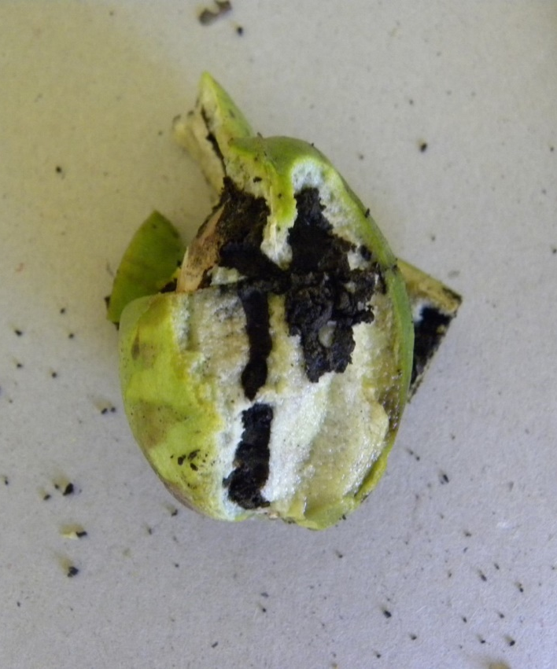
HICKORY SHUCKWORM
Small moth laying eggs on shucks from half shell-hardening to shuck split.
Larval feeding on shuck tissue impairs water movement and kernel development.
Control with insecticides at half-shell hardening stage.

Slide 24
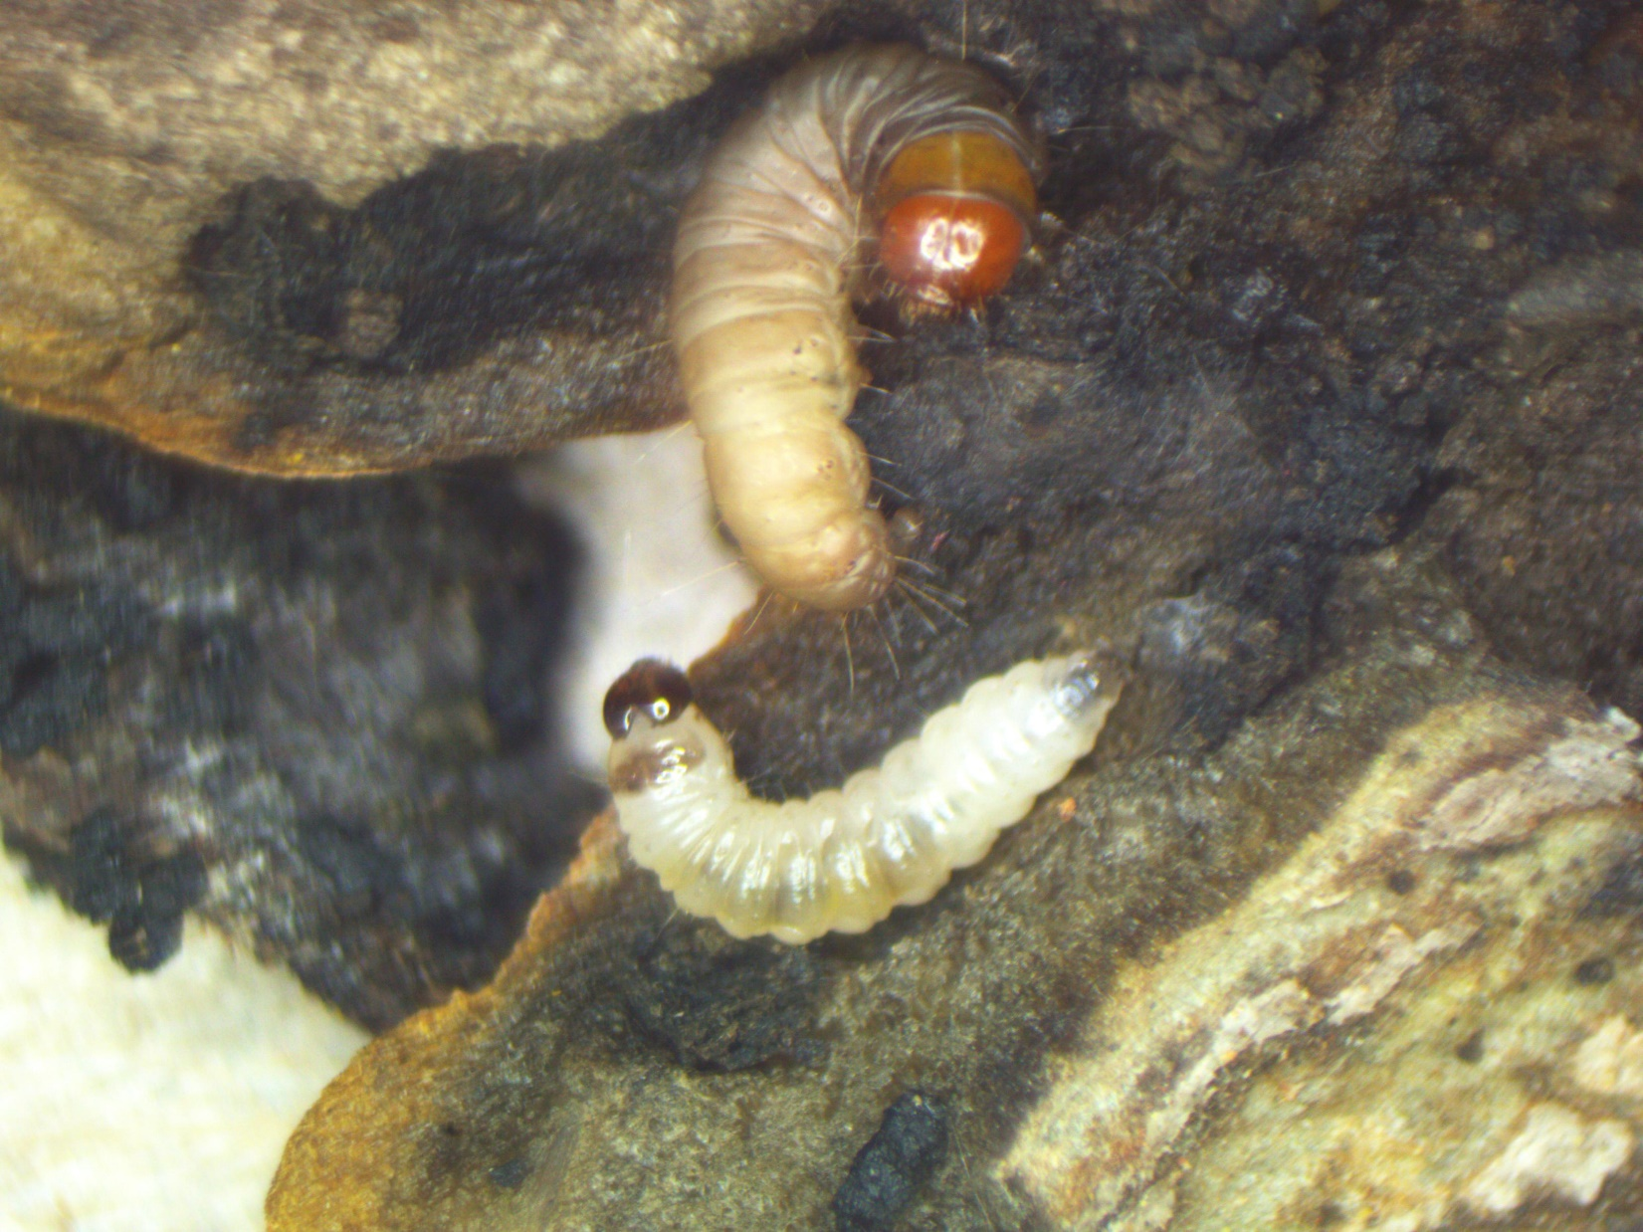
PNC
HSW

Slide 25
Conventional/IPM Control | Organic Control
Sanitation—Burn or bury or flail mow old shucks in the field or in cull piles. | Sanitation—Burn or bury or flail mow old shucks in the field or in cull piles.
Biorational Insecticides Intrepid Spinosad generics Bt—Javelin, Dipel | Organic-approved insecticides Spinosad generics Bt—Javelin, Dipel
Monitoring/Trapping: Blacklight or pheromone traps can refine when present in the orchard. | Monitoring/Trapping: Blacklight or pheromone traps can refine when present in the orchard.

Slide 26
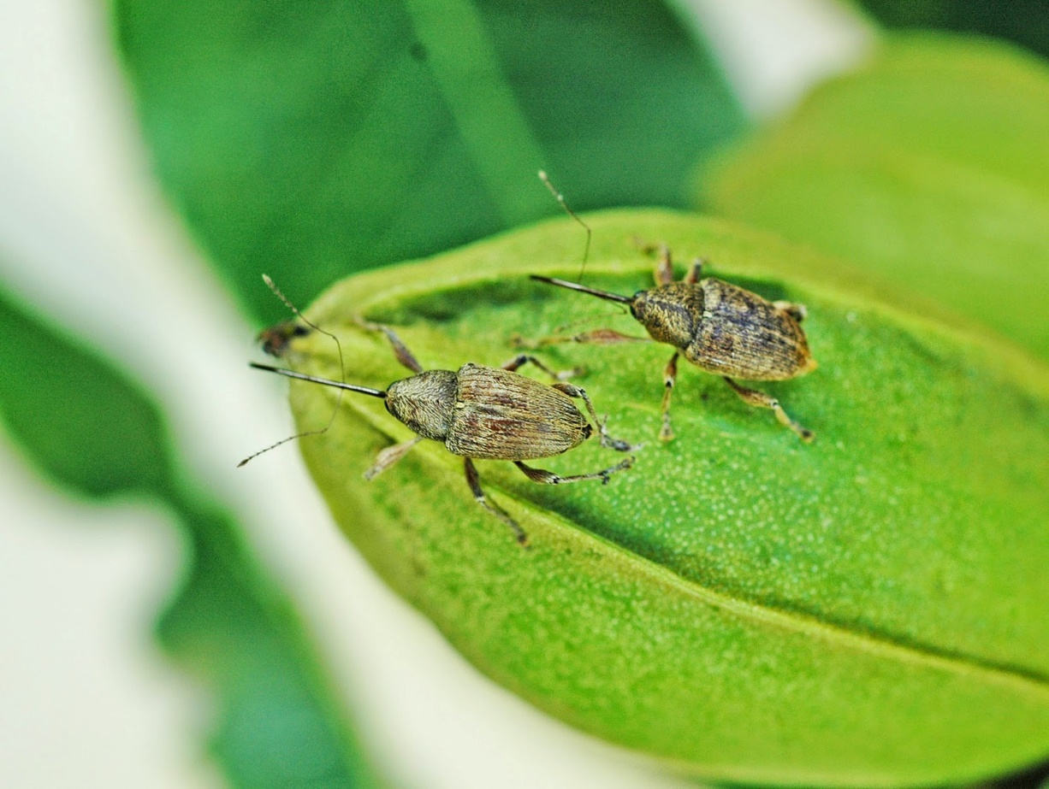
PECAN WEEVIL
Curculio caryae
Photo credit: Bill Reid, Kansas State University

Slide 27
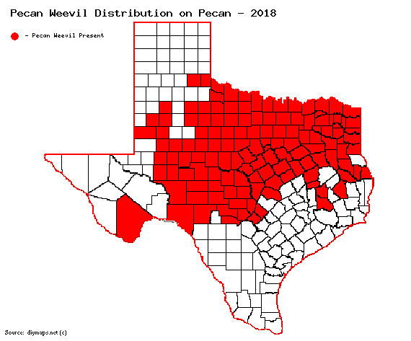
Quarantined area

Slide 28
Pecan Weevil
Grubs feed 30-40 days, emerge and move to soil.
2- 3 year life cycle in the soil
~90 percent on a 2 year cycle
~10 percent on a three year cycle
Notes:
Adults emerging in 2016 came from 2014 and some from 2013

Slide 29
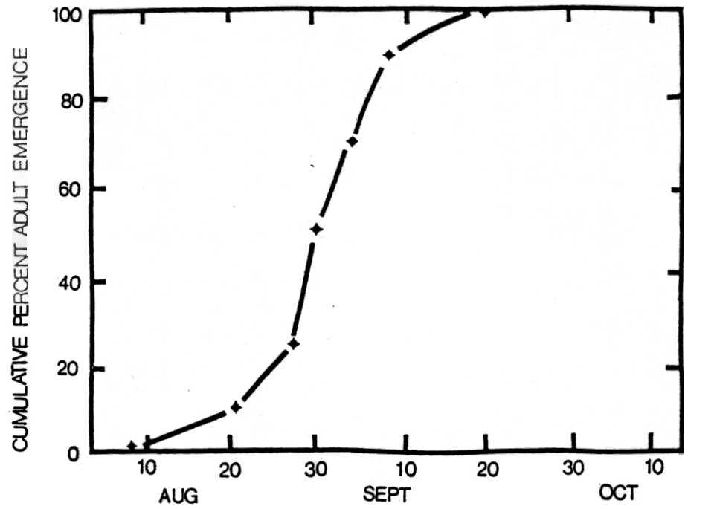
NORMAL ADULT EMERGENCE CURVE
80% EMERGENCE BETWEEN Aug 20 – Sept 10

Slide 30
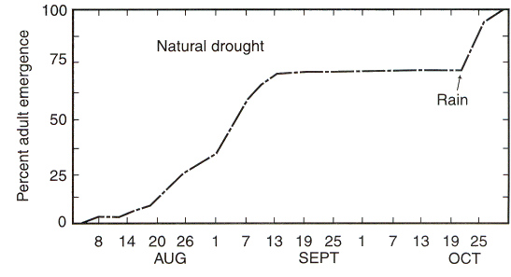
DROUGHT DELAYED ADULT EMERGENCE

Slide 31
How does PW get to the canopy?
77 percent climb to top of stick, grass, etc and fly to trunk at a height of about 6 – 8 feet
About 15 percent fly directly into canopy
About 5 percent walk over to tree trunk

Slide 32
PECAN WEEVIL INSECTICIDE APPLICATIONS
1st application around time of dough formation. Applied regardless of trap catches.
2nd application made 10 days after the first application “if” adults are collected in traps 5 days after the first treatment.
If no adults are being collected after the first treatment then delay the 2nd application until adults are collected.
Continue to monitor traps up to harvest.

Slide 33
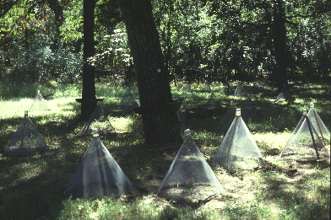
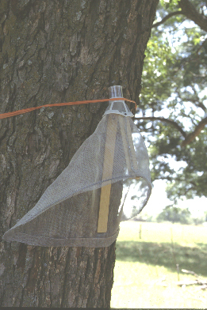
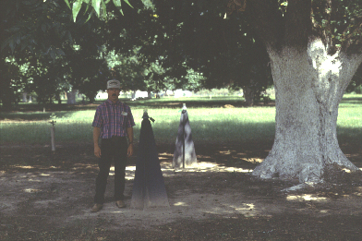
Adult Pecan Weevil Emergence Traps
Wire Cone Traps
Circle Trap
Tedders Trap

Slide 34
Other IPM Options
Do Nothing
Entomophagous fungi, Nematodes?? Not proven
Exclusion
Traps
Barriers

Slide 35
Summary Points
You should anticipate dealing with a combination of foliage and fruit insects attacking your pecan orchard soon after you plant and perpetually thereafter.
Pecan is an example of a “Conventionally-grown” agronomic industry that has a robust IPM program in place to control important foliage and fruit insects.

