Slide 1
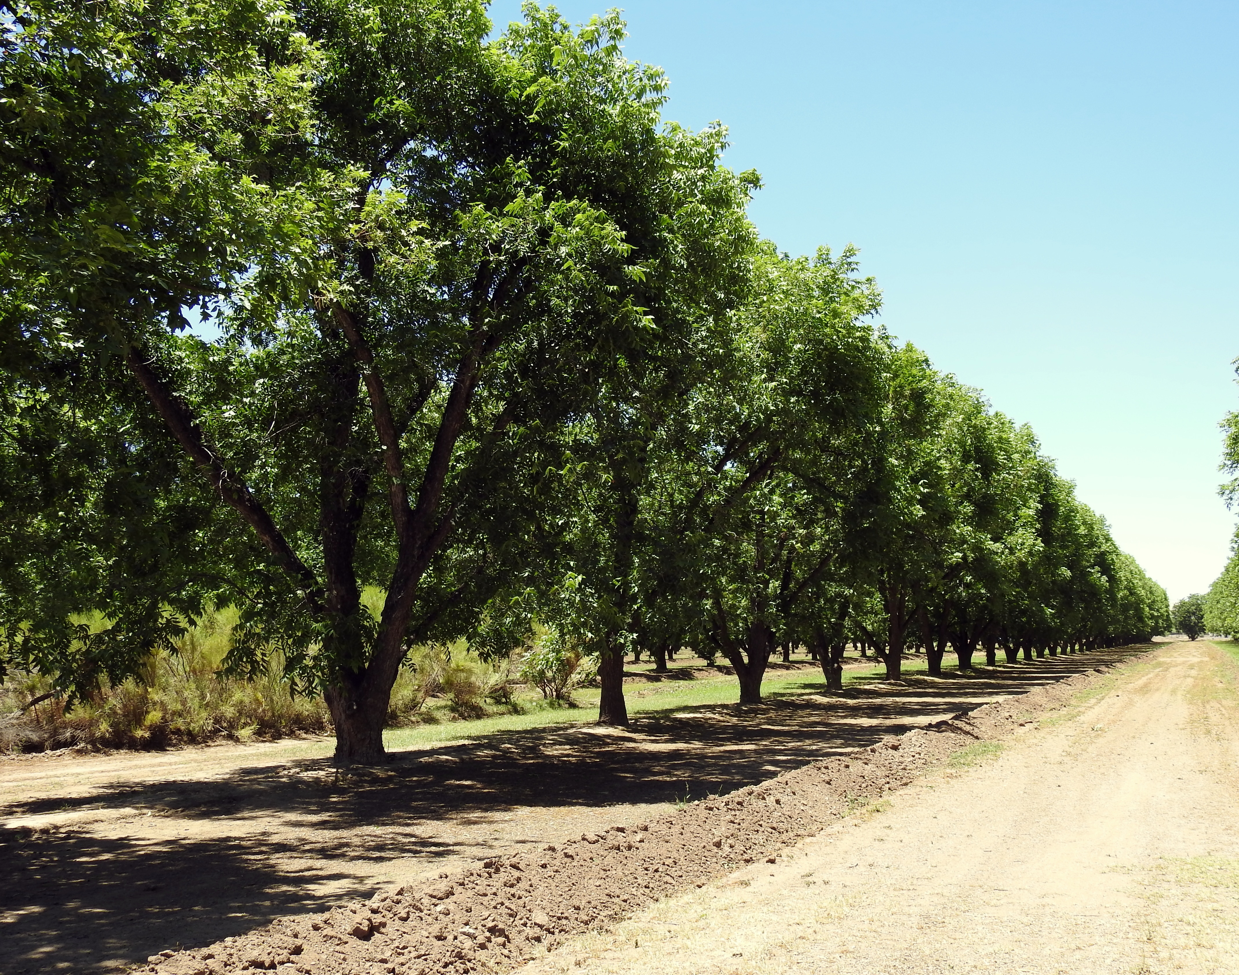
SOIL & LEAF SAMPLING
Colton Ploch

Slide 2
2021 Pecan Grower Survey at the San Saba Pecan Field Day
34 growers participated, representing 17 counties in Central Texas
Approximately 4,360 acres represented
38% of growers reported taking neither soil or leaf samples to direct their fertilizer practices (Approx 9% of total reported acreage)
56% of growers reported taking soil samples to direct their fertilizer practices.
Frequency of every year to every 10 years, some reported as “not regularly”
17% of growers (6 individuals) reported taking leaf samples to direct their fertilizer practices
Frequency of every year to twice per year
83.3% of growers taking leaf samples also take soil samples

Slide 3
Plant Essential Elements (Nutrients) in a Horticultural Production System
Major
Nitrogen, Phosphorus, Potassium, Magnesium, Calcium, Sulfur, Sodium
Minor
Zinc, Copper, Iron, Manganese, Boron, Nickel

Slide 4
Goals of a Testing Program
Determine Pecan Tree Fertility (From The Trees Point Of View)
Maximize Fruit Yield—Pounds Nuts/Acre
Produce High Quality Fruit (Kernels)
Diagnose or Confirm Specific Nutrient Problems (Deficiency Or Excess)

Slide 5
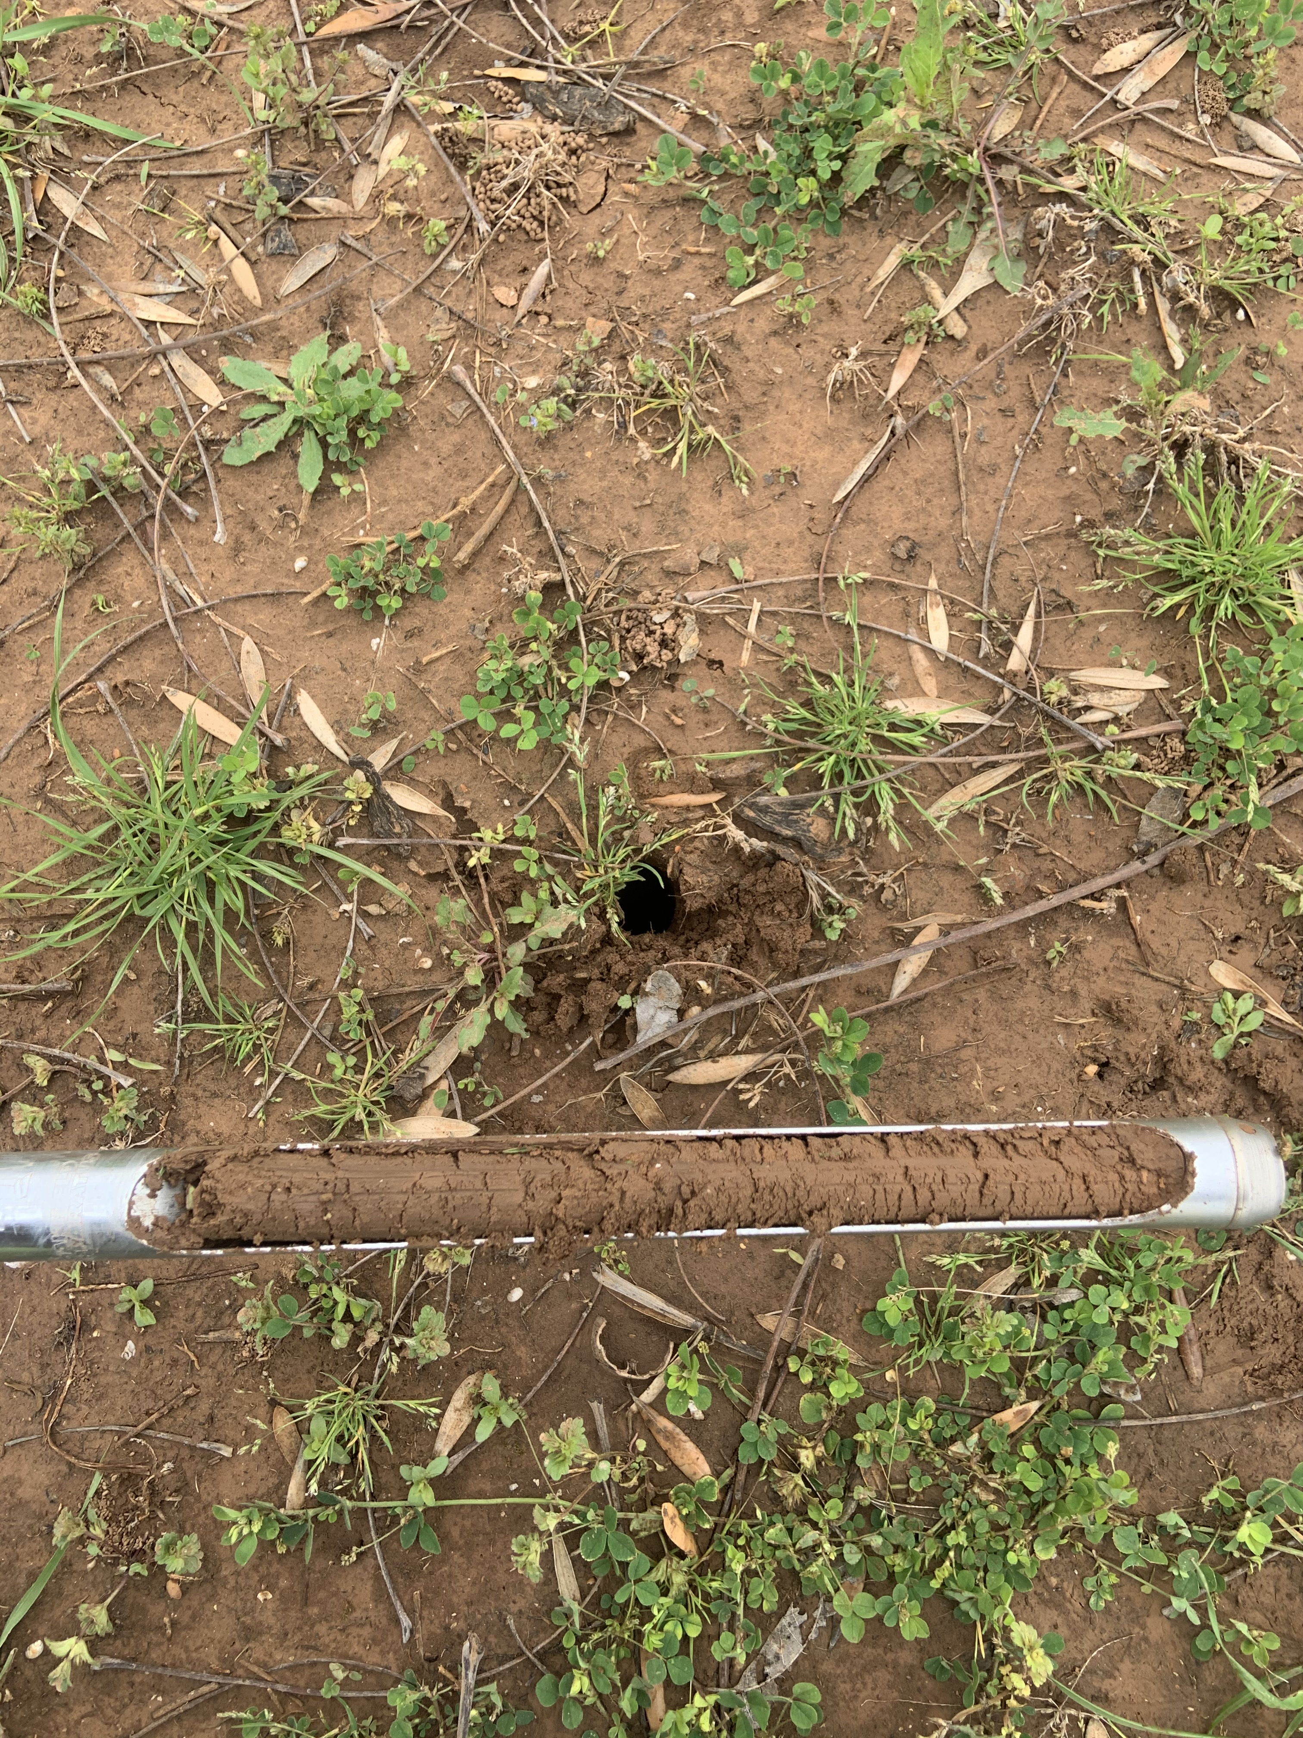
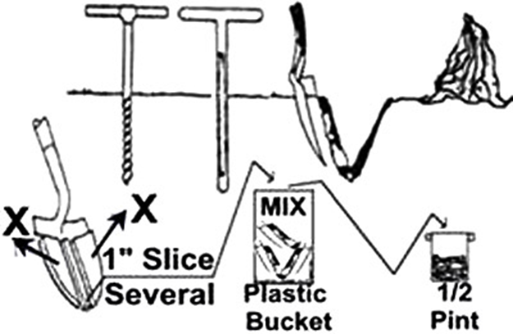
Soil SAMPLING -THE HOW-
Sample 6 inches deep. Consider sampling 6-12’’ also.
Sample underneath the canopy or inside the dripline where the bulk of the roots are located.

Slide 6
TAKING SOIL Samples -THE WHY-

Slide 7
SOIL SAMPLING -WHEN to TEst-
Taking soil samples is recommended annually.
Sample the same way and at the same time every year.
Keep detailed records of soil results and inputs.
There are ups and downs but trends over several years deserve attention.

Slide 8
Leaf Sampling
Digest leaves into their basic elemental composition percentages
Assess how current year fertilizer (or lack thereof) directly influences trees in the orchard to either meet or exceed comparable benchmarks.
Provides little help if not used as a comparison to known standards sampled at the same time (July).
One pinnately compound pecan leaf with
13 leaflets.

Slide 9
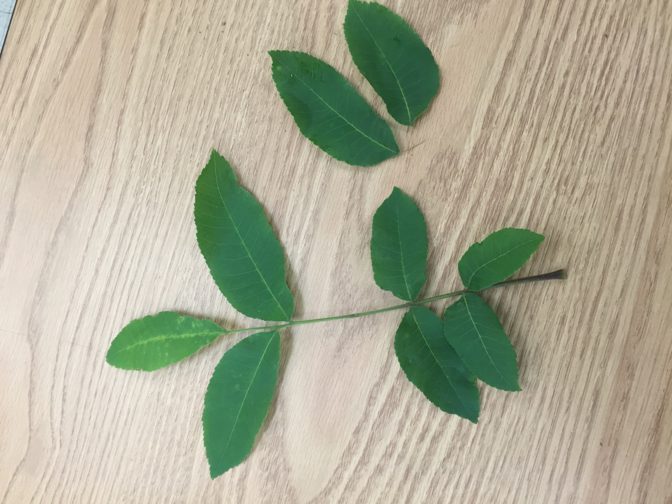
Leaf Sampling -The how-
Find compound leaf at midpoint of current season branch growth in July.
Collect 50 leaflet pairs around the tree canopy

Slide 10
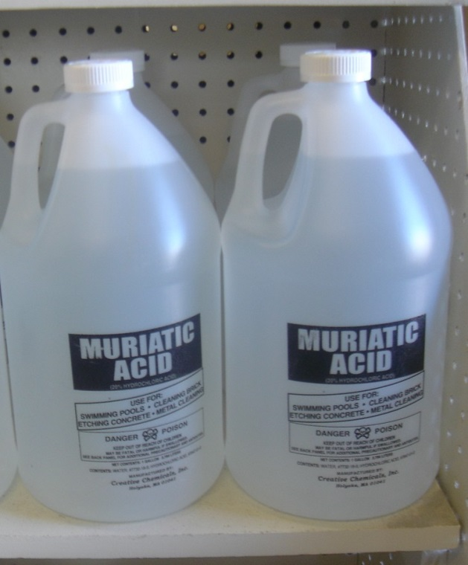
Recommended Leaf Washing Procedures
1. Send leaves directly to laboratory and request acid wash.
Another Option
2. Wash leaflets in a 1% hydrochloric acid solution (Although it depends on the concentration of the muriatic acid, usually 2 TBSP /gallon of water will approximate a 1% hydrochloric acid solution.)
Rinse in five separate distilled water baths and air dry before shipping.”
http://soiltesting.tamu.edu/

Slide 11
Leaf Sampling -The why-
Frequently deficient; regularly evaluated for fertilizer:
N, K, Zn, Fe
Occasionally deficient; regularly evaluated for fertilizer:
P, B, Cu, Ni
Rarely if ever deficient in pecan trees:
Ca, Mg, Mn

Slide 12
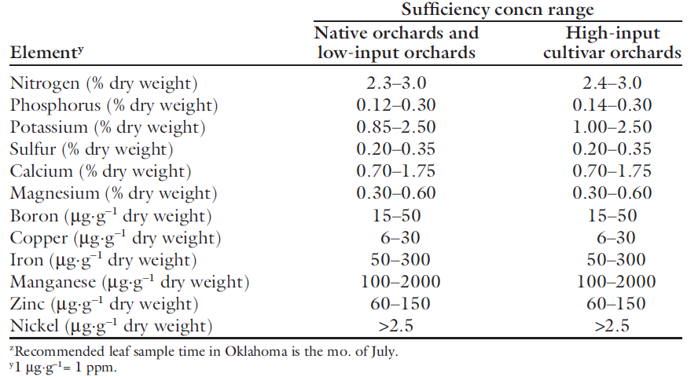
Changes in acceptable element concentration ranges
1995
2012
Smith, Michael W., et al. “Pecan Leaf Elemental Sufficiency Ranges and Fertilizer Recommendations.” HortTechnology, vol. 22, no. 5, 2012, pp. 594–599., doi:10.21273/horttech.22.5.594.

Slide 13
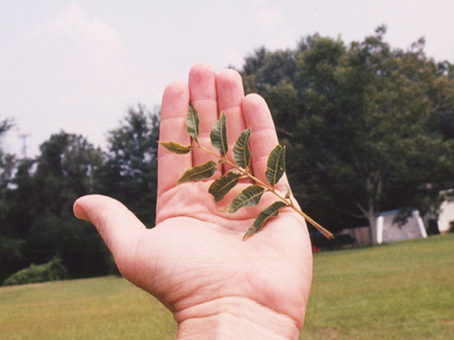
LEAF sampling -when to test-
Be consistent in sampling month (July), sample trees, keeping varieties separate, sampling from nut-bearing or non nut-bearing terminals, sun exposed, canopy position, mid-point of growth…
With a good leaf sampling program, soil sampling can be done on an every third year basis to look at the fertilizer impact on the soil.
If someone is not taking leaf samples, they then should consider soil sampling more frequently, even every year.
Leaf sampling more directly assesses how soil fertility is affecting the tree and is more important to do annually.
Individual trees with unusual symptoms should be sampled separately from routine annual leaf sample collections.

Slide 14
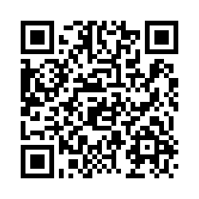
Contact
Colton Ploch
Colton.ploch@tamu.edu
(830) 391-2811

